Slide 1



Social Event Recommendation Agent on Pepper
July 13, 2026
Sunesh Praveen Raja Sundarasami
Hochschule Bonn-Rhein-Sieg | M.Sc. Autonomous Systems
Course
Human-Centered Interaction with Collaborative Robots (HCICR)

Slide 2
Introduction & Motivation
System Architecture
Dialogue Manager
Bayesian Reasoning
Behaviour & Integration
Conclusion & Future Work

Slide 3
Why This Project?
People shouldn't have to fill out a preference form - they should just talk
A robot's recommendation still has to be explainable, not a black box
Goal: natural conversation in, transparent reasoning out

Slide 4
Four Building Blocks
Perception
Dialogue Manager
Bayesian Reasoning
Behaviour & Voice
Traditional Post-Processing
Traditional Post-Processing
LangGraph + Groq LLM turns free speech into structured evidence.
Speech, gesture and a tablet image present the result.
Haar face detection, smoothed over frames, drives Idle -> Greeting.
mity. DBSCAN [5] enforces geometric consistency within isolated clusters. CRFs [6] model pairwise contextual potentials to enforce boundary coherence. Graph-structured label smoothing [7] improves classification accuracy while preserving spatial context.
A 3-layer pyAgrum network ranks 8 events, fully explainable.
KNN majority voting smooths isolated misclassifications based on local spatial proximity. DBSCAN [5] enforces geometric consistency within isolated clusters. CRFs [6] model pairwise contextual potentials to enforce boundary coherence. Graph-structured label smoothing [7] improves classification accuracy while preserving spatial context.

Slide 5
Introduction & Motivation
System Architecture
Dialogue Manager
Bayesian Reasoning
Behaviour & Integration
Conclusion & Future Work

Slide 6
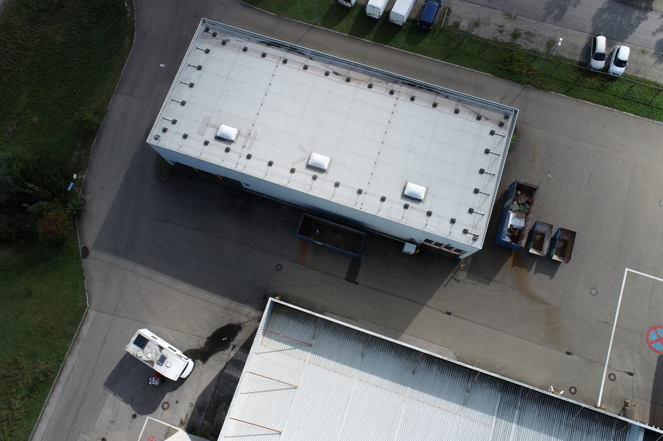
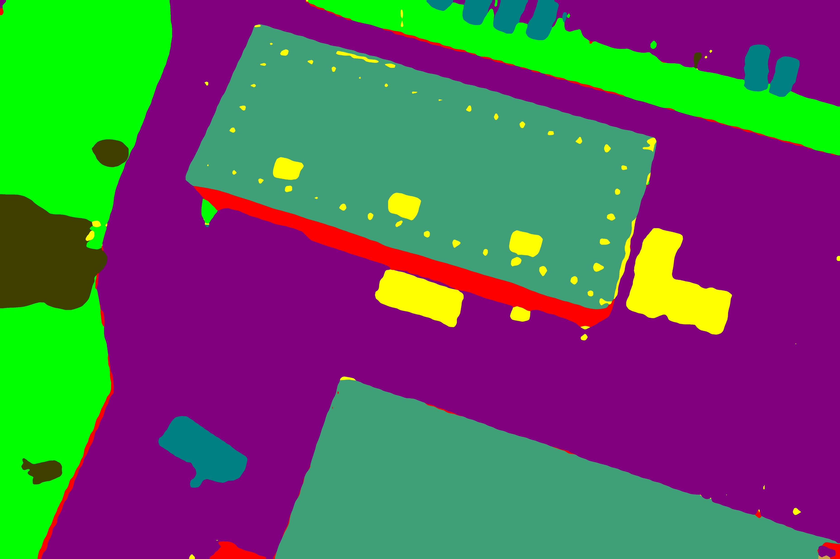
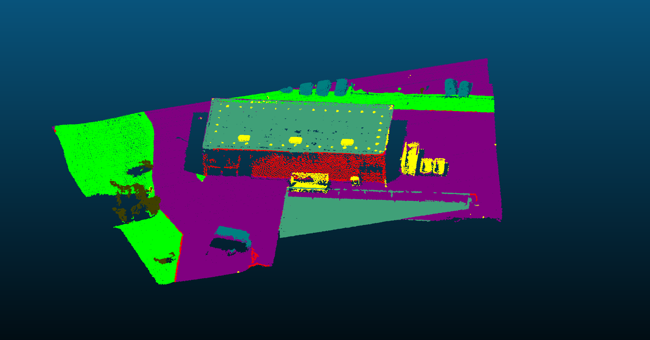
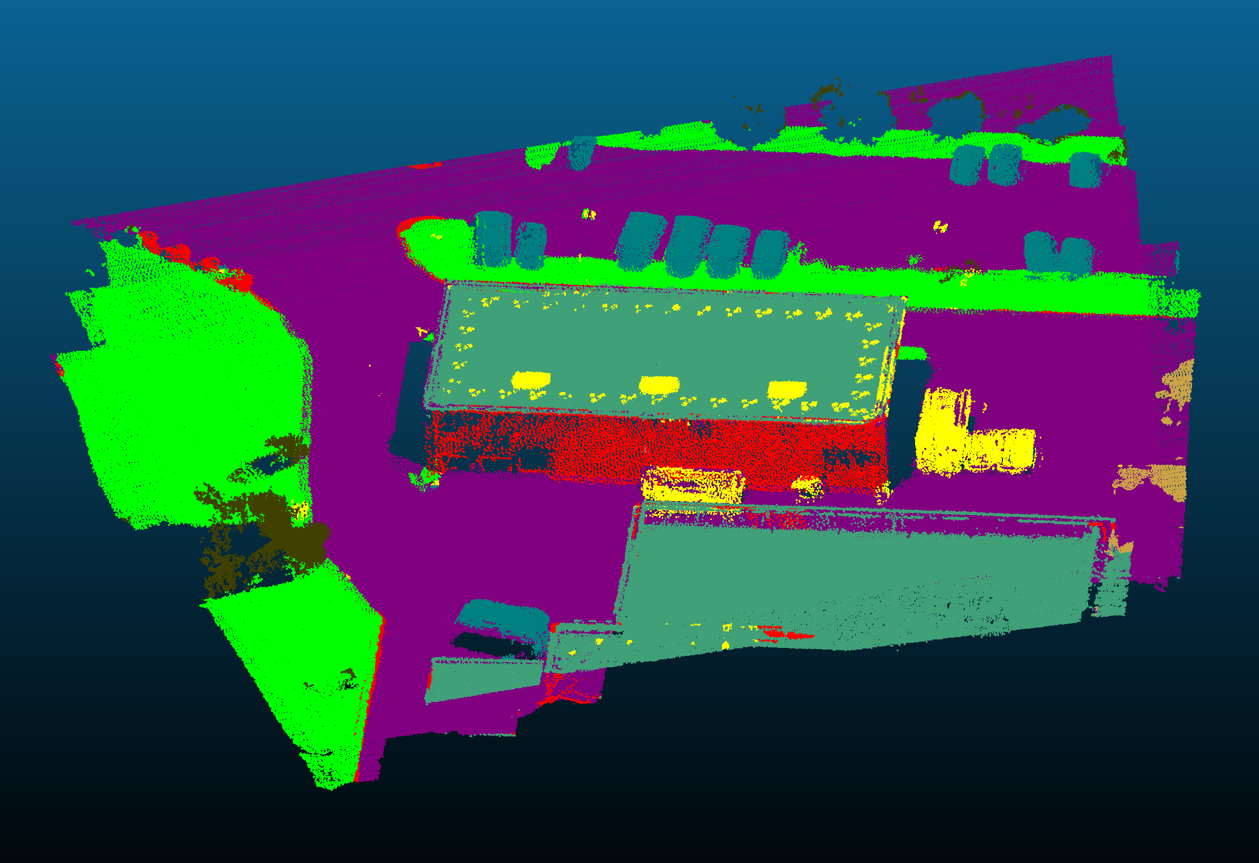
Six-State Interaction Loop
Idle
watch for a stable face
Greeting
wave . nod . open arms
Conversation
collect 6 preferences
Reasoning
Bayesian inference
Recommendation
say + show + explain
Farewell
goodbye, reset
next person

Slide 7
Perception: Noticing a Person
OpenCV Haar cascade over the camera feed (webcam or Pepper's own camera)
5-frame smoothing avoids false triggers from a passing glance
A looser presence check means brief dropouts don't end the interaction

Slide 8
Introduction & Motivation
System Architecture
Dialogue Manager
Bayesian Reasoning
Behaviour & Integration
Conclusion & Future Work

Slide 9
Dialogue Manager -- LangGraph
-> Finish once all 6 slots are filled
Router
pick next empty slot
QuestionFramer
ask, LLM-framed
AnswerParser
reply -> evidence
ConflictResolver
spot contradictions
Evaluator
commit / reframe / default
Finish
return evidence
reframe . conflict . missing slot

Slide 10
Six Preferences the Conversation Learns
Every value the LLM produces passes through a whitelist before it can reach the Bayesian network
A conversation never has to fill all six - partial evidence still works
Preference | Possible values | Example cue
Budget | Low . Med . High | “keep it cheap”
GroupSize | Solo . Small . Large | “just me”
ActivityLevel | Relaxed . Moderate . Active | “something chill”
Setting | Indoor . Outdoor . Either | “fresh air”
TimeOfDay | Day . Evening . Night | “later tonight”
Interest | Arts . Music . Food . Sports | “live music”

Slide 11
Introduction & Motivation
System Architecture
Dialogue Manager
Bayesian Reasoning
Behaviour & Integration
Conclusion & Future Work

Slide 12
Bayesian Reasoning Engine
Interest
Setting
GroupSize
Budget
ActivityLevel
TimeOfDay
VenueType
SocialContext
EnergyProfile
EventRec
8 events, ranked by probability

Slide 13
Explainable, Not a Black Box
Museum 34% · Workshop 19% · Food 15%
“I suggest Museum because your preferences point to a cultural venue with an intimate vibe and a low-key feel.”
Every ranking traces back to the three latent factors, not a hidden score

Slide 14
Introduction & Motivation
System Architecture
Dialogue Manager
Bayesian Reasoning
Behaviour & Integration
Conclusion & Future Work

Slide 15
Behaviour: Voice, Gesture, Tablet
Neural TTS (edge-tts) with an offline pyttsx3 fallback - speech and gesture start together
Optional spoken input via local, on-device Whisper (faster-whisper)
The recommended event's image appears on Pepper's tablet, cleared after each visit

Slide 16
Two Runtimes, One Bridge
newline-delimited JSON over stdio (subprocess)
Robot FSM
Python 3.8 . qiBullet / NAOqi
owns voice + camera
Dialogue Service
Python 3.11 . LangGraph + Groq
owns language understanding
speaks each question, captures the reply
frames questions, parses answers

Slide 17


Evaluation Criteria
RUN MODES
--source
Check | Expected result | Status
Face detection | Starts when a user is visible | Pass
Dialogue | Asks each question once | Pass
Parsing | Converts replies into evidence | Pass
Recommendation | Top events match preferences | Pass
Presentation | Speaks the result + gestures | Pass
scripted . webcam . pepper . hybrid
GOAL
A working prototype
not a full user study
RUNTIMES
Python 3.8 + 3.11
bridged via uv + JSON over stdio

Slide 18
Introduction & Motivation
System Architecture
Dialogue Manager
Bayesian Reasoning
Behaviour & Integration
Conclusion & Future Work

Slide 19
Conclusion & Future Work
CONCLUSIONS
FUTURE WORK
Explainable by design
Face-recognition greeting
1
1
Every recommendation traces back to observed evidence and interpretable latent factors.
Recognise returning users and personalise the greeting.
The LLM stays sandboxed
2
On-hardware evaluation
Free-form replies are parsed, then whitelisted - the model can never inject an illegal value.
2
Run the five demo checks on the physical Pepper robot, not just qiBullet.
Fault-tolerant interaction
3
Missing evidence, unclear answers, or the user leaving are all handled gracefully.
Richer preference elicitation
3
Two runtimes, one bridge
Let the LLM ask smarter follow-ups instead of a fixed six-slot order.
4
Robot (Py 3.8) and dialogue (Py 3.11) run as separate processes over JSON / stdio.
Broader event catalogue
All five work packages complete
4
5
Grow past eight categories using real local event listings.
Perception, dialogue, reasoning, behaviour and integration all wired end-to-end.
6
8
2
5
Preference slots
Event categories
Python runtimes bridged
Evaluation checks passed

Slide 20
Tech Stack
Simulation
Dialogue
Reasoning
Voice
Traditional Post-Processing
Traditional Post-Processing
LangGraph multi-agent graph + Groq (free Llama 3.3).
edge-tts / pyttsx3 for speech, faster-whisper for local ASR.
qiBullet / PyBullet - Pepper's joints, camera and tablet texture.
mity. DBSCAN [5] enforces geometric consistency within isolated clusters. CRFs [6] model pairwise contextual potentials to enforce boundary coherence. Graph-structured label smoothing [7] improves classification accuracy while preserving spatial context.
pyAgrum - the explainable Bayesian network engine.
KNN majority voting smooths isolated misclassifications based on local spatial proximity. DBSCAN [5] enforces geometric consistency within isolated clusters. CRFs [6] model pairwise contextual potentials to enforce boundary coherence. Graph-structured label smoothing [7] improves classification accuracy while preserving spatial context.

Slide 21
Thank You
Questions? A live demo is available.

