Slide 1
A Star Algorithm
SungJun Hong, Yee Shien Yeo
github.com/TerryYeo/A-Search-Algorithm

Slide 2
A star Algorithm
S 0 0 0 0 S: start
1 1 1 0 1 E: end
0 0 0 0 0 1: blocked
0 1 0 1 1 0: empty
0 1 0 0 E

Slide 3
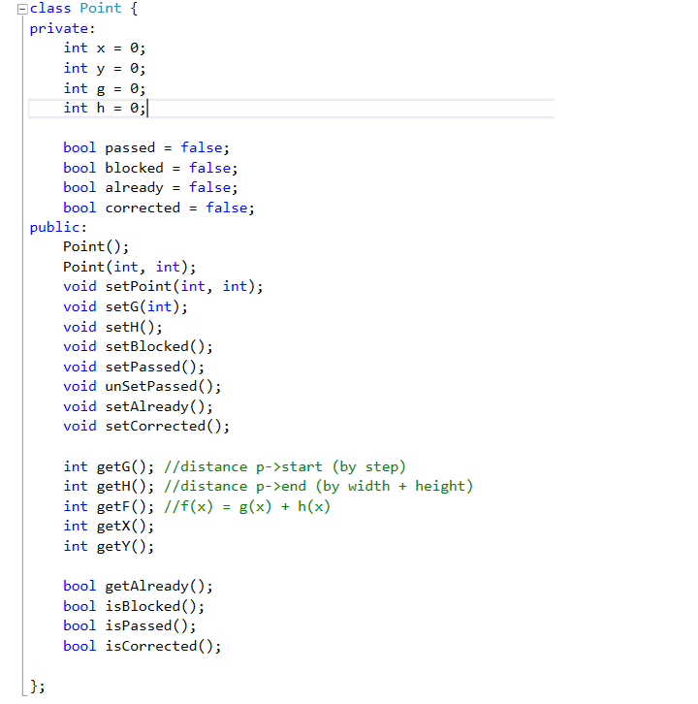

Slide 4
Point* map[7][7];
list<Point*> openList;
list<Point*> closeList;
list<Point*>::iterator iter;
searchAround(point);

Slide 5
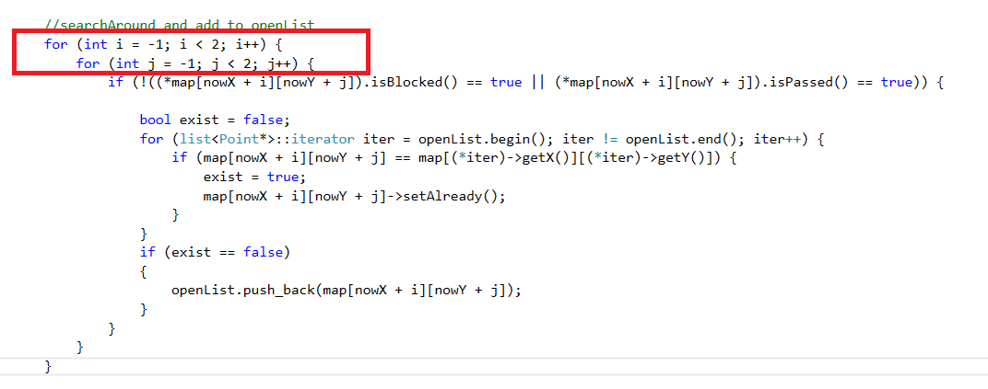
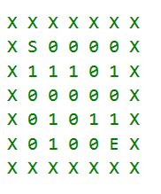

Slide 6
p
start
end
real step predicted value
F = G + H
G(p) : how much step we need to go p from start. (changeable during the progress)
H(p) : (des.x – now.x) + (des.y – now.y)

Slide 7
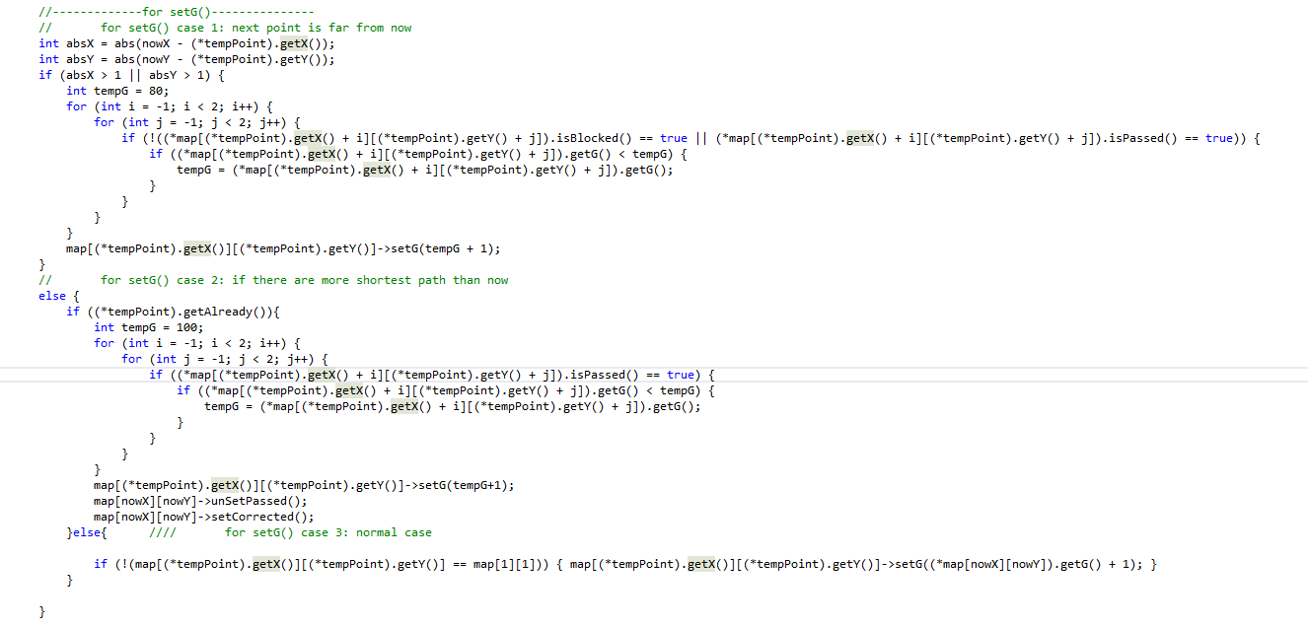

Slide 8
Case 1:
1 1 1 1 1 1: passed
X 0 X !! X 0: empty
X 0 X X X x: blocked
X 0 0 0 0 !!: now

Slide 9
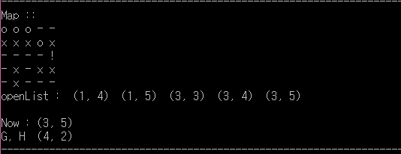
Case 2:

