Slide 1
What Makes People in a Country Happy?
Data Analysis by
Kevin Mai and Sung Mo Yang

Slide 2
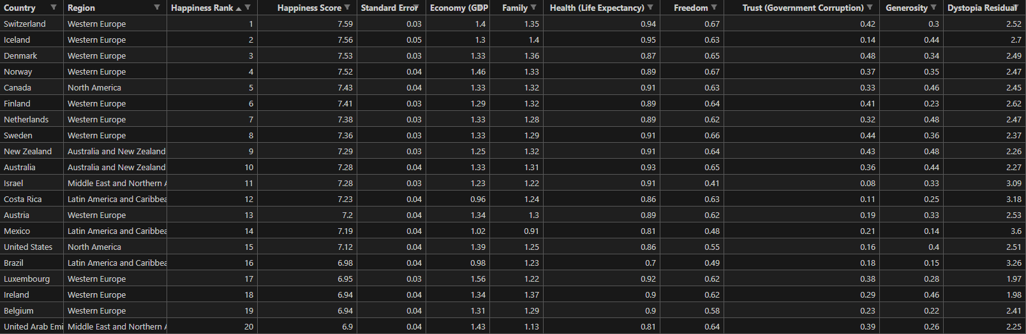
Data Preprocessing

Slide 3
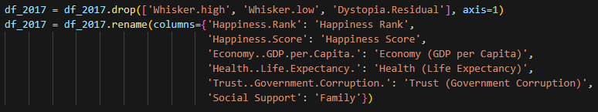
Data Preprocessing

Slide 4
Data Preprocessing
Country | Happiness Rank | Happiness Score | Economy (GDP per Capita) | Family
Health (Life Expectancy) | Freedom | Trust (Government Corruption) | Generosity | Year

Slide 5
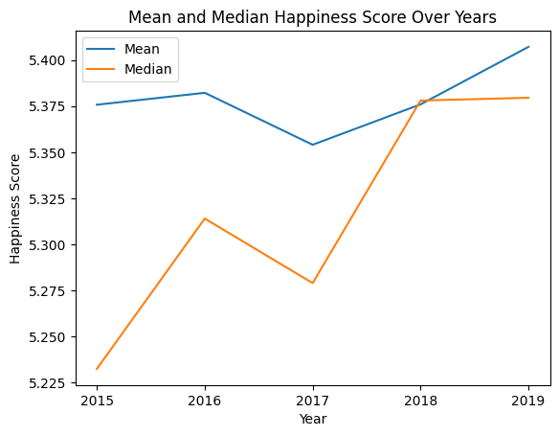
Exploratory Data Analysis

Slide 6
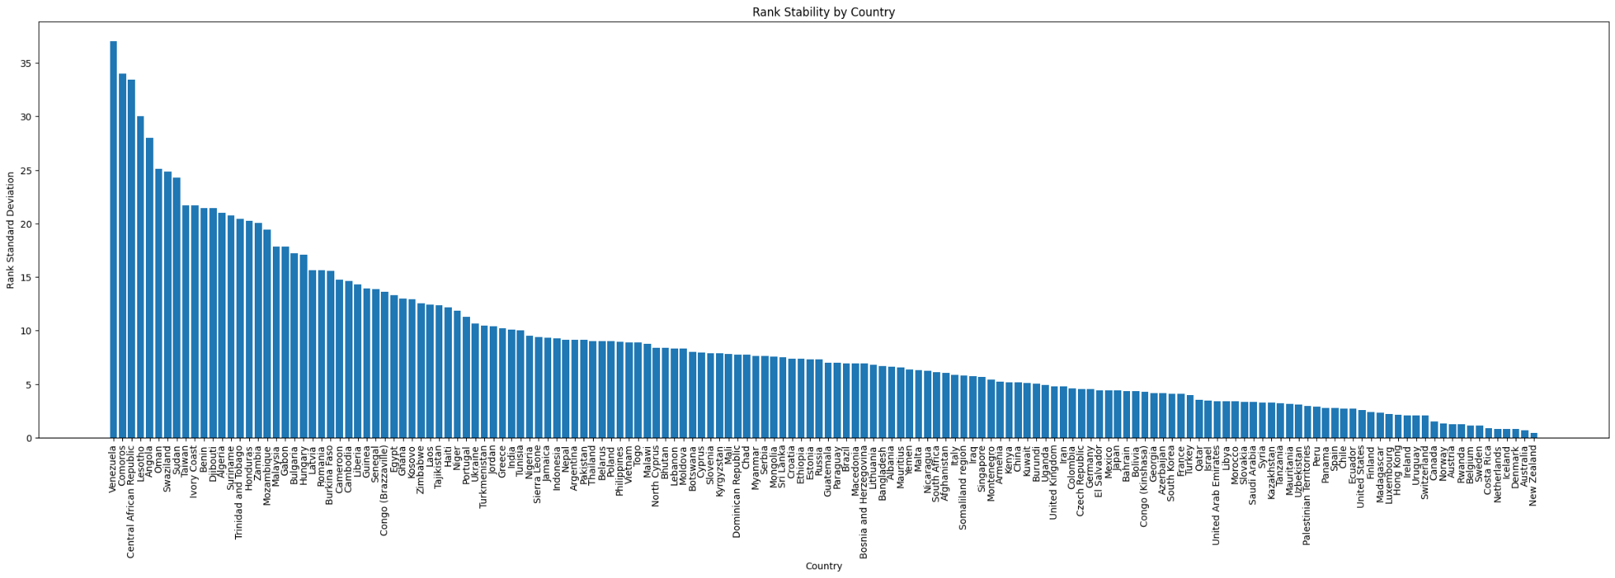
Exploratory Data Analysis

Slide 7
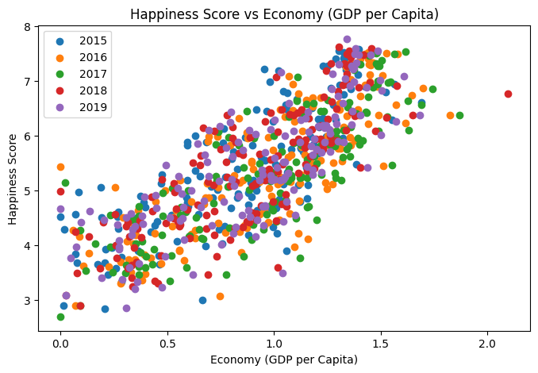
Exploratory Data Analysis

Slide 8
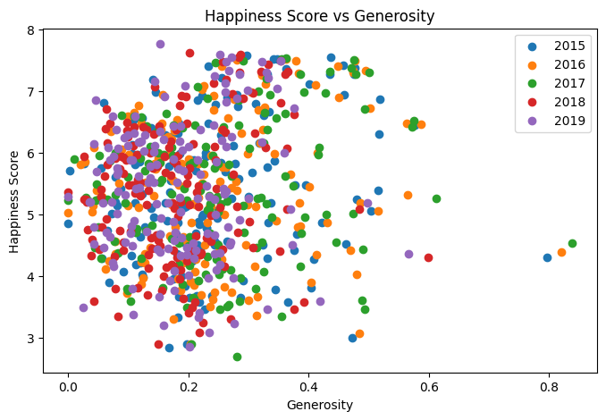
Exploratory Data Analysis

Slide 9
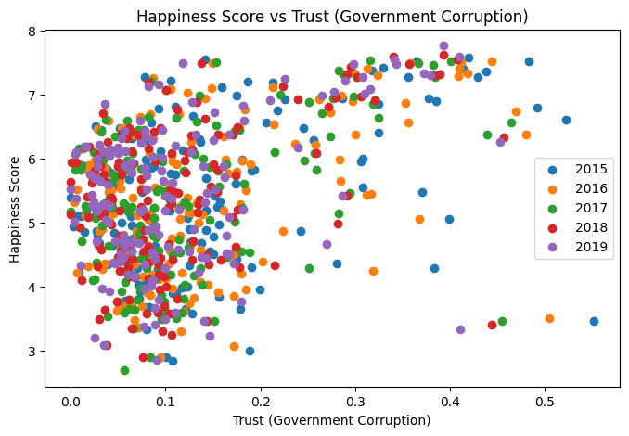
Exploratory Data Analysis

Slide 10
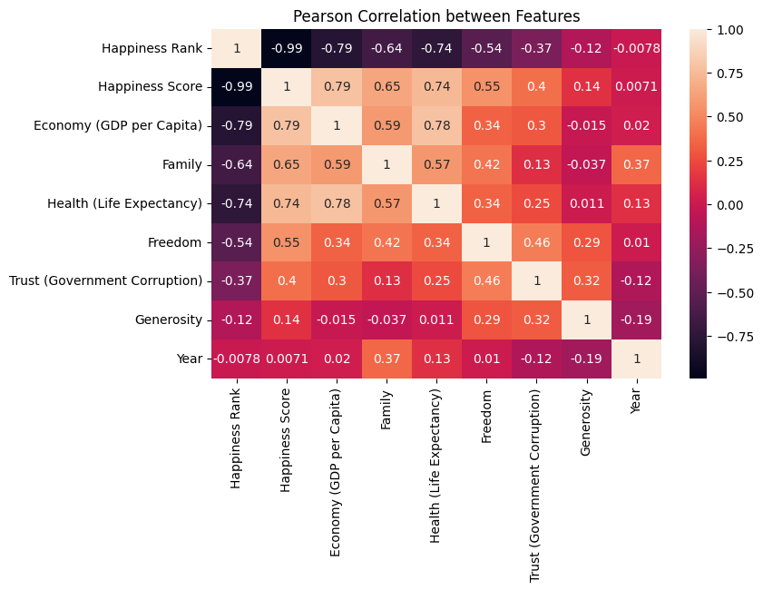
Exploratory Data Analysis

Slide 11
Modeling: Training and Test Sets
Training set is 2015, 2016, 2017, and 2018 data sets
Testing set is simply the 2019 data.
Given the 2019 data, we compare the predicted results of our model compared to the actual results.

Slide 12
Modeling: Linear Regression
Linear regression is a type of statistical analysis used to predict the relationship between two variables. It assumes a linear relationship between the target variable and the input variables/features.
It performed the best of our three models.
Appear to have a linear relationship between input variables and target variables

Slide 13
Modeling: Random Forest Regression (Bagging)
Random forest regression is a supervised learning algorithm and bagging technique that uses an ensemble learning method for regression in machine learning. It creates a set of decision trees in parallel and then averages their predictions to obtain the final prediction.
It should have been more accurate.
However, since it is not as accurate when used for predictions.
It is seen as averaging previous data but happiness scores seem to be increasing with years.

Slide 14
Modeling: Gradient Boosting (boosting)
Gradient Boosting is another ensemble learning technique that combines multiple weak predictive models, usually decision trees, to create a strong predictive model. It creates a next possible best model based off the previous. Then it adds the previous to best model in order to minimize the prediction error.
Needs to be done sequentially and can’t be done in parallel.

Slide 15
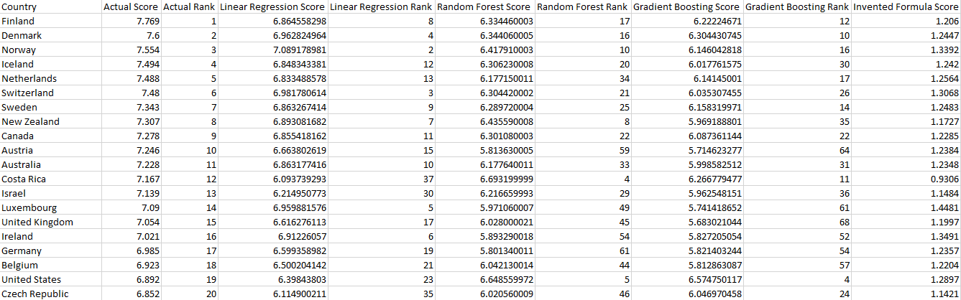
Results
Invented Score: Economy rating * 0.41 + Family rating * 0.72 + Health rating * 0.88 + Freedom rating * 0.8 + Trust rating * 0.4

Slide 16
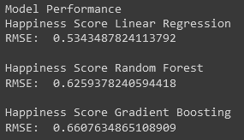
Performance and Accuracy
RMSE:

