Slide 1
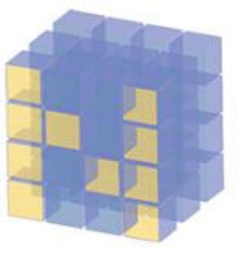
Contiguous vs Non-contiguous Numpy Arrays

Slide 2
Reference
stackoverflow
Youtube
Code

Slide 3
Numpy Arrays is viewed, not copied as default and hence Aliasing

Slide 4
Contiguous Numpy Arrays

Slide 5

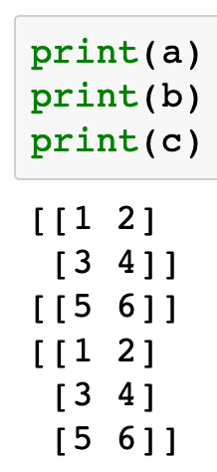
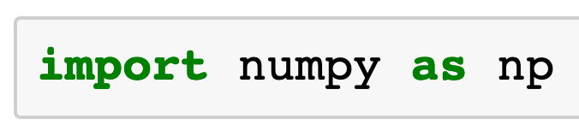

Slide 6
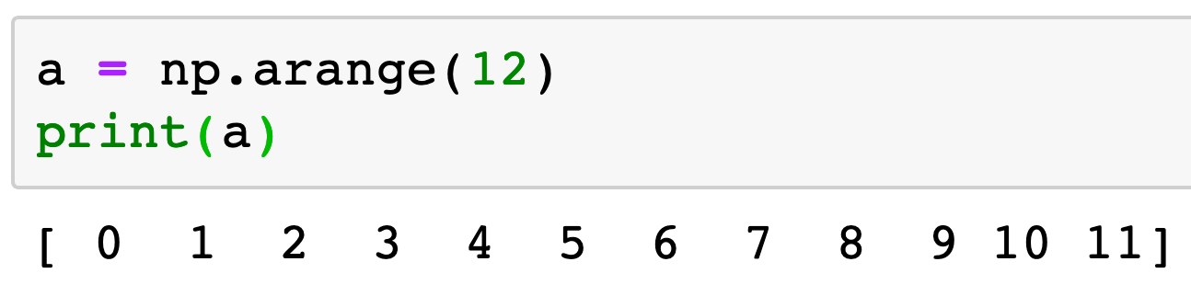

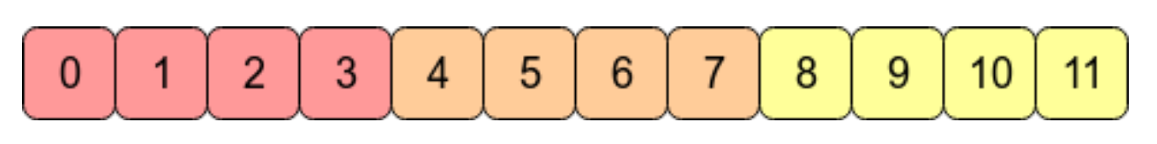
stackoverflow

Slide 7
stackoverflow

Slide 8
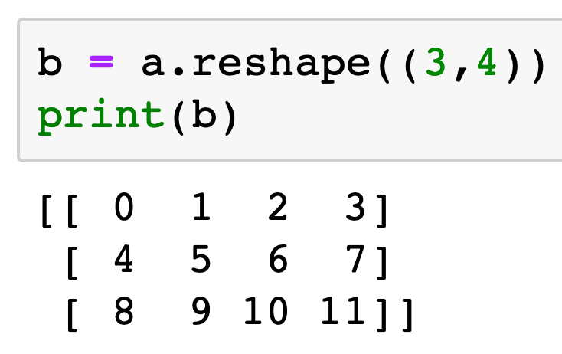
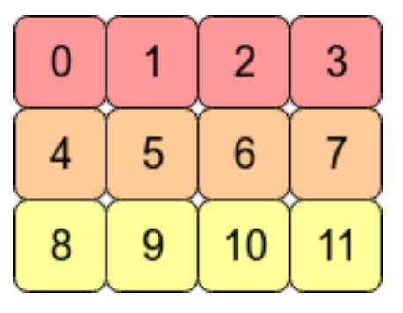
stackoverflow

Slide 9
stackoverflow

Slide 10
Contiguous Numpy Array
stackoverflow

Slide 11
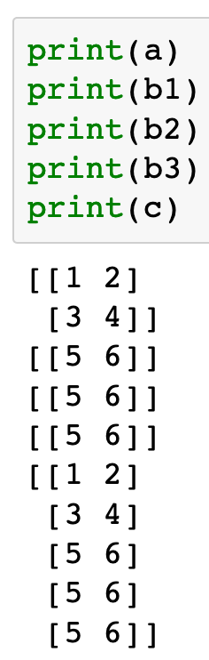
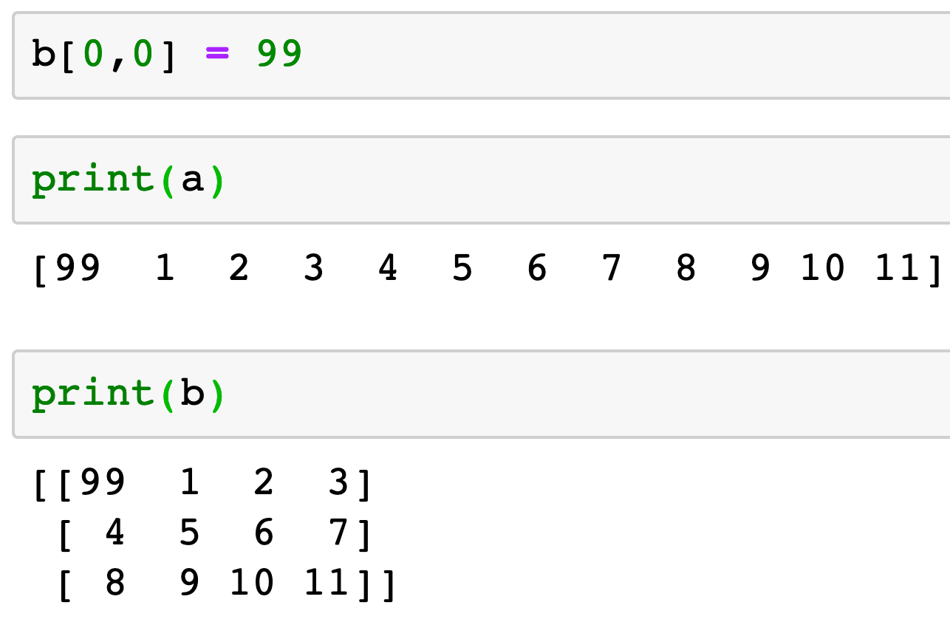

Slide 12
Aliasing

Slide 13
Aliasing
Aliasing is GOOD

Slide 14
Non-Contiguous Numpy Arrays

Slide 15
stackoverflow

Slide 16
Contiguous Numpy Array
stackoverflow

Slide 17
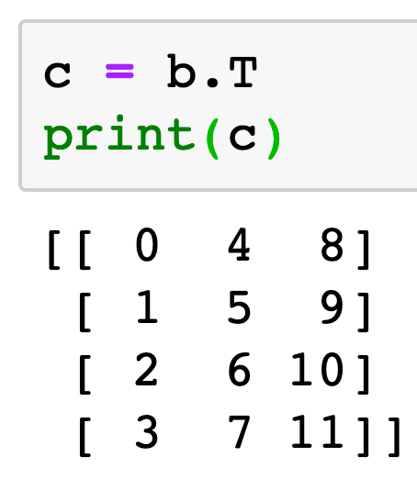
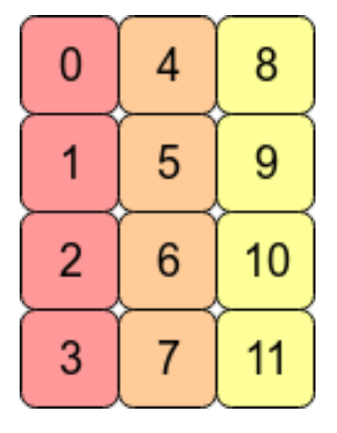
Non-Contiguous Numpy Array
stackoverflow

Slide 18
stackoverflow

Slide 19
Non-Contiguous Numpy Array
stackoverflow

Slide 20
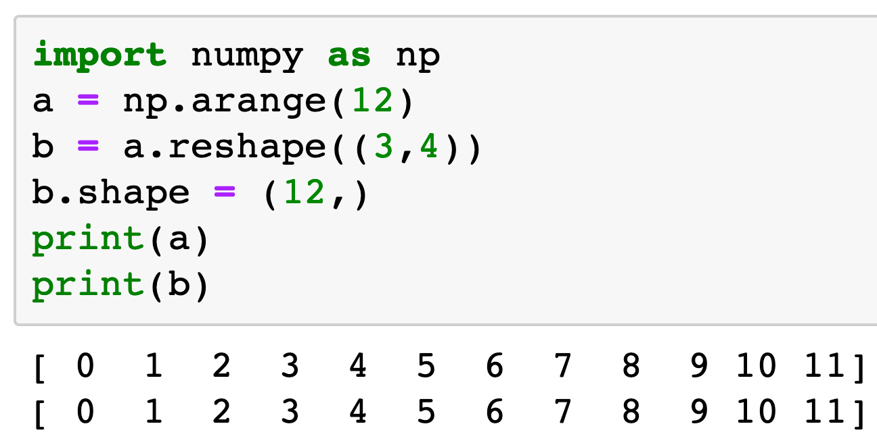

Slide 21
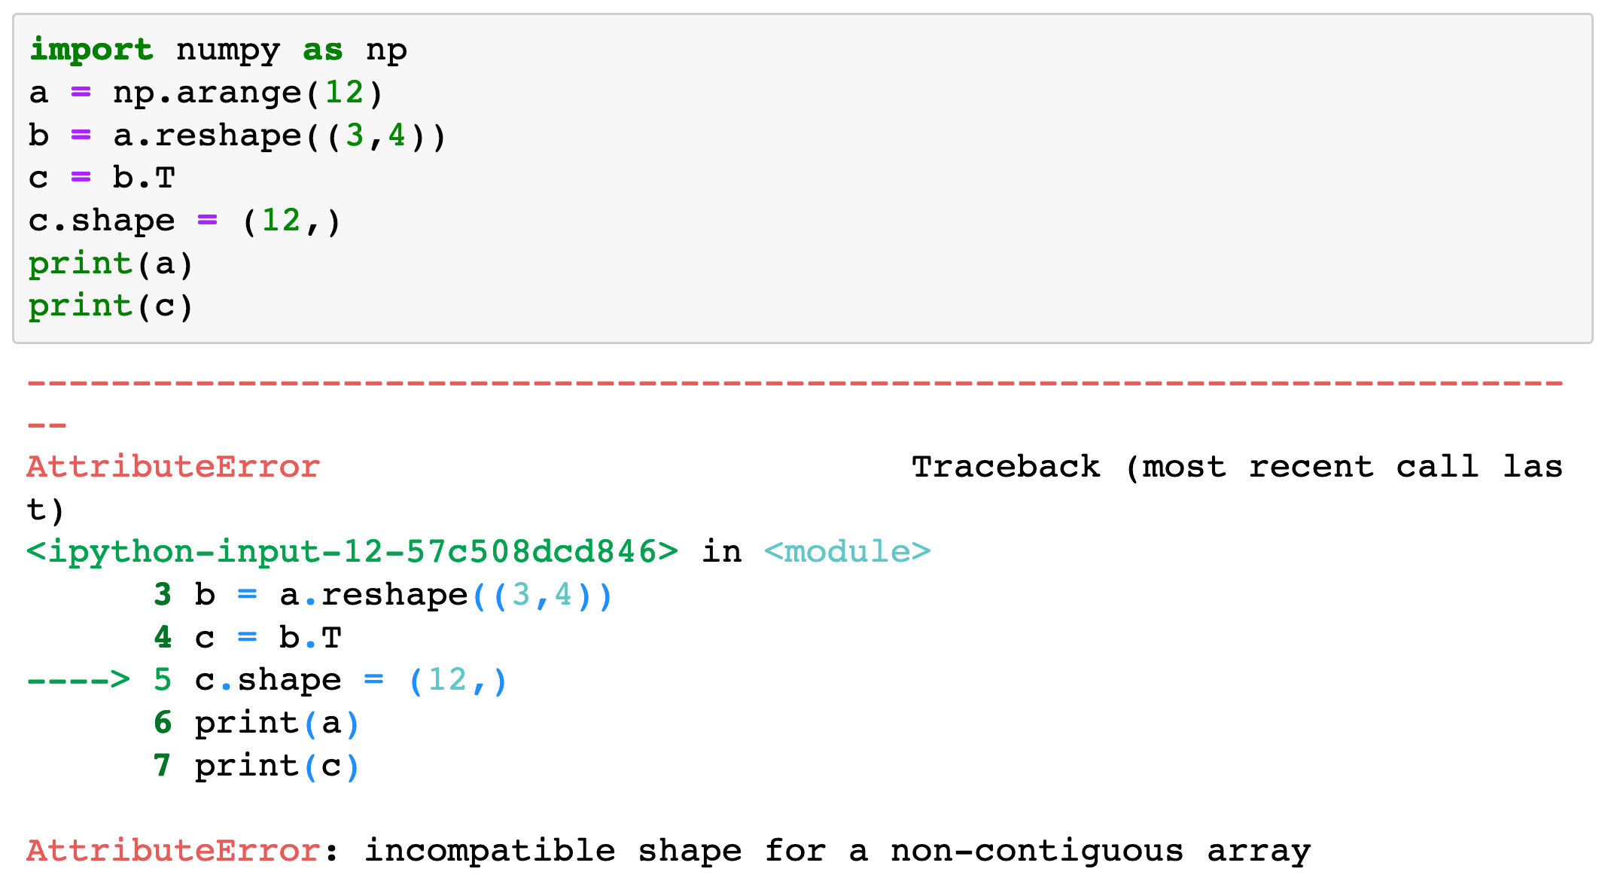

Slide 22
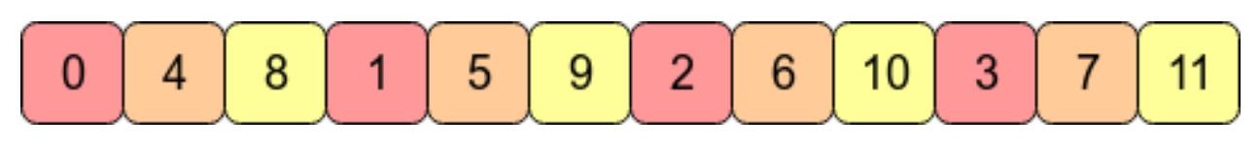
stackoverflow

Slide 23
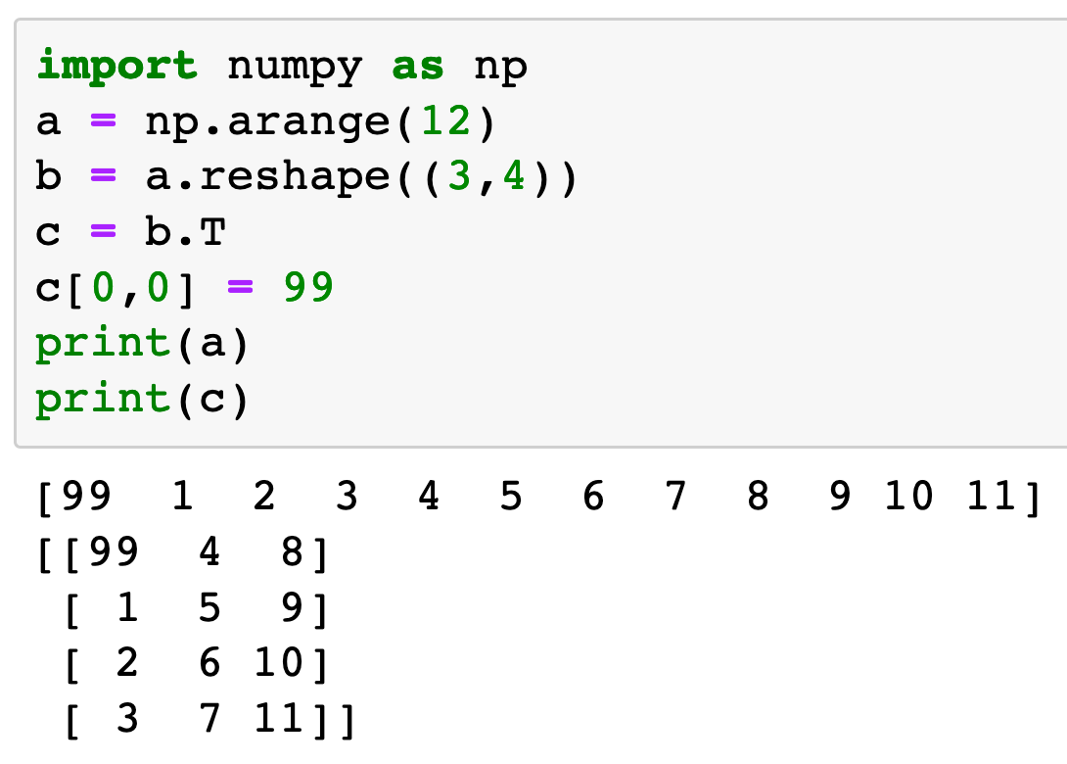

Slide 24
Aliasing for Non-Contiguous Numpy Array still works.

Slide 25
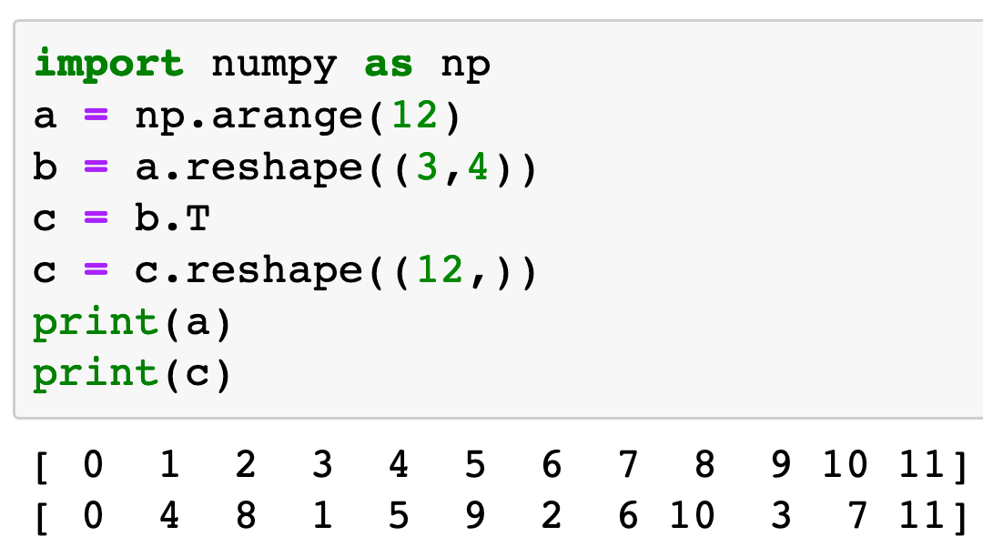
Reshape method still works.

Slide 26
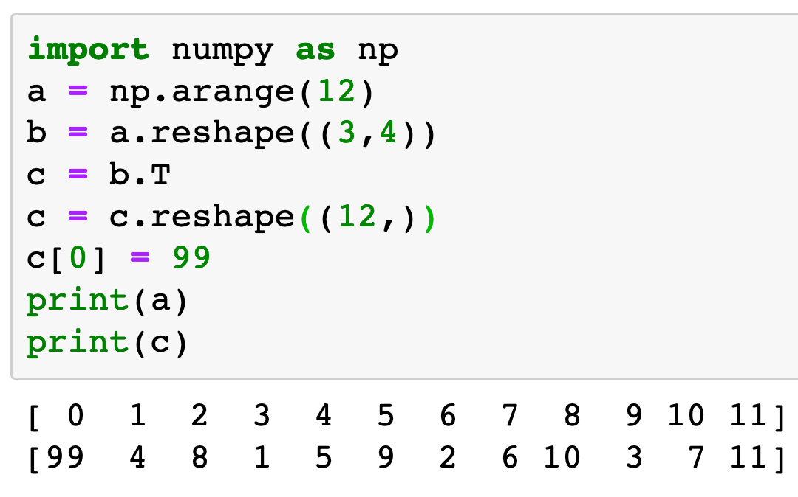
Reshape method works.
However, there is no aliasing for reshaped non-contiguous numpy array.
c is coped, not viewed.

Slide 27
Now
Let’s Play with Code

