Slide 1
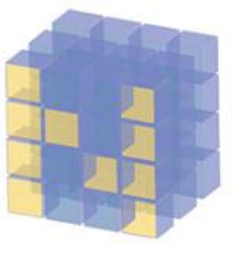
Intro to Numpy

Slide 2
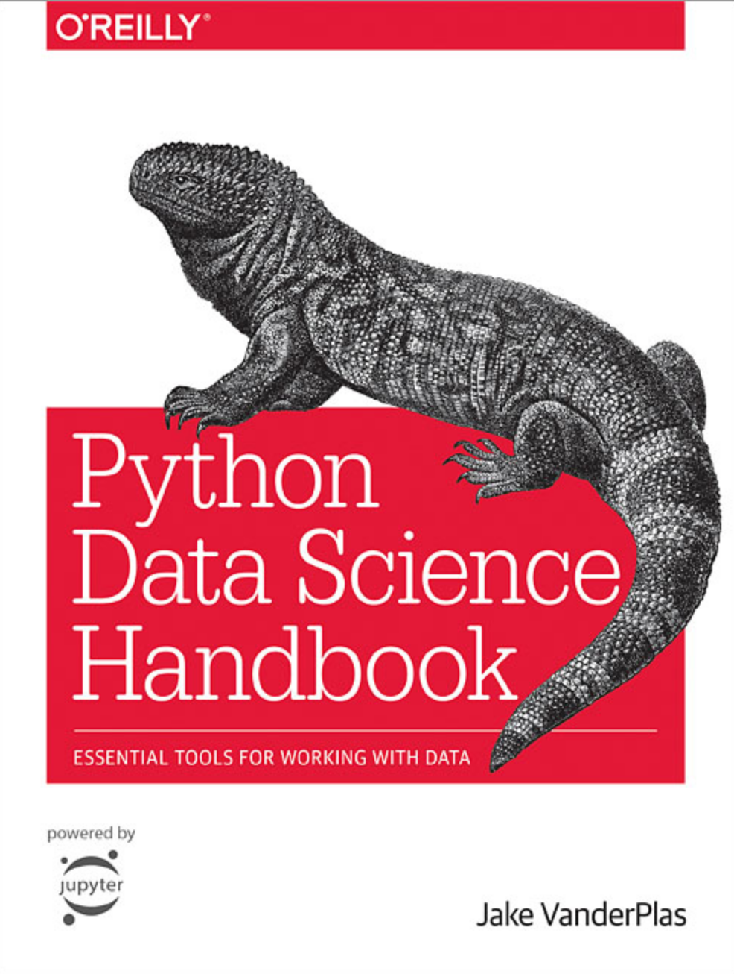
Reference
02.00 Python Data Science Handbook
Youtube
Code

Slide 3

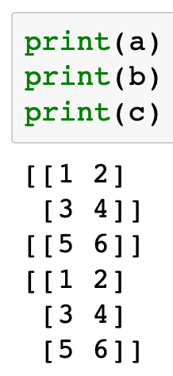


Slide 4
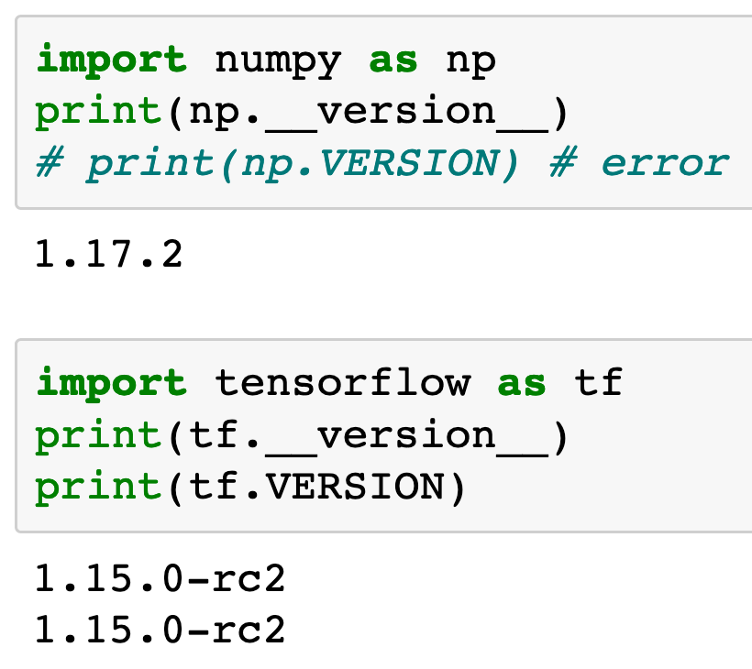


Slide 6
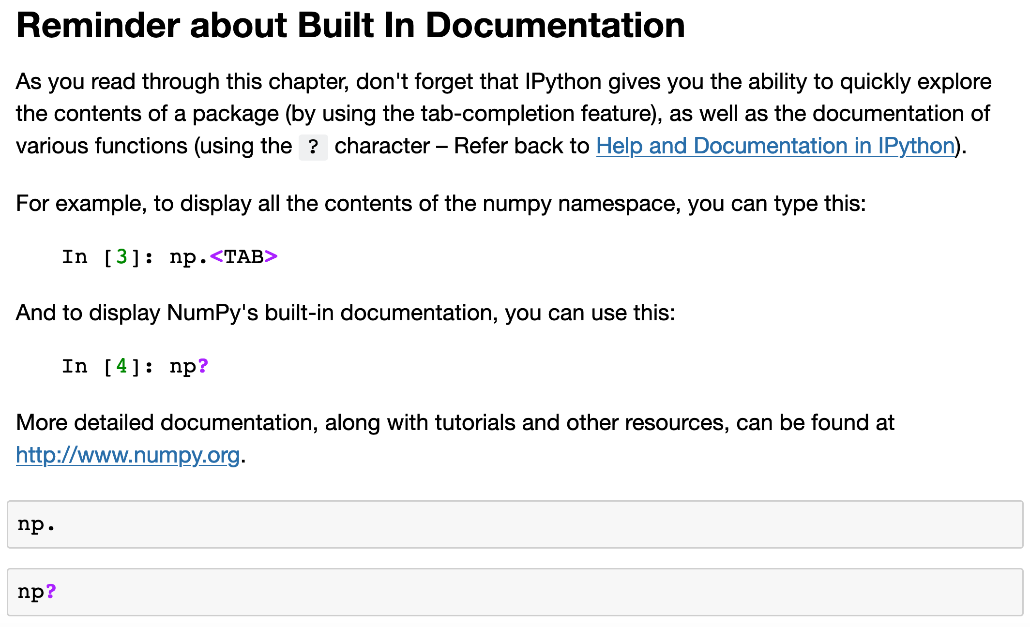

Slide 7
Now
Let’s Play with Code

