Slide 1
Visible Face Recognition
HEO Sunghak 21097305D
JIA Man Qi Vivian 23033073D

Slide 2
Contents
Phase I
Visible Face Recognition
Examples and Applications
Publicly Available Databases
Acquisition and Standardization
Phase II
Background Information for Evaluation
Section 1: 200*3 setting
Section 2: 300*4 setting
Limitation and Improvement

Slide 3
Phase I

Slide 4
Visible Face Recognition
Face recognition is a biometric modality that matches a human face to a digital image or video frame stored in a database.
State-of-the-art algorithms: ArcFace and CurricularFace
ArcFace: Additive Angular Margin Loss
Extrapolates highly distinctive features from faces using DCNN (Deep Convolutional Neural Networks).
CurricularFace: Adaptive Curriculum Learning Loss
Adapts a curricular learning process in its loss functions, with emphasis on simple and hard samples, to address the issue of such samples during the early training stage that may lead to convergence.

Slide 5
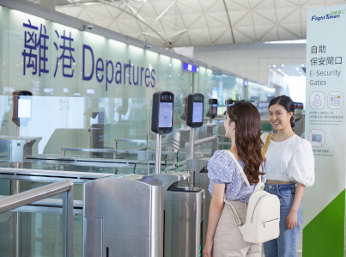
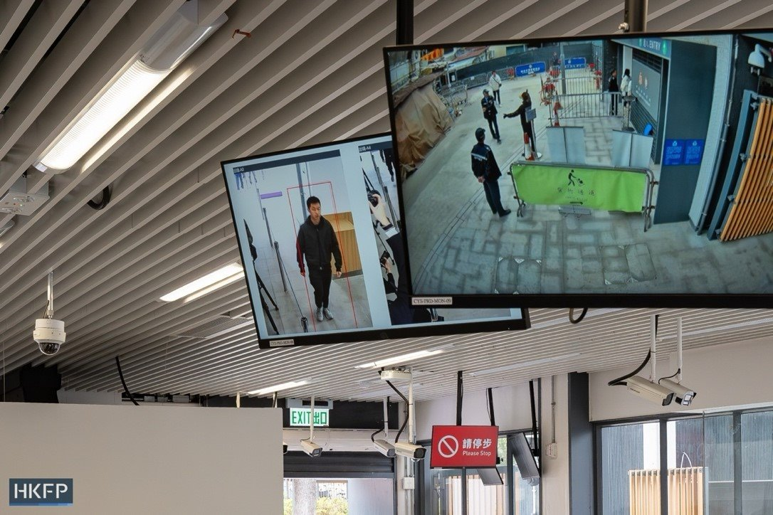
Examples and Applications
Hong Kong International Airport: FlightToken, is a self-service face recognition biometric system that integrates multiple passenger checkpoints.
Smart check-in kiosks
Baggage drop
E-channels for security and boarding
Shau Tau Kok border checkpoint towards the mainland: Face recognition has been implemented with consent, realizing a contactless experience.

Slide 6
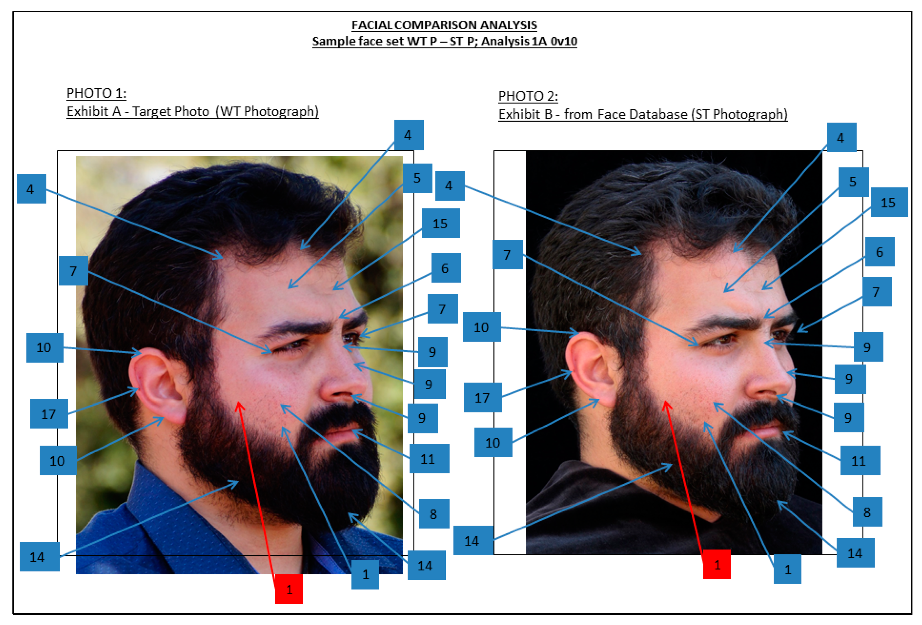
Examples and Applications
Forensic face recognition (FFR) is frequently applied to survey and investigate crime scenes and footage , with a significant advantage due to the ability to analyze large volumes of footage.
Also used in the identification of suspects, victims and repeat offenders, as well as aid in the search for missing persons or provide insights into cold cases.

Slide 7
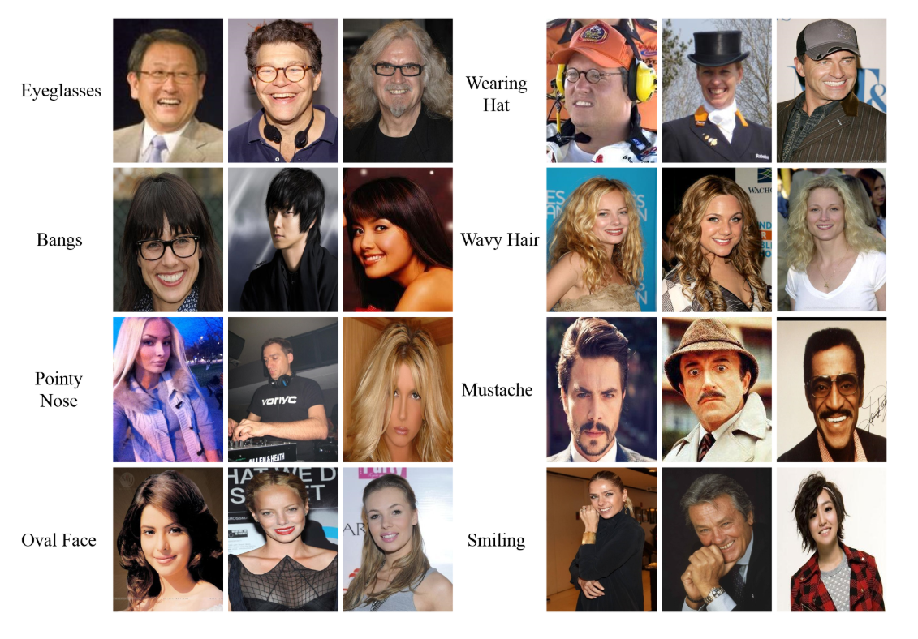
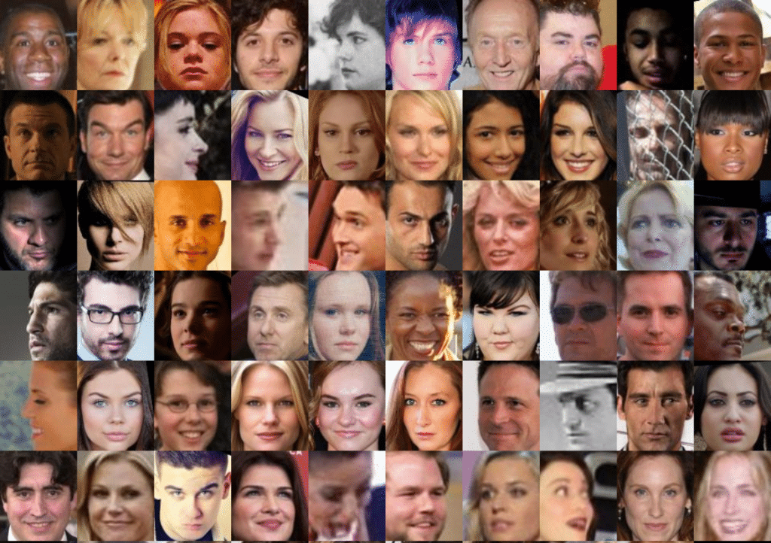
Publicly available databases
There are many publicly available databases, including CelebA, MegaFace, LFW (Labeled Faces in the Wild), CASIA-WebFace, and more.
CelebA (Large Scale CelebFaces Attribute Dataset)
Includes over 200,000 celebrity images
Each has 40 attribute landmarks
10,000+ celebrity identities
Annotations and scale make it a good database for evaluation
MegaFace is a large-scale database made to encourage facial recognition development.
Over 4 million images
670,000 unique identities from the web
Distractor set with one million photos and 690,000 identities, for evaluation and testing
Currently decommissioned due to administration and privacy concerns

Slide 8
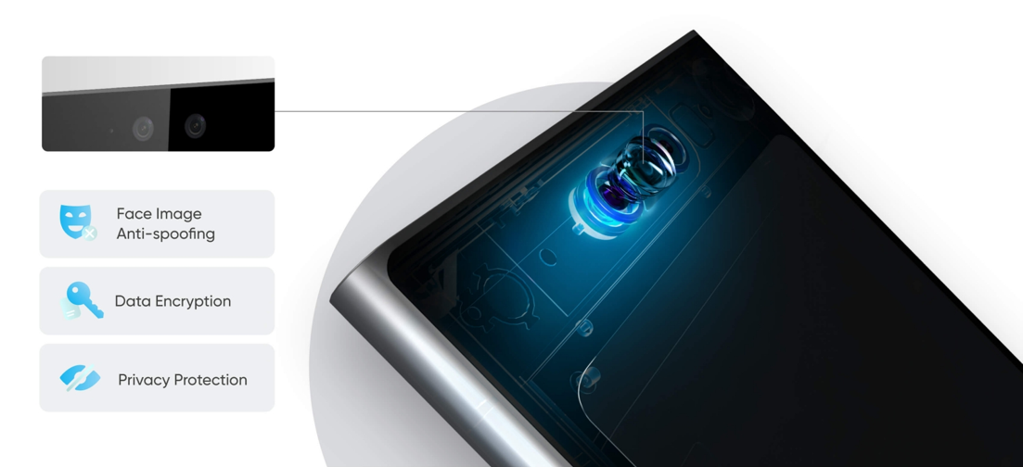
Standardization
Facial recognition has many standardizations due to the versatility of the biometric – it can be applied in various devices, but there must be a common standard to adhere to.
HikVision is a company that sells face recognition terminals with a touch-free, contactless experience for higher security and more convenience.
Has to integrate many important functions such as anti-spoofing, data protection and encryption
Extensive versatility and function within a single device is preferred for easy access

Slide 9
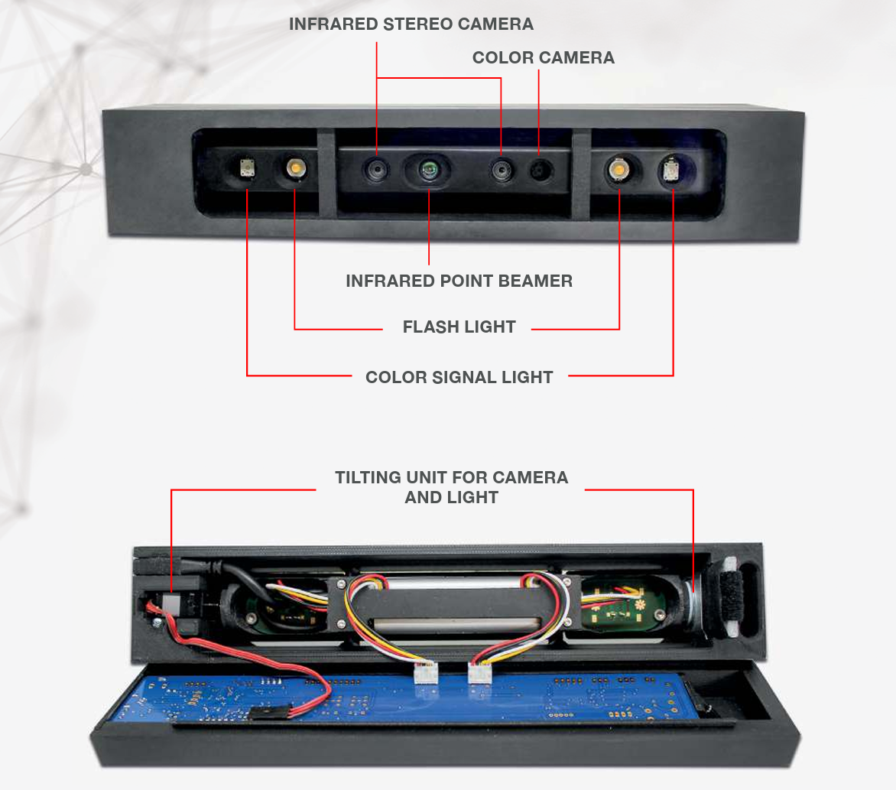
Acquisition
Modivision, another company, designates some requirements for perfect face recognition environments.
Distance: A limited distance means there needs to be implementations such as a tilting camera to encompass all possible heights.
Environment: Facial recognition kiosks may be in dark or badly illuminated places, so there is a need for focused light.
Measurement: To avoid confusion between a target and the crowd behind them, a distance measurement is needed.
Intuitive behavior accommodation: Humans blink and move around, system needs to accommodate these instinctive behaviors.
Distinguishing authentic and false faces: Differentiating real from faces on images or t-shirts is important.

Slide 10
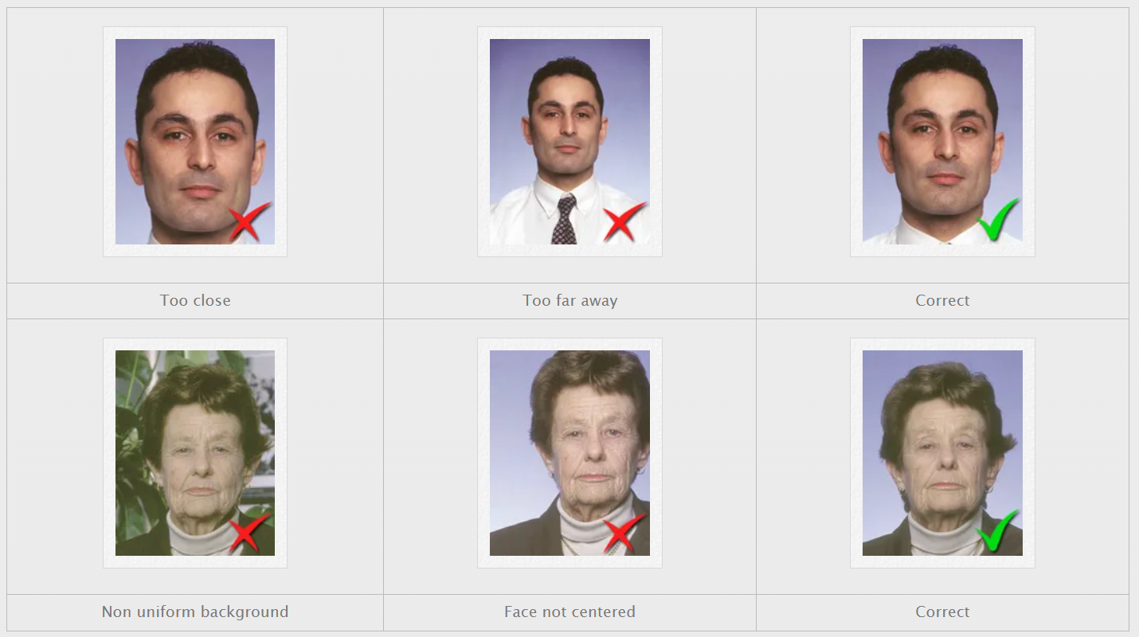
ISO/IEC 19794-5
ISO/IEC 19794-5 is a standard that “specifies a record format for storing, recording, and transmitting information from one or more facial images or a short video stream of facial images” [7]. It is part of the ISO, or the International Organization for Standardization’s guidelines regarding biometric formatting.
ICAO (International Civil Aviation Organization) has some standardized formats for travel documents as assigned by the ISO, so that identification by comparison and detailed examination of human features is possible.
Scenic restraints and image attributes
Posing, clothing, expression
Resolution, size, lighting, saturation, focus

Slide 11
Phase II

Slide 12
Introduction to Evaluation

Slide 13
Which algorithms?
Arcface
CurricularFace

Slide 14
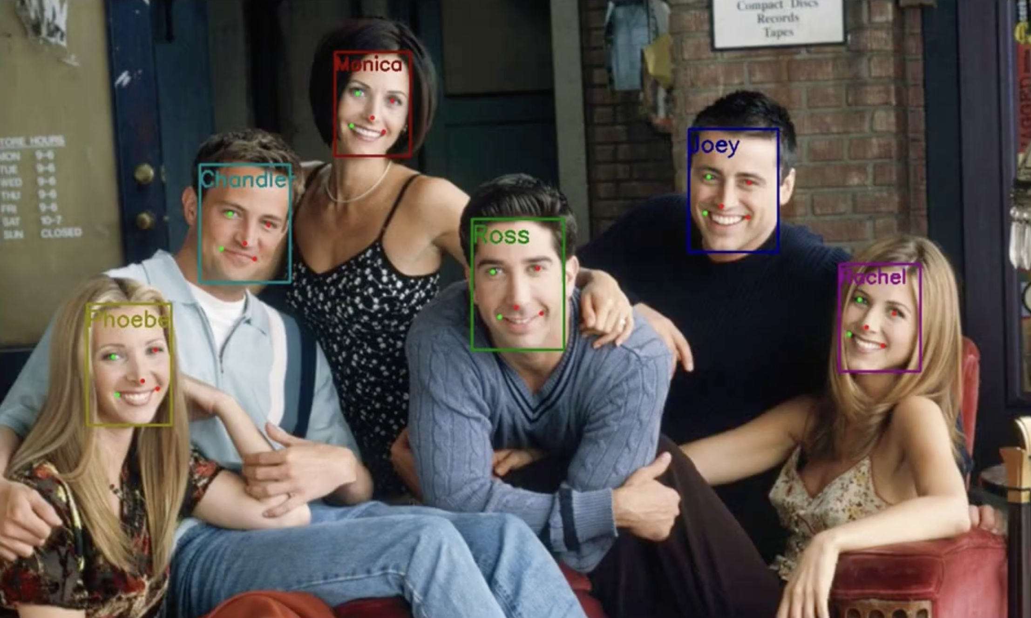
Brief Explanation of Both Algorithms
1. Face Detection
Detect the position of a face in the image
2. Landmark Localization
Detects key facial points: eyes, nose, and mouth
3. Face Alignment
Aligns and crops the face based on detected landmarks
4. Face Embedding Extraction
Extracts a 512-dimensional feature vector from the aligned face

Slide 15
Arcface
1. Face Detection
Detect the position of a face in the image
2. Landmark Localization
Detects key facial points: eyes, nose, and mouth
3. Face Alignment
Aligns and crops the face based on detected landmarks
4. Face Embedding Extraction
Extracts a 512-dimensional feature vector from the aligned face
buffalo_l

Slide 16
CurricularFace
1. Face Detection
Detect the position of a face in the image
2. Landmark Localization
Detects key facial points: eyes, nose, and mouth
3. Face Alignment
Aligns and crops the face based on detected landmarks
4. Face Embedding Extraction
Extracts a 512-dimensional feature vector from the aligned face
buffalo_l
IR_101
Notes:
“Both ArcFace and CurricularFace use buffalo_l for face detection, landmark localization, and alignment.”
“The difference is in the final step: ArcFace uses buffalo_l for embedding extraction, while CurricularFace uses a separate model called IR_101.”
“IR_101 is a deep convolutional neural network specifically trained with CurricularFace loss.”
The overall pipeline is the same, but CurricularFace separates the final step with its own specialized model, while ArcFace uses the all-in-one buffalo_l package

Slide 17
Distance Metric
Cosine Distance
Embeddings are normalized into unit vectors
The same identity tends to have the similar direction
More robust to lighting and distortion than Euclidean distance
Notes:
“To verify whether two face embeddings belong to the same person, we use cosine similarity as the distance metric. It’s one of the most effective similarity measures in face recognition.”

Slide 18
Experiment Process
Setting 1
200 subjects
3 images per subject
1 for gallery
2 for probes
Genuine Pairs
200x2=400
Imposter Pairs
400x199=79600
Setting 2
300 subjects
4 images per subject
1 for gallery
3 for probes
Genuine Pairs
300x3=900
Imposter Pairs
300x899=269,100

Slide 19
Setting 1: 200x3

Slide 20
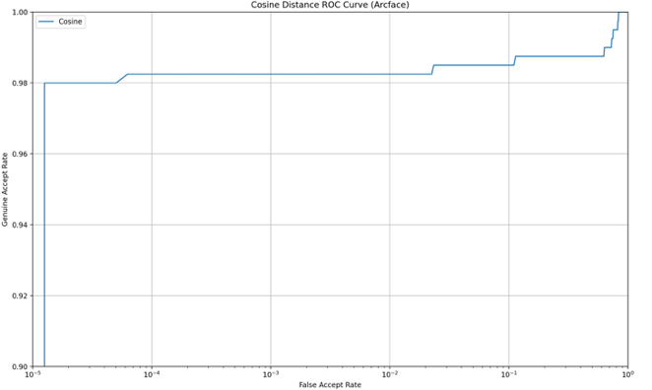
Setting 1 – ROC Curve (Arcface)

Slide 21
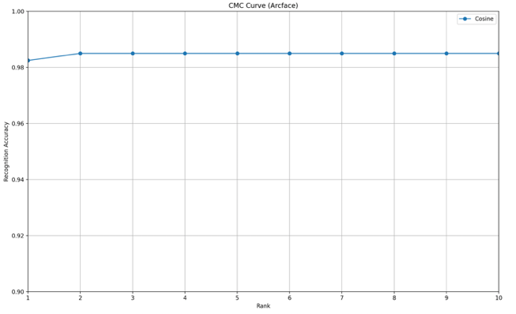
Setting 1 – CMC Curve (Arcface)

Slide 22
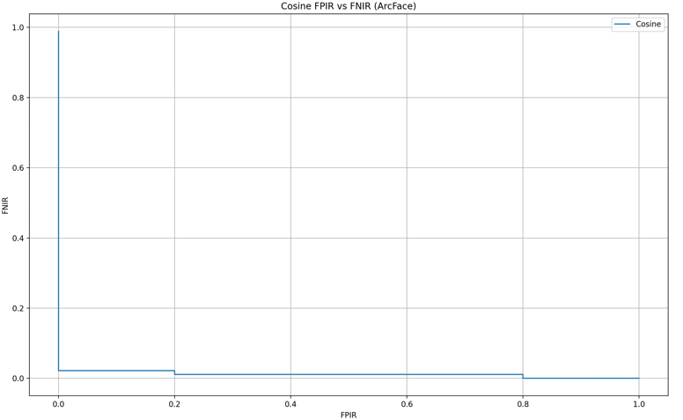
Setting 1 – FPIR vs FNIR Curve (Arcface)

Slide 23
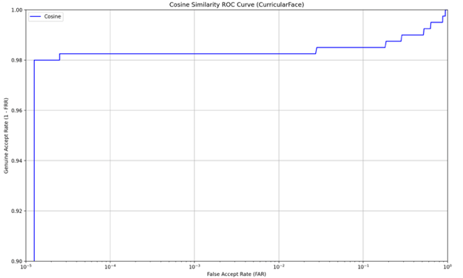
Setting 1 – ROC Curve (Curricular)

Slide 24
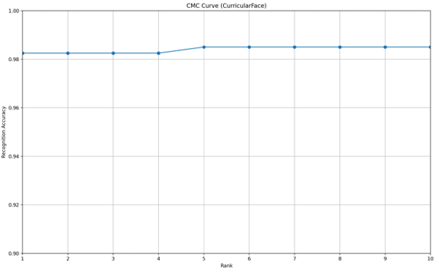
Setting 1 – CMC Curve (Curricular)

Slide 25
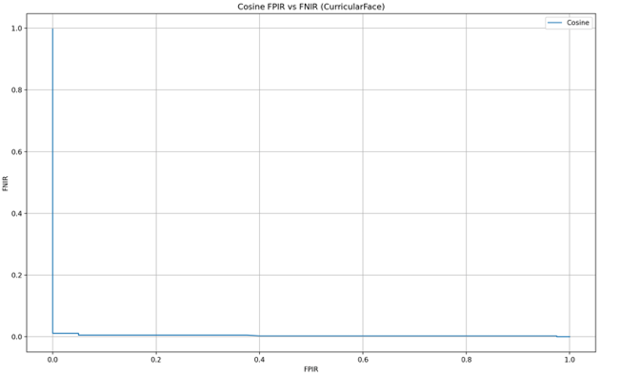
Setting 1 – FPIR vs FNIR Curve (Curricular)

Slide 26
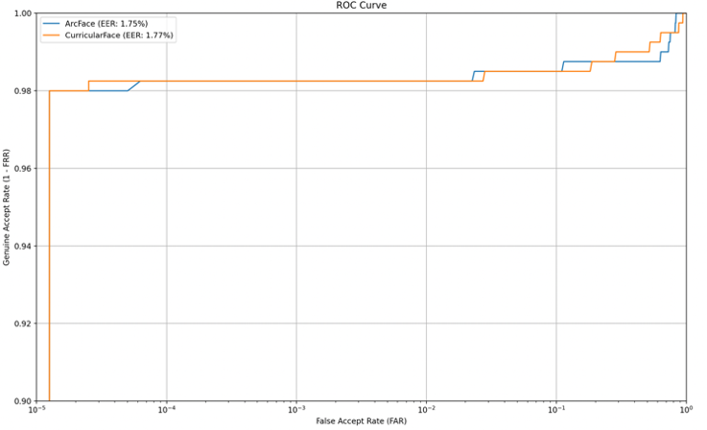
Setting 1 – ROC Curve (Comparison)

Slide 27
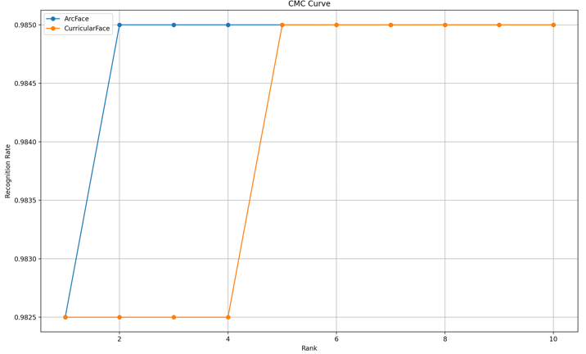
Setting 1 – CMC Curve (Comparison)

Slide 28
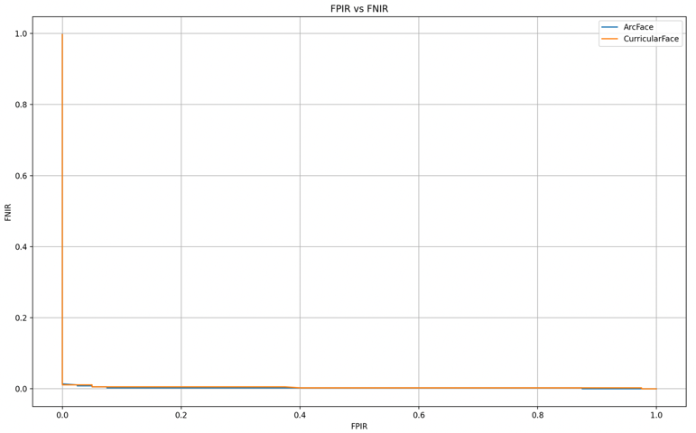
Setting 1 – FPIR vs FNIR Curve (Comparison)

Slide 29
Setting 2: 300x4

Slide 30
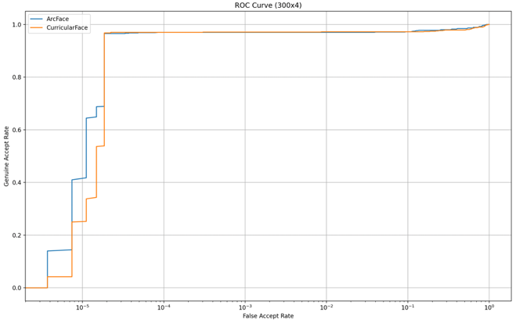
Setting 2 – ROC Curve

Slide 31
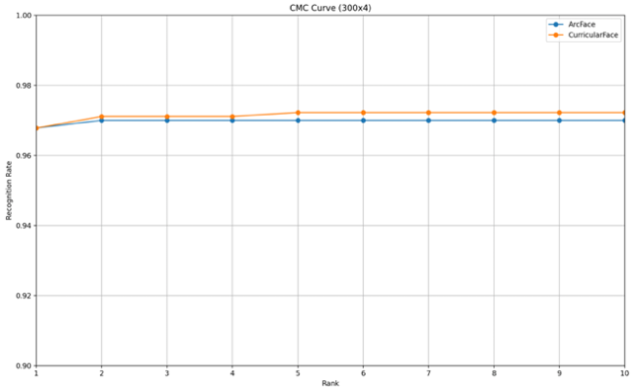
Setting 2 – CMC Curve

Slide 32
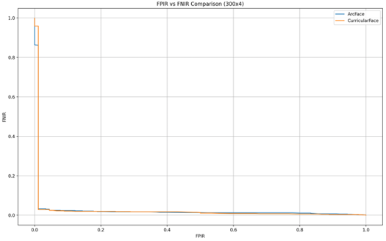
Setting 2 – FPIR vs FNIR Curve

Slide 33
Limitations and Improvements

Slide 34
Limitations
Limited computational power → not large enough Test Images
No distinct gaps between the results from the two algorithms

Slide 35
Improvements
Improvement | Expected Result
Adopt the larger number of images | More stable results
Try with less curated and aligned datasets | Better separation between models CurricularFace may perform better after this improvement
Include more varied lighting / pose conditions | Can evaluate robustness of models
Evaluate on different metrics (inference time, memory usage) | Get a more practical comparison beyond just accuracy

Slide 36
References
https://www.youtube.com/watch?v=y-D1tReryGA
[1] “Face Recognition Terminals,” Hikvision, Feb. 08, 2023. Source: [Online]. Available: https://www.hikvision.com/hk/products/Access-Control-Products/Face-Recognition-Terminals/.
[2] “Flight Token, Passenger Guide,” Hong Kong International Airport. https://www.hongkongairport.com/en/passenger-guide/flight-token.page.
[3] “What are the requirements for a perfect working biometric facial recognition?”, Modivision. Source: [Online]. Available: https://www.modivision.net/wp-content/uploads/2019/08/Requirements.pdf.
[4] G. B. Huang, M. Ramesh, T. Berg, and E. Learned-Miller, October 2007, “Labeled Faces in the Wild: A Database for Studying Face Recognition in Unconstrained Environments”. University of Massachusetts, Amherst, Technical Report 07-49. Source: [Online]. Available: https://www.kaggle.com/datasets/jessicali9530/lfw-dataset.
[5] I. Chan, Hong Kong adopts facial recognition tech at Sha Tau Kok border checkpoint, Hong Kong Free Press HKFP, Dec. 24, 2024. [Online]. Available: https://hongkongfp.com/2024/12/24/hong-kong-adopts-facial-recognition-tech-at-sha-tau-kok-border-checkpoint.
[6] I. Kemelmacher-Shlizerman, S. M. Seitz, D. Miller, and E. Brossard, “The MegaFace Benchmark: 1 Million Faces for Recognition at Scale,” 2016 IEEE Conference on Computer Vision and Pattern Recognition, Jun. 2016, doi:10.1109/CVPR.2016.527.
[7] Information technology — Biometric data interchange formats, ISO/IEC 19794-5, 2011.
[8] ISO/IEC 19794-5 | Correlance. Source: [Online]. Available: https://www.correlance.com/cms/en/iso19794-5.
[9] J. Deng, J. Guo, J. Yang, N. Xue, I. Kotsia, and S. Zafeiriou, “ArcFace: Additive Angular Margin Loss for Deep Face Recognition,” IEEE Transactions on Pattern Analysis and Machine Intelligence, vol. 44, no. 1939–3539, pp. 5962–5979, Jan. 2018, doi: 10.1109/tpami.2021.3087709.
[10] J. Guo, J. Deng, X. An, J. Yu, and B. Gecer, (2024), “InsightFace: 2D and 3D Face Analysis Project.” Source: [Online]. Available: https://github.com/deepinsight/insightface.
[11] Li, L., Mu, X., Li, S., & Peng, H, “A Review of Face Recognition Technology”. IEEE Access, 8, 139110–139120. 2022. doi:10.1109/access.2020.3011028.
[12] M. Chen, W. Qian, J. He, and Z. Zhao, “Research on the application of face recognition system,” Sep. 2022, doi: 10.1088/1742-6596/1684/1/012126.
[13] Schroff, F., Kalenichenko, D., & Philbin, J, “FaceNet: A unified embedding for face recognition and clustering”. 2015 IEEE Conference on Computer Vision and Pattern Recognition (CVPR). 2015. doi:10.1109/cvpr.2015.7298682.
[14] S. Wang, “Facial Recognition in Forensic Investigations: Advancements and Applications,” J Forensic Toxicol Pharmacol, vol. 12, no. 2, Jun. 2023, doi:10.4172/JFTP.1000152.
[15] TSA introduces state-of-the art identity verification technology at DEN security checkpoints | Transportation Security Administration, www.tsa.gov, Nov. 18, 2022. [Online]. Available: https://www.tsa.gov/news/press/releases/2022/11/18/tsa-introduces-state-art-identity-verification-technology-den.
[16] Y. Huang, Y. Wang, Y. Tai, X. Liu, P. Shen, S. Li, J. Li, and F. Huang, (2020), “CurricularFace: Adaptive Curriculum Learning Loss for Deep Face Recognition”, CVPR. Source: [Online]. Available: https://github.com/HuangYG123/CurricularFace.
[17] Z. Liu, P. Luo, X. Wang, and X. Tang, “Deep Learning Face Attributes in the Wild,” Proceedings of International Conference on Computer Vision (ICCV), Dec. 2015. Source: [Online]. Available: https://mmlab.ie.cuhk.edu.hk/projects/CelebA.html.

