Slide 1

CSC696H Project Final Presentation (OECD Country Classification Prediction over XAI)
Presenter : Sunghoon Kim
April. 2022

Slide 2
Review midterm presentation

Slide 3
What is the purpose of my project?
Implement a supervised machine learning model over explainability.
The model predicts the OECD country risk grade with news and economic indicators, ASAP.
Events affecting a country risk are reflected in news first and then in economic indicators.
Baseline : Target grades replicates the previous classifications. It has 97.39% accuracy.
NEWS, Some indicators
(Daily)
Classification
Event
Other economic indicators
(Monthly, Quarterly, Yearly…)

Slide 4
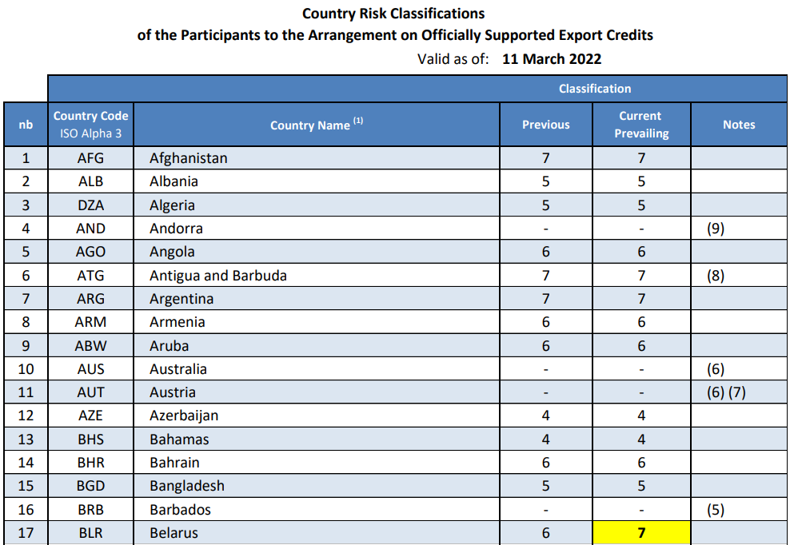
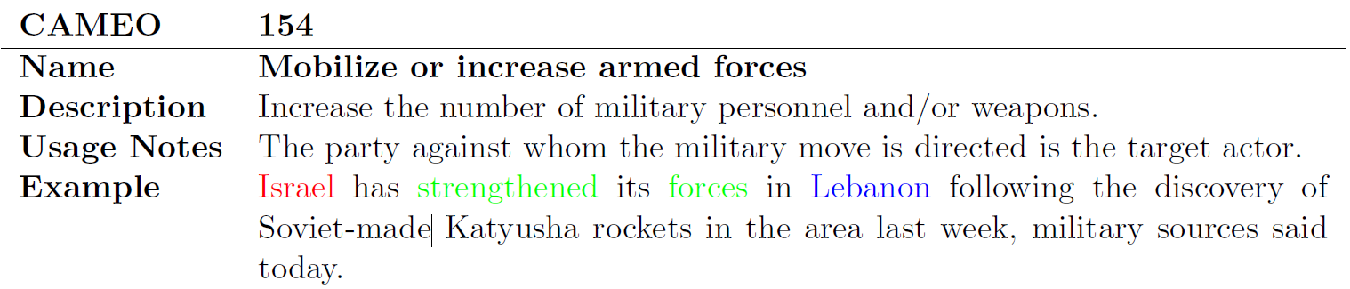
DataSets
OECD : 1 – 7 gradings
86 times grading, during 1999 – Mar 2022
(Most recent) Belarus, Russia downgraded to 7
GDELT news set
CAMEO action code : Event taxonomy
Actor1, Actor2 : Subject, Object of the news
AvgTone: the average “tone” of the news. Score ranges from -100 to +100.
Economic Indicators from IMF data

Slide 5
Experiment setup

Slide 6
Trials for GDELT
How long is the gap between the evaluation date and the base date of the news?
To aggregate each member’s opinion, it needs certain amount of time.
[0, 5, 10, 15, 20, 30]
Extreme news vs All news
Based on AvgTone, News with (AvgTone < -10 or AvgTone > 10) vs All news
Subject vs Subject + Object
Whether to use the countries in the only subject of the news or the countries in both subject and object of the news.
Chosen event code
Select event codes that affect grade’s change by distribution between AvgTone and grade’s changes
[Reject mediation, Threaten with administrative sanctions, Violate ceasefire] vs [Express accord, Appeal to others to engage in or accept mediation, Grant diplomatic recognition]
[5, 10]

Slide 7
Trials for Economic Indicators
1) Normalize the values for each indicator
2) Apply average of all indicators in each country and evaluation period
Compared to the GDELT, relatively few trials were made
Name | Freq
Total balance of Payment | Quaterly
Residential Real Estate Prices, Percent | Monthly
Reserve and Foreign Currency Assets | Monthly
Net lending/borrowing rate | Yearly
Net lending/borrowing rate of government | Yearly
Net operating balance of government | Yearly
Total Capital Account, Debt | Monthly
Economic Activity, Industrial Production | Monthly
Economic Activity, Retail Sales | Monthly
Nominal Effective Exchange Rate | Monthly
Prices, Consumer Price Index | Monthly
Interest Rates, Money Market | Monthly
Labor Markets, Employment | Monthly
Gross Domestic Product | Monthly
Assets and Liabilities (with Fund Record) | Monthly
Financial Market Prices, Equities | Monthly
Imports of Goods and Services | Monthly
Exports of Goods and Services | Monthly

Slide 8
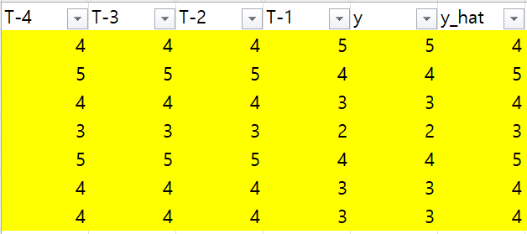
Trials for ML model and architecture
Input: Timeseries dataset (3D array, [data_row, timeslot, data])
To independent of country and evaluation time, there is no input about country and eval_date.
n = ? ➔ [60, 36, 12, 6, 3]
Initial trial: Every event code in GDELT occupy single cell. → Accuracy falls into about 40%
Current: GDELT has 2 cells, which are up/down event code’s mean of AvgTone. And economic indicators occupy single cell, which is average of economic value.
Output
Initial trial: Country risk classification(1-7)
Instead of changes in T-1, it tends to follow the grade of T-2.
Current: -1 / 0 / 1
which mean the grade goes down / stays / goes up.
Architecture: Compare performance in a single layer of [LSTM, GRU, RNN].
T-(n) | T-(n+1) | T-(n+2) | T-(n+3) | T-(n+4) | … | T-1
Grade | Grade | … | … | … | … | Grade
GDELT | GDELT | … | … | … | … | GDELT
Indicators | Indicators | … | … | … | … | Indicators

Slide 9
Trials for Explainability
(PDP → ALE) Accumulated local effects(ALE) describe how features influence the prediction of a machine learning model on average. ALE plots are a faster and unbiased alternative to partial dependence plots. [Apley, Daniel W. (2020)]
I tried to use scikit-learn and PDPBox libraries for PDP. However, scikit-learn requires to “fit” in “scikit-learn” and PDPBox doesn’t allow y_hat’s one-hot encoding.
ALE is in alibi. (https://github.com/SeldonIO/alibi)
(LIME) LIME supports timeseries datasets.

Slide 10
Results

Slide 11
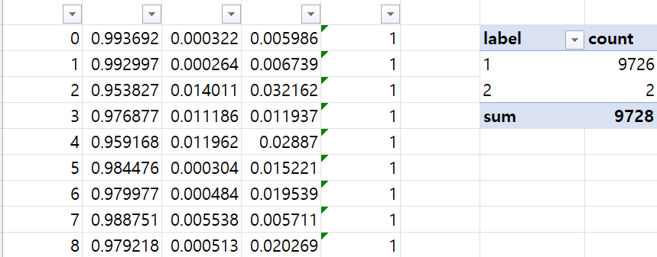
Performance of Model (1/2)
Experiment result to distinguish superiority in the length of timeseries and ML architecture.
By the batch predict of the ML model,
only <=5 grades are different from
previous one. Low “recall”.
 |  | Accuracy(mean) | Accuracy(max) | Accuracy(min) | Loss | MSE
Baseline |  | 97.54% | 98.18% | 97.01% | - | 0.062
Length of time series | 60 | 97.64% | 98.46% | 96.63% | 0.130 | 0.016
 | 36 | 97.62% | 98.20% | 96.50% | 0.130 | 0.016
 | 12 | 97.52% | 98.15% | 96.92% | 0.133 | 0.016
 | 6 | 97.47% | 97.89% | 97.04% | 0.135 | 0.017
 | 3 | 97.46% | 97.79% | 97.03% | 0.135 | 0.017
ML architecture | RNN | 97.54% | 98.46% | 96.50% | 0.132 | 0.016
 | LSTM | 97.54% | 98.46% | 96.55% | 0.131 | 0.016
 | GRU | 97.54% | 98.46% | 96.50% | 0.132 | 0.016

Slide 12
Performance of Model (2/2)
Experiment result to distinguish superiority in GDELT handling options with “archi = RNN” and “length of timeseries = 60”.
 |  | Accuracy(mean) | Accuracy(max) | Accuracy(min) | Loss | MSE
Baseline |  | 97.36% | 97.69% | 96.92% | - | 0.061
Gap of the base date in news set | 0 | 97.50% | 98.55% | 96.34% | 0.138 | 0.017
 | 5 | 97.47% | 98.27% | 96.82% | 0.139 | 0.017
 | 10 | 97.53% | 98.46% | 96.63% | 0.137 | 0.016
 | 15 | 97.44% | 98.46% | 96.82% | 0.141 | 0.017
 | 20 | 97.45% | 98.55% | 96.34% | 0.140 | 0.017
 | 30 | 97.52% | 98.46% | 96.72% | 0.137 | 0.016
Extreme news or not | Extreme | 97.50% | 98.55% | 96.72% | 0.139 | 0.017
 | All | 97.47% | 98.46% | 96.34% | 0.139 | 0.017
Subject? Object? | Sub | 97.50% | 98.55% | 96.63% | 0.137 | 0.016
 | Sub+Obj | 97.46% | 98.46% | 96.34% | 0.140 | 0.017
# of event code | 5 | 97.47% | 98.55% | 96.63% | 0.140 | 0.017
 | 10 | 97.50% | 98.55% | 96.34% | 0.138 | 0.017
Include economic indicators or not | Include | 97.49% | 98.55% | 96.34% | 0.138 | 0.017
 | Exclude | 97.48% | 98.55% | 96.34% | 0.139 | 0.017

Slide 13
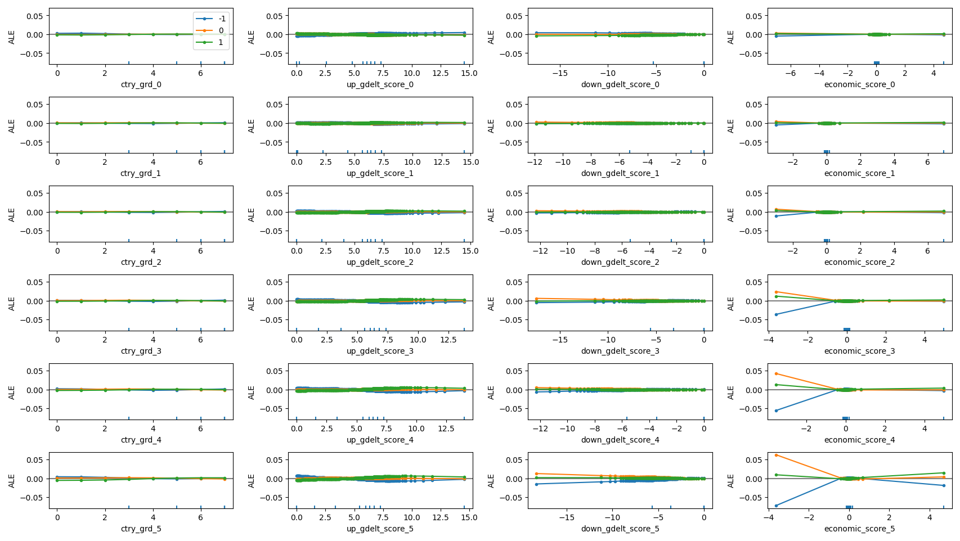
ALE
ALE plots the relationship between all features and model itself.

Slide 14
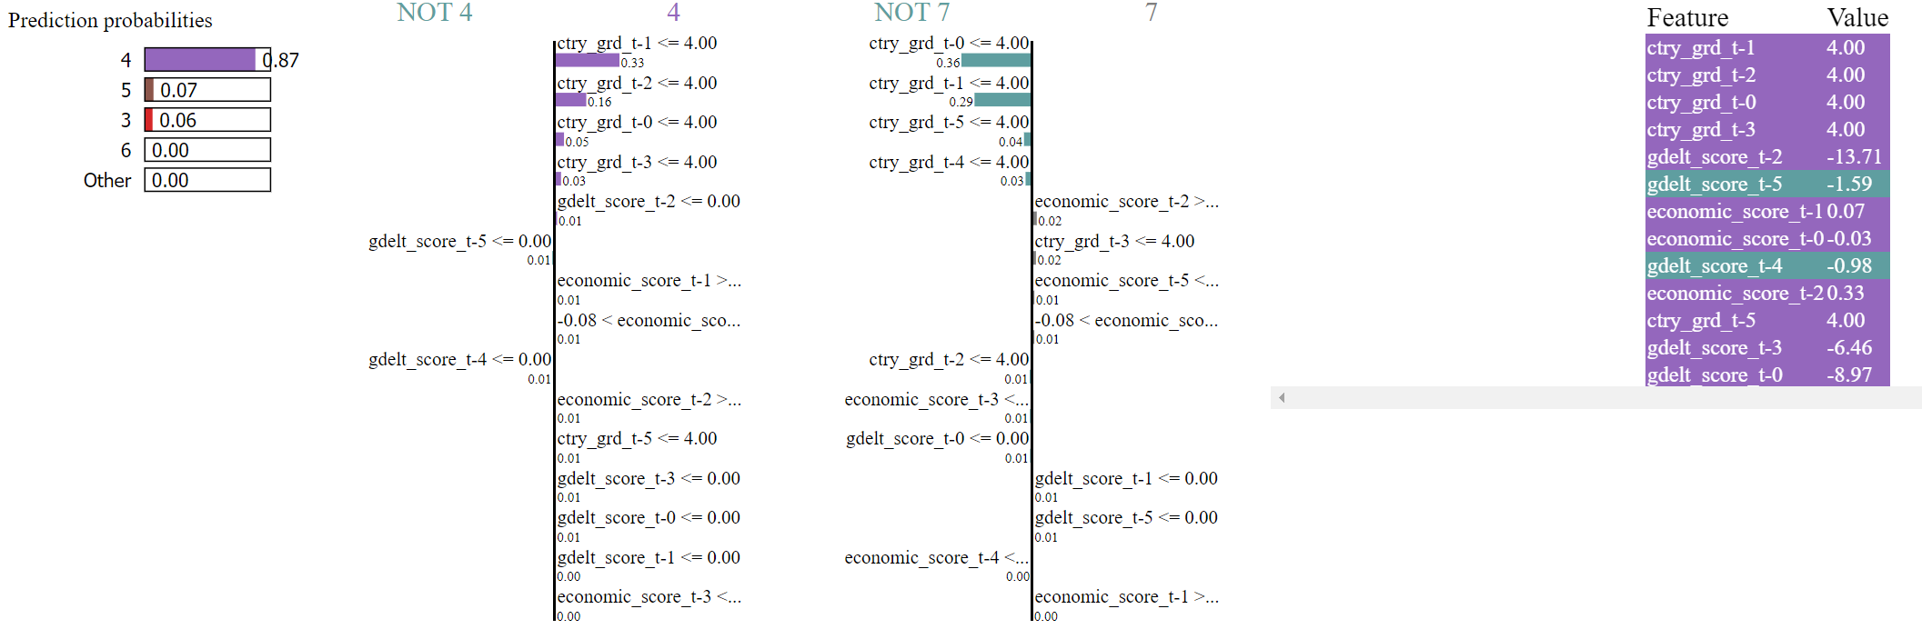
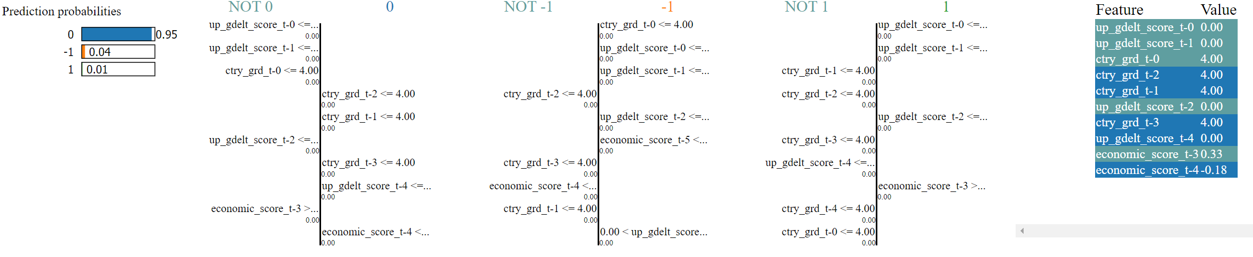
LIME
This LIME displays the change of grade, 4 → 7, in Russia at March 2022.
Predicts grades vs up/down.

Slide 15
(temp) Conclusion and plan

Slide 16
(Temp) Conclusion
I cannot find significant dataset handling options to induce high accuracy of OECD country grades.
It was a long and inefficient journey, since there is no fabulous results in accuracy of prediction despite various trials.
Nevertheless, my ML model have successfully integrated explainability libraries, and these results are intuitive for explaining and debugging the model.

Slide 17
Plan
(GDELT) Continue to uncover clues about the correlation with OECD grades.
(Indicators) Find optimal combinations among economic indicators.
(Explainability) Incorporate key event codes from news and economic indicators into our explainability model.

Slide 18
Thank you!

