Slide 1

CSC696H Project Midterm Presentation (OECD Country Classification Prediction over XAI)
Presenter : Sunghoon Kim
Mar. 2022

Slide 2
INTRODUCTION

Slide 3
What is the purpose of my project?
Implement a supervised machine learning model over explainability.
The model predicts the country risk classification with news and economic indicators, ASAP.
Events affecting a country risk are reflected in news first and then in economic indicators.
NEWS, Some indicators
(Daily)
Classification
Event
Other economic indicators
(Monthly, Quarterly, Yearly…)

Slide 4
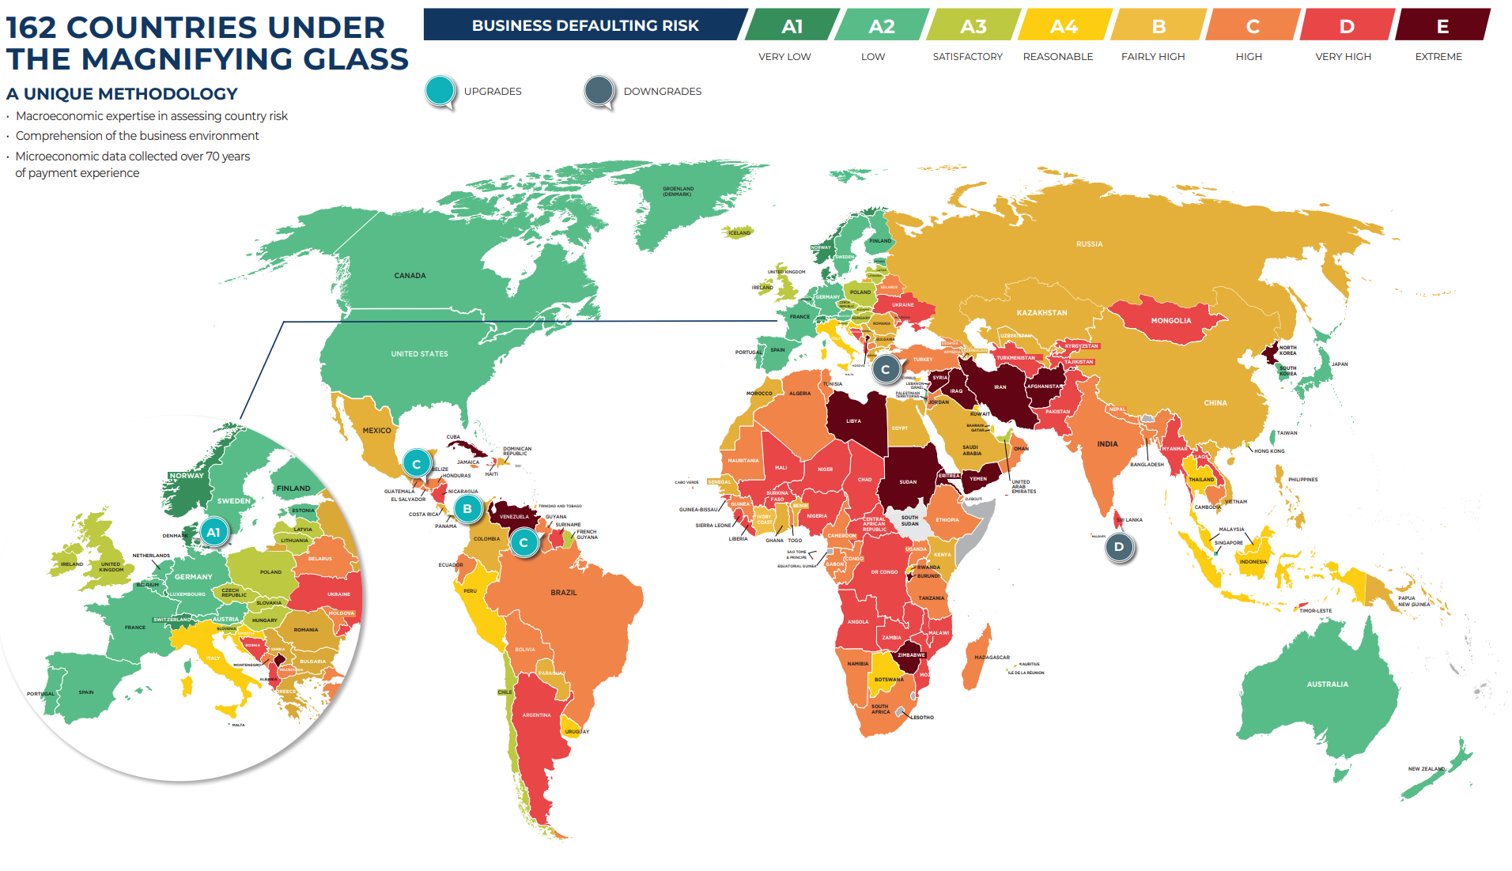
COUNTRY RISK ASSESSMENT MAP - Q4 2021 by COFACE

Slide 5


What is country risk?
Country risk refers to the risk of investing or lending in a country, arising from possible changes in the business environment that may adversely affect operating profits or the value of assets in the country. [Wikipedia]
200+ countries
Saima Qutub @Umm_e_Hanzala

Slide 6
Why country risk prediction is important?
High risk, high return? ➔ Depends on accurate risk prediction.
Importance of country risk?
Risk contaminates to companies in the country and neighboring countries
Greater volume compared to bankruptcy of individual companies
Classification agencies
Fitch Ratings, Moody’s, Standard & Poor's (U.S)
The Organization for Economic Co-operation and Development (OECD) aggregates and condensates 38 Export Credit Agencies(ECA)’s rating.

Slide 7
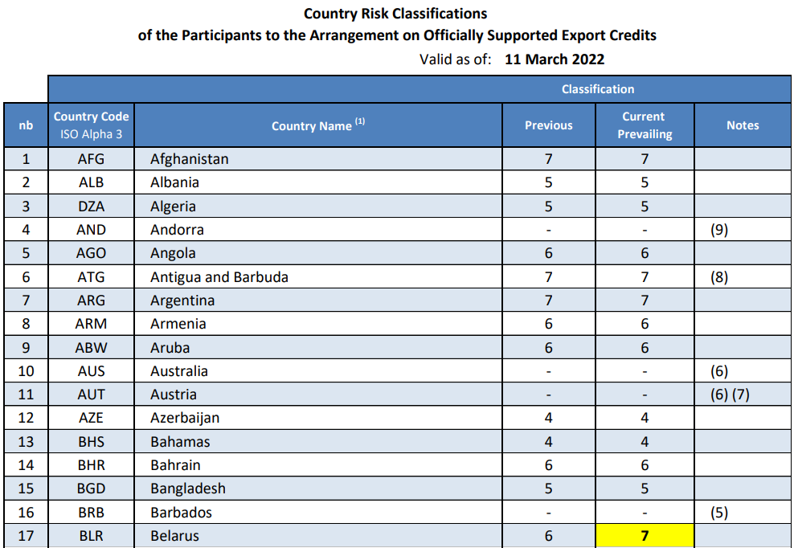
OECD classification dataset’s format
Notes : Some countries aren’t classified because of “High Income OECD Country” and “Low national economy size”.
1 – 7 gradings
86 times grading, during 1999 – Mar 2022
(Most recent) Belarus, Russia downgraded to 7

Slide 8
Why GDELT?
How to choose news agencies for refined datasets?
Which a news agency has the priority in duplicate news of single event?
Those agencies cover all events in the world?
GDELT event database!
the GDELT Project monitors the world's broadcast, print, and web news from nearly every corner of every country in over 100 languages and identifies the people, locations, organizations, themes, sources, emotions, counts, quotes, images and events driving our global society every second of every day, creating a free open platform for computing on the entire world. [gdeltproject.org]
(1.0) From 1979 to Now. Update daily. 58 fields. (220GB+ in CSV)
(2.0) From 2015 to Now. Update 15 mins. 61 fields.

Slide 9
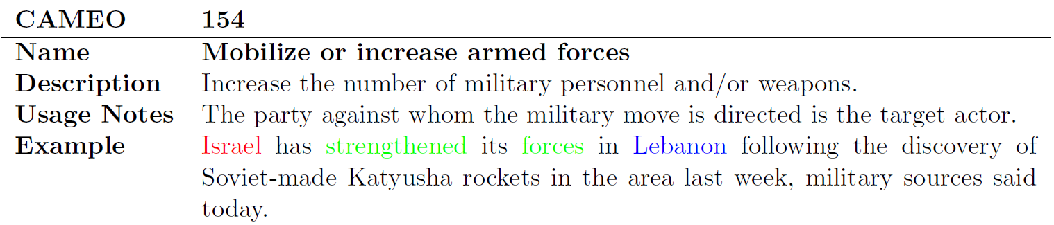
GDELT dataset’s format
CAMEO action code : Event taxonomy
Conflict and Mediation Event Observations (CAMEO) is a framework for coding event data. [Wikipedia]
Actor1, Actor2 : Red / Blue one in above example
Event action attributes
GoldsteinScale: Each CAMEO event code is assigned a numeric score from -10 to +10.
two riots, one with 10 people and one with 10,000, will both receive the same Goldstein score.
NumMentions: the total number of mentions of this event across all source documents.
AvgTone: the average “tone” of all documents containing one or more mentions of this event. The score ranges from -100 (extremely negative) to +100 (extremely positive).

Slide 10
Machine learning model
Input: refined GDELT datasets and Economic Indicators in the evaluation period of each countries
Economic Indicators: interest rate, exchange rate, local stock price index, or else which need to optimize.
Output: Country risk classification(1-7)
Multiclass supervised machine-learning
Architecture: Choose optimized architecture among LSTM, GRU, RNN, MSA(Markov switching autoregression), or else.

Slide 11
Why XAI(Explainable AI)?
When a company needs to judge large investment, the approvement of a senior decision maker is required. To do that, we need explainability to the user about the results of our model.
Apply post-hoc models first, such as LIME(local-agnostic) and PDP(global-agnostic), and then expand to direct explainability model.

Slide 12
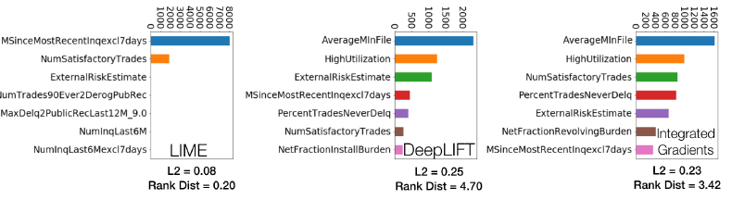
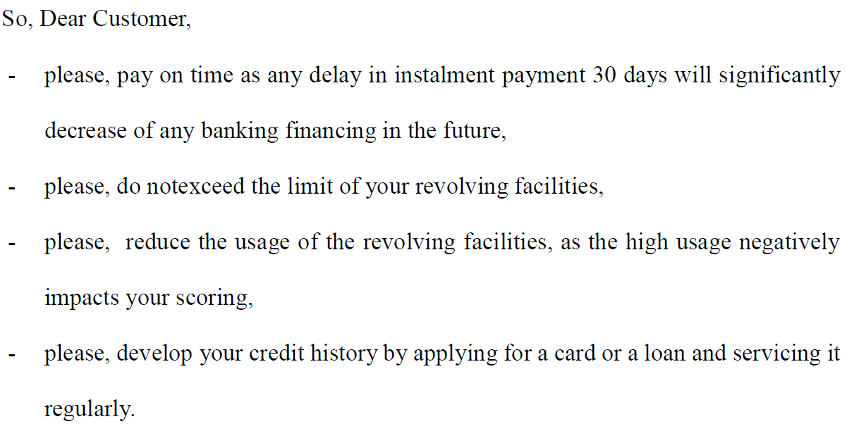
XAI result in Credit Risk
Interpretable graph or text type guidance message will be provided.

Slide 13
plan

Slide 14
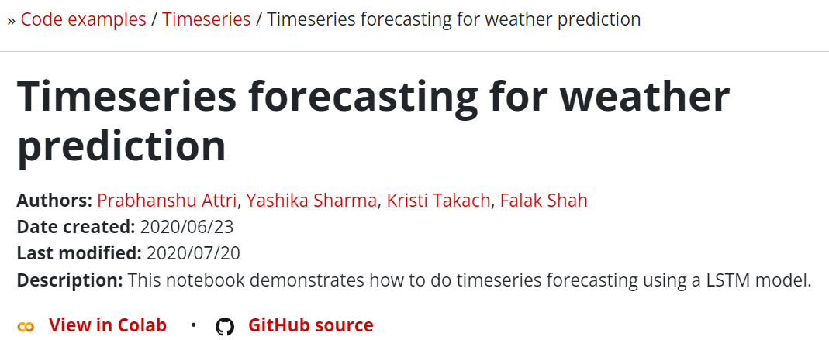
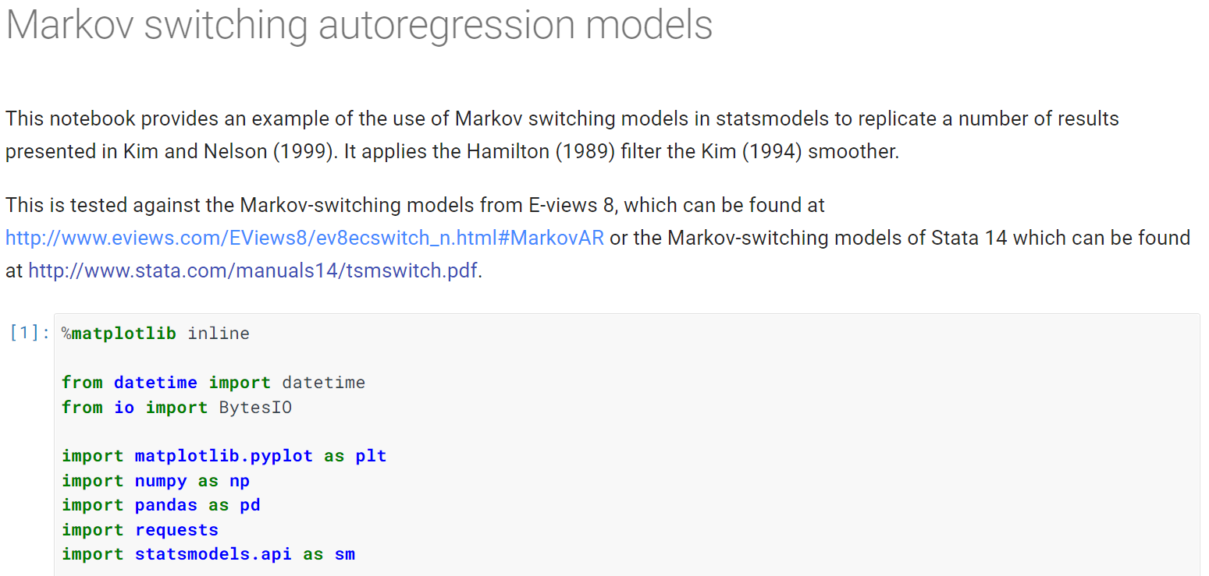
Baseline
Program starts from the example, “Timeseries forecasting for weather prediction” in Keras and “Markov switching autoregression models” in statsmodel.
97.39% of classification is same as the previous classifications.

Slide 15
Optimization
Choose the best architecture among LSTM, GRU, RNN, and MSA.
Choose the best combination of economic indicators such as interest rate, exchange rate, and local stock price index.
Randomized hyperparameter optimization

Slide 16
Milestones
~ 3/31) Prepare GDELT dataset for our project and Implement vanilla model using LSTM.
~ 4/15) Derive an optimized model for machine learning architectures, combination of economic indicators, and hyperparameters.
~ 4/30) Apply XAI model.

Slide 17
Thank you!

