Slide 1
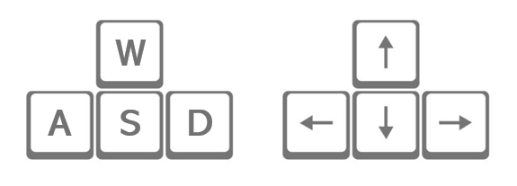














How to Move
How to Clear

Slide 2
How to Move
How to Clear

Slide 3
How to Move
How to Clear

Slide 4
How to Move
How to Clear

Slide 5
How to Move
How to Clear

Slide 6
How to Move
How to Clear

Slide 7
How to Move
How to Clear

Slide 8
How to Move
How to Clear

Slide 9
How to Move
How to Clear

Slide 10
How to Move
How to Clear

Slide 11
How to Move
How to Clear

Slide 12
How to Move
How to Clear

Slide 13
How to Move
How to Clear

Slide 14
How to Move
How to Clear

Slide 15
How to Move
How to Clear

Slide 16
How to Move
How to Clear

Slide 17
How to Move
How to Clear

Slide 18
How to Move
How to Clear

Slide 19
How to Move
How to Clear

Slide 20
How to Move
How to Clear

Slide 21
How to Move
How to Clear

Slide 22
How to Move
How to Clear

Slide 23
How to Move
How to Clear

Slide 24
How to Move
How to Clear

Slide 25
How to Move
How to Clear

Slide 26
How to Move
How to Clear

Slide 27
How to Move
How to Clear

Slide 28
How to Move
How to Clear

Slide 29
How to Move
How to Clear

Slide 30
How to Move
How to Clear

Slide 31
How to Move
How to Clear

Slide 32
How to Move
How to Clear

Slide 33
How to Move
How to Clear

Slide 34
How to Move
How to Clear

Slide 35
How to Move
How to Clear

Slide 36
How to Move
How to Clear

Slide 37
How to Move
How to Clear

