Slide 1
DlY Humidifier
201031515 이준오
201534103 하성혁
201635845 장윤지

Slide 2
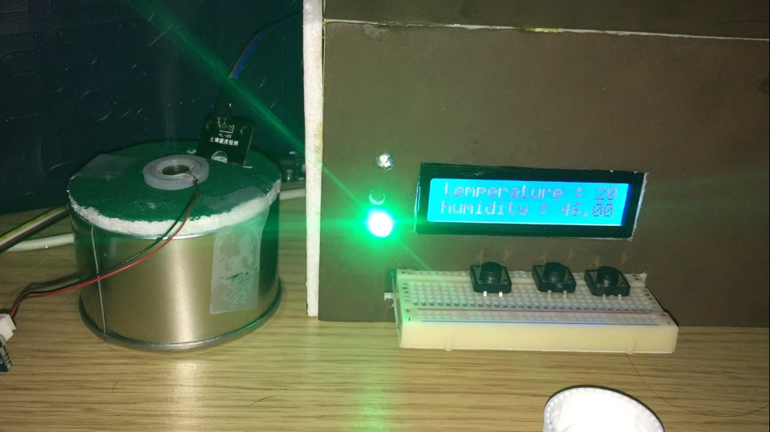
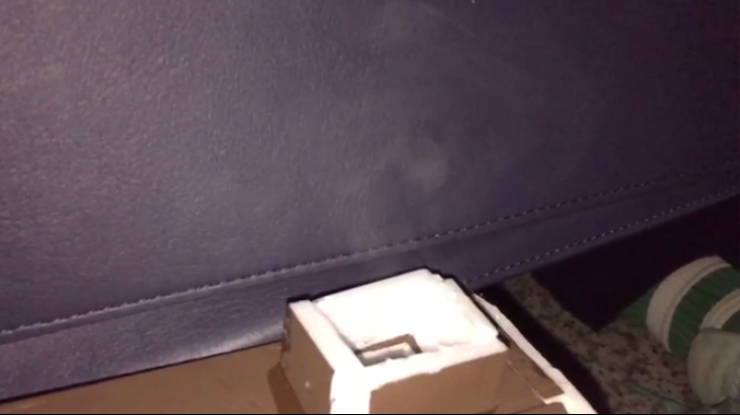
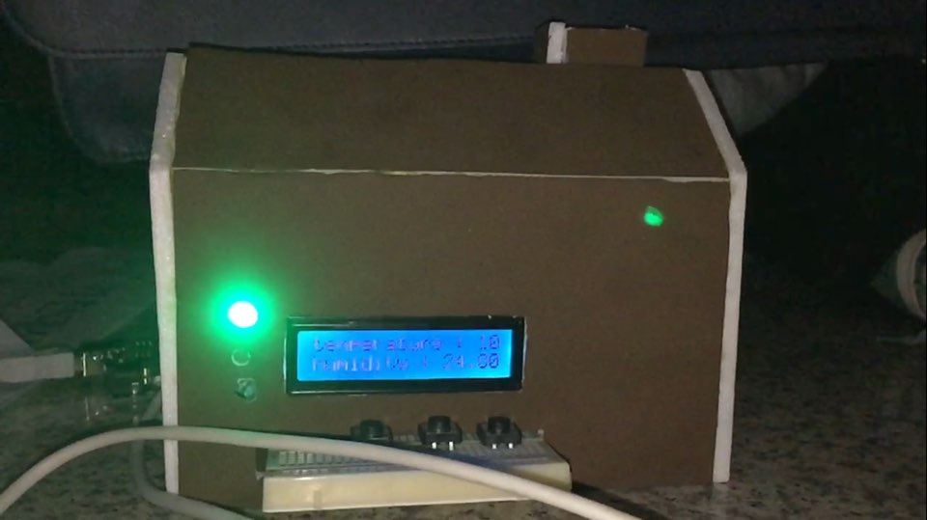
DIY Humidifier

Slide 3
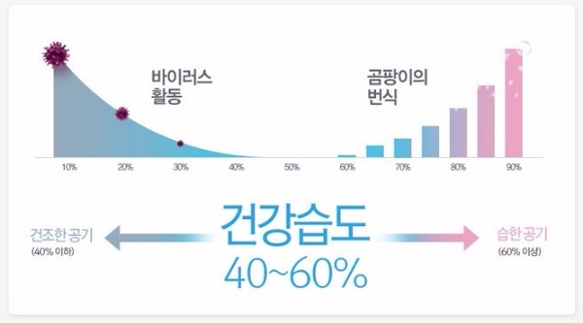


Practicality and Creative
It can manage humidity easily.
Turn on or turn off automatically.
We can see if the humidity is appropriate or not by the led

Slide 4

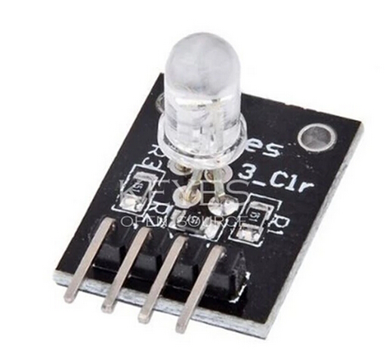


Function and Special Point
When humidifier turn off, it can turn on Passively .
If there is no water, make a sound and turn on LED.
Timer function. Set the time.

Slide 5
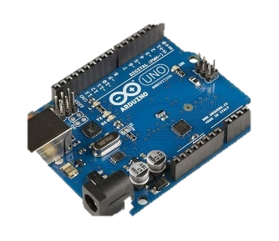
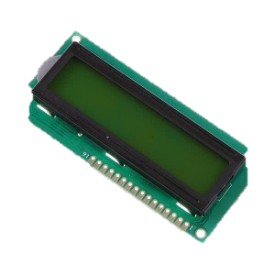
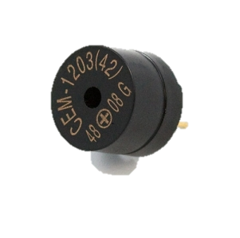
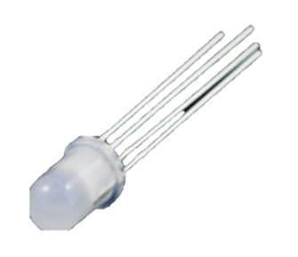
Component and Role
It is a component that compose humidifier.
Arduino Uno
Process source and control product.
LCD Screen
Display humidity and temperature.
Plezo Speaker
When water is lack, make a sound.
RGB LED
Depending on humidity, turn on LED.

Slide 6
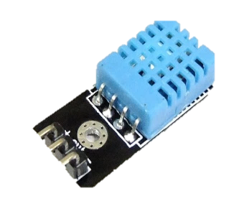
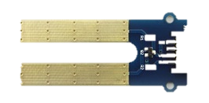

Component and Role
It is a component that compose humidifier.
Temperature-Humidity Sensor
Detect humidity.
Depth Sensor
Detect water depth.
Ultrasonic transducer
Detect humidity.

Slide 7
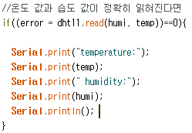
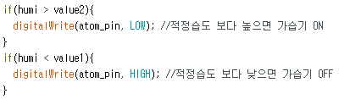
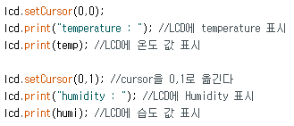
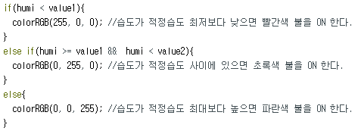
Algorithm
How to progress our work
Start
Enter the room.
Temperature-Humidity Sensor can be use.
Detect the humidity
Make the vapor
Display the humidity
We can see the humidity for LCD.
To increase the humidity.
(Use ultrasonic waves)
NO
40% <=RH <= 60%?
YES
People could breath comfortable
the 40%~60% humidity.
Most of the humidity value is 50~60%.(In winter, 30% or more.)
If the value is under 20%,
It may cause trouble our eyes or skin.
Print the Output
(Turn on the LED)
Turn on LED as much percent of humidity.
Finish
Turn off the switch.

Slide 8
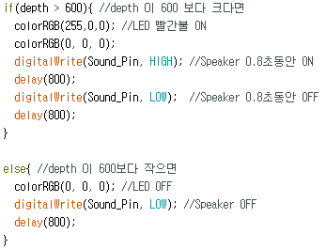
Algorithm
How to progress our work
Start
Enter the room.
Depth Sensor can be use.
Detect the depth
Display the humidity
NO
depth > 600 ?
YES
People could use humidifier,
when water is enough.
Make a Sound and turn on LED
Turn on LED and make a sound
Finish

Slide 9
데모영상

Slide 10
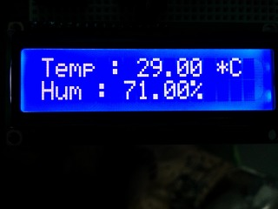

Pros and Cons of our proposed system.
Advantages
Temperature and humidity appear on LCD.
We can know humidity condition as LED
Disadvantages
Do not detect fast and accurately.
Do not generate much vaper.

Slide 11

Conclusion and future work
Problem and Improvement
Lack Point
Temperature-Humidity Sensor do not detect accurately.
And detect temperature and humidity slowly.
-> Use more accurate Sensor.
Vapor is less than other humidifier.
-> Use more powerful Ultrasonic Sensor.

