Slide 1


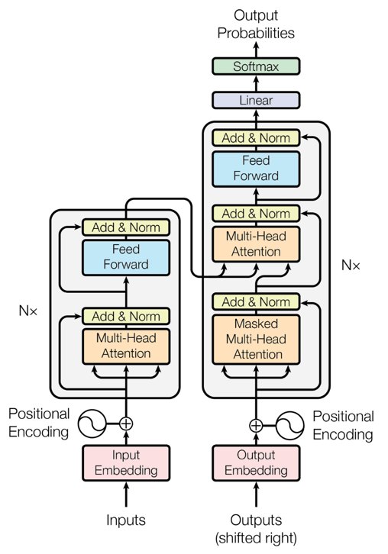
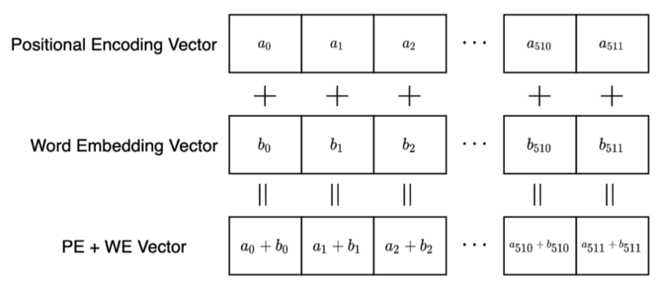
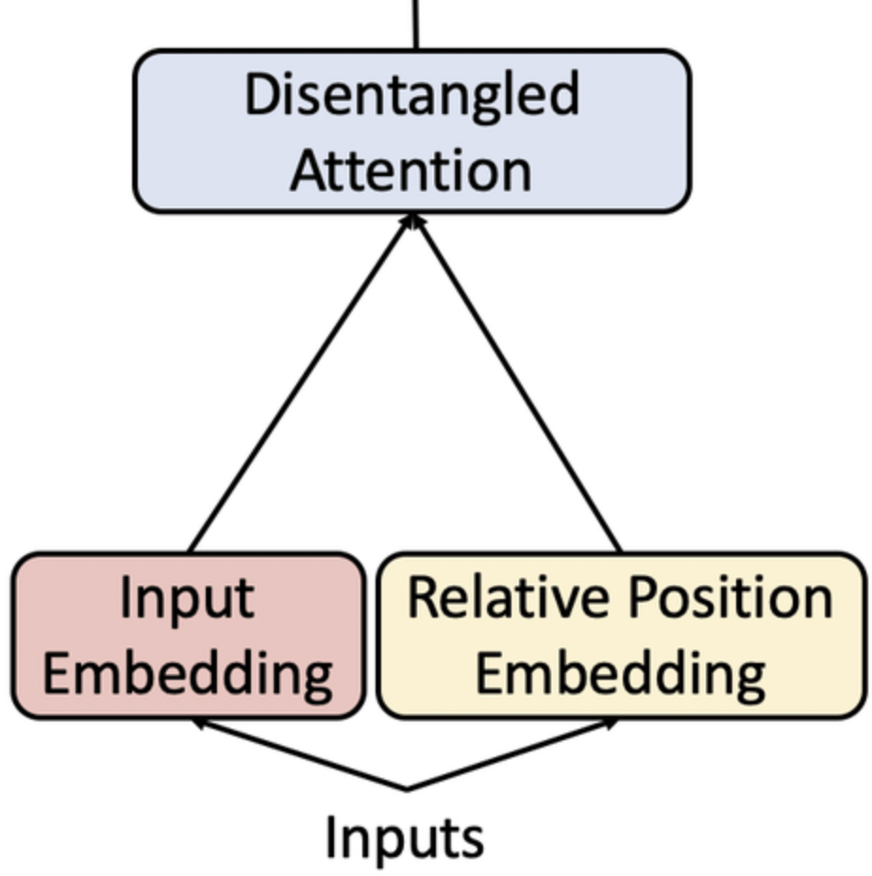
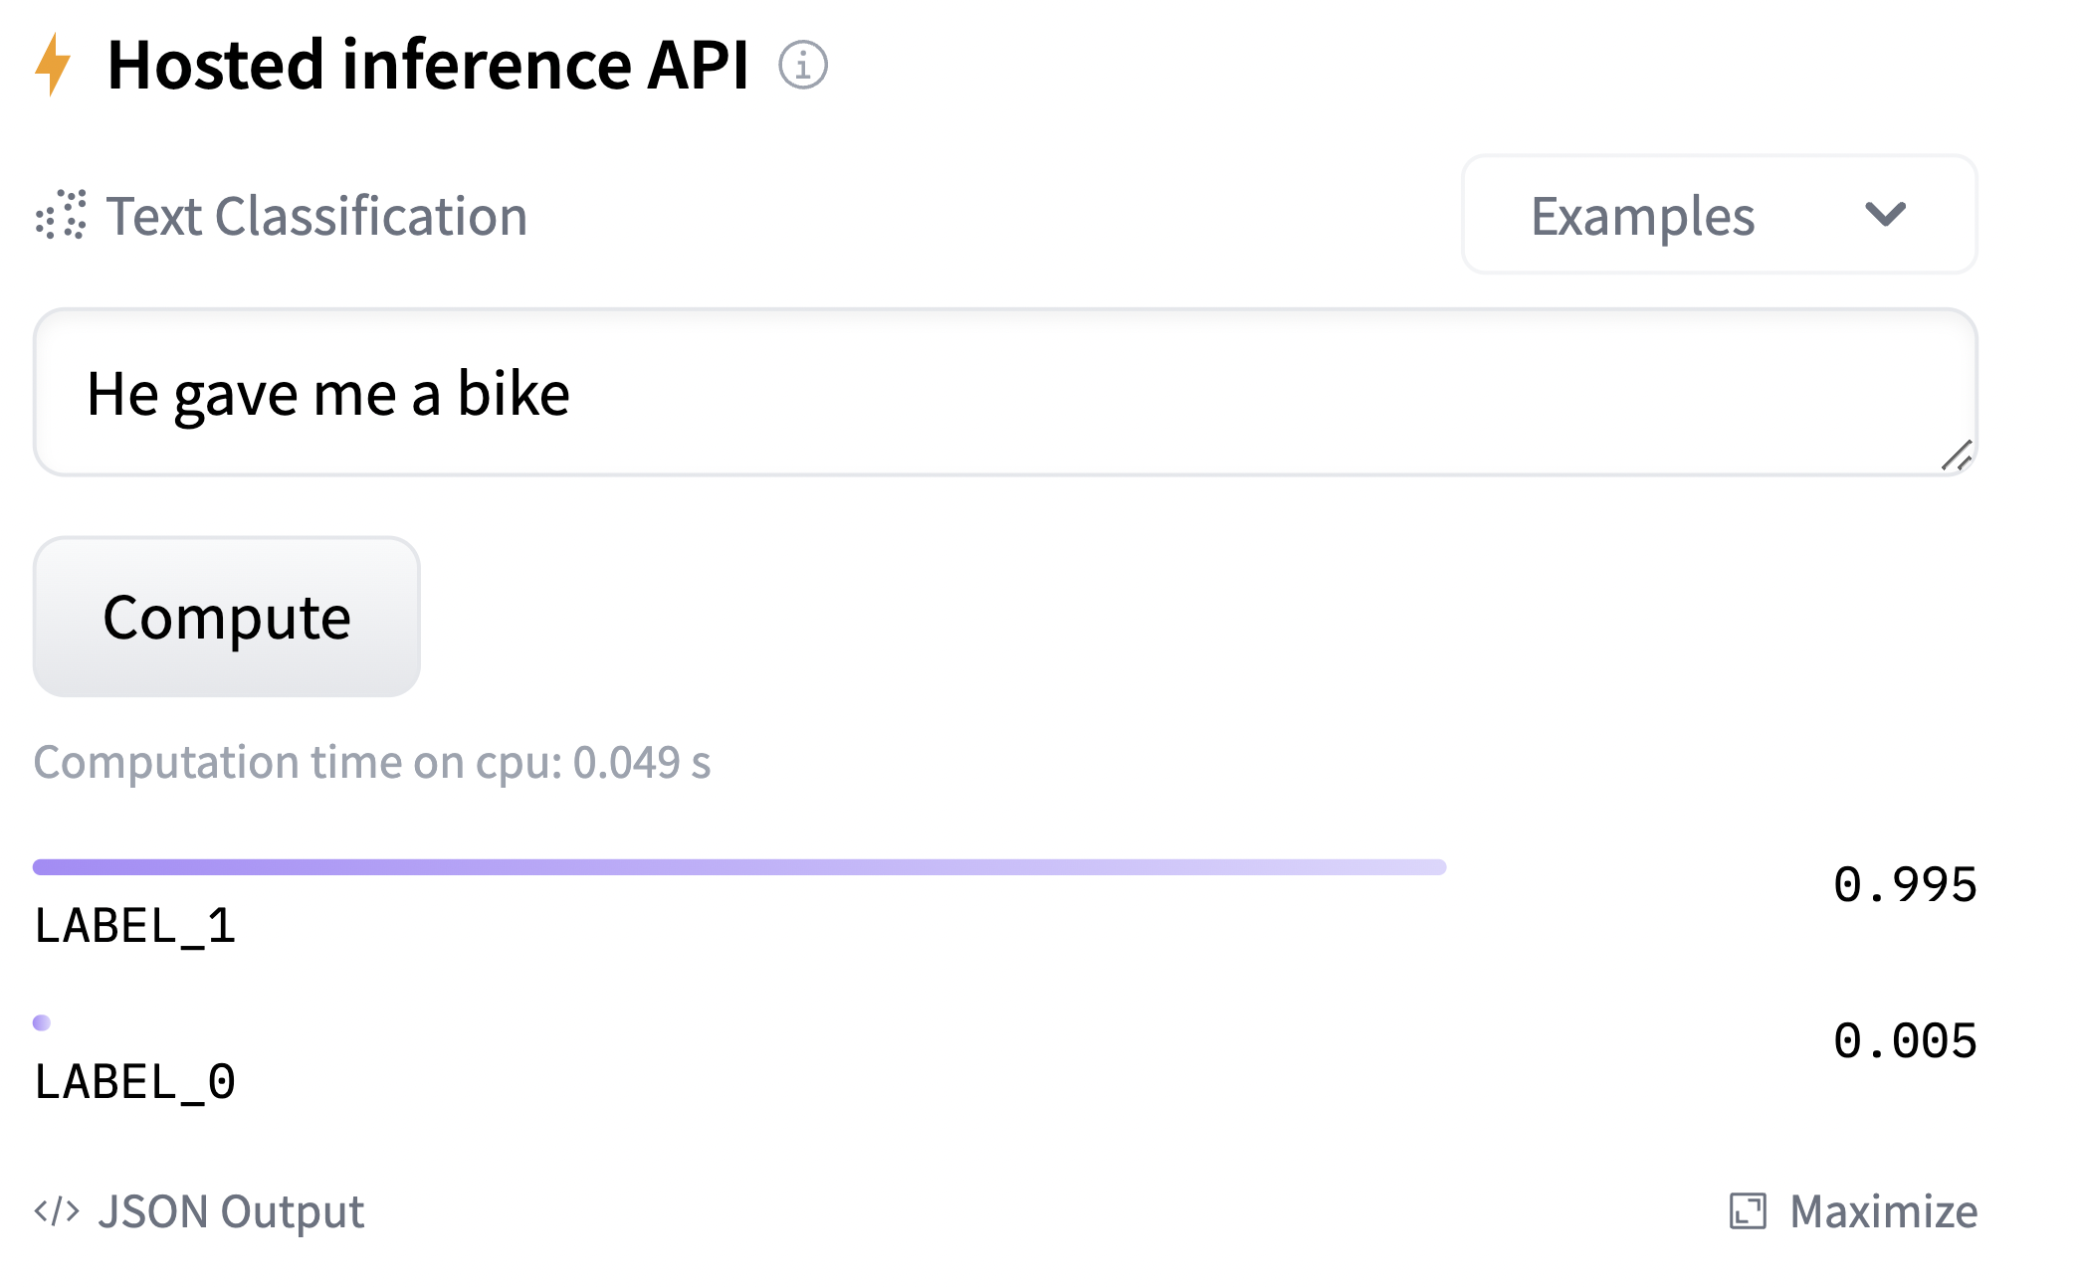
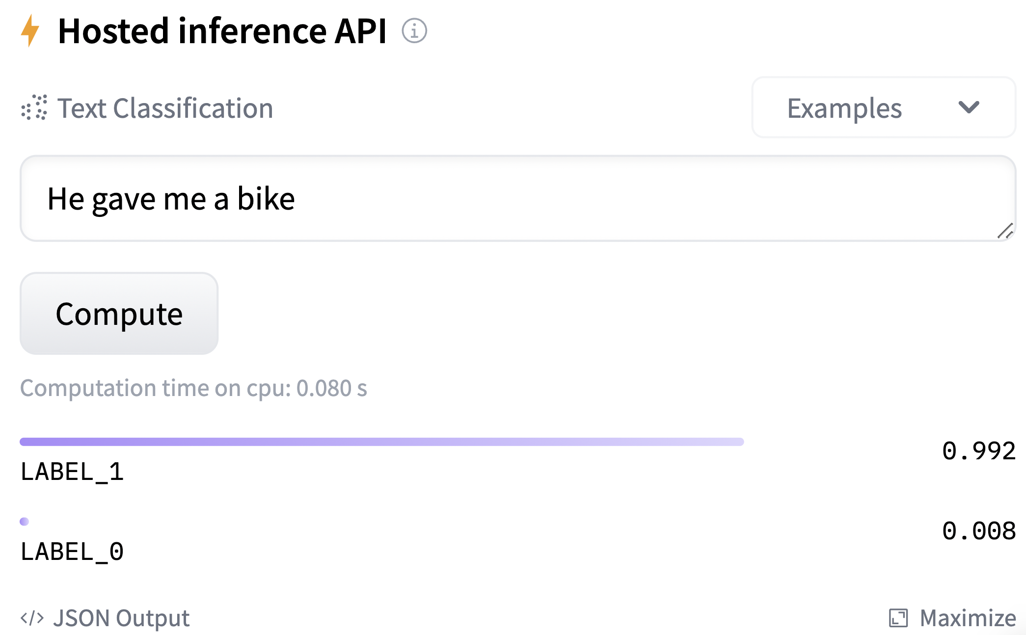
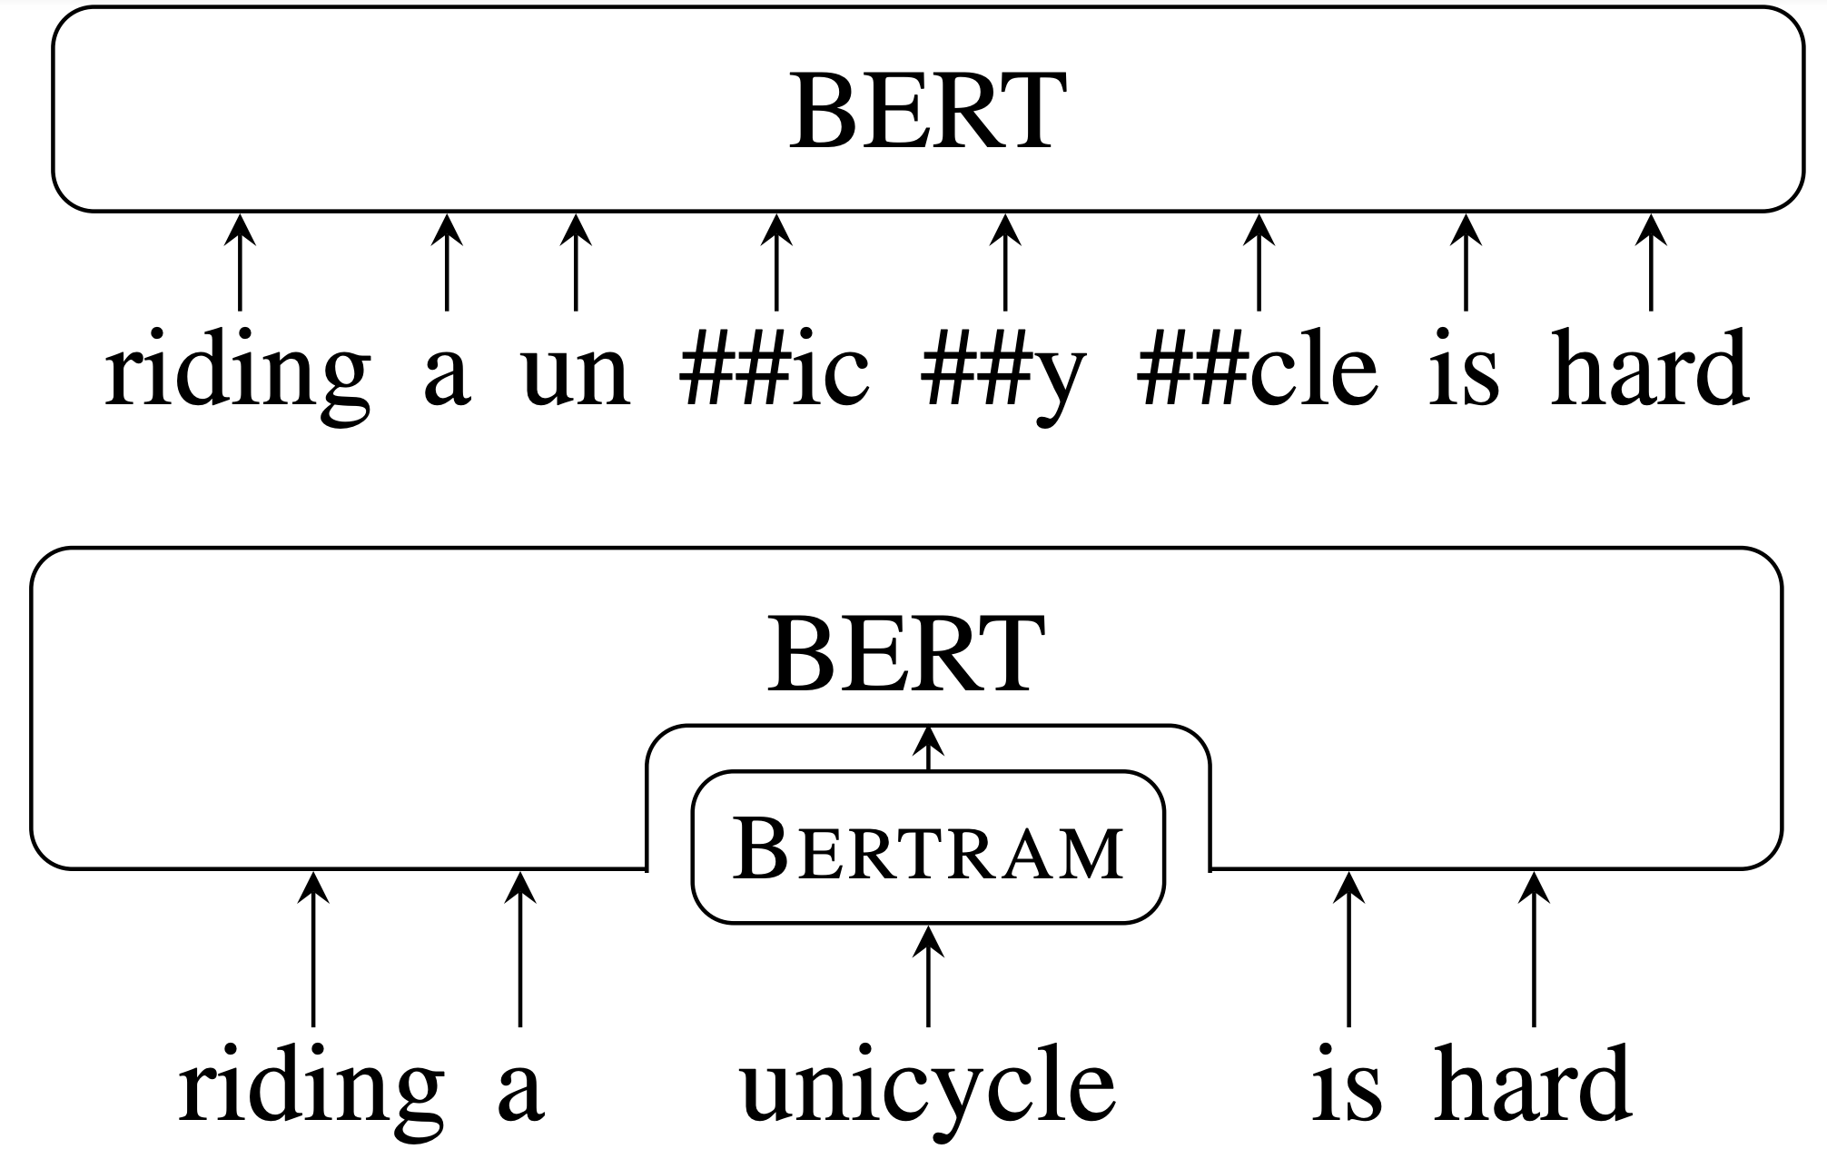
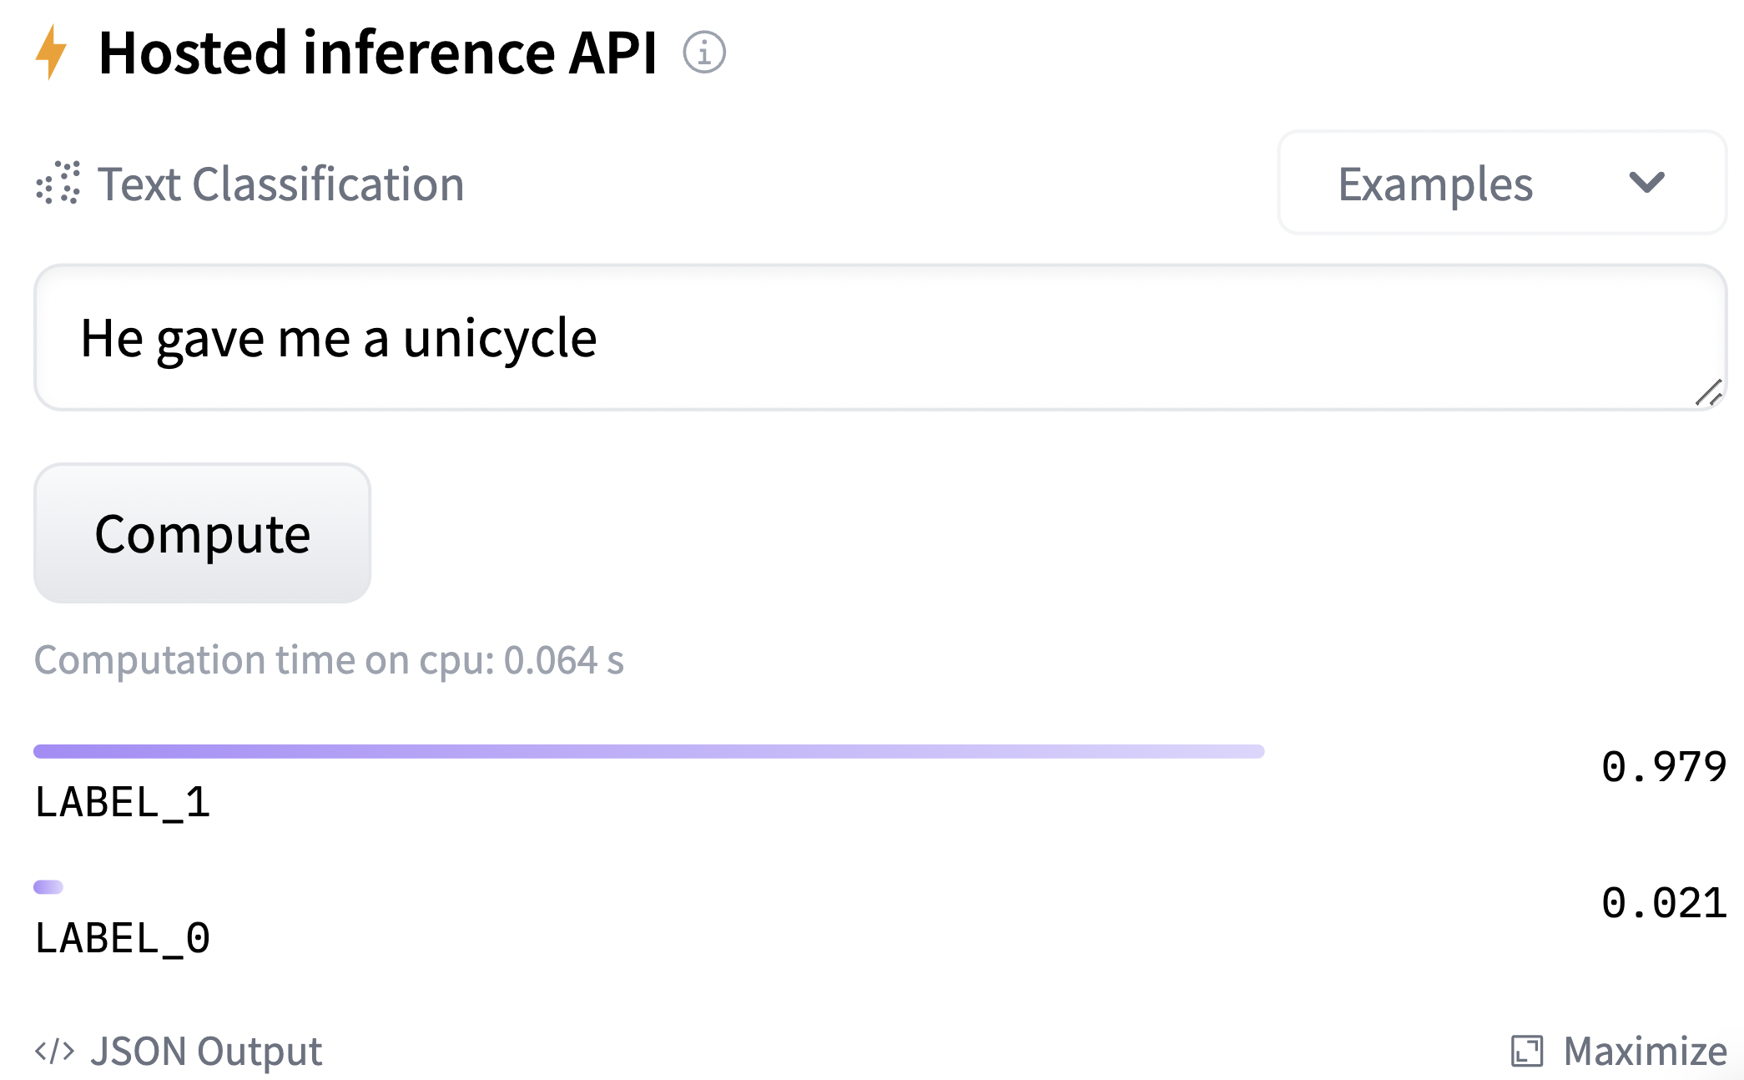
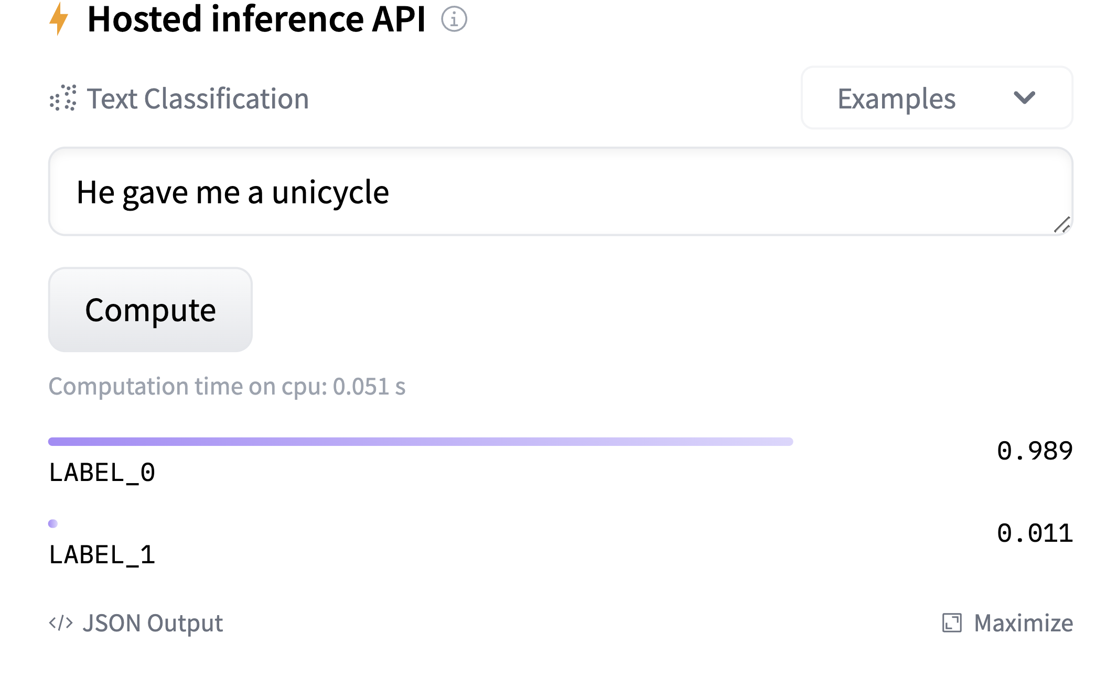
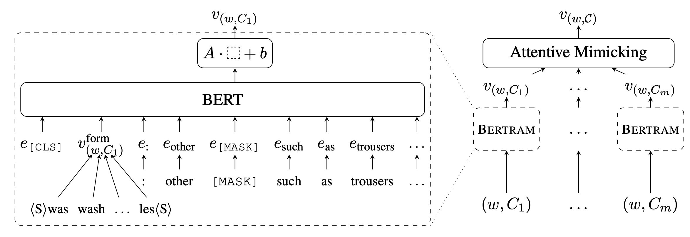
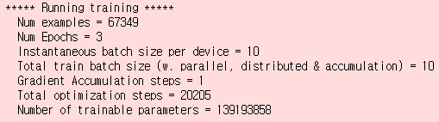
DeBERTRAMa: Merging BERTRAM and DeBERTa to Achieve a High-Performance Sentiment-Analysis Model with Rare Word Contextualization
Ryan Corkill & Sungman Kang
University of Alabama at Birmingham
Try our model on HuggingFace:
Introduction
Methods
Results
DeBERTa
Pre-processing Data
Fine-tuning on SST-2
Transformer-based architecture, modified BERT model
Brown Corpus used to pre-train Bertram instances
 | Epoch 1 (Acc/Val. Loss) | Epoch 2 (Acc/Val. Loss) | Epoch 3 (Acc/Val. Loss) | ∆ BERTRAM
BERT_{BASE} | 92.2 / 0.35 | 91.9 / 0.34 | 92.0 / 0.36 | -
RoBERTa_{BASE} | 93.1 / 0.25 | 93.0 / 0.33 | 93.7 / 0.34 | -
DeBERTa_{BASE} | 93.9 / 0.25 | 93.3 / 0.34 | 93.2 / 0.34 | -
BERT + BERTRAM | 91.7 / 0.35 | 92.5 / 0.36 | 93.0 / 0.36 | 1.0
RoBERTRAMa | 92.5 / 0.29 | 92.8 / 0.32 | 93.7 / 0.33 | 0.0
DeBERTRAMa | 93.0 / 0.30 | 93.7 / 0.32 | 94.2 / 0.32 | 1.0
Two key novel changes from BERT:
Pre-processing data involved generating “buckets” of words occurring at designated frequencies in the pre-training corpus
Disentangled Attention
Brown Corpus
Words occurring at least 20 times
Bucket 20
Model fine-tuning and testing on SST-2 evaluates performance at a sentiment-analysis task
Pre-training BERTRAM Instances on Brown Corpus
Addition of BERTRAM to BERT and DeBERTa (referred to as DeBERTRAMa) improves performance of each
Word content and relative position vectors are used
Enhanced Masking
Instances of BERTRAM trained for (1) BERT, (2) RoBERTa, (3) DeBERTa
DeBERTRAMa outperforms all other models on SST-2 benchmark
Absolute word position vectors are introduced in pre-training via masked language modeling
Each instance requires pre-training of a form-only model and a context-only model
HuggingFace Model Comparison
Form and context models are fused, and the fused model is pre-trained
BERTRAM
--model_cls 'deberta'
--bert_model 'microsoft/deberta-base'
--vocab ./training/train.vwc100
--emb_file ./fcm/wordEmbeddings/glove.6B.300d.txt
--num_train_epochs 3
--emb_dim 768
--max_seq_length 100
--mode context
--train_batch_size 32
--smin 4
--smax 32
--model_cls 'deberta’
--bert_model 'microsoft/deberta-base’
--vocab ./training/train.vwc100
--emb_file ./fcm/wordEmbeddings/glove.6B.300d.txt
--num_train_epochs 20
--emb_dim 768
--mode form
--train_batch_size 32
--smin 4
--smax 32
--learning_rate 0.01
BERT-SST2
DeBERTRAMa-SST2
Employs “attentive mimicking” (AM) to represent rare words contextually
He gave me a bike
--form_model ./outputs/deberta_form
--context_model ./outputs/deberta_context
--mode ‘add’
--output ./outputs/deberta_fused
Combined surface-form and context of words, leading to better representation and embeddings (particularly for rare words)
Injecting Words with Context into Models
Previously integrated with BERT and RoBERTa, resulting in better performance in contextualization compared to base models
Once a (fused) BERTRAM instance is pre-trained, a “wrapper” is made to inject words with context into BERT/RoBERTa/DeBERTa
“bike” to “unicycle”
Integration with DeBERTa has thus far not been attempted
Words with context form:
{WORD₁: [CONTEXT₁, CONTEXT₂ … CONTEXT_{N}]
…
}
Fine-tuned models uploaded to HuggingFace (rcorkill/DeBERTRAMa-SST2)
Aim
Context_{i} is a sentence from the corpus containing the word
Using the HuggingFace API, DeBERTRAMa-SST2 compared to BERT-SST-2
Fine-tuning on SST-2
Test text: “He gave me a bike”, both models assign a positive sentiment
Capitalize on strong performance of DeBERTa relative to BERT and RoBERTa
1. Define training parameters:
2. Encode the dataset
“bike” changed to “unicycle” (an example of a rare word). BERT fails to correctly predict the sentiment, where DeBERTRAMa remains successful
Merge DeBERTa with BERTRAM to further enhance rare word contextualization
training_args = TrainingArguments(
evaluation_strategy="epoch",
logging_steps=30,
output_dir=f"{model_name}-finetuned-{task}",
save_strategy = "epoch",
learning_rate=2e-5,
per_device_train_batch_size=10,
per_device_eval_batch_size=10,
)
encoded_dataset = DatasetDict({
train: Dataset({ features: ['sentence', 'label', 'input_ids', 'token_type_ids', 'attention_mask'], num_rows: 67349 })
validation: Dataset({ features: ['sentence', 'label', 'input_ids', 'token_type_ids', 'attention_mask'], num_rows: 872 }) })
References
DeBERTa
3. Train and evaluate each model
trainer = Trainer(
args=training_args,
model=model,
train_dataset=encoded_dataset['train'],
eval_dataset=encoded_dataset['validation'],
compute_metrics=compute_metrics,
tokenizer=tokenizer
)
BERTRAM+(Ro/De)BERT(a)
He, P., Liu, X., Gao, J., & Chen, W. (2020). Deberta: Decoding-enhanced bert with disentangled attention. arXiv preprint arXiv:2006.03654.
Pre-trained (Ro/De)BERT(a)
Schick, T., & Schütze, H. (2020). BERTRAM: Improved Word Embeddings Have Big Impact on Contextualized Model Performance. ACL.

