Slide 1
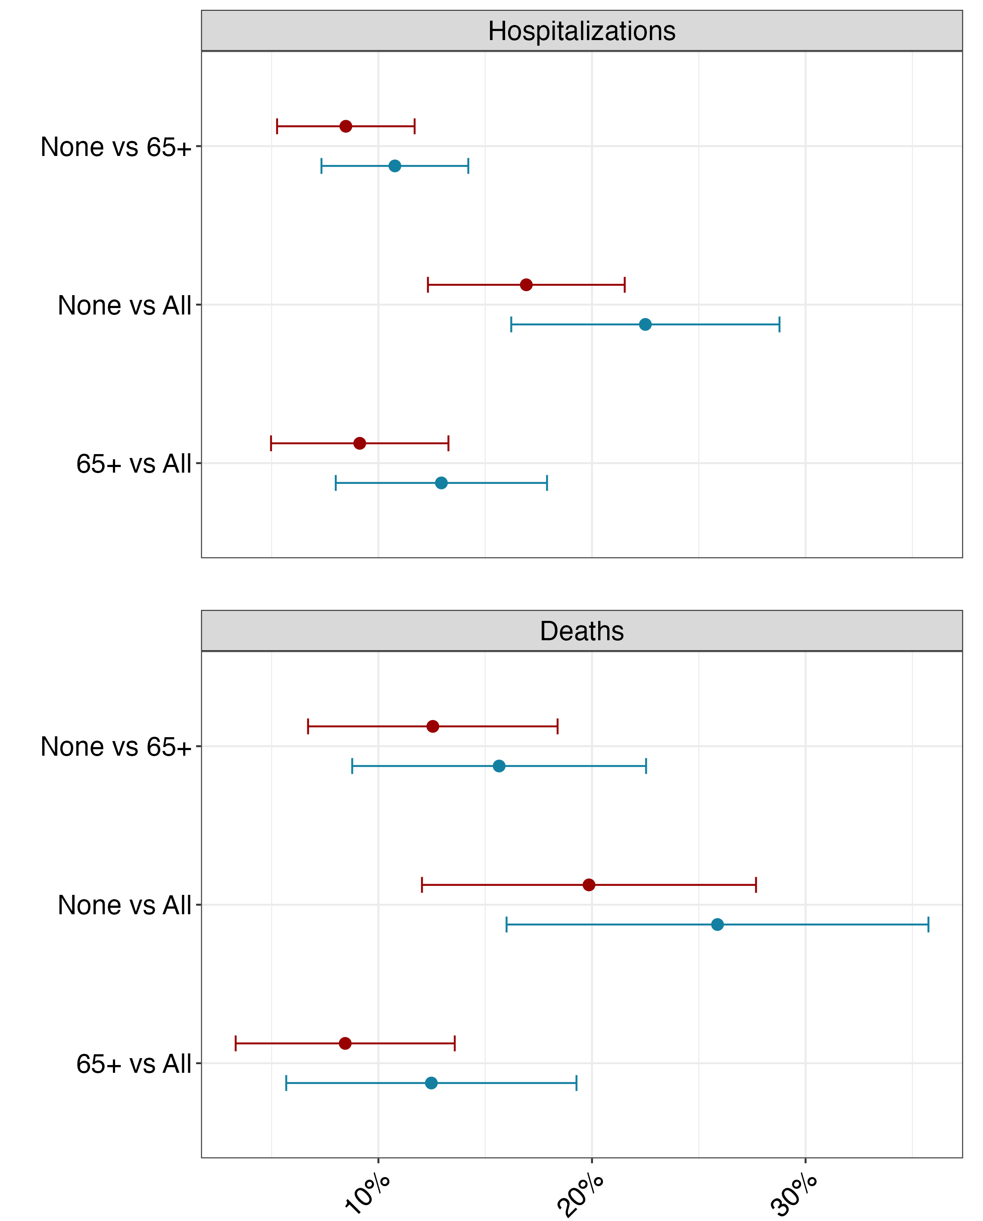
Percent prevented (%)
Total prevented (95% PI)
High immune escape
Low immune escape
Hospitalizations
229,578 (104,367–354,788) | 201,850 (113,547–290,512)
430,914 (263,930–597,897) | 416,119 (255,379–576,858)
197,679 (119,740–275,619) | 207,738 (118,818–296,659)
Deaths
32,707 (11,564–53,850) | 28,444 (12,707–44,181)
48,982 (28,701–69,262) | 46,113 (28,378–63,849)
16,492 (10,584–22,400) | 17,729 (11,792–23,666)

Slide 2
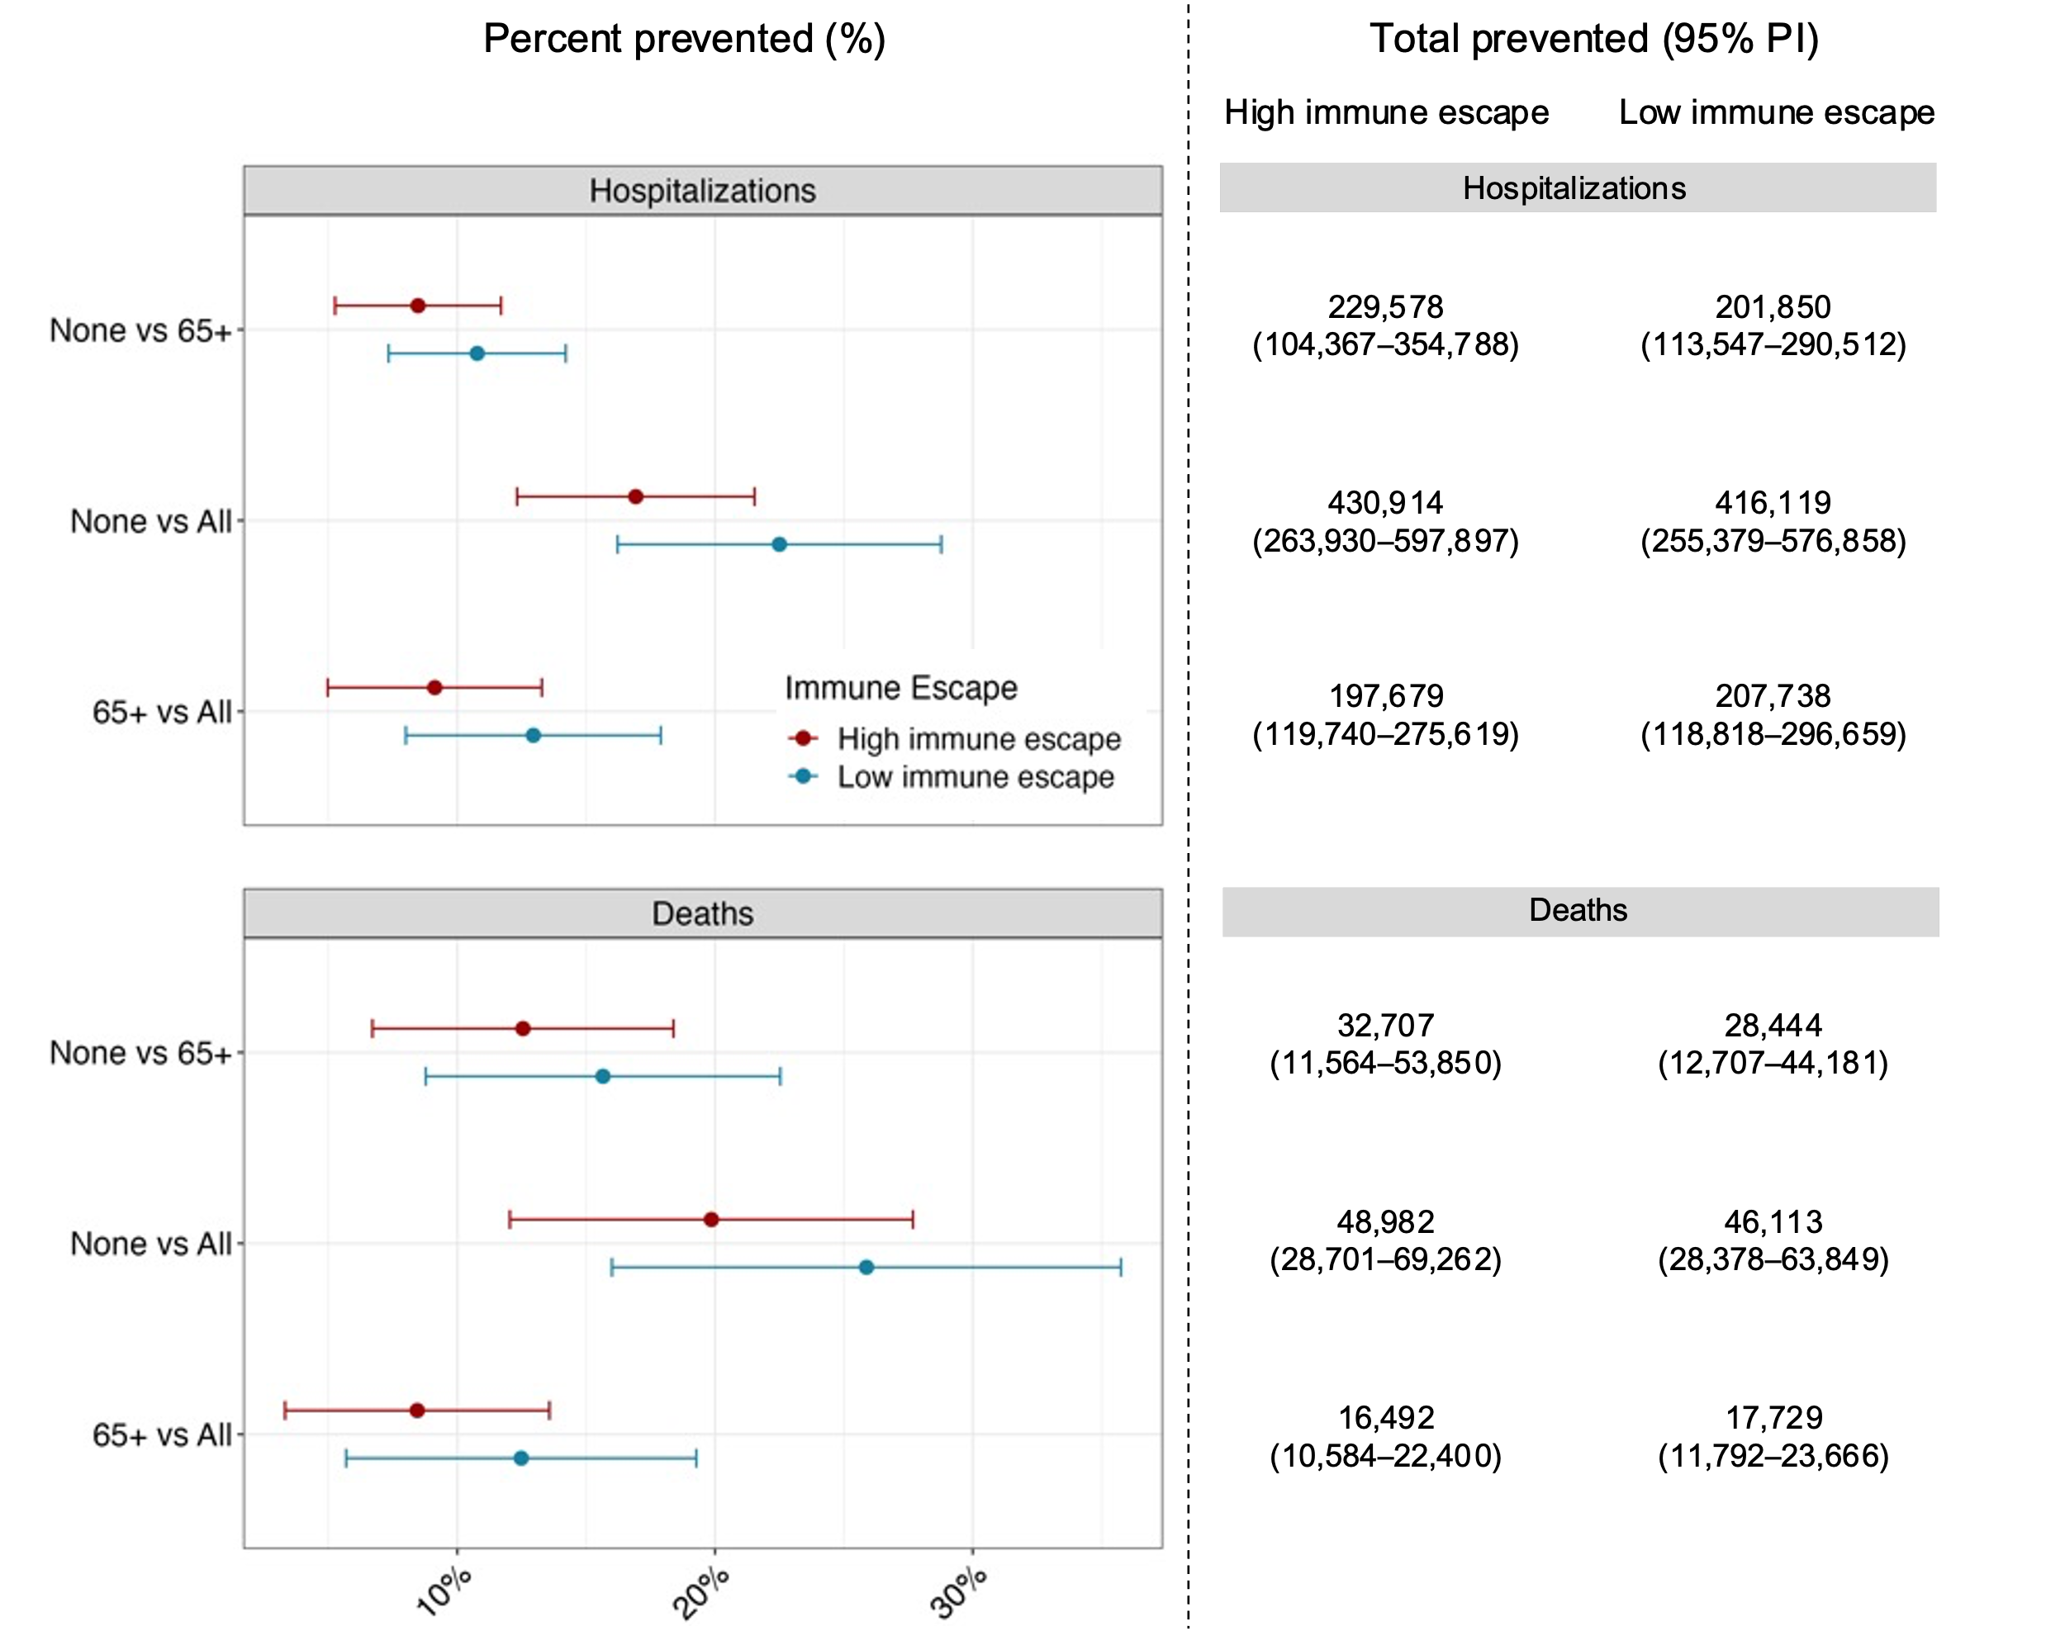

Slide 3
