Slide 1
칼만 필터
스마트자동차학과
박성근(keiny@sch.ac.kr)

Slide 2
Review Bayesian filter
Control Update
Measurement update

Slide 3
Difficulty Bayesian filter in Practical Implementation
It is hard to compute integration of multi-modal probability.

Slide 4
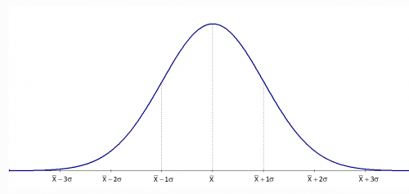
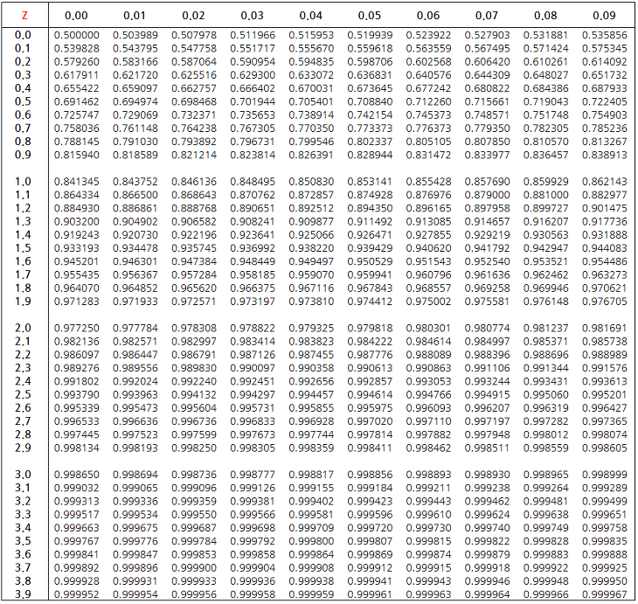
Kalman filter
Easy to Integrate Probability Density Function

Slide 5
Kalman filter
X : state
U : control input
Z : measurement
In Gaussian distribution, we can express probability density function using only Mean/Covariance.

Slide 6
Kalman filter
To compute probability integration easily, we make some assumptions
- State eq. is linear.
- Measurement eq. is linear.
- Noise Distribution is Gaussian.
→ Distribution will maintain Gaussian while system is progressing
We can update the probability of state using only mean and covariance.
The main advantage of Kalman filter is not only reducing the effect of noise but also estimating latent state (which are observable) variables.

Slide 7
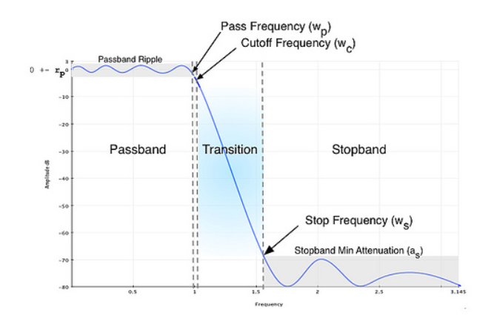
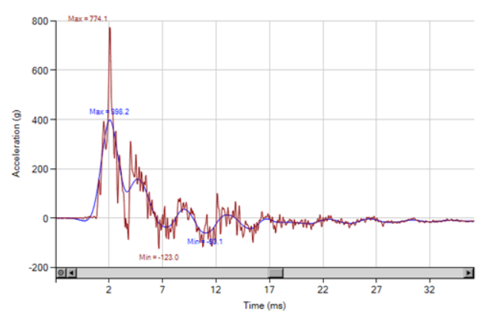
Filters?
Smoothing : Low pass filter

Slide 8


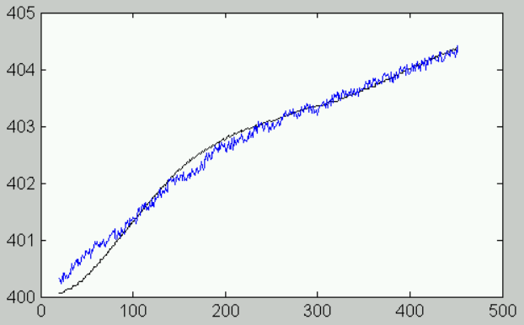


Filters?
Smoothing : alpha beta filter

Slide 9
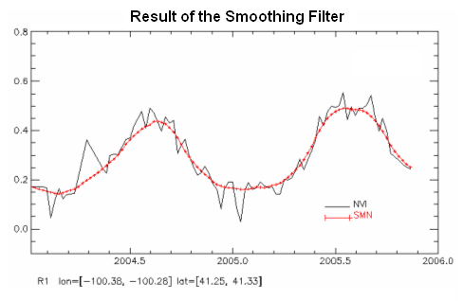
Kalman filter

Slide 10
Derivation of Kalman Filter

Slide 11
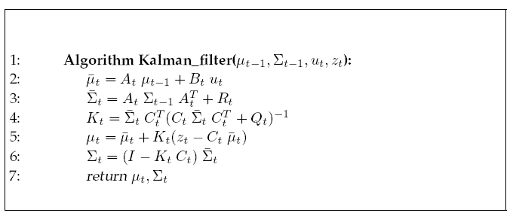
Kalman filter
Control Update
Kalman Gain
Measurement update
Control Update
Measurementupdate

Slide 12
Kalman filter

Slide 13
Kalman filter
Correlation :
Kalman Gain

Slide 14
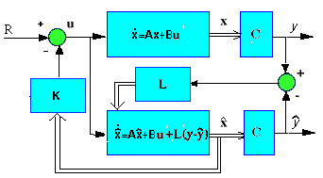
Kalman filter

Slide 15
Kalman filter

Slide 16
Kalman filter
Q : Covariance of Control Input Noise
R : Covariance of Measurement Noise
Meaning of Covariance?

Slide 17
Kalman filter

Slide 18
Kalman filter

Slide 19
Kalman filter

Slide 20
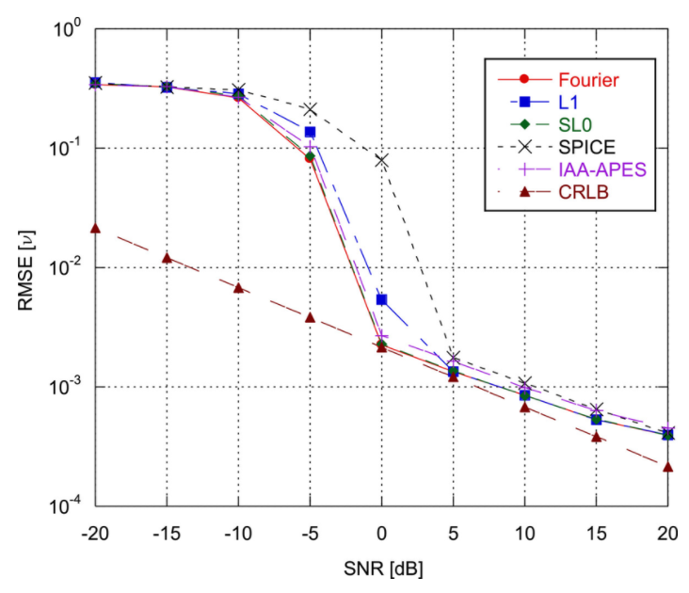
Kalman filter
• Given an estimation problem, what is the variance of the best possible estimator?
- As a side product, the CRLB theorem gives also a method for finding the best estimator.
Kalman filter
= CRLB in Linear/Gaussian Case!

Slide 21
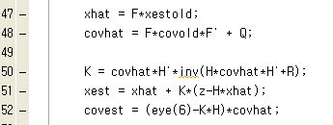
Implementation Kalman filter using Matlab

Slide 22
Kalman filter Experiment #1
State eq.
Measurement eq.

Slide 23
Kalman filter Experiment #1
Simulation Time : 0:0.1:10
Control Input

Slide 24
Kalman filter Experiment #1
Load Data.mat
Ref_data : Real Robot Pose from time 0 to 10 sec
Time interval – 0.1sec (3 x 101 matrix)
Sensor_data : Sensor Measurement of Real Robot Pose
Time interval – 0.1sec
Noise – mean : zero, variance : 0.1;
2. Define System/Measurement Matrix
3. Design Kalman filter

Slide 25
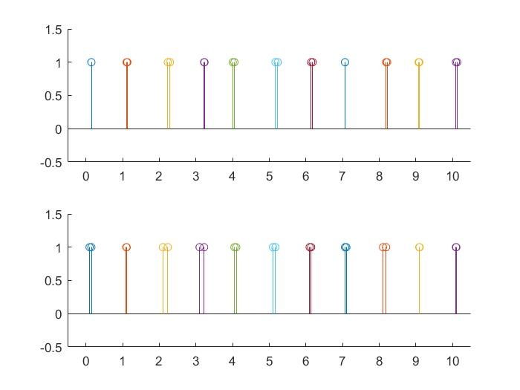
Kalman filter Experiment #1
Robot Localization
Real Pose vs Localization Results
Real Pose vs Sensor Measurements

Slide 26
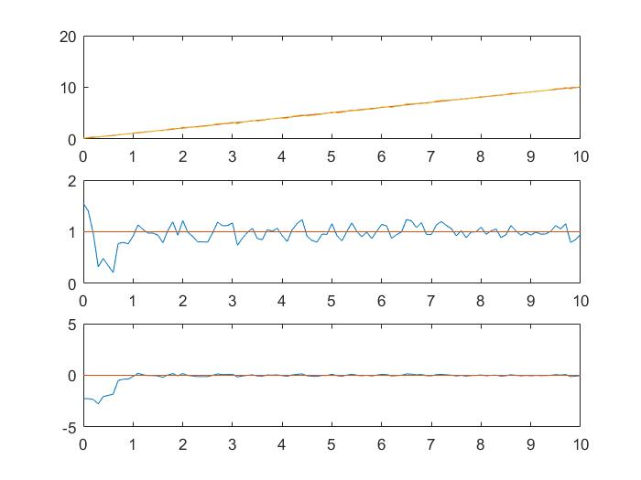
Kalman filter Experiment #1
Robot Localization

Slide 27
Kalman filter Experiment #2

Slide 28
Kalman filter Experiment #2
Load Data.mat
Ref_data : Real Robot Pose from time 0 to 10 sec
Time interval – 0.1sec (3 x 101 matrix)
Sensor_data : Sensor Measurement of Real Robot Pose
Time interval – 0.1sec
Noise – mean : zero, variance : 0.1;
3. u : Control Input – don’t use in Tracking problem
2. Define System/Measurement Matrix
3. Design Kalman filter

Slide 29
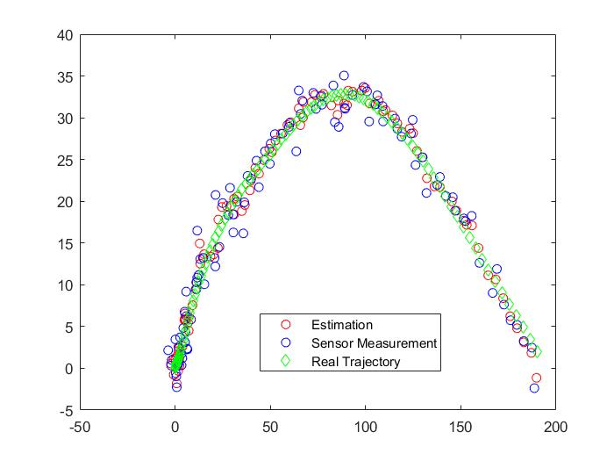
Kalman filter Experiment #2

