Slide 1
비선형 칼만 필터
스마트자동차학과
박성근(keiny@sch.ac.kr)

Slide 2
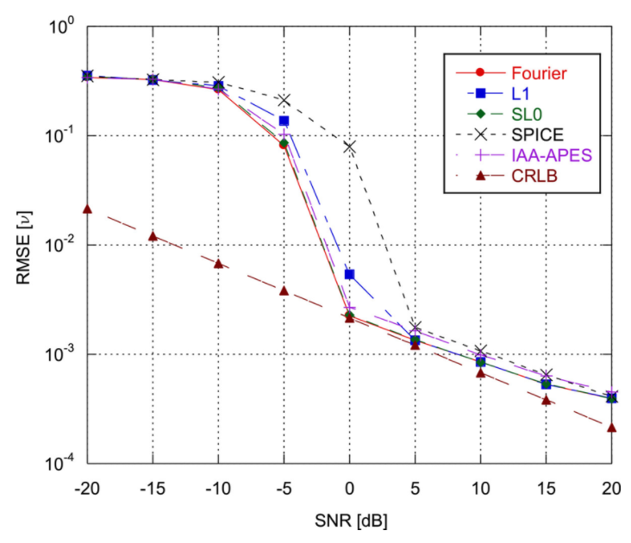
Drawback of Kalman filter
• Given an estimation problem, what is the variance of the best possible estimator?
- As a side product, the CRLB theorem gives also a method for finding the best estimator.
Kalman filter
= CRLB in Linear/Gaussian Case!

Slide 3
Drawback of Kalman filter
• But!
- Most case, even noise is Gaussian, system(state) equation or measurement equation are not linear!

Slide 4
Drawback of Kalman filter
• The advantage of Kalman filter
: Optimal solution in Linear Gaussian case
• The disadvantage of Kalman filter
: Optimal solution in Linear Gaussian Case

Slide 5
Solution in non-linear case
• If distribution is Gaussian, then
- Approximation to Linear System
: Extended Kalman filter
- Using Non-linear Transform
: Unscented Kalman filter

Slide 6
Extended Kalman filter
In equation case, linearization is…
Taylor Extension
: We can express nonlinear function to infinite polynomial summation function
Approximate nonlinear function using Taylor Extension

Slide 7
Kalman filter

Slide 8
Extended Kalman filter

Slide 9
Extended Kalman Filter : Jacobian
In matrix equation case, linearization is…

Slide 10

Extended Kalman filter
Linearization nonlinear function at point p
Where,

Slide 11
Extended Kalman filter

Slide 12
Extended Kalman filter

Slide 13
Extended Kalman filter

Slide 14
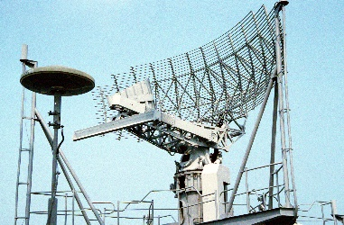
Extended Kalman filter : Experiment #1

Slide 15
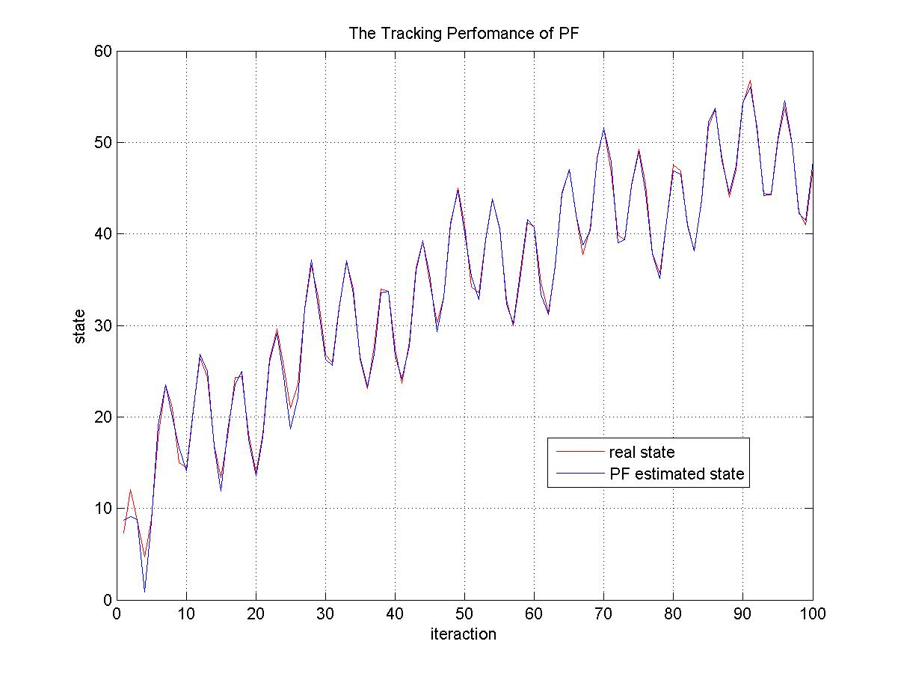
Extended Kalman filter : Experiments #2

Slide 16
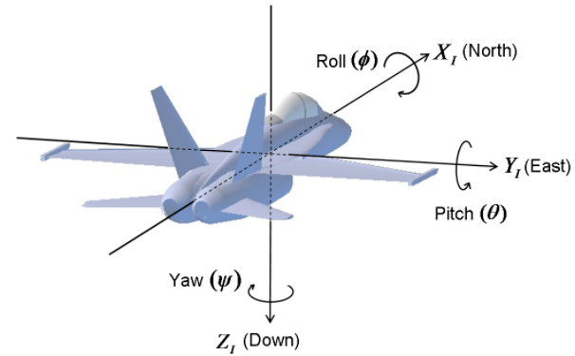
Extended Kalman filter : Experiment 2
p/q/r : 각속도 -> 제어입력

Slide 17
Unscented Kalman filter
• The advantage of Extended Kalman filter
: It maximize to utilize Kalman filter’s advantage!
→ easy to implement
• The disadvantage of Extended Kalman filter
: If system is highly nonlinear, linearization make original system too different to its own model!

Slide 18
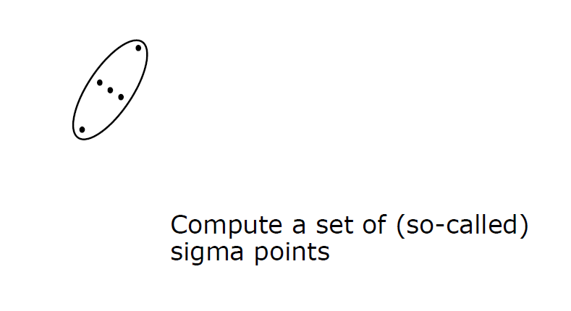
Unscented Transform

Slide 19
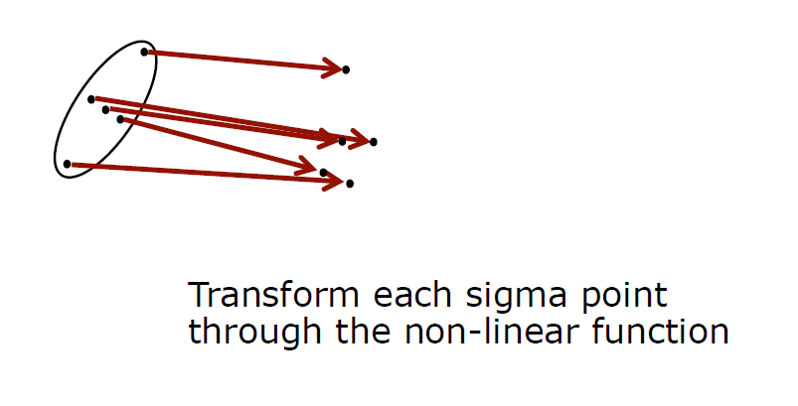
Unscented Transform
Nonlinear transformation

Slide 20
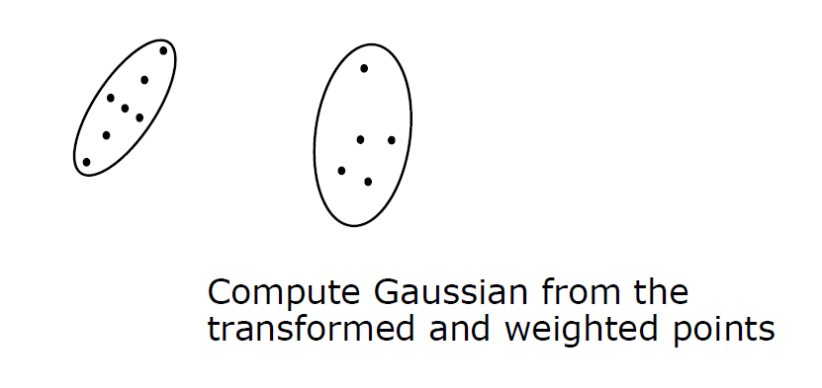
Unscented Transform
We compute a Gaussian, but after non-linear transformation.

Slide 21
Unscented Transform
Compute a set of sigma points
Each sigma points has a weight
Transform the point through the non-linear function : Unscented Transform
Compute a Gaussian form weighted sigma points
→ Avoid to linearize around the means as the EKF does

Slide 22
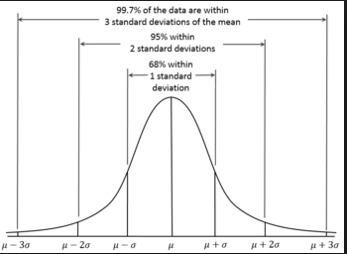
Unscented Transform : Sigma Points
The important things in UT are
- How to choose the sigma points?
- How to set the weights?

Slide 23
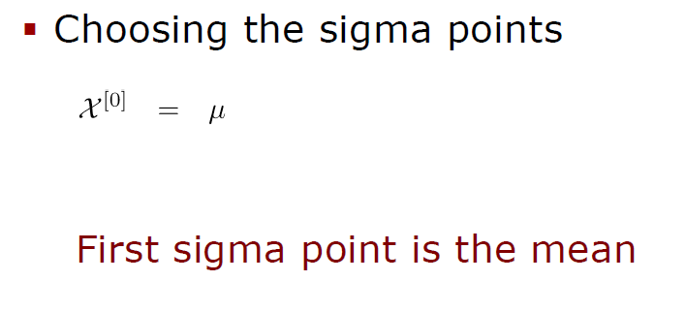
Unscented Transform : Sigma Points

Slide 24
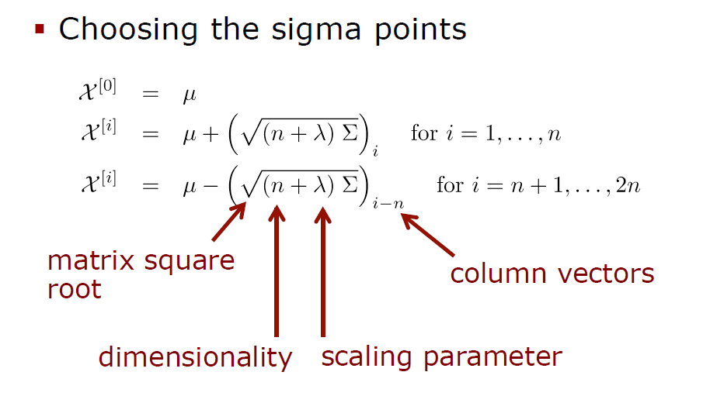
Unscented Transform : Sigma Points
→ How to compute matrix square root?

Slide 25
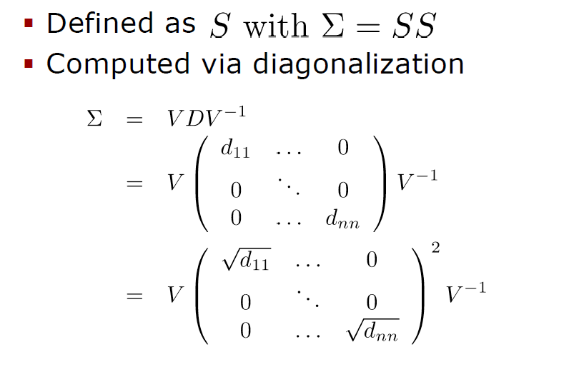

Unscented Transform : Sigma Points
S is the matrix square root of Σ if

Slide 26
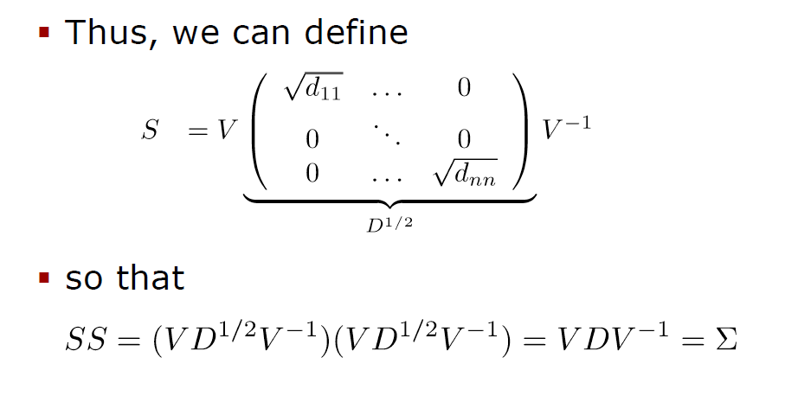
Unscented Transform : Sigma Points

Slide 27
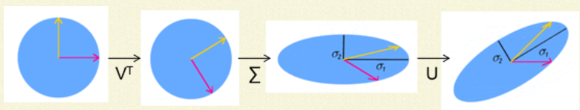
Unscented Transform : Sigma Points

Slide 28
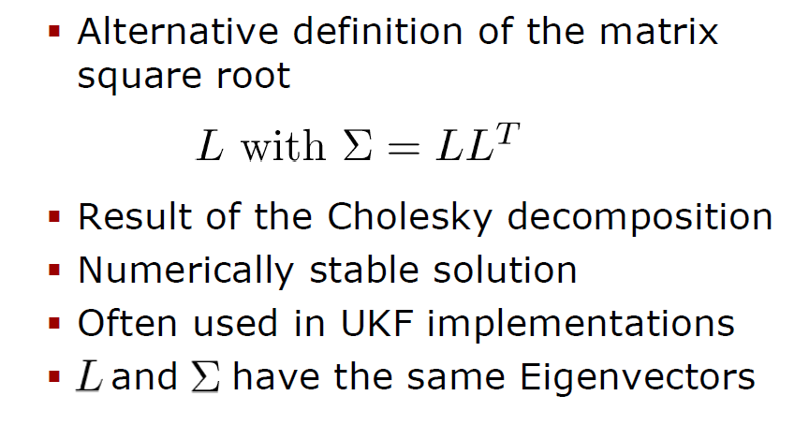
Unscented Transform : Sigma Points
Cholesky decomposition for matrix square root

Slide 29
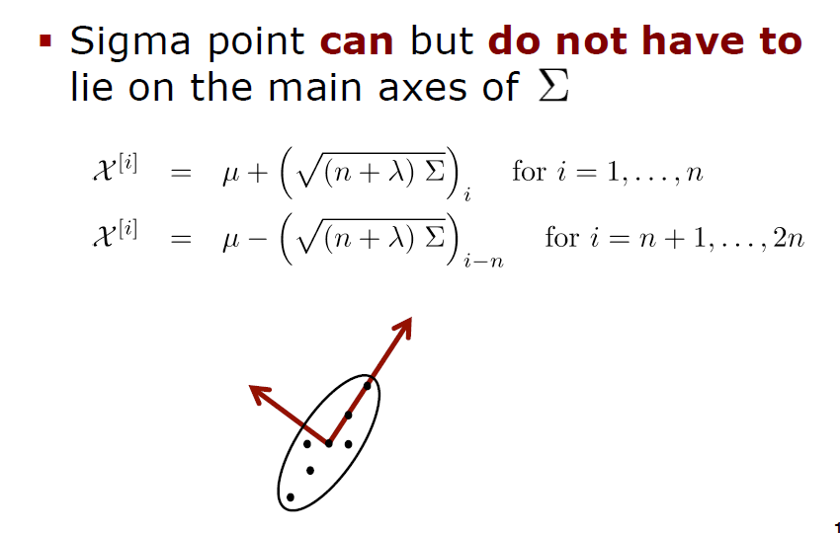
Unscented Transform : Sigma Points

Slide 30
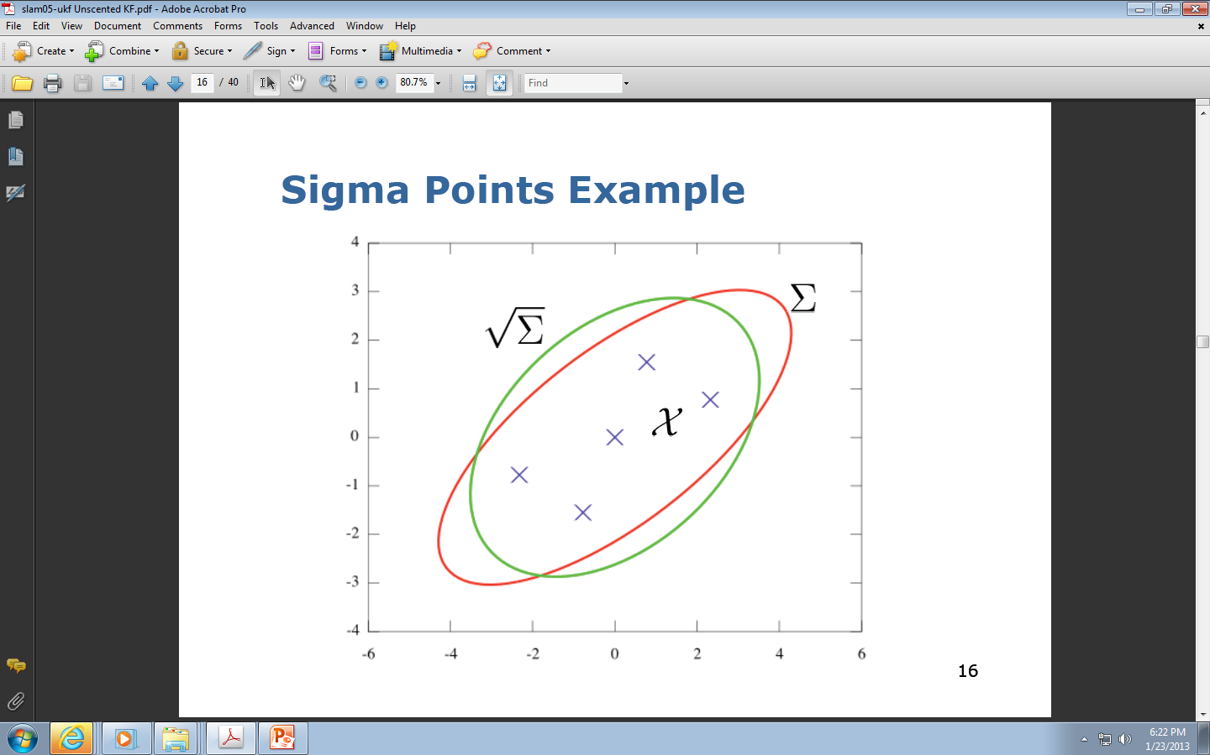
Unscented Transform : Sigma Points

Slide 31
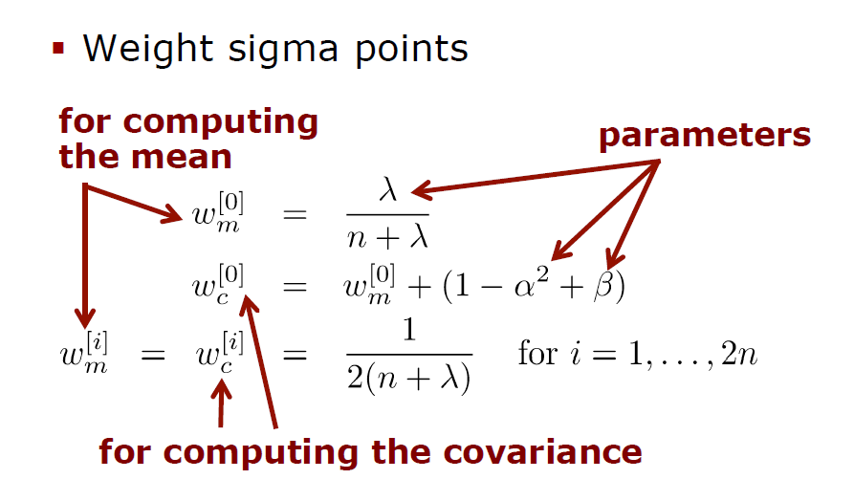
Unscented Transform : Sigma Points
n is dimension
λ is scaling parameter

Slide 32
Unscented Transform : Sigma Points
Sigma points Weights
Pass sigma points through nonlinear function

Slide 33
Unscented Transform : Sigma Points
Recover mean and covariance

Slide 34
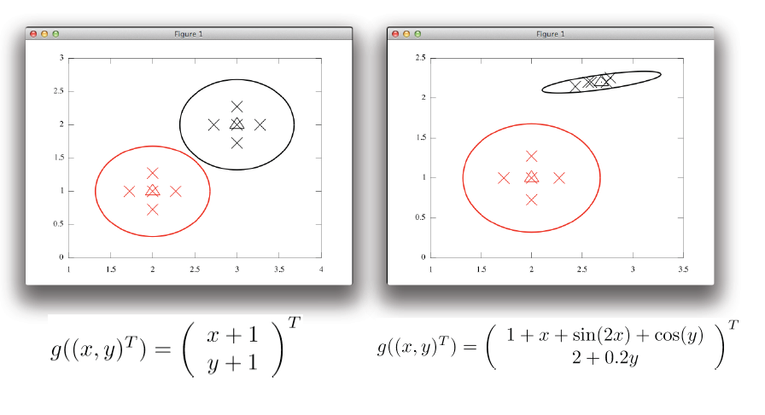
Unscented Transform : Example
nonlinear

Slide 35
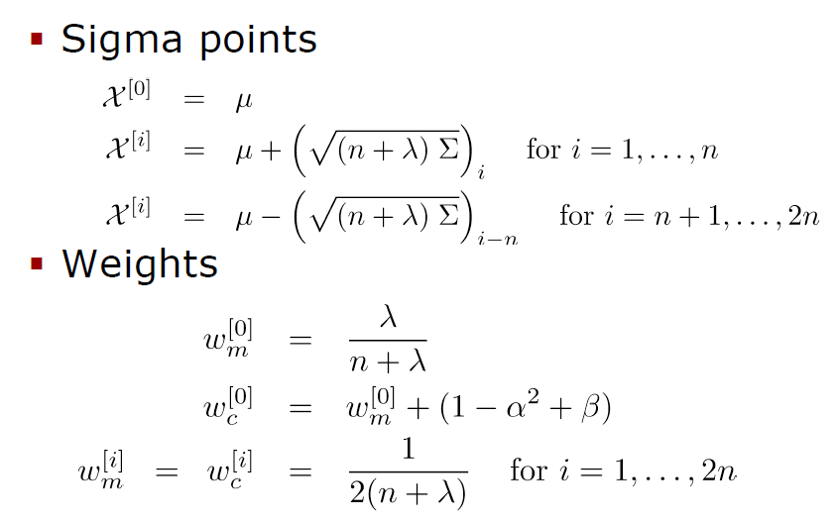
Unscented Transform : Sigma point

Slide 36
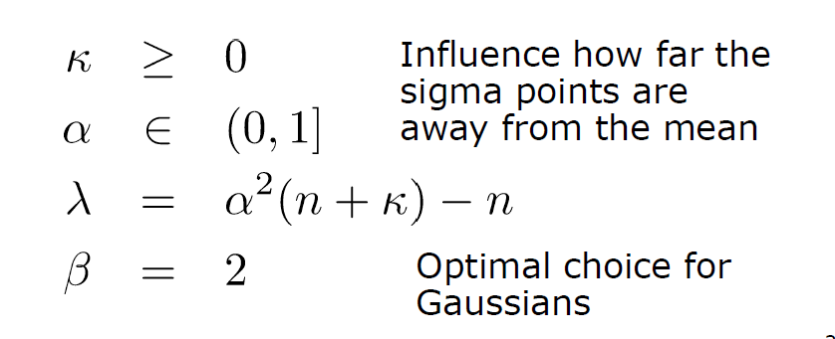
Unscented Transform : Sigma point
Unscented Transform has free parameters, there is no unique solution – this gives us freedom of design, learning etc.
Unscented Transform uses many scale coefficients:

Slide 37
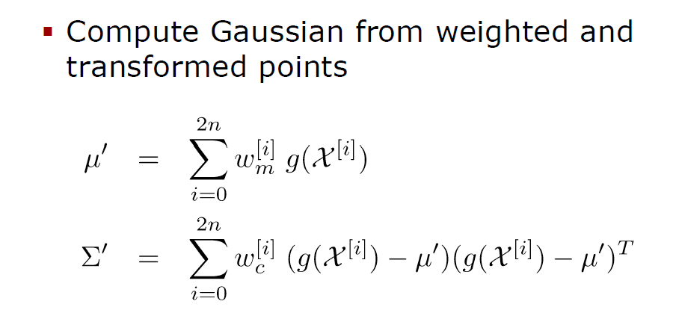
Unscented Transform : Gaussian Approximation
New mean
New covariance matrix
We create a new shape of Gaussians

Slide 38
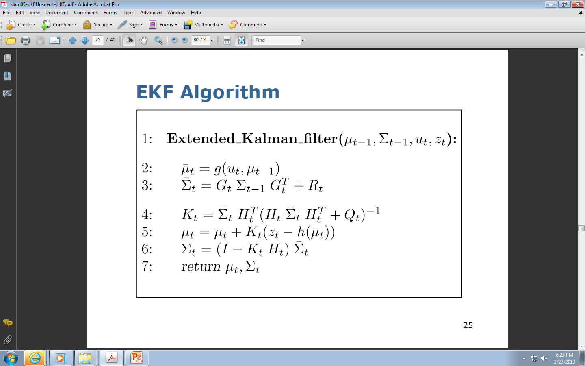
Unscented Kalman filter
Recall EKF

Slide 39
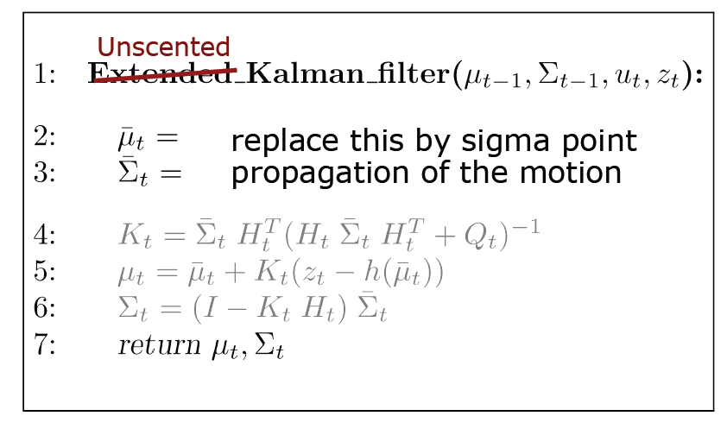
Unscented Kalman filter
UKF is a modified EKF

Slide 40
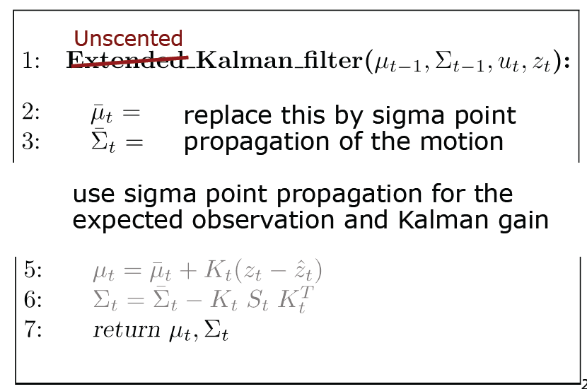
Unscented Kalman filter

Slide 41
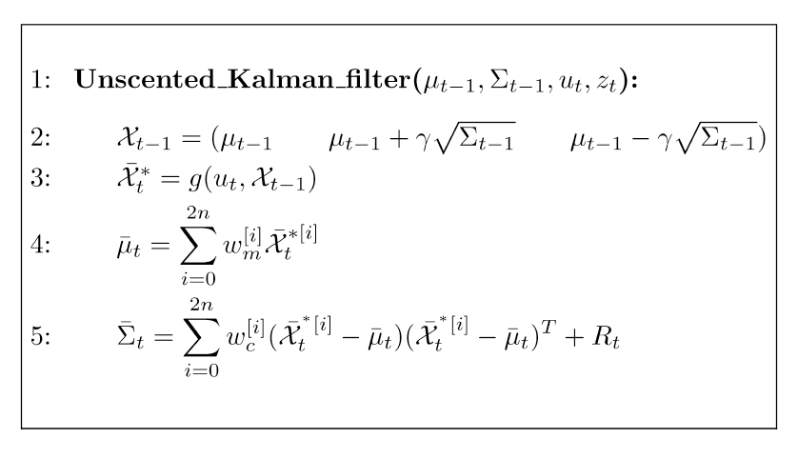
Unscented Kalman filter

Slide 42
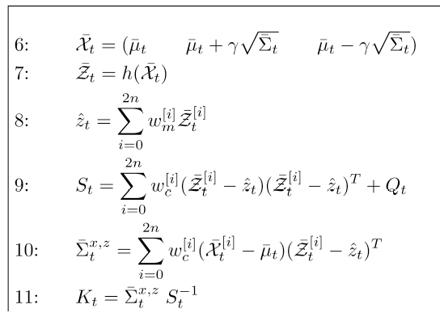
Unscented Kalman filter
EKF
EKF

Slide 43
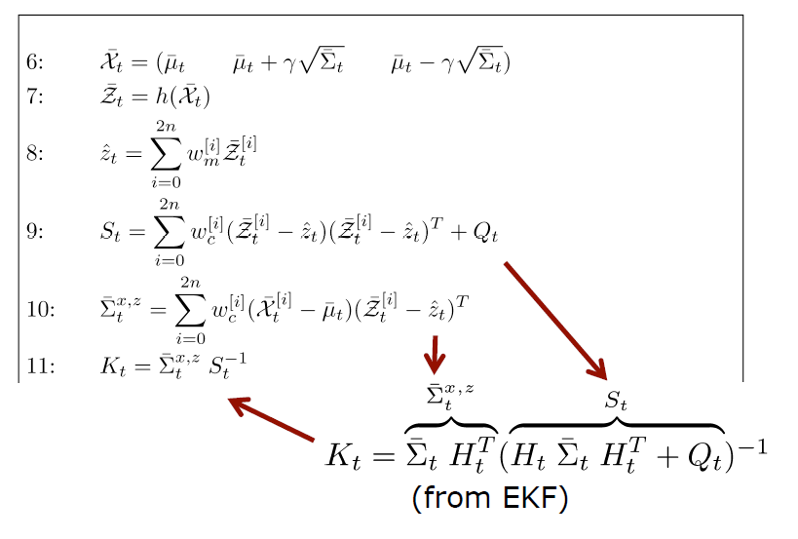
Unscented Kalman filter

Slide 44
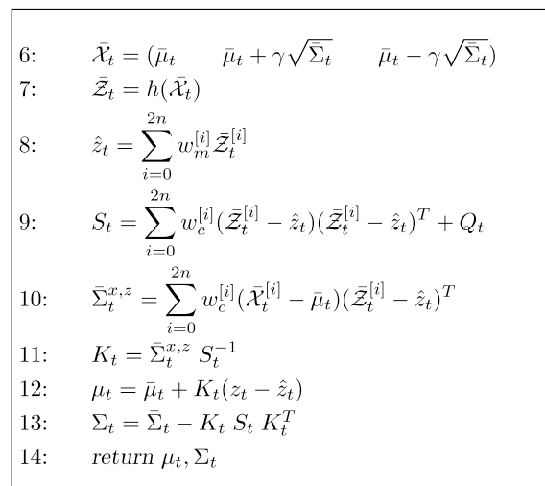
Unscented Kalman filter

Slide 45
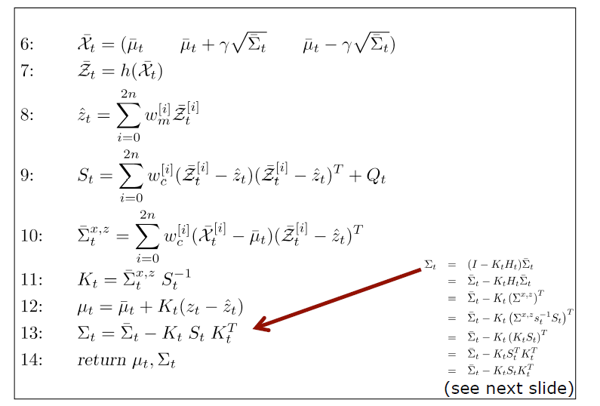
Unscented Kalman filter

Slide 46
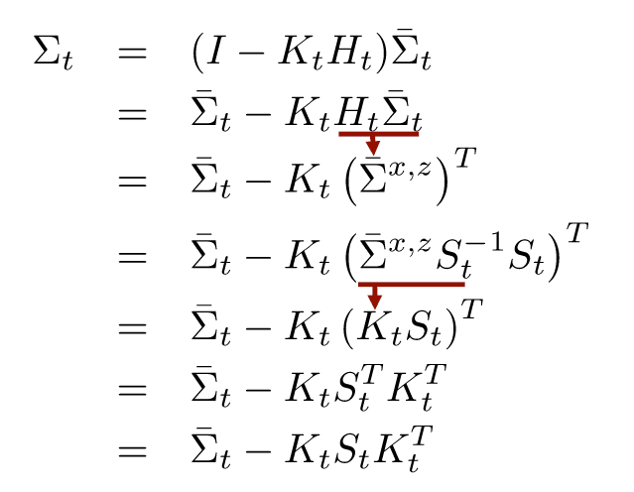
Unscented Kalman filter

Slide 47
Unscented Kalman filter : Experiment #1

Slide 48
Unscented Kalman filter : Experiments #2

