Slide 1
Particle Filter
스마트자동차학과
박성근(keiny@sch.ac.kr)

Slide 2
Non Parametric Approach
In Gaussian distribution case, Kalman filter series work well even system is non-linear
The problem is every system cannot be express Gaussian distribution even system is linear.
The distribution of system is non-Gaussian, it is hard to express system using any functional model.
Non-Parametric Approach!

Slide 3
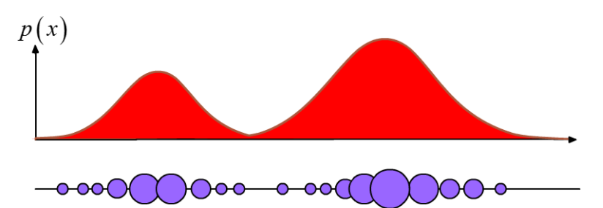
Non Parametric Approach

Slide 4
Sampling
While nothing is more uncertain than the duration of a single life, nothing is more certain than the average duration of a thousand lives.
Elizur Wright
Figure: Elizur Wright (1804 - 1885), American mathematician, the father of
life insurance", father of insurance regulation" (http://en.wikipedia.org)

Slide 5

Monte Carlo Sampling

Slide 6
Monte Carlo Sampling

Slide 7
Monte Carlo Sampling

Slide 8
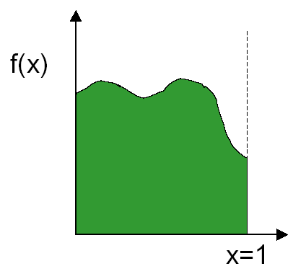
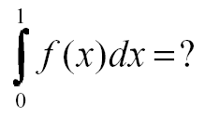
Sampling
How to evaluate integral of f(x)?

Slide 9
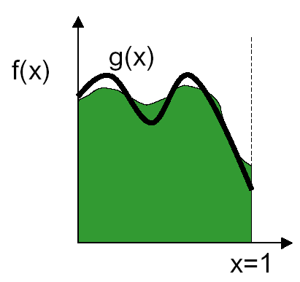
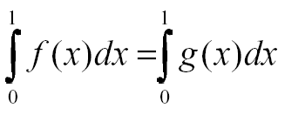
Sampling
Can approximate using another function g(x)

Slide 10
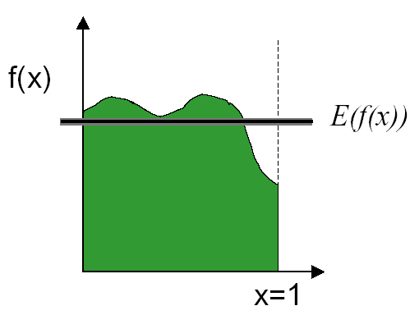
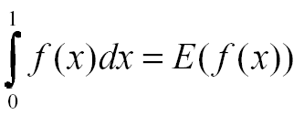
Sampling
Can approximate by taking the average or expected value

Slide 11
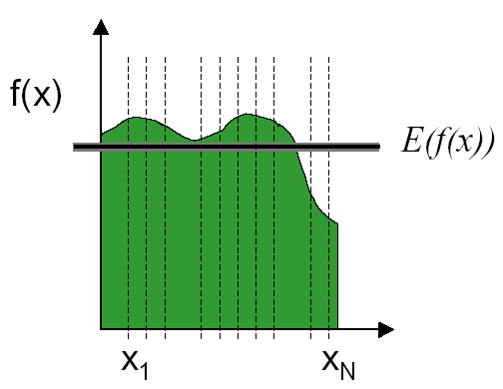
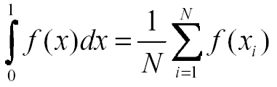
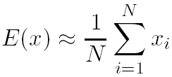
Sampling
Estimate the average by taking N samples

Slide 12
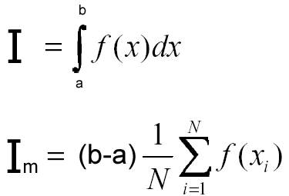

Sampling
I_{m} = Monte Carlo estimate
N = number of samples
x₁, x₂, …, x_{N} are uniformly distributed random numbers between a and b

Slide 13
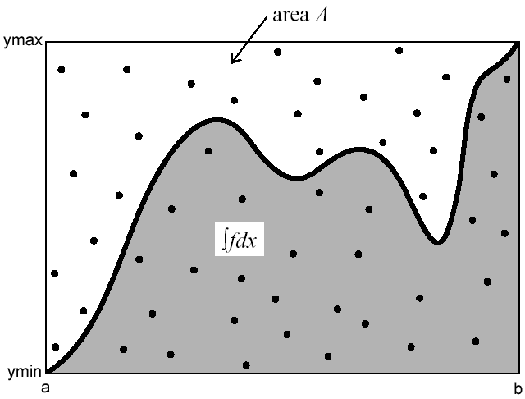
Sampling

Slide 14

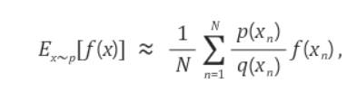


Sampling
We have the definition of expected value and how to estimate it.
Since the expected value can be expressed as an integral, the integral is also approximated by the sum.

Slide 15
Particle filter
Baysian Recursive filter
+ Importance Sampling
= Sequential Importance Sampling!

Slide 16
Particle Filter
Represent belief by random samples
Estimation of non-Gaussian, nonlinear processes
Monte Carlo filter, Survival of the fittest, Condensation, Bootstrap filter, Particle filter
Filtering: [Rubin, 88], [Gordon et al., 93], [Kitagawa 96]
Computer vision: [Isard and Blake 96, 98]
Dynamic Bayesian Networks: [Kanazawa et al., 95]d

Slide 17
Particle filter
State Equation
Measurement Equation
We need construct with given data and

Slide 18
Particle filter
Also known as Sequential Monte Carlo Methods
Representing belief by sets of samples or particles
are nonnegative weights called importance factors
Updating procedure is sequential importance sampling with re-sampling

Slide 19
Particle Filter

Slide 20
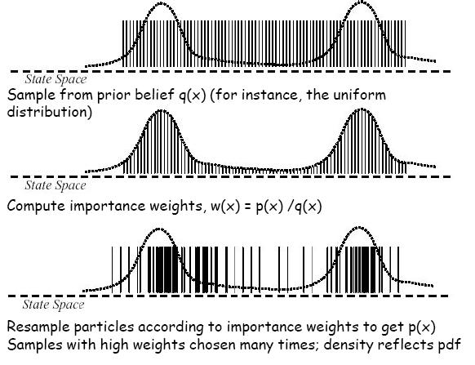
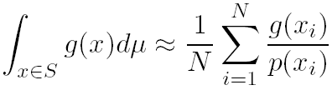
Particle Filter

Slide 21
Particle Filter
Particle filter is a technique for implementing recursive Bayesian filter by Monte Carlo sampling
The idea: represent the posterior density by a set of random particles with associated weights.
Compute estimates based on these samples and weights
Posterior density
Sample space

Slide 22
Particle Filter
If we choose proposal density like below, and apply importance weight.

Slide 23
Particle Filter
(with Markcov assumption)
and

Slide 24
Particle Filter

Slide 25
Particle Filter
Illustration of SIS:
Degeneracy problems:
variance of importance ratios increases stochastically over time (Kong et al. 1994; Doucet et al. 1999).
In most cases then after a few iterations, all but one particle will have negligible weight

Slide 26
Particle Filter
Illustration of degeneracy:

Slide 27
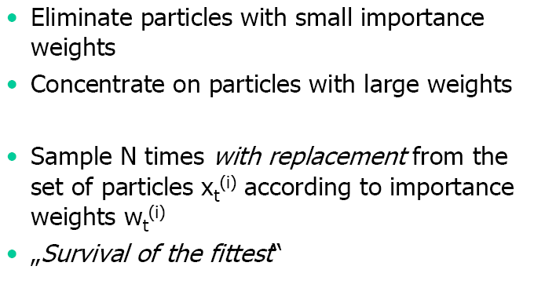
Particle Filter

Slide 28
Particle Filter
Effective sample(particle) number?
Resampling

Slide 29
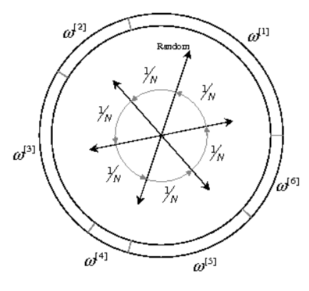
Particle filter
Cumulated sum resampling

Slide 30
Particle filter

Slide 31
Particle filter

Slide 32
Particle Filter
x

Slide 33
Particle Filter
Illustration of SIR with sample smoothing:

Slide 34
Particle Filter
Then, importance weight is
And if we do resampling every filter stage, then

Slide 35
Particle Filter

Slide 36
Particle Filter
Draw
Importance sampling

Slide 37
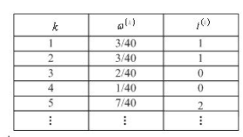
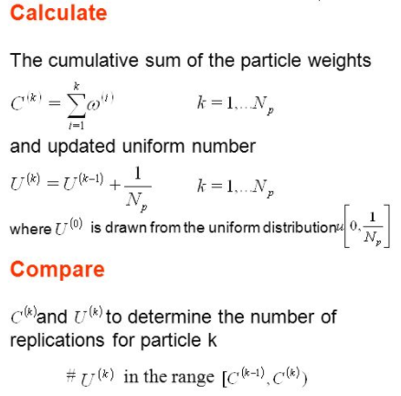
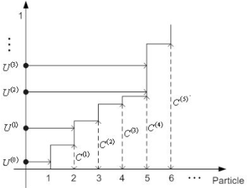
Particle Filter

Slide 38
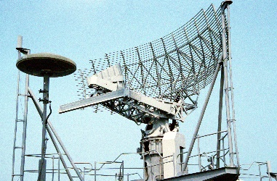
Particle filter : Experiment #1

Slide 39
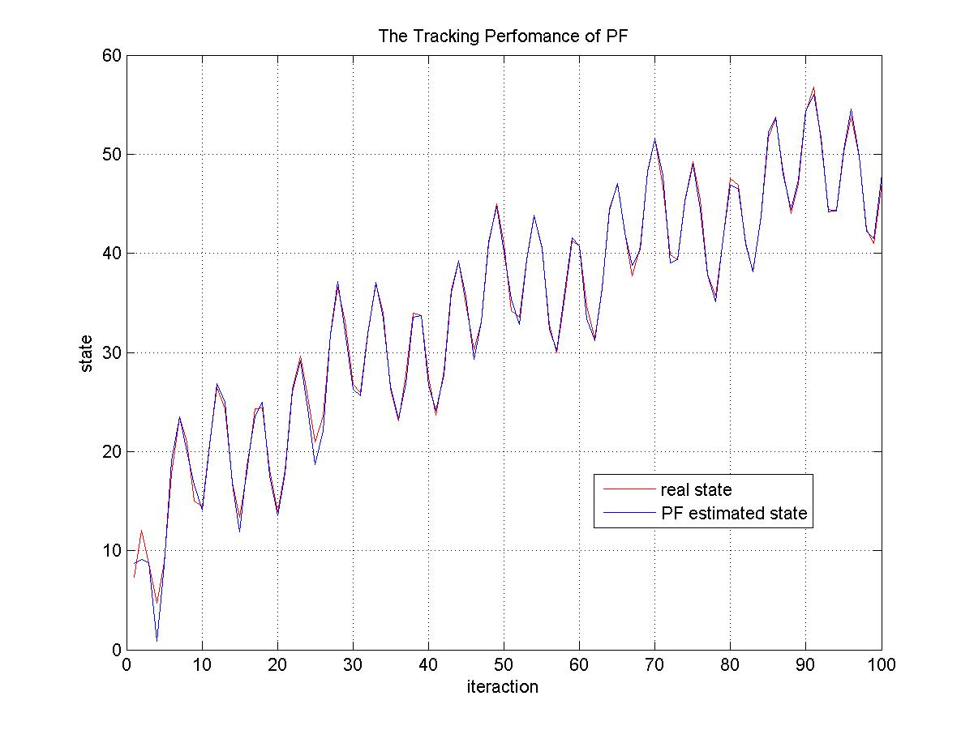
Particle filter : Experiments #2

