Slide 1
Research project overview
standai: a 2D humanoid that learns to get up
One neural network trained with PPO · Nov 2026

Slide 2
standai overview and key results
A single PPO-trained network gets up from lying down and is still standing 20 s later in 94.2% of starts
94.2%
Lying start → standing 20 s later
Mean of supine / prone, 50:50
600 starts per side, unseen seeds
97.7% · 90.7%
Success by start side
Supine (on the back) 97.7%
Prone (face down) 90.7%
+23.4 pt
vs. rule-based controller
70.8% → 94.2%
0/160 at the start of the project
Task | A 2D MuJoCo ragdoll gets up from lying on its back or face down and stays standing
Method | Train role-specific policies separately → distil into one network (DAgger) → end-to-end PPO fine-tuning
Measurement | Simulation only; fixed seeds, deterministic policy; ±2.5 pt sampling error
※ Verified in 2D simulation only; start poses come from the environment's own generator; one training run per configuration
2

Slide 3
Problem: why is getting up from the floor hard?
A single policy never got up from the floor (0/160), and one policy could not learn floor motion and balance together
Task definition
What made it hard
Start
Lying on the back (supine) or face down (prone)
A single policy could not get up
Reward shaping, replaying failed starts, a 1.5× stronger body, exploration noise: none changed the 0/160 on lying starts
Success
Still standing 20 s later
Floor motion and balance conflict
The policy alone raised the head above 0.5 m in only 4–8% of floor starts (random patterns: 77%). One policy's action noise cannot be wide on the floor and narrow while balancing
Evaluation
Fixed seeds, deterministic policy, 600 starts per side
Training logs hide real progress
Log metrics sometimes moved opposite to real success, and the same seeds shift ±4 pt between runs, so everything was re-measured on fixed seeds
3

Slide 4
Approach: grow the pieces, distil, fine-tune end to end
Grow role-specific policies first, merge them into one network, then fine-tune it end to end
Grow the pieces
Distil into one network
End-to-end fine-tuning
Train the floor (supine / prone), hand-over and stand policies separately, each with its own reward and curriculum, joined by a rule-based controller
Distil the whole controller, switching rules included, into one 512×512 network with DAgger
Fine-tune with PPO on a 20 s 'standing' reward for 40M steps (value head warmed up first)
Standing after 20 s
24% → ~72%
Standing after 20 s
74.5% (rules: 73.8%)
Standing after 20 s
94.2%
Big networks trained from scratch never got off the floor → growing the pieces first is the key
※ The 24% → 72% of the first step is the several-week improvement of the rule-based controller (see the progress slide)
4

Slide 5
Controller: three policies joined by rules
The start pose (sign of the initial pitch) picks the floor policy, which hands over to the stand policy via a hand-over policy
Start pose
On the back (supine) or face down (prone)
Floor policy
One policy per pose (supine / prone), chosen by the sign of the initial pitch
Hand-over policy
Moves to a pose the stand policy can catch without falling (prone only)
Stand policy
Keeps the body standing
If the stand policy falls, control returns to the floor policy
Final rule-based controller (standing after 20 s)
73.1%
50:50 average
61.8%
Supine
84.4%
Prone
※ After fixing an evaluation bug; six fresh seed sets (1,200 starts per side). Most losses came at the floor → stand seam; a single network has no seam, which is the presumed reason for the gain
5

Slide 6
Progress: from 0% to 94%
The last jump came from training one network end to end (73% → 94%)
※ Standing after 20 s (%). Test sets, start mixes (80:20 → 50:50) and seeds differ between stages, so this is not a strict comparison. Start: 0/160 for the single policy; 10/12: 3/100
6

Slide 7
Final result: one network beats the rule-based controller
On the same seeds: 94.2% vs. 70.8% for the rule-based controller, with large gains on both start sides
Standing after 20 s
Checks
Test setup
Fresh seeds (99100 · 99200 · 99300), 600 starts per side, ±2.5 pt sampling error
Shortcut checks
No unphysical force (root_x, root_ry) is applied; moving the opponent far away changes nothing; pushes of 150–500 N after the get-up change nothing
Calm standing
Torso-height std 0.009 m, joint speed 0.17–0.46 (rules: 1–2)
7

Slide 8
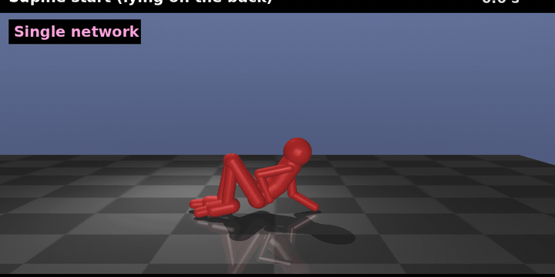
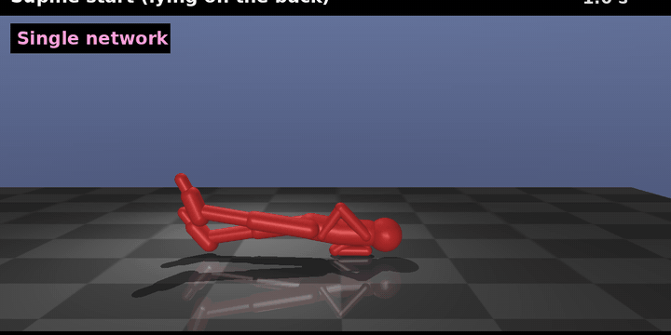
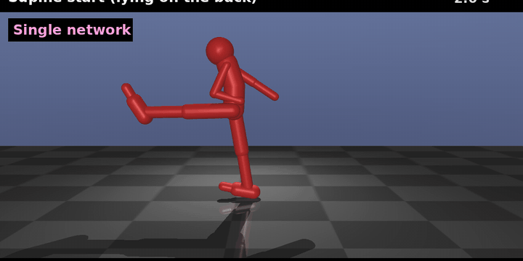
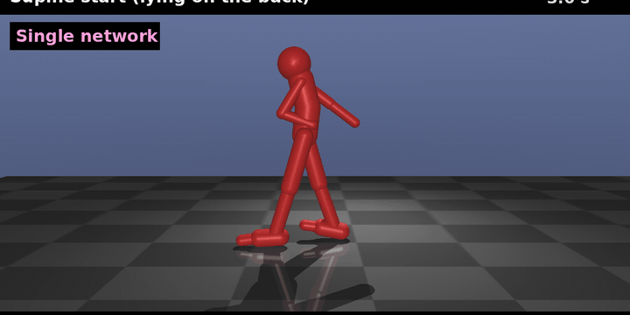
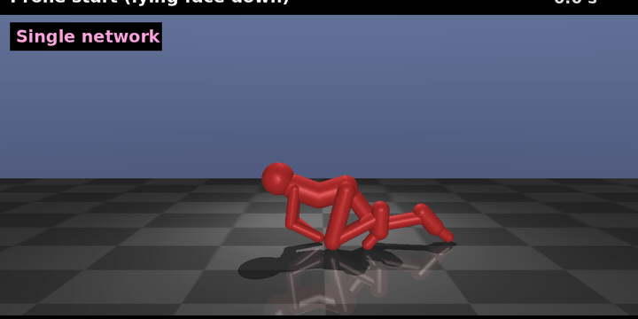
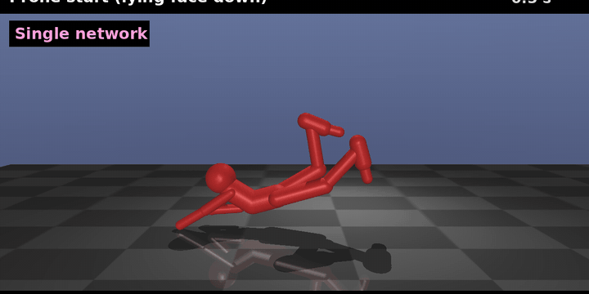
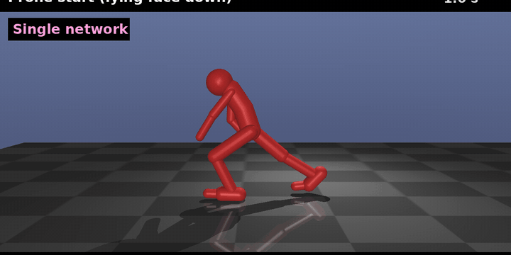
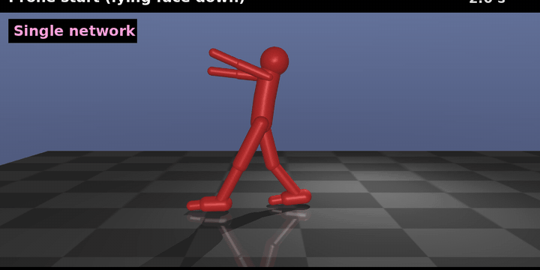
Demo: getting up from lying down
Two selected runs (supine / prone): standing within about 2.5 s
Start on the back (supine)
0.0 s
1.0 s
2.0 s
3.0 s
Start face down (prone)
0.0 s
0.5 s
1.0 s
2.0 s
※ Selected runs, not typical: about 98% (supine) and 91% (prone) of starts end up standing after 20 s. Source: standai/assets/demo.gif
8

Slide 9
Network size was not the bottleneck
Shrinking to 256×256 keeps performance; even 64×64 beats the rules by 13 pt → the recipe made the gain
Standing after 20 s (50:50)
How to read
Capacity is not the bottleneck
Performance holds down to 256×256 (93%); 128×128 gives 89%
Small still beats rules
64×64 reaches 85% vs. 72% for the rule-based controller
Big nets from scratch fail
Big networks trained from scratch on the floor task failed repeatedly → grow the pieces, distil, fine-tune
※ Same recipe (distillation, then 12M end-to-end steps), fresh seeds 99500+, 200 starts per side. One run per size, so differences of ~3 pt are not resolved. A big network trained from scratch was not run in this comparison
9

Slide 10
Lessons: what worked and what did not
Growing small policies, distilling and lowering the learning rate worked; stacking rewards mostly did not
What worked
What did not work · caveats
Distil, then fine-tune
Distil a working small policy into a bigger net, then fine-tune end to end (big nets from scratch fail)
Big nets from scratch
A floor policy trained from scratch as a big network (256×256) kept failing; distilling a small policy worked
Lower learning rate
Stand-policy PPO 3e-4 → 5e-5: standing after 20 s 29% → 41%
Stacking rewards and timing
Reward stacking, re-training the stand policy, hand-over timing gates and critic-based rewards did not move the rule-based system
Arrival-quality reward
Reward the floor policy for arriving in a state the stand policy can catch; supine 49.5% → 60%
Evaluation bugs flip conclusions
A hand-over policy applied to the wrong start side under-reported the result (68%) → 73.1% after the fix; new measurements are checked against the official controller
10

Slide 11
Limits and roadmap
Results are simulation only; next steps are standing from any posture → walking → transplant into combat
Limits
Roadmap
Scope
Simulation and 2D only; start poses come from the environment's own generator (others untested)
1. Standing from any posture
A policy that stands from any pose, not only lying
Statistics
One training run per configuration, ±2.5 pt sampling error, same seeds move ±4 pt between runs
2. Walking
Assumption
The 50:50 supine/prone mix is an assumption; the real fall-direction mix is unknown
Extend to velocity tracking
Scale
About 1B steps in total (get-up papers use ~5B); limb torque ×1.5 without scaling link masses
3. Transplant into combat
Move into fightai's combat action/observation space (transplant)
Related work: multi-expert distillation (Rusu 2015, Actor-Mimic 2016), DAgger (Ross 2011), growing local policies then distilling (Ghosh 2018), getting up (Tao 2022, He 2025). Not a new technique: the contribution is an experimental record of how much each step mattered on this task
11

