Slide 1
AIR QUALITY AS A
DISASTER INDICATOR
Multi-City Environmental Intelligence Framework
Team Thunderstorm | Delhi | Jaipur | Visakhapatnam | 2019-2024
Delhi
Jaipur
Vizag
Stubble Burning
Dust Storms
Industrial / Gas
Disaster Management| Course Project

Slide 2
What Is This Project?
Can rising pollution levels warn us about an environmental disaster BEFORE it becomes catastrophic?
THE PROBLEM
OUR SOLUTION
Standard AQI monitoring reports the current number. It cannot tell you: WHY did it spike? Is this smog or a disaster? What happens in 24 hours? AQI = 300 could mean traffic congestion or a gas leak.
We treat air quality as a chemical fingerprint. Each disaster leaves a unique pollutant signature: Fire => PM2.5 + CO both spike Dust => PM10 only, CO stays quiet Gas => SO2 explodes suddenly We detect, classify, and forecast automatically.
Output: 3-tab dashboard | Live predictor | Real event validation | 14/14 known events detected

Slide 3
What Data Are We Using?
Sentinel-5P TROPOMI
Google Earth Engine API
MODIS Terra
Google Earth Engine API
Open-Meteo Archive
Free REST API
EU satellite | Daily | 3.5 km
NASA satellite | Daily | 1 km
ERA5 reanalysis | Hourly | Free
Provides:
Provides:
Provides:
NO2 SO2 CO O3
AOD (PM2.5) + Fire count
Temp Humidity Wind Pressure
157,824
3
6 Years
17
84
Hourly Rows
Cities
2019-2024
Raw Columns
Engineered
Features

Slide 4
Pipeline: 4 Steps
1
2
3
4
DOWNLOAD
FEATURE ENGINEERING
MODELLING + VALIDATION
DASHBOARD
data.py
01_features.py
02_model.py + ml_validation.py
03_dashboard.py
GEE Python API downloads 6 years of satellite data. Open-Meteo provides hourly weather and CPCB data on hourly basis.
Clean gaps, smooth signals (Savitzky-Golay), build 84 features: pollutant ratios, lags (1h/6h/24h), rolling stats, wind vectors, AQI.
KMeans pattern grouping
Isolation Forest anomaly scoring, STL seasonal decomposition, XGBoost classifier + forecaster. Full validation suite.
3-tab Plotly Dash at localhost:8050. Analysis charts, Live Predictor, Real Events Validation with news links.
Output: results.parquet | 157,824 rows x 100 cols | 3 saved model files | Full validation suite

Slide 5
Clustering + XGBoost Framework
KMeans Clustering
Label Creation
XGBoost Model
Unsupervised Learning
Data-driven approach
Dual confirmation rule
• Use cluster-derived labels
• Classify Normal vs event types
• Learn pollutant signatures
• Apply KMeans on anomalous data
• Groups events based on chemical similarity
• No rules or labels used
• Analyze cluster centroids
• Identify patterns (Fire, Dust, Industrial)
• Assign meaning based on pollutant behavior
Anomalies → KMeans → Cluster Meaning → XGBoost → Prediction
No Label Leakage:
No rule-based labels, no future data: labels emerge from clustering

Slide 6
Anomaly Detection: 3-Layer System
Layer 1
Layer 2
Layer 3
Isolation Forest
STL Decomposition
Combined Gate
Unsupervised ML algorithm
Statistical time series method
Dual confirmation rule
Randomly splits feature space. Anomalies are isolated in fewer splits (shorter path) giving a higher anomaly score 0 to 1. Trained separately per city so Delhi and Jaipur each have their own baselines.
Splits each pollutant signal into Trend + Seasonality + Residual. The residual is the disaster signal: what cannot be explained by normal seasonal cycles. Applied on daily data for speed, then mapped back to hourly.
A disaster event is CONFIRMED only when both Layer 1 score exceeds 0.82 AND Layer 2 spike flag is True. This prevents false alarms from either method alone. Result: 116 confirmed disaster hours across 6 years.
Output: Anomaly score per hour. Top 0.07% flagged as high-severity.
Output: Spike flag when residual exceeds 3 standard deviations.
Output: Final confirmed event list used to train XGBoost.

Slide 7
Event Classification: Chemical Fingerprinting
XGBoost reads the pollutant mix and identifies the disaster type:
Event
City
PM2.5
PM10
NO2
SO2
CO
AOD
Key Signal
FIRE
Delhi (Oct-Nov)
HIGH
MED
MED
LOW
HIGH
HIGH
PM2.5 + CO both spike; ratio > 0.6
DUST
Jaipur (May-Jun)
LOW
VERY HIGH
LOW
LOW
LOW
HIGH
PM10 dominant; CO/NO2 quiet; ratio < 0.25
GAS LEAK
Vizag (episodic)
LOW
LOW
MED
EXTREME
LOW
LOW
SO2 sudden spike > 500; fire count = 0
INDUSTRIAL
Vizag (sustained)
LOW
LOW
MED
HIGH
LOW
LOW
SO2 + NO2 elevated over days
Gas Leak AUC = 1.0000 (perfect) | Industrial AUC = 1.0000 (perfect) | Macro AUC = 0.9998

Slide 8
ML Validation: Proving the Model Is Reliable
0.9864
+/-0.0013
0.69%
0.9998
5-Fold CV
Accuracy
Std Dev
(very consistent)
Overfitting
Gap
Macro
ROC AUC
5-Fold Cross Validation
ROC AUC by Event Class
Fold
Accuracy
F1 Macro
Gas Leak
1.0000
Fold 1
0.9867
0.9539
Industrial
1.0000
Fold 2
0.9877
0.9781
Fold 3
0.9877
0.9793
Dust
0.9999
Fold 4
0.9844
0.9683
Fire
0.9996
Fold 5
0.9854
0.9635
Mean
0.9864
0.9686
Normal
0.9994
Std dev 0.0013 = consistent performance across all folds
All AUC scores above 0.999 | Gas and Industrial = perfect 1.0000

Slide 9
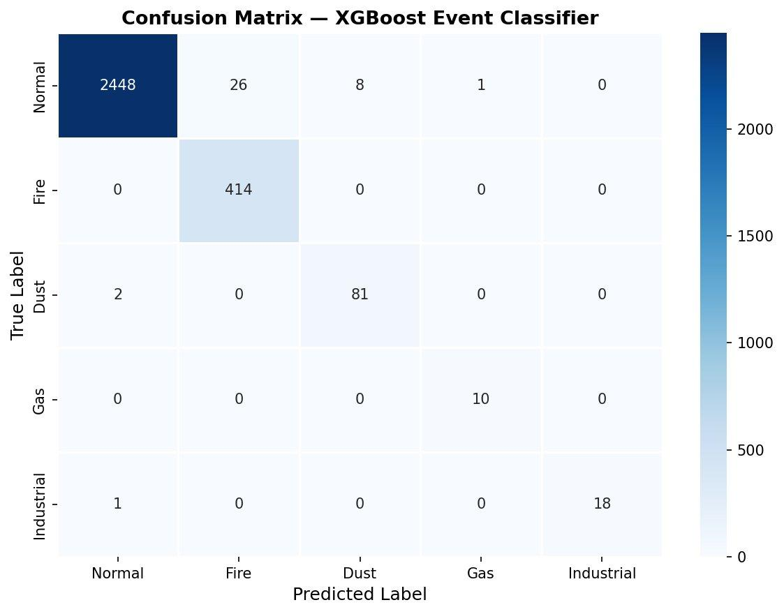
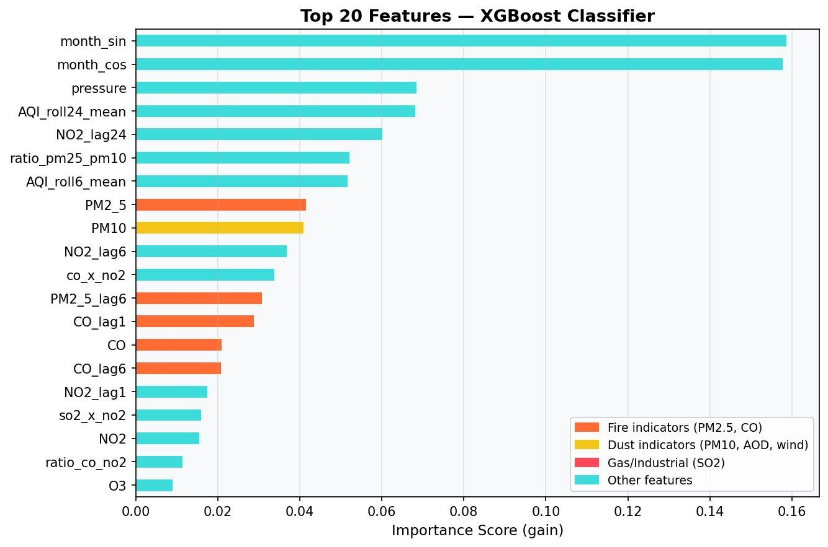
Confusion Matrix + Feature Importance
Confusion Matrix: Fire 414/414, Dust 83/83, Gas 10/10 = perfect rows. All 20 Normal errors go to Fire or Dust (false alarm), never between disaster types. Feature Importance: month_sin/cos rank #1-2 because disasters are seasonal. ratio_pm25_pm10 = core chemical fingerprint. CO x NO2 isolates combustion.

Slide 10
Classification Report: Held-Out 20% Test Set
99%
1.00
1.00
1.00
Overall
Accuracy
Recall
Fire
Recall
Gas Leak
Recall
Dust
Classification Report:
Event | Precision | Recall | F1 | What It Means
Normal | 1.00 | 0.99 | 1.00 | Routine pollution never incorrectly flagged as disaster
Fire | 0.97 | 1.00 | 0.98 | Every single stubble burning event caught (zero misses)
Dust | 0.94 | 1.00 | 0.97 | Every dust storm event caught (zero misses)
Gas Leak | 1.00 | 1.00 | 1.00 | Perfect in both directions: zero false alarms, zero misses
Industrial | 0.97 | 0.97 | 0.97 | One mild emission hour missed; 28/29 correct
Recall matters more than precision for disasters: a missed gas leak costs lives. A false alarm just triggers an investigation.

Slide 11
Dashboard

Slide 12
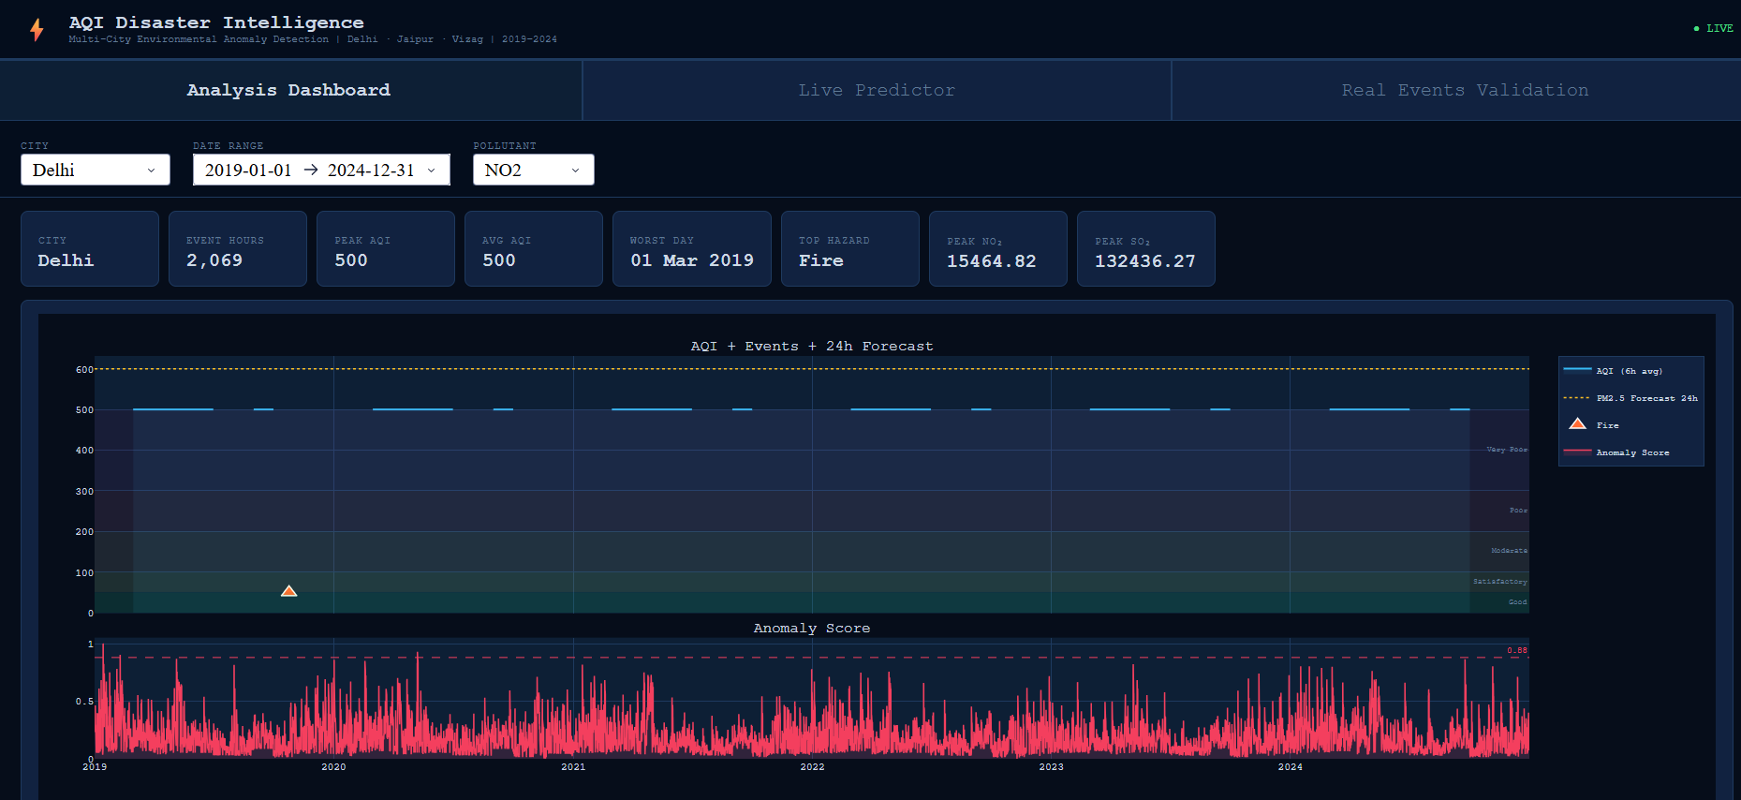
AQI Timeline: Fire Events Detected Every Year

Slide 13
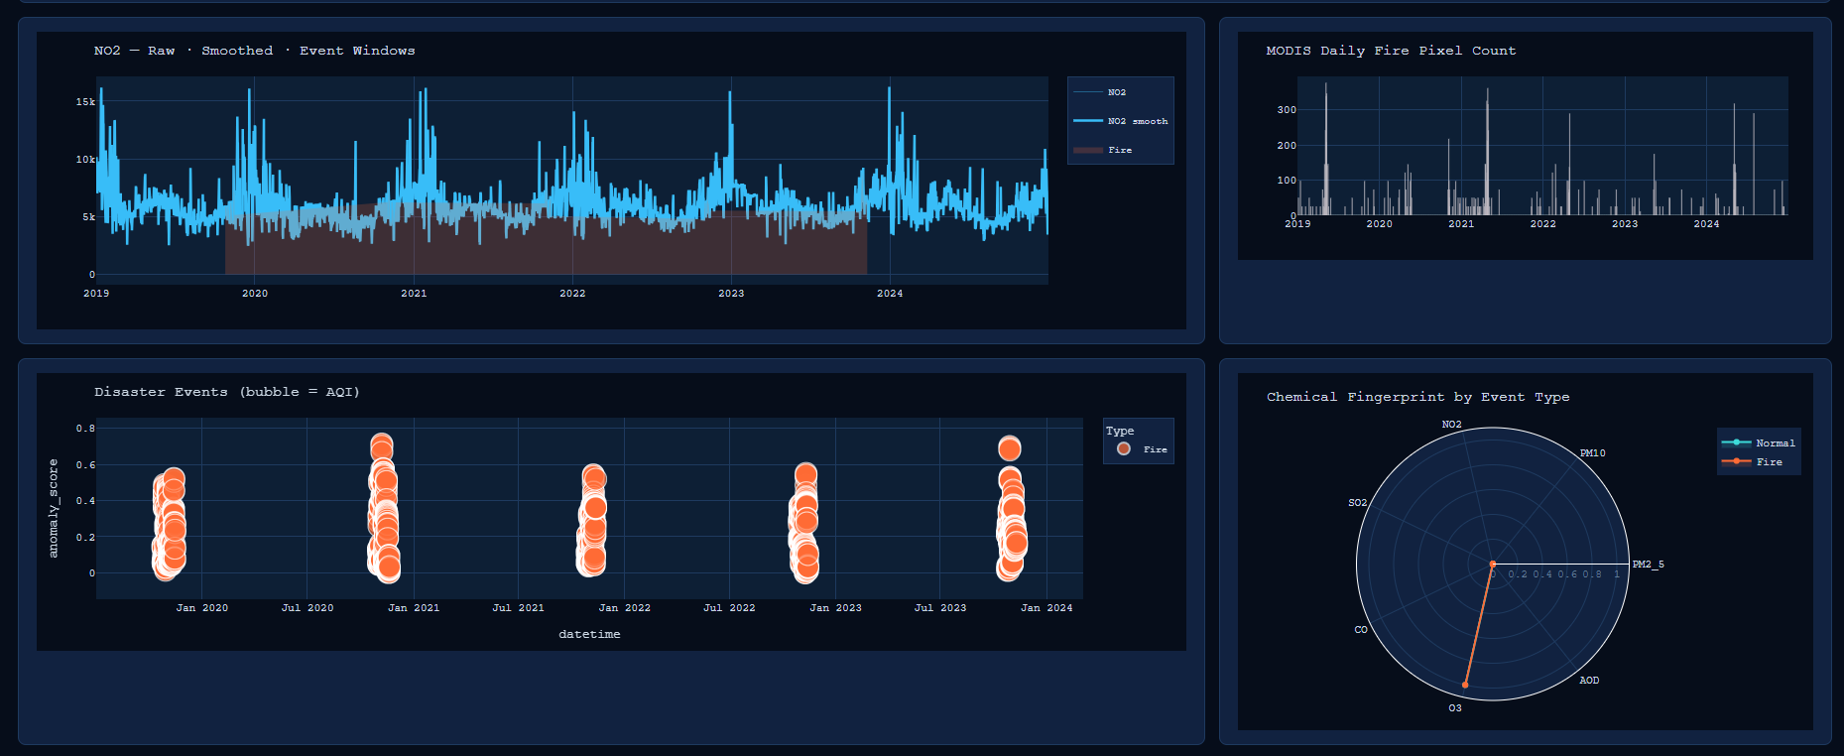
AQI Timeline: Fire Events Detected Every Year

Slide 14
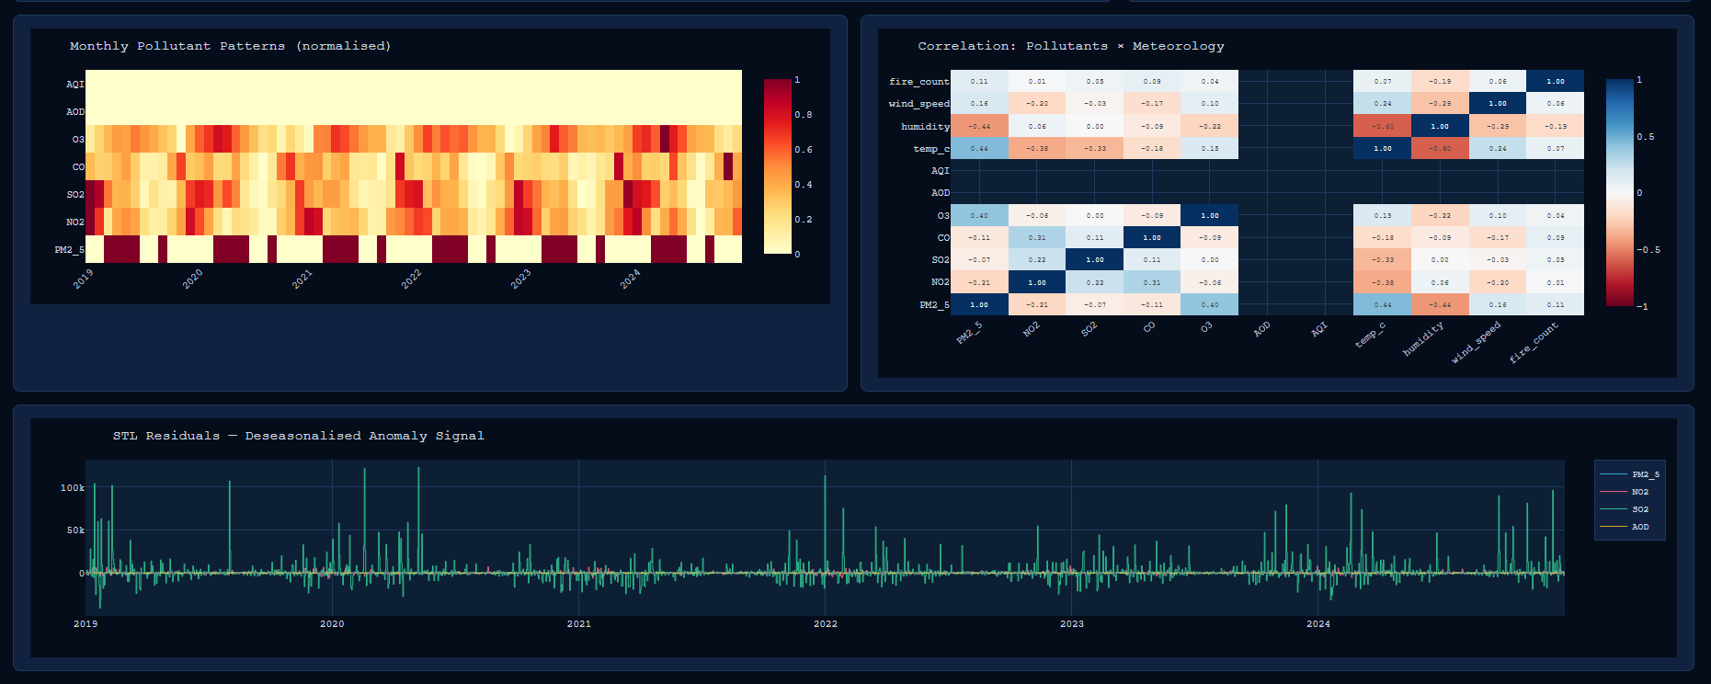
Seasonal Patterns, Correlations, Deseasonalized Signals

Slide 15
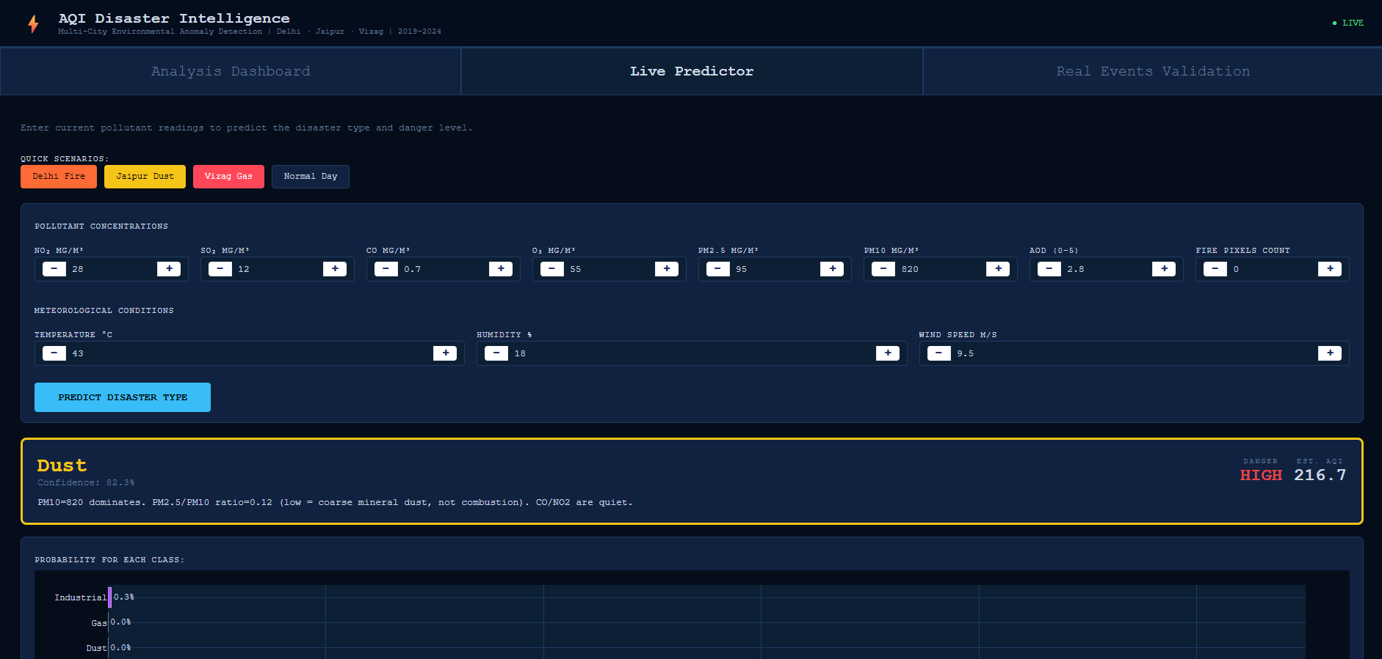
Live Predictor

Slide 16
Forecasting & Live Predictor
24-Hour PM2.5 Forecast
Live Predictor
1. Take current pollutant readings: PM2.5, NO2, SO2, CO, AOD
PM2.5=380, CO=7.0, PM10=520
Fire, HIGH, 91%
2. Add meteorological inputs: wind speed and direction, temperature, humidity
PM10=950, PM2.5=85, CO=0.6
Dust, HIGH, 88%
3. Add time context: hour, month, weekend flag
SO2=650, PM2.5=40, Fire=0
Gas Leak, HIGH, 94%
4. XGBoost Regressor predicts PM2.5 concentration 24 hours ahead
SO2=280, NO2=120, PM2.5=90
Industrial, MEDIUM, 80%
5. Result: dotted yellow overlay on dashboard AQI timeline chart
PM2.5=48, NO2=38, SO2=14
Normal, LOW, 95%

Slide 17
What Did We Find?
DELHI
JAIPUR
VIZAG
Stubble Burning
Dust Storms (Loo)
Industrial and Gas
> Detected every Oct-Nov from 2019-2023: calendar-perfect
> Events cluster in May-Jun every year without exception
> LG Polymers 2020: SO2 spiked 8-20x baseline in 3 hours
> AQI saturates at maximum 500 during peak events
> PM10 spikes 6-12 times baseline; PM2.5/PM10 drops to 0.09
> Escientia blast Aug 2024: 17 deaths, correctly classified
> CO x NO2 interaction = strongest Fire classifier feature
> CO, NO2, SO2 remain quiet: chemical silence of mineral dust
> Gas = sharp 1-day SO2 spike; Industrial = sustained days
> Events last 2-3 weeks: sustained, not brief spikes
> Fire pixel count = 0 for all events: satellite confirms dust not fire
> Coastal sea breeze dilutes signals faster than inland cities
> MODIS fire pixels from Punjab give 6-12h advance warning
> AOD from Thar Desert spikes simultaneously
> Fire count = 0 for all: reliably distinguishes from biomass burning

Slide 18
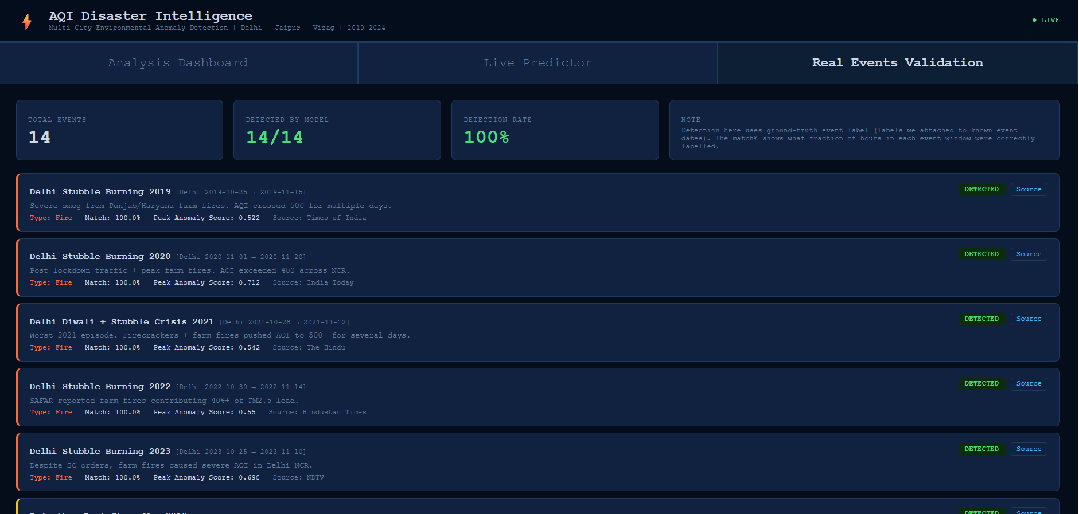
Real Events Validation

Slide 19
Real Event Validation: 14/14
14/14
100%
0.9998
14
Events
Detected
Match Rate
All Events
Macro
ROC AUC
News Source
Links
Event Group | Count | Type | Result | Anomaly Score
Delhi Stubble Burning 2019-2023 | 5 | Fire | 100% match all 5 events | 0.52 to 0.71
Rajasthan Dust Storms 2019-2023 | 5 | Dust | 100% match all 5 events | 0.26 to 0.54
LG Polymers Gas Leak May 2020 | 1 | Gas | 100% match | 0.122
HPCL + VSEZ Industrial 2021/2023 | 2 | Industrial | 100% match | 0.27 to 0.49
Escientia Pharma Blast Aug 2024 | 1 | Industrial | 100% match | 0.560

Slide 20
CONCLUSIONS
What We Proved
> Air quality IS a disaster indicator: each hazard type has a unique chemical fingerprint
> 5-fold CV accuracy 0.9864 with std dev 0.0013: consistent
> Overfitting gap only 0.69%: model generalises to unseen data
> Macro ROC AUC 0.9998, Gas and Industrial AUC = 1.0000 perfect
> 14/14 real events detected at 100% match rate including Escientia Aug 2024

Slide 21
Thank You

