Slide 1
Online Education Website Aimers
By-Sunidhi Jain

Slide 2
Introduction
This is the Online education website- Aimers which provide us the best courses according to the latest technologies and trending in market like Frontend developer, web developer, IOT and AI, Data Science with Python and Android etc.
Here, I used HTML, CSS and JavaScript.
HTML file- index.html
CSS- style.css
JavaScript- script.js

Slide 3
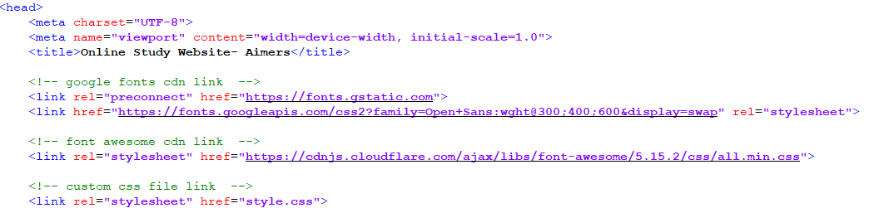
Code:
Index.html:

Slide 4
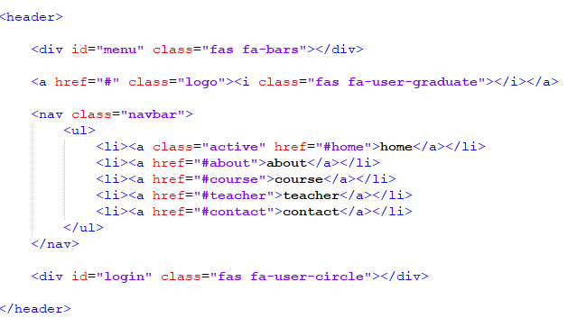
Continue..
Here, I am using some cdn link to make my website attractive.
Google fonts cdn- to use some google fonts styling
Font awesome cdn- to use icon set.

Slide 5

The above part is used to create navbar at the top of the page. Below is the snap for the same,

Slide 6
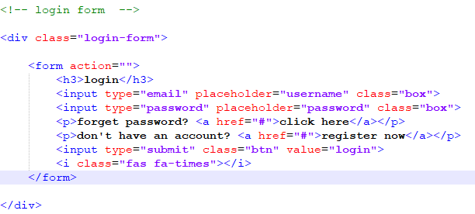
Login Form- Code

Slide 7
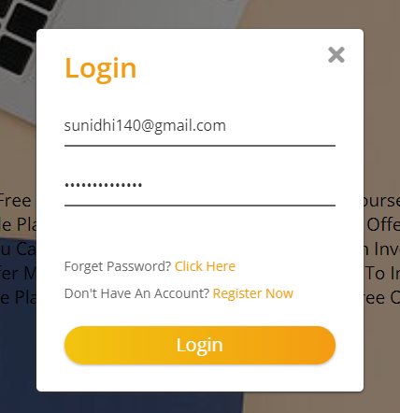
Continue…

Slide 8
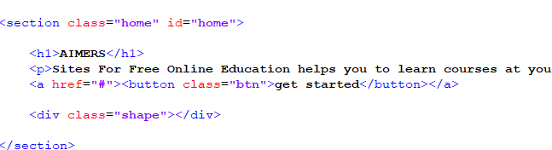

Home

Slide 9
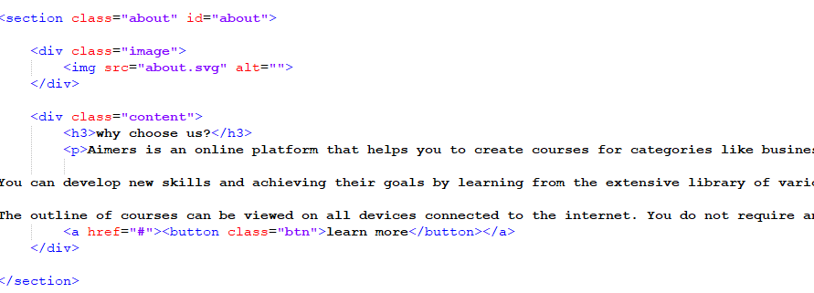

About

Slide 10
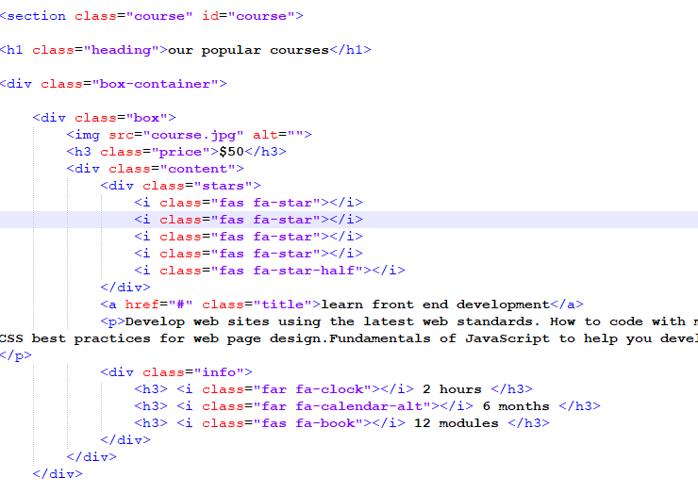

Course

Slide 11
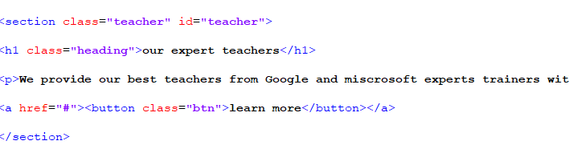

Teacher section

Slide 12
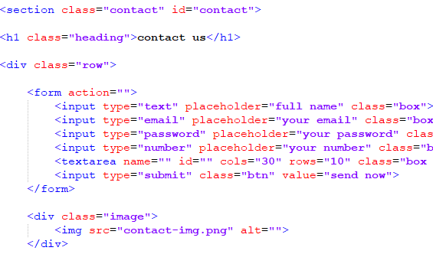
Contact

Slide 13
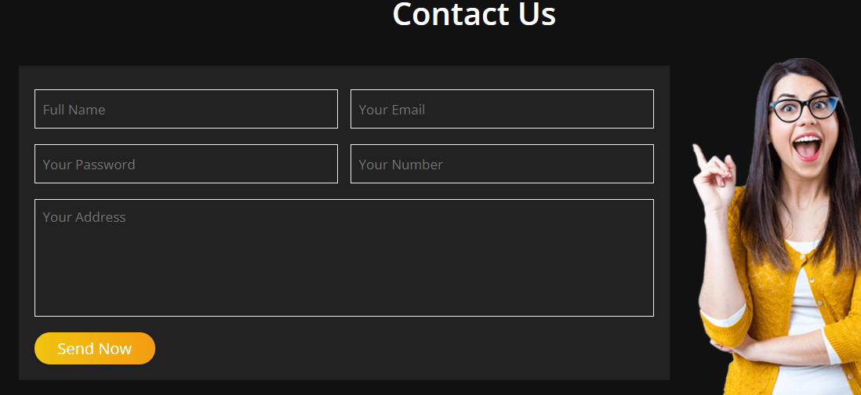

Slide 14
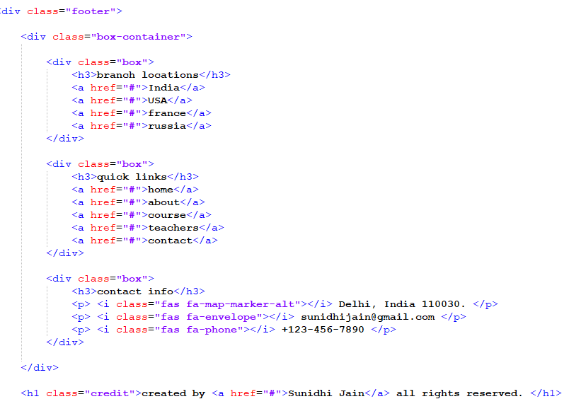
Footer Section

Slide 15
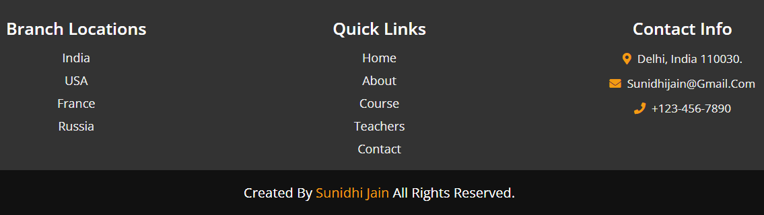

Slide 16
Thank you

