Slide 1
Hackathon Ideation Phase
Idea Submission Template

Slide 2
👨‍👦‍👦 Team details
Team name - SUNEHRI
Team member name ( Single person )
Suniksha Ben Patel

Slide 3
📝 Theme details
Theme name – Adaptive Learning Systems for Personalized Learning Plans
Proposed Concept: "SkillBridge - AI-Powered Peer Learning Matchmaker"
Reasons for selecting this theme
Growing Education Gap Crisis : Traditional education systems are failing to provide personalized learning solutions while costs for private tutoring skyrocket, creating an urgent need for accessible, scalable alternatives.
Market Timing & Feasibility : The post-COVID surge in edtech adoption, combined with existing institutional infrastructure and low development costs, creates the perfect environment for implementing a peer-learning platform.
Untapped Peer Learning Potential "Educational institutions possess an untapped goldmine of peer knowledge that, when properly leveraged, can create a powerful learning ecosystem

Slide 4
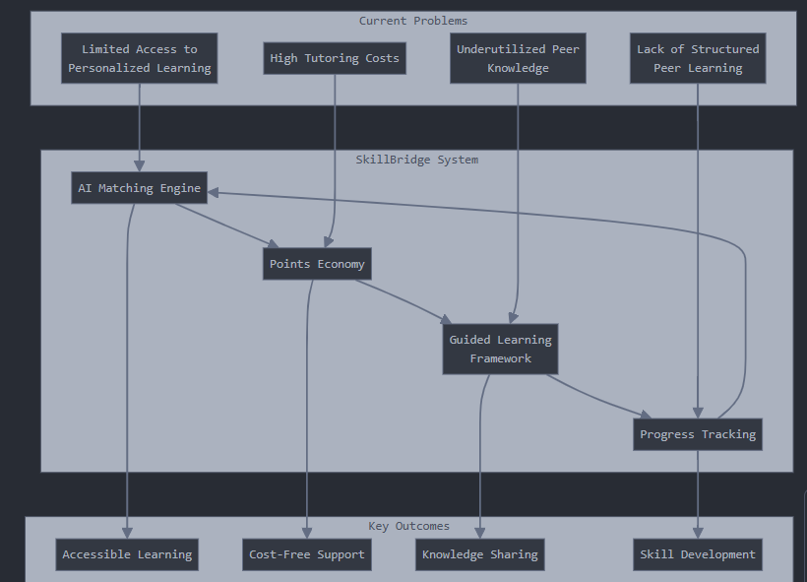
🚩 Approach details
How it helps to solve the problem?
SkillBridge eliminates financial barriers through an AI-powered points system that matches students with peer tutors, making personalized learning accessible to everyone. The platform ensures quality through AI-guided sessions and real-time progress tracking, turning casual peer help into structured, effective learning experiences. Built for scale, the system automatically grows with demand and works across multiple subjects and institutions, maximizing the use of existing peer knowledge.

Slide 5
What are the impact metrics that one can use to analyze the effect of the solution?
🚩 Approach details
Engagement Metrics:
Number of Active Users: Count of students and peer tutors using the platform regularly.
Session Completion Rate: Percentage of scheduled learning sessions completed successfully.
Time Spent on Platform: Average duration of user activity, indicating engagement.
Learning Outcomes: 1) Skill Improvement: Measured through quizzes, assessments, or self-reported progress. 2)Tutor Effectiveness: Ratings and feedback from students about their peer tutors. 3)Subject Mastery Rate: Percentage of students achieving predefined milestones.
Operational Metrics:
1) System Scalability: Ability to handle increased user demand across various subjects and institutions.
2) AI Accuracy: Match success rate of AI-powered tutor-student pairing.
3) Cost Efficiency: Operating cost per session or per user.

Slide 6
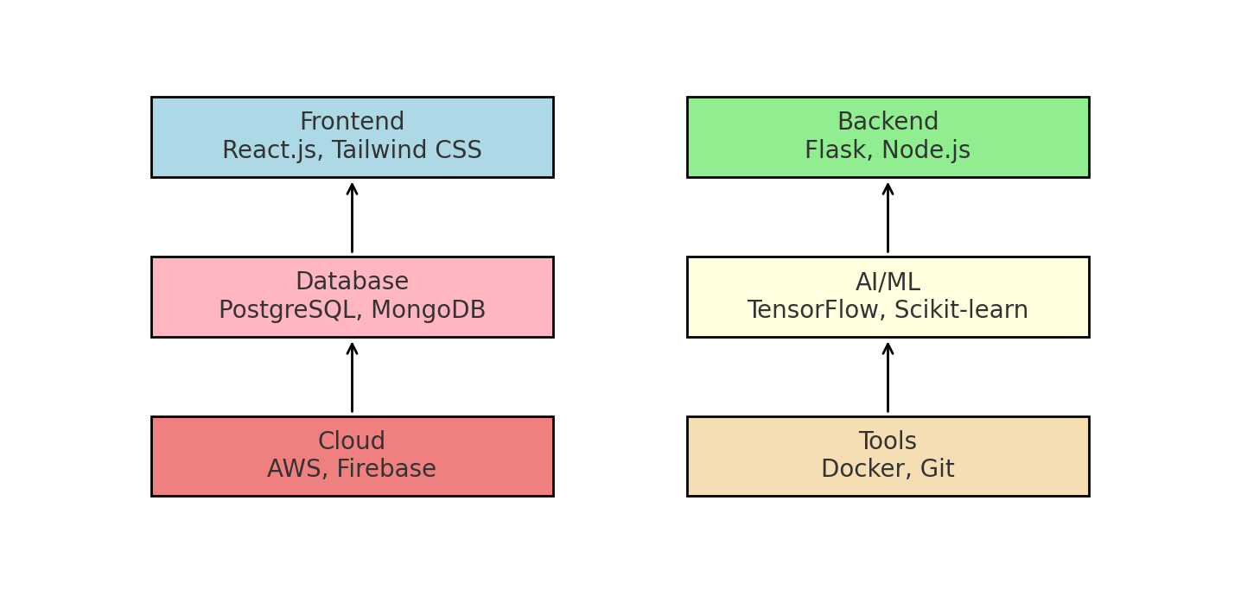
🚩 Approach details
Frameworks/Technologies stacks to be used

Slide 7
🚩 Approach details
Assumptions, constraints, and solution decision points (Reason behind choosing a technology)

Slide 8
How easily can your solution be implemented and how effective will it be?
🚩 Approach details
Ease of Implementation:
Clarity of Requirements: If your requirements are clear and well-defined, implementation is usually straightforward.
Technical Compatibility: If the solution leverages tools, libraries, or frameworks you're already familiar with, it can be implemented quickly.
Guidance Provided: I provide step-by-step instructions and examples, making it easier for you to follow and execute.
Resources and Skills: Your access to required skills, time, and tools can impact ease.
Effectiveness:
Relevance of the Solution: My solutions are designed based on the information you provide. The more accurate and detailed your input, the better the results.
Scalability and Flexibility: Solutions are tailored to be adaptable to your current and future needs whenever possible.
Feedback and Iteration: You can refine the solution iteratively with my support, ensuring it fits your context effectively.

Slide 9
🚩 Approach details
Scalability
Horizontal Growth: Add more servers/resources to support increasing users or workload.
Vertical Growth: Upgrade existing hardware or systems to boost performance.
Modular Design: Break down the system into independent, scalable components (e.g., microservices).
Usability
1. Intuitive UI: Ensure the interface is user-friendly and easy to navigate.
2. Accessibility: Design for inclusivity (e.g., compatibility with screen readers).
Extent of Scalability/Usability

Slide 10
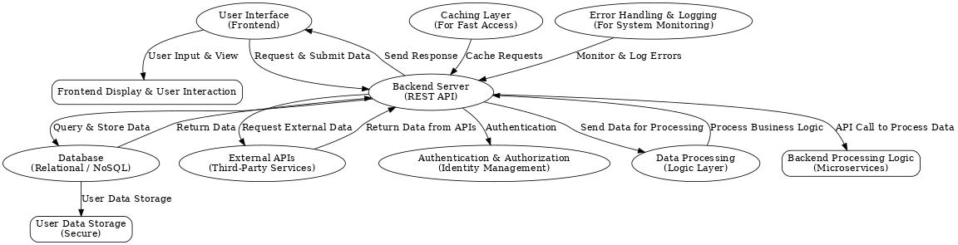
📊 Methodology / Architecture diagram

Slide 11
🚀 Future Scope
Business relevance
Frontend UI: Directly impacts user experience, engagement, and satisfaction. A well-designed UI enhances retention and conversion rates.
Backend Server: Handles business logic and data processing. Scalable backends support business growth and improve performance.
Database: Efficient data storage ensures fast access, scalability, and operational efficiency.
External APIs: Enhance functionality (e.g., payment gateways, integrations) while saving time and resources.
Authentication: Ensures user privacy and security, building trust and brand reputation.
Data Processing: Accurate and quick processing of business-critical data improves decision-making and competitiveness.
Caching Layer: Speeds up data access, reducing latency and improving system performance.
Error Handling: Proactive error detection minimizes downtime, ensuring smooth business operations.

Slide 12
🚀 Future Scope
Optimization
Scalability: The system can scale horizontally to handle increasing traffic and user demands.
Component Upgrades: The frontend and backend can be enhanced with new technologies (e.g., WebAssembly, AI/ML).
Database Changes: Switch between relational and NoSQL databases as needed, and implement replication for larger datasets.
API Integrations: Add or swap third-party APIs to enhance functionality and business operations.
Security: Enhanced security measures like 2FA and encryption can be integrated to improve user trust.
Scope of Modification
Frontend Optimization: Techniques like lazy loading and image compression improve performance and user experience.
Backend Optimization: Load balancing and query optimization ensure quick responses and scalability.
Database Optimization: Indexing and query improvements boost data retrieval speed.
Caching: Distributed caching (e.g., Redis) reduces database load and improves response times.
Error Handling: Automated alerts and system checks ensure issues are resolved quickly, minimizing downtime.

Slide 13
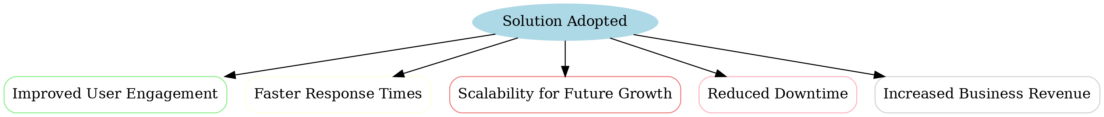
🎯 Impact / Novelty
Once the solution is adopted, what impact would it create?

Slide 14
Thank You
Team - Sunehri

