Slide 1

Jadavpur University
Application For Career Advancement Scheme (CAS)
Sign In
Email
Password
Sign Up for New Registration Forgot Password?
Email
Password
Sign In

Slide 2
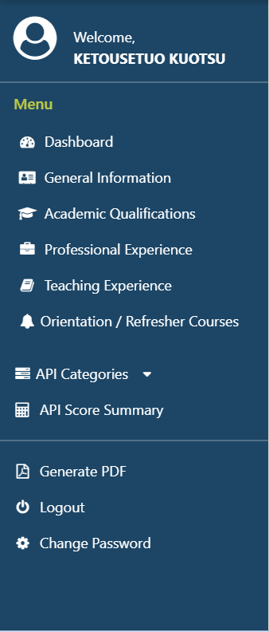
Step 1: Click below to generate your endorsement form
Endorsement Form
Creates the pdf of the form (opens in new tab)
Step 2: Copy and paste the link of the signed endorsement from below
URL of signed endorsement form
Step 3: Click below to submit your form (appears only when the link is given)
Submit

Slide 3
Jadavpur University
Application For Career Advancement Scheme (CAS)
New Registration
First Name Last Name
Department Designation
Post Applied For Email
Password Confirm Password
Back to Sign In
First Name
Last Name
Drop Down
Assistant Professor
Associate Professor
Professor
Drop Down
Assistant Prof. (Stage 2)
Assistant Prof. (Stage 3)
Associate Prof. (Stage 4)
Professor (Stage 5)
Department
Designation
Name of the Post
Email
Password
Confirm Password
Register

Slide 4
Jadavpur University
Career Advancement Scheme (CAS)
Name of the Faculty
Application For Promotion of University Teachers Under CAS
Drop Down
Assistant Prof. (Stage 1)
Assistant Prof. (Stage 2)
Assistant Prof. (Stage 3)
Associate Prof. (Stage 4)
Drop Down
Assistant Prof. (Stage 2)
Assistant Prof. (Stage 3)
Associate Prof. (Stage 4)
Professor (Stage 5)
From:
Stage/ Designation
To:
Stage/ Designation
Choose Option
Choose Option
Part A : General Information
Sl. No. | Topics | Data
1 | Full Name | IN BLOCK LETTERS, Auto Fill (Editable)
2 | Father’s Name / Mother’s Name | IN BLOCK LETTERS
3 | Date of Birth | DD/MM/YYYY
4 | Category | Dropdown: SC/ ST/OBC-A/OBC-B/Gen
5 | Department / School | Auto Fill(Editable)
6 | Current Designation | Auto Fill(Non Editable)
7 | Academic Grade Pay (AGP) | Numeric

Slide 5
Jadavpur University
Career Advancement Scheme (CAS)
Name of the Faculty
Application For Promotion of University Teachers Under CAS
Sl. No. | Topics | Data
8 | Date of Last Promotion (if any) | DD/MM/YYYY
9 | Date of Eligibility for promotion | DD/MM/YYYY
10 | Address for correspondence (with PIN code)
11 | Permanent Address (with PIN code)
12 | Mobile No. | Numeric 10 digits
13 | Email ID | Auto Fill (Editable)
Save and Next

Slide 6
Jadavpur University
Career Advancement Scheme (CAS)
Name of the Faculty
Application For Promotion of University Teachers Under CAS
Part B : Academic Background
A. Last Academic Qualification (other than research degree(s))
Degree/Certificate | Name of the Board / University | Year of Passing | % of Marks Obtained | Division/ Class/ Grade | Subject(s)
+ Add Row
B. Research Degrees
Degree | Title of Dissertation/ Thesis | Date of Award | Name of the University
 |  | DD/MM/YYYY
+ Add Row

