Slide 1
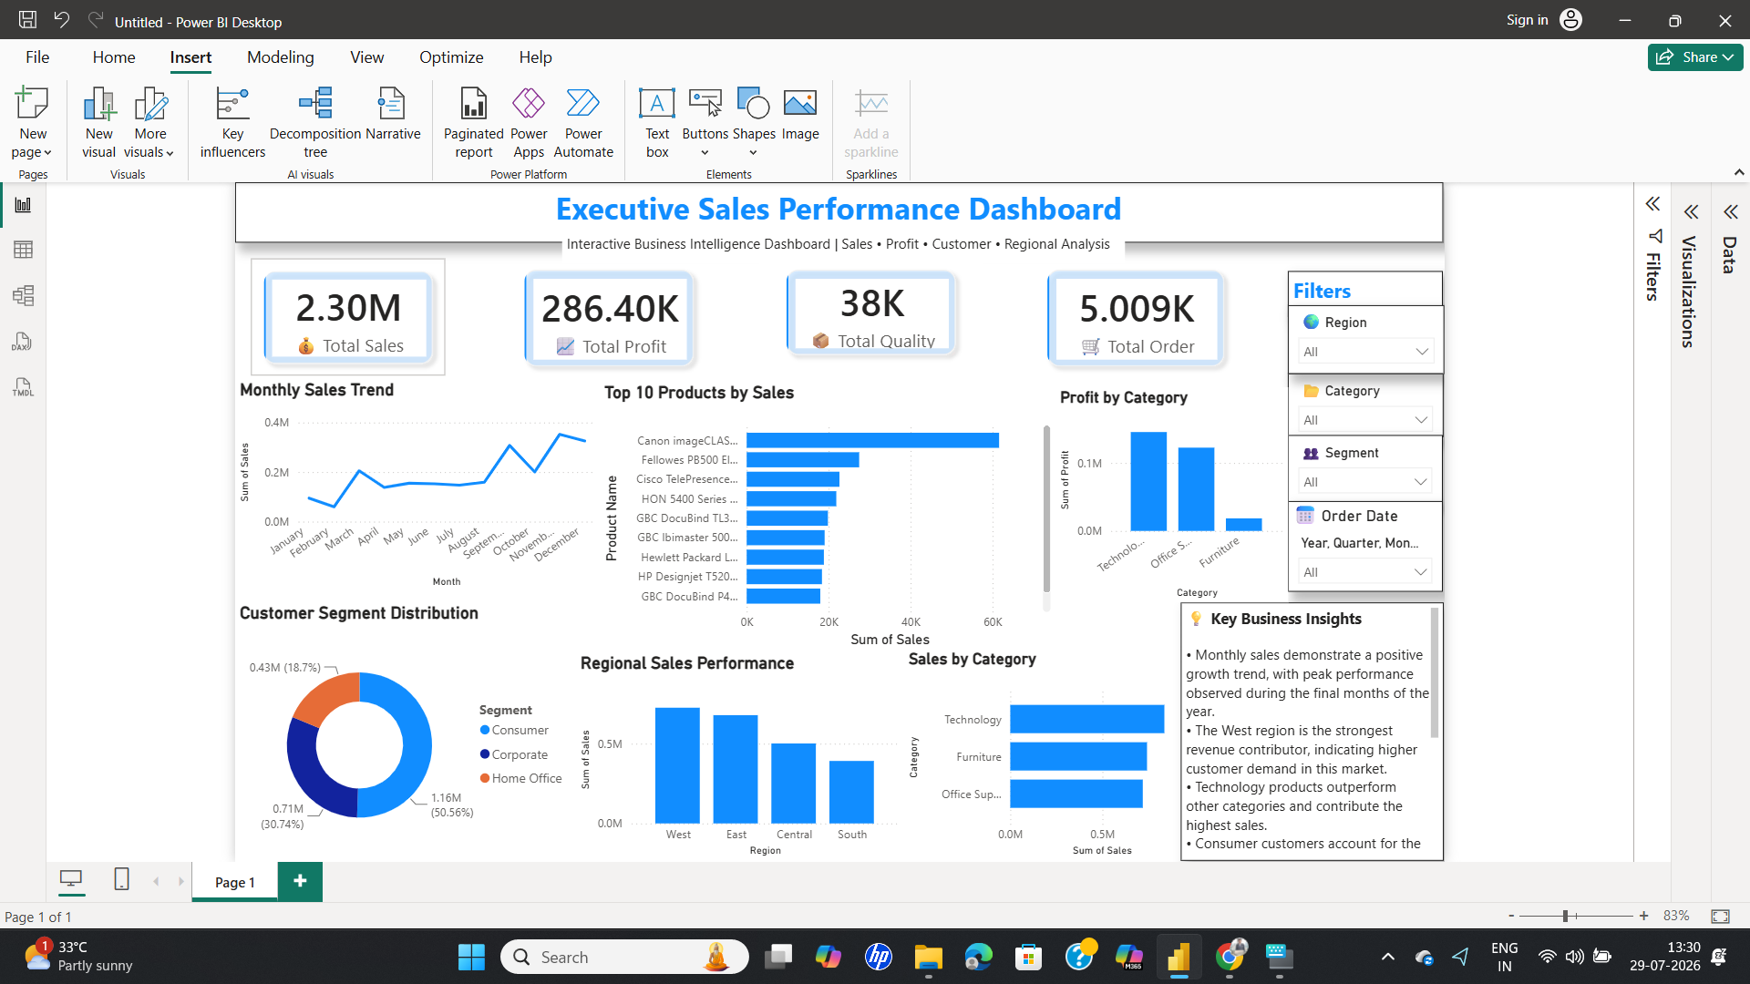
SALES PERFORMANCE
DASHBOARD
Power BI Internship Task 4
Prepared By: Sunil Kumar
Executive Sales Performance Dashboard — built in Power BI

Slide 2

Objective
The objective of this project is to design an interactive Power BI dashboard that enables business stakeholders to monitor sales, profit, customer segments, regional performance, and product trends for data-driven decision making.
Sales Performance Dashboard | Power BI Internship Task 4
2

Slide 3


Dataset Overview
Key Columns
Dataset Name
Order Date
Sales
Sample Superstore Dataset
Source
Profit
Quantity
Kaggle
Region
State
Rows
9,994 records
Segment
Category
Use Case
Sales, profit & performance analysis
Product Name
Sales Performance Dashboard | Power BI Internship Task 4
3

Slide 4
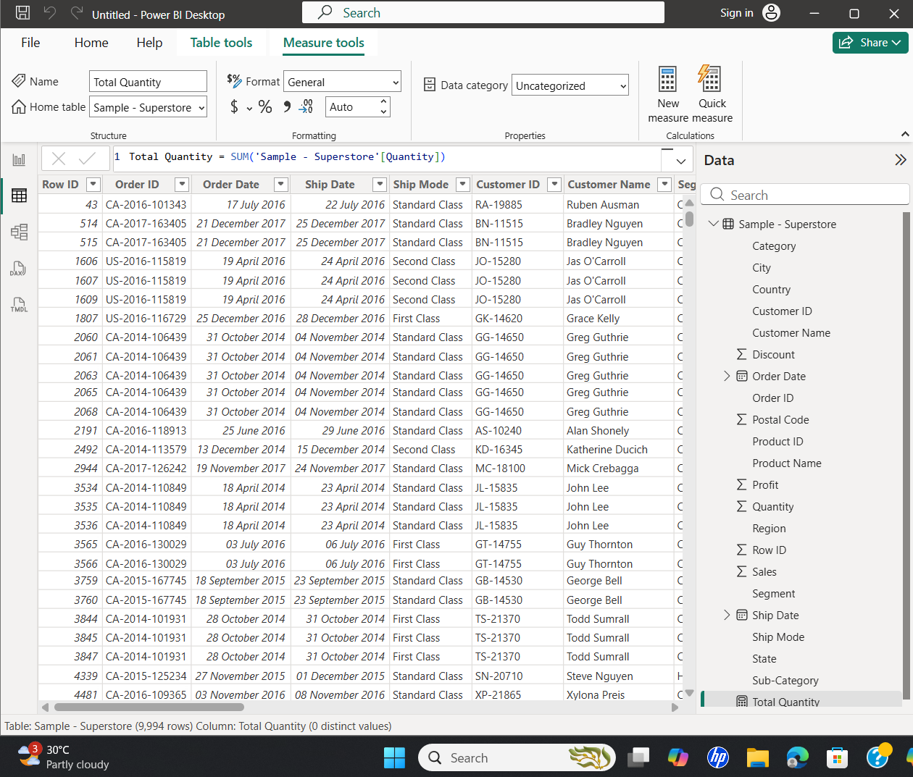
Data Cleaning & Preparation
Imported dataset into Power BI
Building DAX Measures in Power BI
Verified data types
Removed unnecessary fields
Built KPI Cards
Created Time-Series Analysis
Added Interactive Slicers
Designed Professional Dashboard
Sales Performance Dashboard | Power BI Internship Task 4
4

Slide 5

Dashboard Components
KPI Cards
Monthly Sales Trend
Sales by Category
Regional Sales Analysis
Customer Segment Analysis
Top 10 Products
Executive Sales Performance Dashboard
Interactive Filters
Business Insights
Sales Performance Dashboard | Power BI Internship Task 4
5

Slide 6





Business Insights
Technology category generated the highest sales.
Consumer segment contributed the highest revenue.
West region showed strong performance.
Top products contributed significantly to total sales.
Sales trend improved during later months.
Sales Performance Dashboard | Power BI Internship Task 4
6

Slide 7




Business Recommendations
Focus marketing on high-performing customer segments.
Increase inventory in strong-performing regions.
Promote best-selling products.
Monitor low-profit categories.
Use dashboard insights for strategic decisions.
Sales Performance Dashboard | Power BI Internship Task 4
7

Slide 8

Conclusion
The dashboard successfully transforms raw sales data into meaningful business insights through interactive visualizations, KPI tracking, and filtering.
Skills Demonstrated
Power BI
Power Query
Data Visualization
Dashboard Design
Business Intelligence
Sales Performance Dashboard | Power BI Internship Task 4
8

