Slide 1
Project on Logistic Regression Company Bankruptcy Prediction Work done by- Sunil Kumar

Slide 2
Content
Problem Statement.
Project Steps.
Visualization.
Steps and challenges.
Model and Ensembles.
Imbalanced classification.
Model Calibration.
Model Accuracies and differences
Challenges.
Conclusion.

Slide 3
Problem Statement
Prediction of bankruptcy is a phenomenon of increasing interest to firms who stand to loose money because on unpaid debts. Since computers can store huge dataset pertaining to bankruptcy making accurate predictions from them before hand is becoming important.
The data were collected from the Taiwan Economic Journal for the years 1999 to 2009. Company bankruptcy was defined based on the business regulations of the Taiwan Stock Exchange.
The goal of this project is that you will use various classification algorithms on bankruptcy dataset to predict bankruptcies with satisfying accuracies long before the actual event.

Slide 4
Project Steps
Data collection and data Understanding.
Loading to tool and importing Libraries.
Data Preparation and Data cleaning.
Data Transformation.
Feature selection and removal.
Modeling- importing models, Defining the dependent and independent.
Imbalanced classification.
Model Ensembles.
Model Calibration.
Model Evaluation and selection.
Deployment.

Slide 5
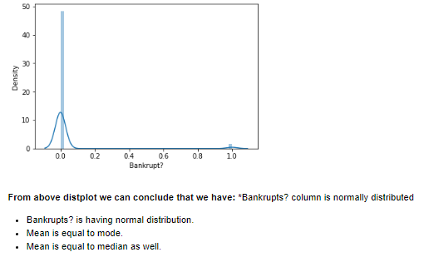
Visualization

Slide 6
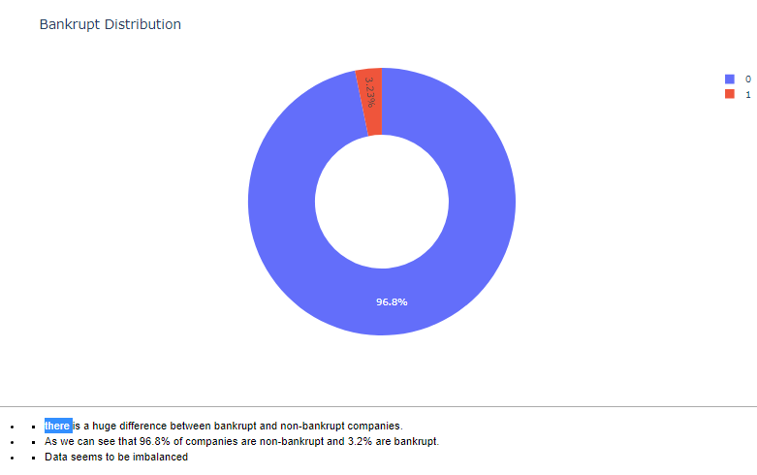
Visualization

Slide 7
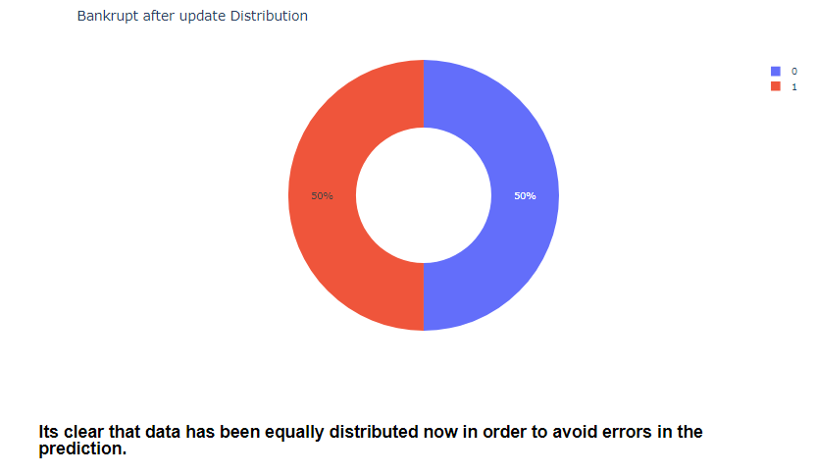
Visualization continued..
.

Slide 8
Steps and challenges
Finding out missing values.
Finding out duplicates.
Finding out outliers.
Data Transformation.
Feature selection and feature dropping.

Slide 9
Model and ensembles
Logistic Regression.
Decision tree.
Model ensembles.
Random forest.
Ada Boost.
Gradient Boost.
Voting Boost.

Slide 10
Imbalanced Dataset
The number of observations belonging to one class is significantly
lower than those belonging to the other classes.
Fraudulent transactions in banks, identification of rare diseases or in this case of bankrupt company or not etc. In this situation, the predictive model developed using conventional machine learning algorithms could be biased and inaccurate.
This happens because Machine Learning Algorithms are usually designed to improve accuracy by reducing the error. Thus, they do not take into account the class distribution / proportion or balance of classes.

Slide 11
Imbalanced Dataset
Imbalanced dataset resembling techniques:
Random Under sampling.
Random Over sampling.
SMOT(Synthetic Minority Oversampling Technique.

Slide 12
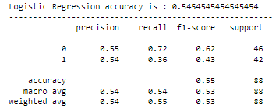

Techniques and accuracies
1ST Approach- Resembling-Minority Accuracies

Slide 13

Techniques and accuracies continued..
^{2nd} Approach- SMOT Accuracies

Slide 14
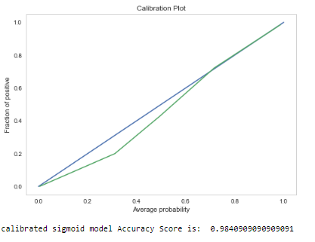
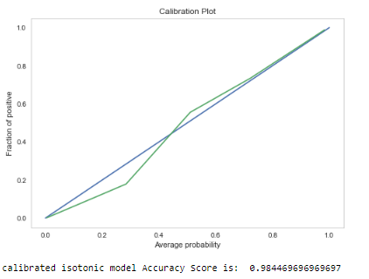
Model Calibration
1)Predicted probabilities that match the expected distribution of probabilities for each class are referred to as Calibrated.
2)comparison of the actual output and the expected output given by a model.
3) Assuring reliable benchmarks and results.
Sigmoid Isotonic

Slide 15
Conclusion
Started with data loading and importing the libraries and then started with the exploring the data and looking into columns and rows. It was seen that there were no missing values.
While looking into Bankrupt? Column It was seen that column was following almost normal distribution. While exploring Bankrupt? column further it was evident that data is imbalanced and there is a huge difference between bankrupt and non-bankrupt companies.
I have used 2 techniques to overcome this problem. 1st was to create a dataframe and divide into equal rows that was equal (220,220) rows and 96 columns.
Once I was done here then applied modeling techniques started with Logistic regression and the other ensembles.

Slide 16
Conclusion continued..
I achieved the consistently better quality with a better model every time, I also have used voting classifier which basically takes ensemble of numerous models and gives the best predicted output/accuracy. Voting classifier have given me the best quality. 2nd I have used Synthetic Minority Oversampling Technique(SMOT)in which I oversampled the minority class and balanced the data. I also performed the normalization on non-fractional columns to make sure data following the same scale. I have seen and found that after SMOT results for accuracy were better than the 1st technique.
Finally I have used calibration, it basically assures the reliable benchmark and accuracy results when features are very important, by this way I have achieved the best accuracy for the model prediction.

Slide 17
Challenges
The major challenges I have faced in this project are mentioned Below:
I handling the imbalanced data.
Non-fractional column containing uneven values.
Choosing right Model for this problem, explored the Voting classifier.
While oversampling I was unable to create a dataframe and results were coming out different even after few iterations.
Calibration of the Model.

Slide 18

Thank you!

