Slide 1
Exploratory Data analysis
Global Terrorism
Project by-Sunil Kumar

Slide 2
AGENDA
Data preparation.
Most attacked region.
Most attacked year.
Number. Of attacks in year and territory.
Most attacked region globally.
Visualization.
Percentages of attackers.
Attackers interest of target.
Number of people killed by attackers.
Al-Qaeda gang.
Country exceeding sum of killing.
Most active gangs.

Slide 3
DATA PREPARATION
Libraries
pandas ,seaborn.
%matplotlib inline.
matplotlib.pyplot.
!pip install folium.
Folium.
Understanding data using:
df.head(), df.tail, df.shape(),df.dtypes,
type(df),df.describe(),df.corr(),df.summary.
Understanding important columns and dropping others.
Handling Null
data.isnull()
Identifying null values in the columns&
dropping those.
approxdate 94.914993%, related 86.219461% of null values in these two columns.
Important Visualization
Sns.heatmap()
ma= mp.Map()
plt.bar()
sns.barplot()
pd.crosstab()
WordCloud()

Slide 4
MOST ATTACKED REGION
Country with most attacks: Iraq
City with most attacks: Baghdad
Region with the most attacks: Middle East & North Africa
Year with the most attacks: 2014
Month with the most attacks: 5
Group with the most attacks: Taliban
Most Attack Types: Bombing/Explosion

Slide 5
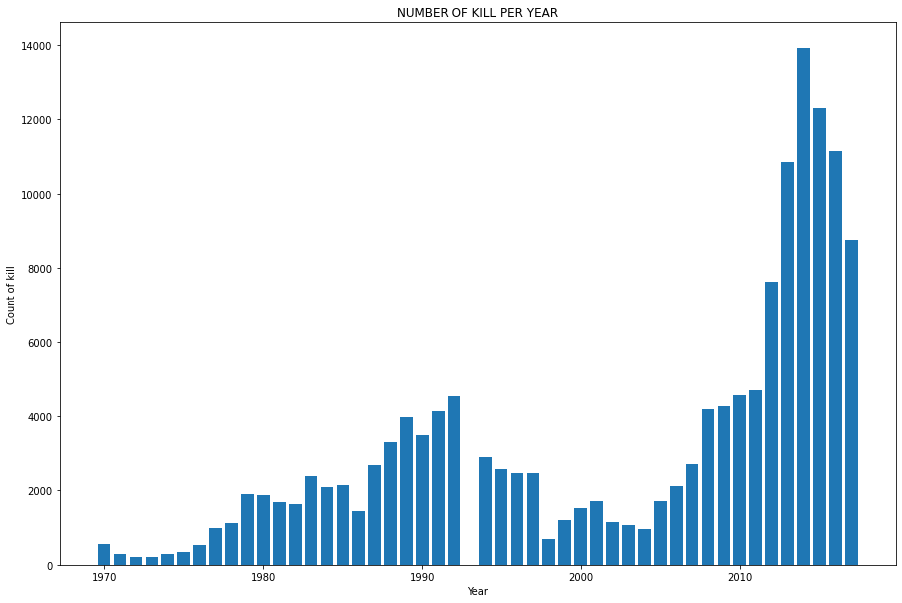
MOST ATTACKED YEAR
Notes:
We can conclude that most attacks were done in the year 2014. We can see here that attacks slowly start to increase from 1972 until about 1993 where until 2004 we see a downward global trend in Terrorist incidents then after 2014 the terrorist activities starts increasing till 2014 then slowly decreases.

Slide 6
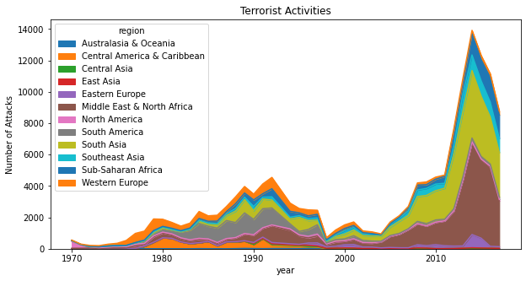
NUMBERS OF ATTACKS IN YEAR AND TERRITORY
Most attacks were made in 2014 on Australasia & Oceania.
Moving 1970-90 most terrorist attacks occurred in Western Europe,
than Sub-Saharan Africa, South east asia,South America and South Asia as well.
After 2010 trend we can say that there have been rapid attacks in 2010-2014 and so next years.

Slide 7
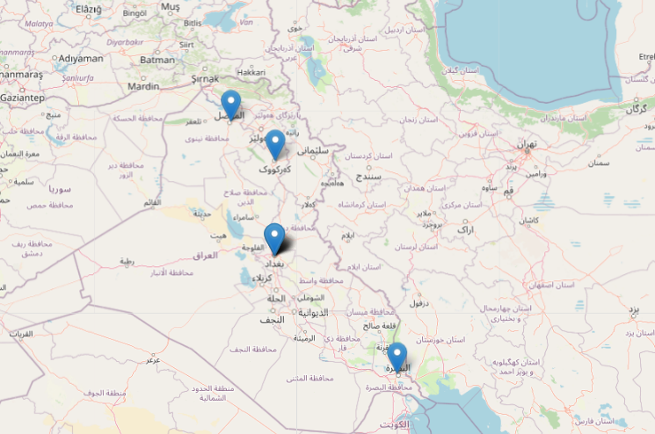
MOST ATTACKED REGION GLOBALLY
Map shows 4 location as per coordinates with most attacked country.
Basra
Mosul
Kirkuk
Baghdad

Slide 8
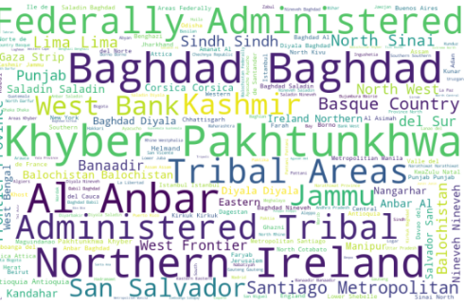
WORDCLOUD VISUALIZATION
This picture explains that
there are more repeated attacks as per the word cloud frequency
Baghdad, Khyber, Pakhtunkhwa, Al Anber, Northern Ireland, Federally Administered.
Followed by Administered Tribal, Kashmir west Bank, San Salvador and Jammu.

Slide 9
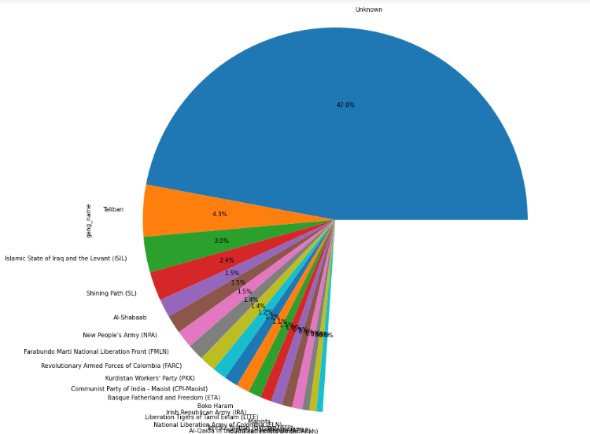
PERCENTAGES OF ATTACKERS
This pictorial representation shows that we have 47% of attackers which are Unknown,
Then Taliban 4.3%,ISIL 3.0%,Shining Path(SL) 2.4% Al Shabaab 1.5% followed by New People’s Army1.5%
And list goes on.

Slide 10
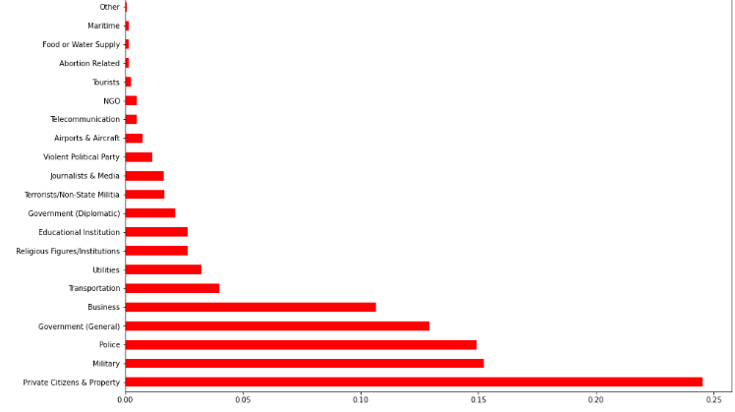
ATTACKERS INTEREST OF TARGET
Mostly Targeted for the attacks are Private Citizens & Property, Military,Police,Government(General),Business and Transportation.
Followed by utilities, Religion institutions, Educational institution, Government(diplomatic).

Slide 11
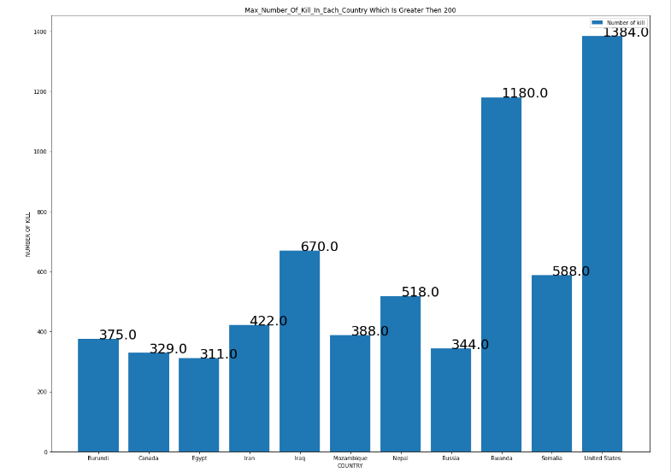
NUMBER OF PEOPLE KILLED BY ATTACKERS
This pictorial representation tells us that we have more number of killing from United States 1384, followed by Rwanda 1180, Iraq 670, Somalia 588,Nepal 518, Iran 422 and others with 300 and more killings.

Slide 12

AL-QAEDA GANG
Al -Qaeda have done most number of killings.
Often used weapons:
Explosives and vehicle-borne explosive.
Year 2001 performed more than 1 attack on US.

Slide 13
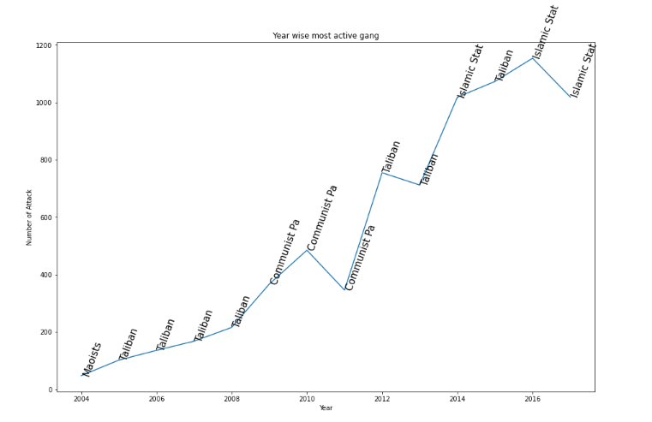
MOST ACTIVE GANGS
We gets to know that we have most active gangs:
Taliban.
CPI-Maoist.
ISIL.
Showing more numbers of attacks with years in an increasing trend.

Slide 14
COUNTRY EXCEEDING SUM OF KILLING 3000
Countries | Number of killings
Iraq | 21510
Pakistan | 12756
Afghanistan | 10871
India | 10491
Colombia | 6865
Philippines | 5843
Peru | 4916
Turkey | 3767
El Salvador | 3369
Thailand | 3346
United Kingdom | 3212

Slide 15


