Slide 1
Capstone Project on Regression Ted talk views Prediction Work done by- Sunil Kumar

Slide 2
Content
Problem Statement.
Data Summary.
Project Story.
Visualization.
EDA-Top 5 speakers according to daily Views.
EDA-Most Popular speakers.
EDA-Most Popular speakers.
EDA-Data Cleaning- Steps and challenges.
Correlation.
Models.
Feature Importance XGBoost and Random forest.
Model Scores.
Challenges.
Conclusion.

Slide 3
Problem Statement
TED is devoted to spreading powerful ideas on just about any topic. These datasets contain over 4,000 TED talks including transcripts in many languages. Founded in 1984 The main objective is to build a predictive model, which could help in predicting the views of the videos uploaded on the TEDx website.

Slide 4
Data Summary
This dataset include the variables from 17 October 2017 to 20 April 2018
Talk id- Talk identification number provided by TED
title -Title of the talk
speaker_1 -First speaker in TED's speaker list
speakers -Speakers in the talk
occupations -Occupations of the speakers.
About speakers *Blurb about each speaker dictionary
Views(Dependent Variable) Count of views.
Recorded date -Date the talk was recorded.

Slide 5
Data Summary
Available lang-All available languages (lang code) for a talk .
Comments-Count of comments.
Topics-Related tags or topics for the talk .
Related talks-Related talks (key='talk id', value='title') dictionary .
Url -URL of the talk.
Description-Description of the talk
Transcript-Full transcript of the talk.
Published date-Date the talk was published to TED.com
event -Event or medium in which the talk was given.
Native lang Language the talk was given.

Slide 6
Project Story
Data collection and data Understanding.
Loading to tool and importing Libraries.
Data Preparation and Data cleaning.
Data Transformation.
Feature selection and removal.
Modeling- importing models, Defining the dependent and independent.
Model improvement- Regularization.
Model improvement- Hyper parameter tuning.
Model Evaluation and selection.
Deployment.

Slide 7
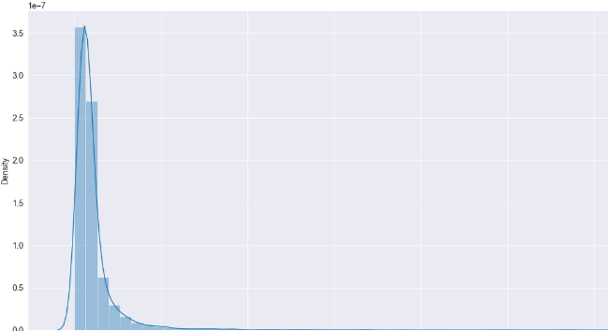
Visualization
Views are right skewed. Views have positive skewed distribution of data. Mean is greater than mode. Mean is greater than median as well.

Slide 8
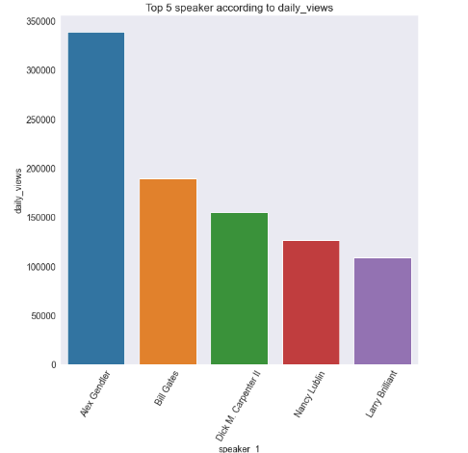
EDA-Top 5 speaker according to daily_Views

Slide 9
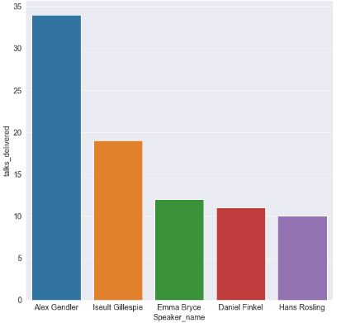
EDA-Most Popular speakers
More talks session delivered shows more views and popularity.

Slide 10
EDA-Data Cleaning- Steps and challenges
Finding out missing values
Finding out duplicates.
Finding out outliers.
Data Transformation.
Feature selection and feature dropping.

Slide 11
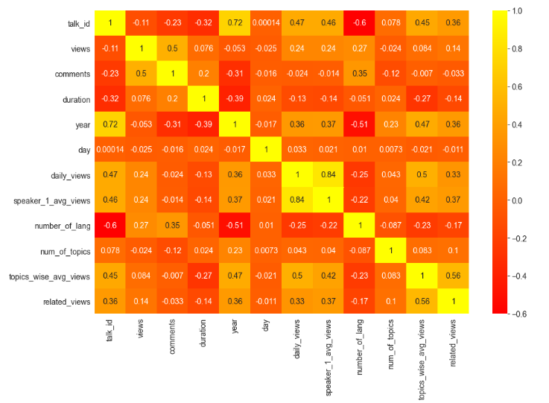
Correlations

Slide 12
Models
Linear Regression.
Catboost.
XGBoost.
Random forest.
Model improvement.

Slide 13
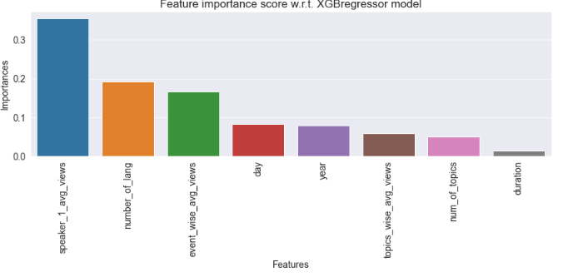
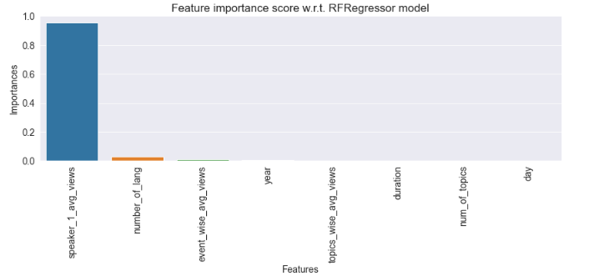
Feature Importance XGBoost and Random forest

Slide 14
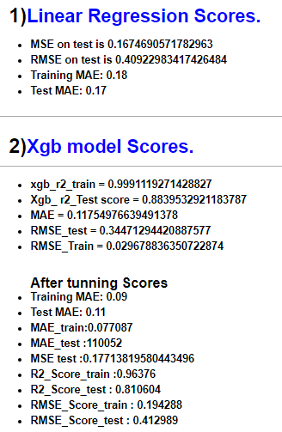
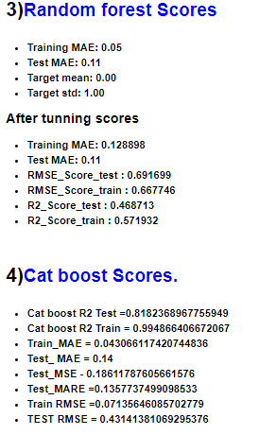
Model scores

Slide 15
Challenges
I have faced many challenges during this project starting with looking for converting the data into numerical and standardization also selecting the right amount of features and encoding including target encoding and one_hot_encoding.
I have made a few observations that keeping right amount of features and right feature selection is very important and finally are responsible for your models betterment and good accuracy.
Regularization and hyper parameter tuning.
I have faced some of challenges during converting the str type to the dictionary type column.

Slide 16
Conclusion
I have started with data loading data and importing the libraries and then I started with the exploring the data and looking into columns and used visualization. I have seen few columns for the null values and outliers as well.
I treated the data accordingly and since I have categorical data with me I did target encoding and one hot ending on given columns. Since some values were varying and causing the heteroskedasticity. I have done standardization accordingly.
I have explored the data and looked for the trend in bi-variate analysis.
I have checked that views are correlated with the speakers as shown top 5 speaker with daily views exceeding 100000.
More talks session delivered is showing that more views and popularity also duration is not much influenced when there are poplar speakers.
Finally I started modeling and saw XGBoost , cat boost and random forest performed well. For score improvement I have used regularization and hyper parameter tuning. I was able to predict views correctly more than 80% of time.

Slide 17

Thank you..

