Slide 1
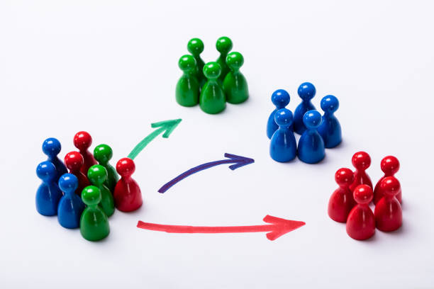

Unsupervised Learning
Project : Customer Segmentation
By : Sunil Kumar

Slide 2
Content
Problem Statement.
Attribute description.
Customer segmentation-Project steps.
Modeling and finding Optimal K.
Top 5 Countries based on most Numbers of Customers.
Top 5 Countries based on least numbers of customers.
Bottom 5 and top 5 products based on selling.
Month wise analysis for Customers purchases.
Day wise analysis for Customers purchases.
Hours and time Zone for Customers Purchases.
Use of Models.
Models With distinct approaches.
Model Summary for Optimal clusters output.
Conclusions.
Challenges.

Slide 3
Problem Statement
In this project, your task is to identify major customer segments on a transactional data set which contains all the transactions occurring between 01/12/2010 and 09/12/2011 for a UK-based and registered non-store online retail. The company mainly sells unique all-occasion gifts. Many customers of the company are wholesalers.

Slide 4
Attribute description
Data Description
Attribute Information:
Invoice No: Invoice number. Nominal, a 6-digit integral number uniquely assigned to each transaction. If this code starts with letter 'c', it indicates a cancellation.
Stock Code: Product (item) code. Nominal, a 5-digit integral number uniquely assigned to each distinct product.
Description: Product (item) name. Nominal.
Quantity: The quantities of each product (item) per transaction. Numeric.
Invoice Date: Invoice Date and time. Numeric, the day and time when each transaction was generated.
Unit Price: Unit price. Numeric, Product price per unit in sterling.
CustomerID: Customer number. Nominal, a 5-digit integral number uniquely assigned to each customer.
Country: Country name. Nominal, the name of the country where each customer resides.

Slide 5
Customer segmentation-Project steps
1 Data-Preprocessing
Data collection, data understanding and data Loading.
Exploratory Data Analysis and data cleaning.
Data wrangling and transformation.
Feature engineering and feature extraction.
2 Data-Processing-Modeling
RFM Model
K-mean-clustering.
Hierarchical clustering.
DBSCAN.
3 Metrics evaluation
Finding optimal clusters using Elbow method, using Silhouette
and DBSCAN.

Slide 6
Modeling and finding Optimal K
Model used
Models
RFM model-Heuristic approach
K-Mean clustering.
Hierarchical clustering.
DBSCAN.
Optimal K-finding
Elbow method.
Silhouette score.
Dendrogram.

Slide 7
Models With distinct approaches
RFM Model
K-Means with silhouette score
K-Means with Elbow method
DBSCAN
RM K-Means with silhouette score
K-Means with Elbow methods DBSCAN
FM K-Means with silhouette score
RFM K-Means with Elbow method
RFM Hierarchical clustering
RFM DBSCAN RFM

Slide 8
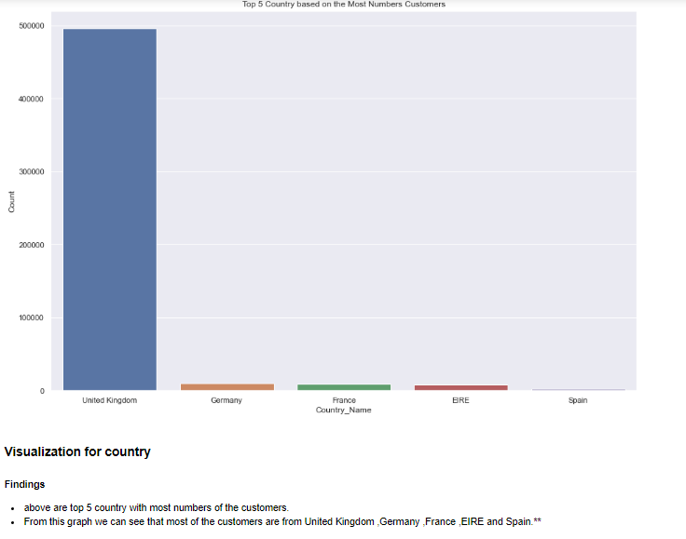
Top 5 Countries based on most Numbers of Customers

Slide 9
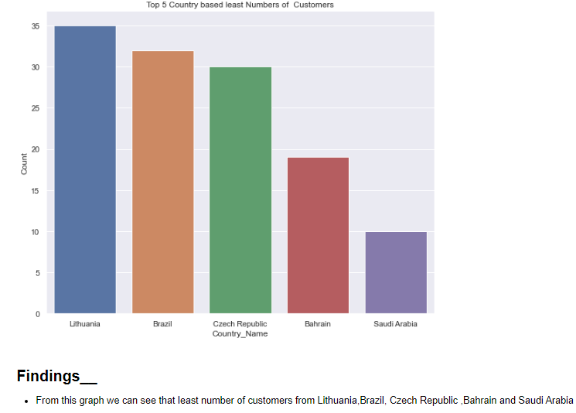
Top 5 Countries based on least numbers of customers

Slide 10
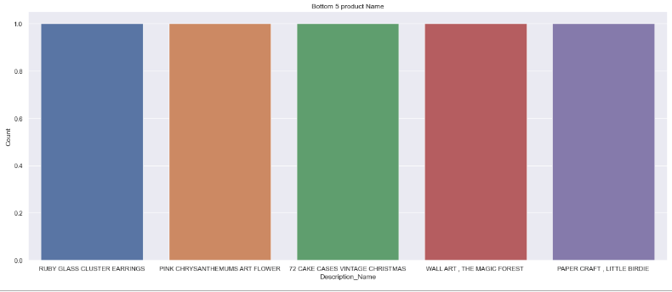
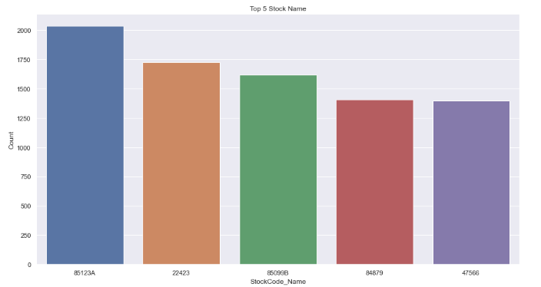
Bottom 5 and top 5 products based on selling
Bottom 5 Products based on the selling are:
1.light decorated battery operated.
2.Water damaged.
3.throw away.
4.re dotcom quick fix.
5.Birthday Banner Tape.
Top 5 Stocks name based on selling are:
85123A
22423
85099B
47566
20725

Slide 11
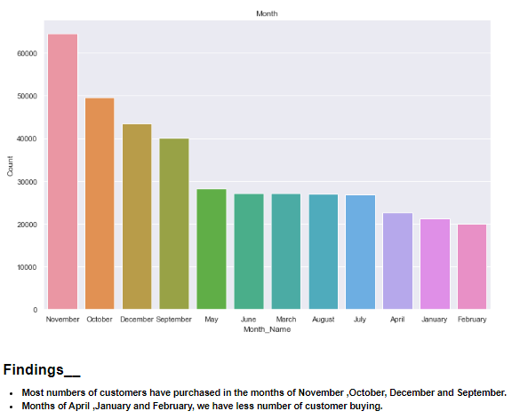
Month wise analysis for Customers purchases

Slide 12
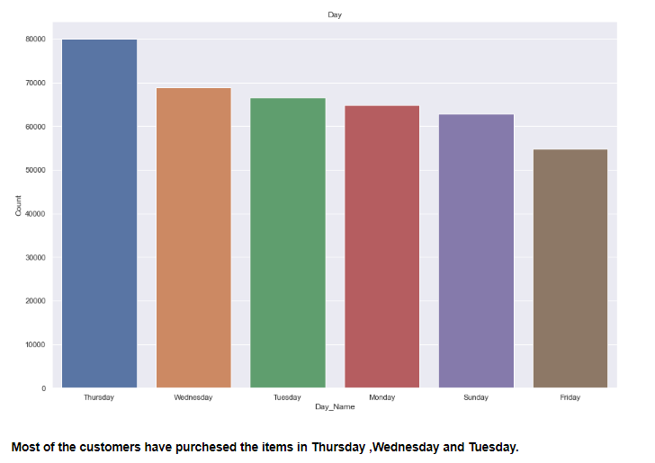
Day wise analysis for Customers purchases.
Most of the Customers have purchased Thursday, Wednesday and Tuesday.

Slide 13
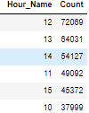

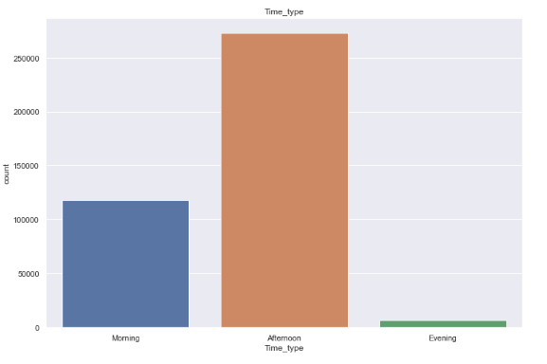
Hours and time Zone for Customer Purchases
Findings__
We can also say that afternoon timings are popular for the purchasing items.
Especially 11-12-13-14-15 gave the more numbers of customer purchasing.
Top 6 Active_hrs
Least 5 Active_hrs
Findings__
We have Afternoon time where we have maximum customer purchasing items/gifts.
Least numbers of customers have purchased the items in Evening.

Slide 14
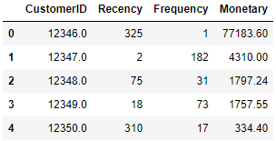
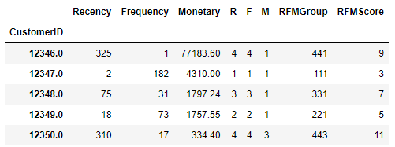
Use of Models
RFM model (Recency, Frequency, Monetary value)
The first step in building an RFM model is to assign Recency, Frequency and Monetary values to each customer. The second step is to divide the customer list into tiered groups for each of the three dimensions (R, F and M)
Calculating RFM scores.
The number is typically 3 or 5. If you decide to code each RFM attribute into 3 categories, you'll end up with 27 different coding combinations ranging from a high of 333 to a low of 111. Generally speaking, the higher the RFM score, the more valuable the customer.
Before Quintile Binning
After Quintile Binning

Slide 15
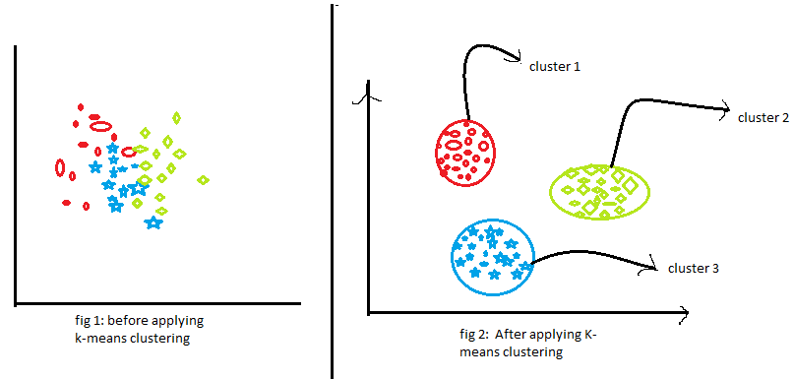
Use of Models continued
K-mean-clustering(Unsupervised algorithm works by clustering similar groups.)
K-Means Clustering is an Unsupervised Learning algorithm, which groups the unlabeled dataset into different clusters.
Step 1: Choose the number of clusters k.
Step 2: Select k random points from the data as cancroids.
Step 3: Assign all the points to the closest cluster centroid.
Step 4: Recompute the centroids of newly formed clusters.
Step 5: Repeat steps 3 and 4.

Slide 16
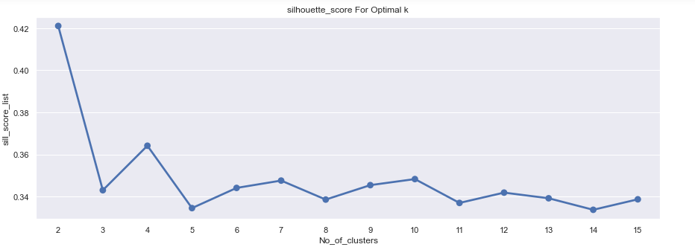
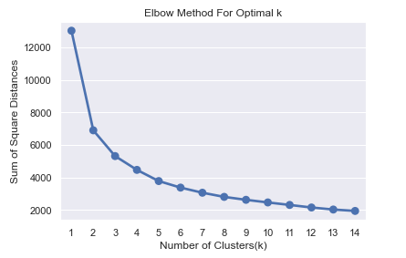
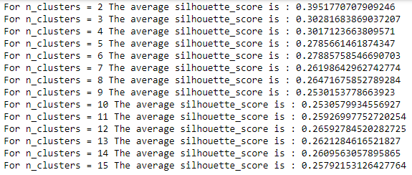
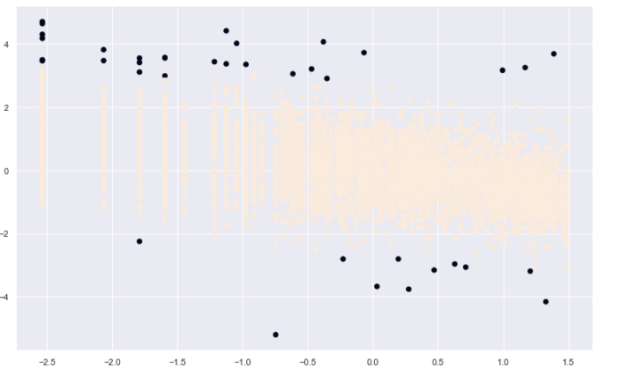
Use of Models continued
K-mean-Using Silhouette Score method
K-mean using Elbow method
DBSCAN method

Slide 17
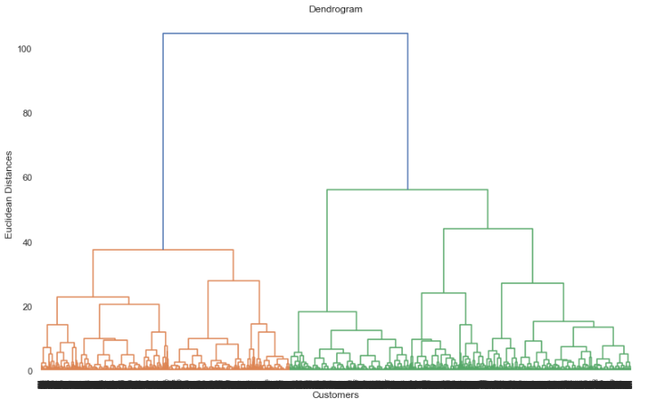
Use of Models continued
Hierarchical-clustering(Optimal clusters Using dendrogram)
An algorithm that groups similar objects into groups in a hierarchy called hierarchical clustering. The endpoint is a set of clusters, where each cluster is distinct from each other cluster, and the objects within each cluster are broadly similar to each other.
Hierarchical clustering starts by treating each observation as a separate cluster. Then, it repeatedly executes the following two steps: (1) identify the two clusters that are closest together, and (2) merge the two most similar clusters. This iterative process continues until all the clusters are merged together.

Slide 18
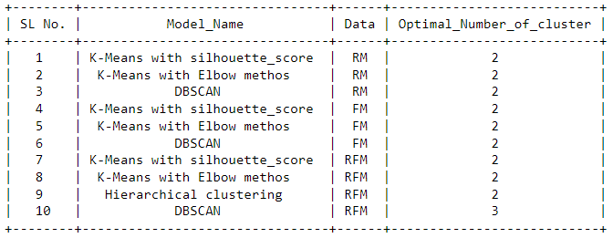
Model Summary for Optimal clusters output
Finding optimal “K” using different model and features.
Data are the features and Model Name are used methods.

Slide 19
Conclusions
I started with the loading, understanding, and exploring the dataset to see the major trends and insights from data regarding the purchases. I have made few observations while performing the project on the given dataset. Which are below:
There were (541909, 8) rows and columns out of which I saw that there were null values in the description and CustomerID columns, which were of float and object data types. I have removed the null values as imputing them with mode would not be meaningful.
After removal of the null values I had (406829, 8) observation and variables respectively.
I did see the overall data distribution and found few points as below:
In quantity we have values in negative and as well as in Unit Price.
Found Positively skewed distribution of the dataset.

Slide 20
Conclusions _continued
Once I started exploring further country wise, monthly basis, day basis and hourly basis and as per time zone my findings were below:
Countries with top customers are: United Kingdom ,Germany ,France ,EIRE and Spain.
Most numbers of customers have purchased in the months of November ,October, December and September.
Most of the customers have purchased the items in Thursday ,Wednesday and Tuesday.
I have seen that afternoon timings are popular for the purchasing items.
Especially 11-12-13-14-15 gave the more numbers of customer purchasing.
Once I have seen the data and for its major minor trends, I then started with modeling techniques which are below:
Used RFM model for to find out the valuable customers based on Recency, Frequency and Monetary values.

Slide 21
Conclusion _continued
While using this model I have seen few points that there were customers which were having more Recency and more Monetary, more Recency and less monetary.
Similarly, like for these combinations I have checked for each customer and found the best set of customers after setting the threshold to 5 and 8 respectively given 1263 customers and 2587 customers with threshold of setting to 8.
I then started with K-mean clustering to cluster the same set of customers and tried with 2 features and 3 features which were (RFM) Recency, Frequency and Monetary.
I checked the cluster formation with the help of Silhouette score and elbow method and DBSCAN.
I found DBSCAN performing good to find out the optimal clusters whereas K-mean clustering is not proven that well with elbow method and silhouette scores. After using all methods I have seen that most of the time optimal numbers of clusters were 2.

Slide 22
Challenges
The major challenges I have faced in this project are mentioned Below:
Null handling for Description column and Customer ID.
Looking for few values which were negative like in Total Price.
Applying Log transformation would be right or not.
Handling skewed dataset.
Binning of quintile for the customers based on 1,2,3,4 score.
Getting Silhouette score for every sample.
Finding optimal “K”.

Slide 23
Thank you!

