Slide 1
⚡ IEEE IGNITE HACKATHON 2026 · HOST: SKIT JAIPUR
MuleWatch
AI-Powered Detection of Suspicious Financial Advertisements & Cyber Cell Dispatch System
Proactive threat intelligence harvesting, multimodal OCR/QR forensics, localized district risk mapping, and tamper-proof police evidence generation.
HACKATHON CHALLENGE
Problem ID: SKIT002
Theme: AI Detection of Suspicious Financial Ads & Mule Syndicates
DEVELOPMENT TEAM
Team: capycoders
Focus: Full-Stack AI, Computer Vision, Digital Forensics & Cyber Defense
HOST INSTITUTION
SKIT Jaipur
Swami Keshvanand Institute of Technology, Management & Gramothan
PUBLIC GITHUB REPOSITORY: https://github.com/Sunil-saini1818/MuleWatch [Production-Ready Fullstack Codebase · Complete Verified Commits]
IEEE Ignite Hackathon 2026 · Host: SKIT Jaipur | Team Capycoders | Problem ID: SKIT002 | Slide 1 of 10
github.com/Sunil-saini1818/MuleWatch

Slide 2
PROBLEM ANALYSIS · THE THREAT LANDSCAPE
The Silent Epidemic of Digital Mule Account Syndicates
How organized financial cybercriminals exploit open communication channels and outpace manual policing
EMERGING THREAT VECTOR
The Underground Syndicate Model
• Proliferation of Social Adverts: Fraud rings openly advertise on Telegram, WhatsApp, Facebook, and forums offering cash for 'unused' bank accounts and UPI IDs.
• Commercialized Money Laundering: Accounts are leased at 5% to 15% commission or purchased outright to layer proceeds from investment, gaming, and loan scams.
• Ultra-Rapid Churning & Evasion: Syndicates discard channels, burn SIMs, and cycle UPI QR codes within hours of laundering dirty funds.
• Vulnerable Demographics Target: Students and unemployed youths are enticed by 'easy work-from-home' earnings, unknowingly becoming criminal accomplices.
OPERATIONAL DEFICIENCY
Existing Law Enforcement Bottlenecks
• Manual & Fragmented Monitoring: Police personnel manually monitor social media—a reactive, unsustainable strategy facing millions of posts daily.
• Multimodal Obfuscation: Fraudsters conceal UPI handles and bank details inside image banners and QR codes, completely evading keyword text filters.
• 48–72 Hour Critical Triage Lag: By the time a complaint is registered, mule accounts have dispersed funds across multiple layered banking layers.
• Lack of Court-Admissible Evidence: Raw phone screenshots lack cryptographic timestamps, origin IP metadata, and tamper-proof SHA-256 digital hashes required for FIRs.
STAGE 1: ADVERTISING
Social Ads recruiting 'mules' on Telegram/Forums
STAGE 2: ONBOARDING
KYC docs, ATM cards & UPI leased for 10% cut
STAGE 3: LAUNDERING
Dirty funds injected & instantly split across accounts
STAGE 4: ATTRITION
Rapid ATM cash-out; victims left with frozen assets
IEEE Ignite Hackathon 2026 · Host: SKIT Jaipur | Team Capycoders | Problem ID: SKIT002 | Slide 2 of 10
github.com/Sunil-saini1818/MuleWatch

Slide 3
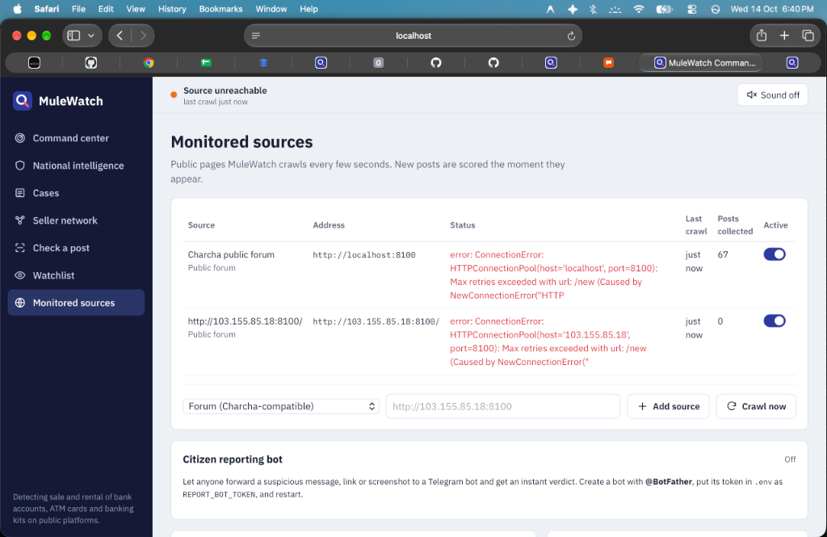
SYSTEM SOLUTION · EXECUTIVE OVERVIEW
MuleWatch: Autonomous Threat Intelligence to Cyber Interdiction
An integrated fullstack platform bridging continuous threat crawling, multimodal AI, and rapid cyber cell dispatch
END-TO-END CYBER DEFENSE
Key Capabilities & Architecture
• Autonomous Multichannel Harvesting: Continuous background ingestion workers monitor Telegram underground groups, discussion forums (Charcha), and public social streams.
• Multimodal Entity Extraction: Combines high-accuracy Tesseract OCR with OpenCV QR decoding to extract masked bank numbers, UPI handles, and payment links.
• Dynamic Heuristic Risk Scoring: NLP threat categorization instantly scores posts (0-100%) against urgency triggers, commission bait, and illicit financial keywords.
• Rapid Cyber Cell Dispatch: One-click generation of court-admissible PDF dossiers with SHA-256 tamper-proof hashes and direct dispatch to bank nodal officers.
📷 Figure 1: MuleWatch Real-Time Command Center & Threat Stream
IEEE Ignite Hackathon 2026 · Host: SKIT Jaipur | Team Capycoders | Problem ID: SKIT002 | Slide 3 of 10
github.com/Sunil-saini1818/MuleWatch

Slide 4
SYSTEM ARCHITECTURE · TECHNOLOGY STACK
Production-Grade, Modular & Resilient Fullstack Stack
Engineered for high-concurrency ingestion, asynchronous processing, and zero-compromise digital forensics
CLIENT PRESENTATION
Frontend Experience Layer
• React 18 & Vite: Lightning-fast reactive UI with hot module replacement and optimized production bundle.
• Tailwind CSS & Lucide Icons: Ergonomic, modern cyber operations center aesthetic with high-contrast data visualization.
• Gapless TopoJSON Vector Map: Custom-rendered SVG district map of Rajasthan with zero-gap borders and hover state binding.
• Dynamic Polling Telemetry: Self-healing telemetry hooks polling live crawler status, alert counts, and actor networks.
MICROSERVICE ENGINE
Backend & Intelligence Core
• FastAPI & Python 3.12: Asynchronous ASGI framework delivering ultra-low latency REST APIs and strict Pydantic models.
• Computer Vision & OCR: Tesseract OCR with adaptive image binarization; PyZBar for instant UPI QR payload decoding.
• Telethon MTProto Client: Native Telegram API integration capable of real-time message stream harvesting.
• SQLite WAL Database: High-performance Write-Ahead Logging mode providing ACID transactions without heavy database overhead.
FORENSIC INTEGRITY
Forensics & Police Interdiction
• SHA-256 Evidence Seals: Cryptographic fingerprinting of raw ad screenshots and metadata to ensure Section 65B legal validity.
• Automated PDF Dossiers: ReportLab PDF engine compiling investigator-ready case reports complete with IP and user-agent data.
• Reversible State Machine: Enforcement safety guardrail allowing investigators to confirm fraud or revert false positives seamlessly.
• Unified Launcher (`./run.sh`): One-click shell deployment bootstrapping backend, frontend, and simulated mock services concurrently.
IEEE Ignite Hackathon 2026 · Host: SKIT Jaipur | Team Capycoders | Problem ID: SKIT002 | Slide 4 of 10
github.com/Sunil-saini1818/MuleWatch

Slide 5
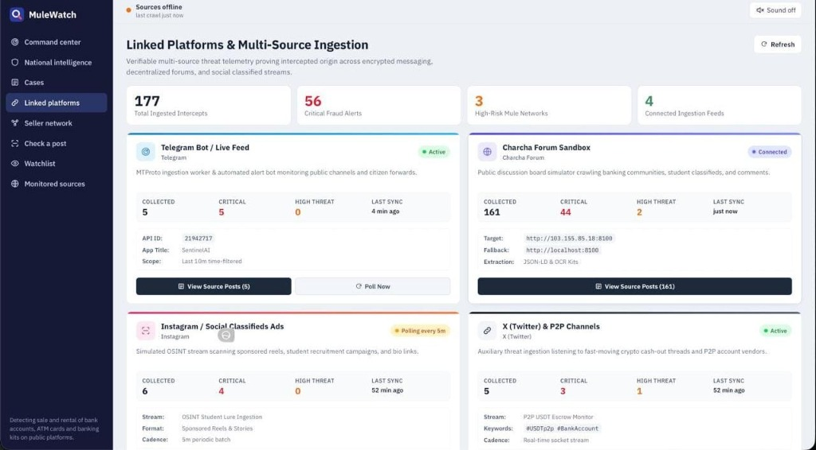
CORE CAPABILITY 1 · INTELLIGENCE HARVESTING
Autonomous Multi-Source Ingestion & Crawler Telemetry
Proactively scanning underground Telegram channels, public discussion boards, and social threads
DATA INGESTION PIPELINE
Automated Ingestion Infrastructure
• Telethon MTProto Ingestion: Subscribes directly to suspect Telegram channels, capturing incoming messages, forwarded posts, and embedded image assets in real time.
• Charcha Forum Scraper: Dedicated resilient crawler with dynamic pagination, thread tracking, and deduplication for local underground discussion boards.
• SimHash & LSH Deduplication: Locality-Sensitive Hashing identifies duplicate syndicated ads reposted across dozens of channels, consolidating threat records.
• Live Crawler Health Telemetry: Real-time heartbeat monitoring tracks active endpoints, fetch latencies, and total harvested records with automatic retry policies.
📷 Figure 2: Multi-Platform Ingestion Telemetry & Health Monitoring
IEEE Ignite Hackathon 2026 · Host: SKIT Jaipur | Team Capycoders | Problem ID: SKIT002 | Slide 5 of 10
github.com/Sunil-saini1818/MuleWatch

Slide 6
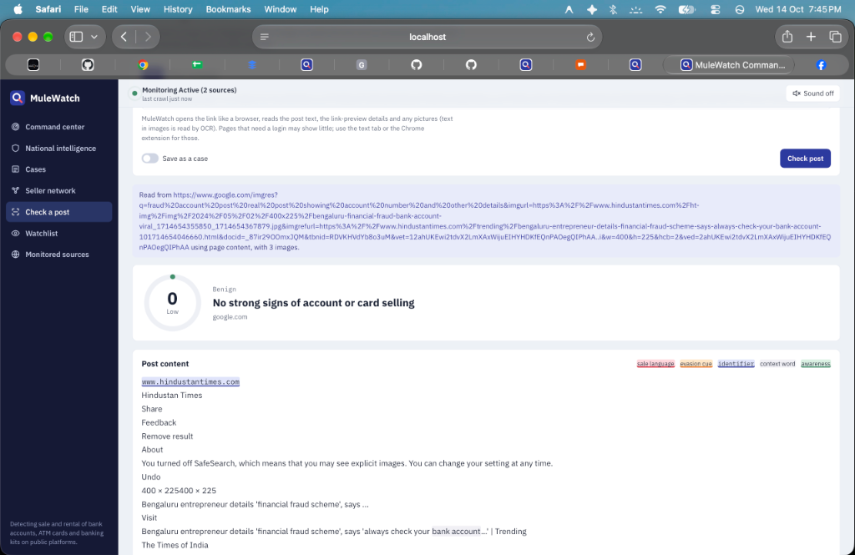
CORE CAPABILITY 2 · MULTIMODAL FORENSICS
Multimodal OCR, QR Code Decoding & Entity Extraction
Exposing financial identifiers deliberately disguised within images, posters, and payment barcodes
MULTIMODAL INTELLIGENCE
Deep Visual Extraction Engine
• Adaptive Image Pre-Processing: Applies contrast stretching, adaptive thresholding, and noise reduction to overcome obfuscated fonts and low-resolution screenshots.
• Tesseract OCR Entity Parsing: Extracts masked bank names, IFSC codes, phone numbers, and commission percentages from graphic ad banners.
• Instant UPI & Crypto QR Decoding: OpenCV and PyZBar decoder extracts raw `upi://pay?pa=...` merchant strings and crypto wallet addresses directly from payment graphics.
• Interactive 'Check a Post' Hub: Allows investigators to test suspicious URLs, paste raw text, or upload image screenshots for instantaneous risk analysis.
📷 Figure 3: Interactive Multimodal Analyzer with QR & Entity Extraction
IEEE Ignite Hackathon 2026 · Host: SKIT Jaipur | Team Capycoders | Problem ID: SKIT002 | Slide 6 of 10
github.com/Sunil-saini1818/MuleWatch

Slide 7
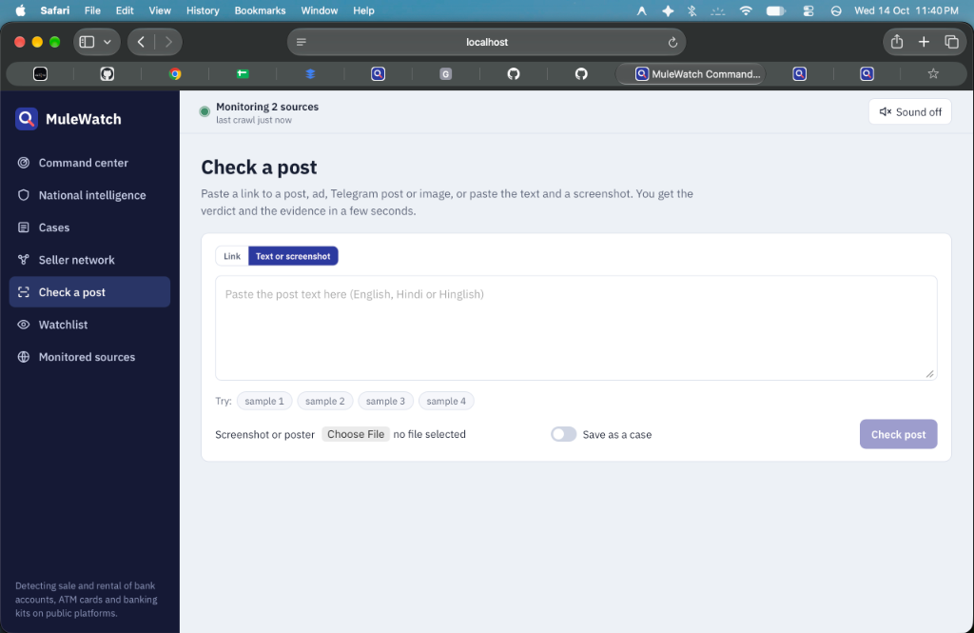
CORE CAPABILITY 3 · GEOSPATIAL INTELLIGENCE
Localized Rajasthan District-Level Fraud Analytics
Interactive TopoJSON visualization mapping mule account syndicates across Rajasthan administrative districts
GEOSPATIAL THREAT MAPPING
Hyper-Local Regional Telemetry
• High-Fidelity Vector TopoJSON: Custom-crafted SVG district boundaries with clean, gapless polygon borders, eliminating geographic rendering distortion.
• Real-World Hotspot Correlation: Reflects real ground intelligence across known financial cybercrime hotspots including Jaipur, Bharatpur, Alwar, and Mewat border zones.
• Dynamic Hover & Click Data Binding: Interactive UI binds to live district metrics, displaying active cases, suspected mule accounts, flagged volume, and resolution rates.
• Tactical Law Enforcement Deployment: Enables State Cyber Police Headquarters to allocate investigative resources directly to emerging fraud epicenters.
📷 Figure 4: Rajasthan District-Level Fraud TopoJSON Intelligence Map
IEEE Ignite Hackathon 2026 · Host: SKIT Jaipur | Team Capycoders | Problem ID: SKIT002 | Slide 7 of 10
github.com/Sunil-saini1818/MuleWatch

Slide 8
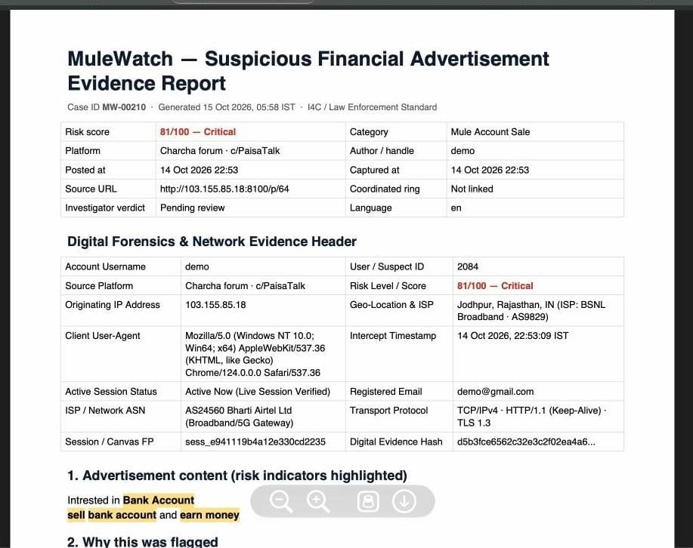
CORE CAPABILITY 4 · LAW ENFORCEMENT INTERDICTION
Cyber Cell Dispatch & Tamper-Proof Evidence Dossier
Bridging the critical gap between automated intelligence and judicial action with 1-click police exports
JUDICIAL & BANKING INTERDICTION
Operational Enforcement Pipeline
• Dedicated Nodal Dispatch Queue: Confirmed fraud cases move automatically from general investigation into a dedicated 'Cyber Cell Dispatch' operational queue.
• Automated Evidence Dossier (PDF): Generates standardized judicial evidence dossiers featuring post URLs, origin IP addresses, actor handles, and device user-agents.
• Cryptographic SHA-256 Proof: Every generated report seals raw evidence with SHA-256 checksums to satisfy Section 65B Indian Evidence Act standards.
• 1-Click Simulated Dispatches: Direct webhook dispatches to the National Cyber Crime Reporting Portal (I4C) and automated bank account lien freeze notices.
📷 Figure 5: Forensic Evidence Report with SHA-256 Cryptographic Hash
IEEE Ignite Hackathon 2026 · Host: SKIT Jaipur | Team Capycoders | Problem ID: SKIT002 | Slide 8 of 10
github.com/Sunil-saini1818/MuleWatch

Slide 9
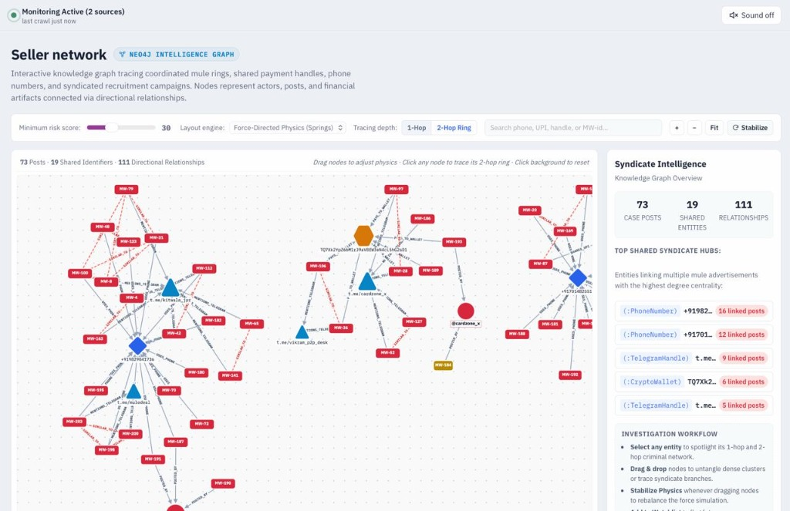
IMPACT & FORENSIC SYNERGY · OPERATIONAL METRICS
Measurable Impact & Syndicate Network Linkage
Uncovering complex multi-actor mule syndicates through automated entity relationship graphs
HIGH-IMPACT OUTCOMES
Quantifiable Operational Advantage
• >85% Reduction in Triage Time: Reduces incident verification timelines from 48-72 hours of manual searching to under 3 minutes per flagged advertisement.
• Mule Syndicate Linkage Graph: Force-directed visual graph uncovers shared UPI handles, phone numbers, and Telegram channels linking disparate mule accounts.
• Digital Chain of Custody: Immutable digital audit trail records timestamps, examiner actions, and state transitions for courtroom presentation.
• Proactive Threat Neutralization: Freezes mule bank accounts before dirty scam funds can be layered or cashed out at ATMs.
📷 Figure 6: Mule Syndicate Linkage Graph & Financial Entity Clustering
IEEE Ignite Hackathon 2026 · Host: SKIT Jaipur | Team Capycoders | Problem ID: SKIT002 | Slide 9 of 10
github.com/Sunil-saini1818/MuleWatch

Slide 10
MISSION SUMMARY · FUTURE HORIZONS
Securing the Digital Financial Ecosystem
MuleWatch delivers an operational, end-to-end defense system against organized financial cybercrime
HACKATHON EXECUTION
Delivered Milestones
• Production Fullstack Engine: FastAPI + React 18 with persistent SQLite WAL database and live telemetry.
• Multimodal AI Pipeline: Automated OCR extraction, QR decoding, and NLP heuristic threat scoring.
• Rajasthan District Map: Gapless TopoJSON SVG vector map bound to localized district metrics.
• Cyber Cell Dispatch Queue: 1-click I4C dispatch, bank lien notices, and SHA-256 PDF dossiers.
PRODUCTION SCALE
Immediate Roadmap
• WhatsApp & Dark Web Crawlers: Expanding autonomous crawlers to WhatsApp Business channels and Tor forums.
• Direct NPCI / RBI API Hooks: Real-time automated account freezing via official banking nodal gateways.
• Indic LLM Dialect Fine-Tuning: Specialized NLP models for regional Indian slang, Romanized Hindi, and evasive code-words.
• Automated Sec 65B Certificates: Automated digital signing and hash stamping for formal court filings.
OPEN SOURCE & READY
Team & Repository
• Team Capycoders: Developers dedicated to building high-impact cyber defense and financial integrity tooling.
• Host Institution: SKIT Jaipur (Swami Keshvanand Institute of Technology)
• Event Context: IEEE Ignite Hackathon 2026 · Problem ID: SKIT002
• GitHub Repository: github.com/Sunil-saini1818/MuleWatch (Public, active commit history)
THANK YOU · READY FOR LIVE DEMONSTRATION & JUDGES' Q&A
Explore the live system, test suspicious advertisements, and verify the end-to-end evidence generation pipeline.
IEEE Ignite Hackathon 2026 · Host: SKIT Jaipur | Team Capycoders | Problem ID: SKIT002 | Slide 10 of 10
github.com/Sunil-saini1818/MuleWatch

