Slide 1

PROJECT PRESENTATION
By Sunil Naik

Slide 2
TCS STOCK ANALYSIS - LIVE & LATEST
Khethavath Sunil Naik
IIT BHILAI
sunilnaikkethavath@gmail.com
github/Sunil0012

Slide 3

INTRODUCTION
Welcome to my project on TCS Stock Data – Live and Latest, where I explore how machine learning and deep learning can be applied to predict stock prices with real-world financial data. Using historical records of Tata Consultancy Services (TCS), this project analyzes trends, engineers key features, and builds predictive models to forecast future stock prices. By combining traditional linear regression with advanced LSTM networks, the goal is to demonstrate how data-driven methods can enhance decision-making in financial markets.

Slide 4
BACKGROUND
GENERAL OVERVIEW
Stock market prediction is a complex yet valuable task in finance. This project analyzes TCS stock data using machine learning and deep learning to forecast future prices accurately.
HISTORY
The history of this project began with the idea of using real-world financial data from Tata Consultancy Services (TCS) to explore how machine learning and deep learning models can predict stock prices. It evolved from basic data exploration into building advanced models like LSTM to capture temporal patterns and enhance forecasting accuracy.

Slide 5
GOALS
GOAL 01
GOAL 02
To analyze historical TCS stock data and uncover key patterns using exploratory data analysis for better understanding of market behavior.
To engineer new features like moving averages and lag values that help capture market patterns and improve the prediction accuracy of stock prices.

Slide 6
PROBLEMS
Stock market prices are highly volatile, making manual prediction unreliable for investors.
Traditional methods (e.g., technical indicators alone) often fail to capture hidden patterns in historical data.
There is a need for intelligent models that can learn from past trends and predict future prices with better accuracy.

Slide 7
HYPOTHESIS
TCS stock prices exhibit temporal patterns that can be captured using historical daily trading data.
Machine learning models like Linear Regression can provide a reasonable baseline for stock price prediction.
LSTM models, trained on sequential data, will outperform traditional models by learning complex time-dependent trends.

Slide 8
METHODOLOGY
LINEAR REGRESSION
LSTM
A classical supervised ML model that predicts stock closing price using tabular features like Open, High, Low, Volume, and Prev_Close.
Assumes a linear relationship between inputs and the closing price.
A deep learning model that captures sequential patterns by learning from past closing prices.
Ideal for time series forecasting due to its memory of past trends.

Slide 9
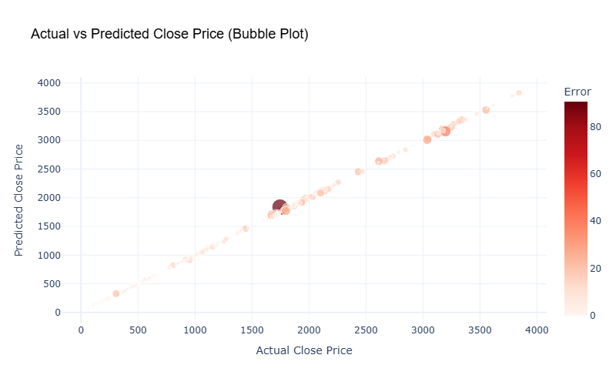
DATA ANALYSIS
The interactive bubble plot shows a strong alignment between actual and predicted closing prices, with most points clustering near the diagonal. Smaller bubbles indicate low prediction errors, confirming model reliability in the majority of cases. Larger bubbles, mostly at price extremes, highlight where the model struggled to capture sharp fluctuations.
Overall, the model demonstrates high accuracy with minimal deviation in most of the predicted values.

Slide 10
CONCLUSION
This project successfully demonstrated the use of machine learning and deep learning for stock price prediction, with LSTM outperforming linear regression in accuracy.
Through detailed analysis and modeling, we uncovered valuable trends and patterns in TCS's historical stock behavior.
The framework built here can be extended for real-time forecasting, multi-stock analysis, and financial decision support systems.

Slide 11
THANK YOU
By Sunil Naik
github/Sunil0012

