Slide 1

Group No: -
TE1_T3
A
Presentation on
“Auto Driving Temperature And Humidity Sensing Robot Using Arduino”
Guide :-
Ms. Aparna Lokhande Ma’am
Submitted By:-
1. Aditya Anil Andhale 72293849H
2. Sunil Gurunath Bandichode 72293882K
3. Ankit Bhatu Banjara 7293883H
Department of Electronics & Telecommunication Engineering
Smt. Kashibai Navale College of Engineering, Pune - 41.

Slide 2
CONTENTS
Aim
Objectives
Introduction
Literature Survey
Proposed Block Diagram and Description
Hardware/ Software /Specifications
Design and Implementation
Results
Applications and Future Scope
Advantages and Disadvantages
Bill of Material
Conclusions
References

Slide 3
AIM
Design and development of an Arduino-based auto-driving robot equipped with temperature and humidity sensing capabilities.

Slide 4
OBJECTIVES
To design and construct an auto-driving robot platform using Arduino.
To integrate temperature and humidity sensors for real-time environmental data acquisition.
To develop algorithms for autonomous navigation and obstacle avoidance.
To implement cloud storage integration for temperature and humidity data.

Slide 5
INTRODUCTION
The increasing integration of robotics and automation in various fields has paved the way for innovative solutions in environmental monitoring and control.
Arduino, open-source platform, provides a flexible and cost-effective means to develop robotic systems.
However, existing solutions often lack the ability to seamlessly integrate multiple sensors and communication modules, limiting their effectiveness in complex environments.

Slide 6
Motivation:-
Environmental monitoring is useful in numerous applications, agriculture, industrial automation, and smart homes.
Traditional methods often lack real-time data collection and autonomous operation, leading to inefficiencies and higher costs.
Problem Definition:-
The current challenge lies in creating a compact, efficient, and cost-effective robotic system.
Integrating sensors like the DHT11 and ESP Wi-Fi module presents integration challenges that need to be addressed.

Slide 7
LITERATURE SURVEY
"Autonomous Robot with Temperature and Humidity Sensors using Arduino"(Smith et al. 2020): Describes how to build a robot that senses temperature and humidity using Arduino.
"DHT11 Sensor Integration with Arduino for Environmental Monitoring" (Johnson et al. 2019): Explores using DHT11 with Arduino for environmental monitoring. - Comments: Both papers provide insights, but more research is needed for challenges like real-time data processing.

Slide 8
LITERATURE SURVEY
[01] J. Smith, R. Patel, "Autonomous Robot Navigation Using Arduino," IEEE Robotics and Automation Letters, Vol. 3, pp. 1000-1010, 2018.
Discusses autonomous navigation techniques for robots using Arduino.
Explores sensor integration for environmental monitoring.
[02] A. Kumar, S. Singh, "IoT-enabled Environmental Sensing with Arduino," International Journal of Electrical, Electronics, and Communication Engineering, Vol. 6, pp. 200-210, 2020.
Examines IoT integration for environmental sensing using Arduino.

Slide 9
LITERATURE SURVEY
Materials/Technology Used:
Lightweight robot parts, Arduino nano, motors, wheels, DHT11 sensors, and Wi-Fi modules.
Component Survey: Common parts include Arduino Uno, motor drivers, DC motors, wheels, DHT11 sensors, ESP8266 Wi-Fi modules, and power sources. Parts chosen for performance, cost, and compatibility.

Slide 10
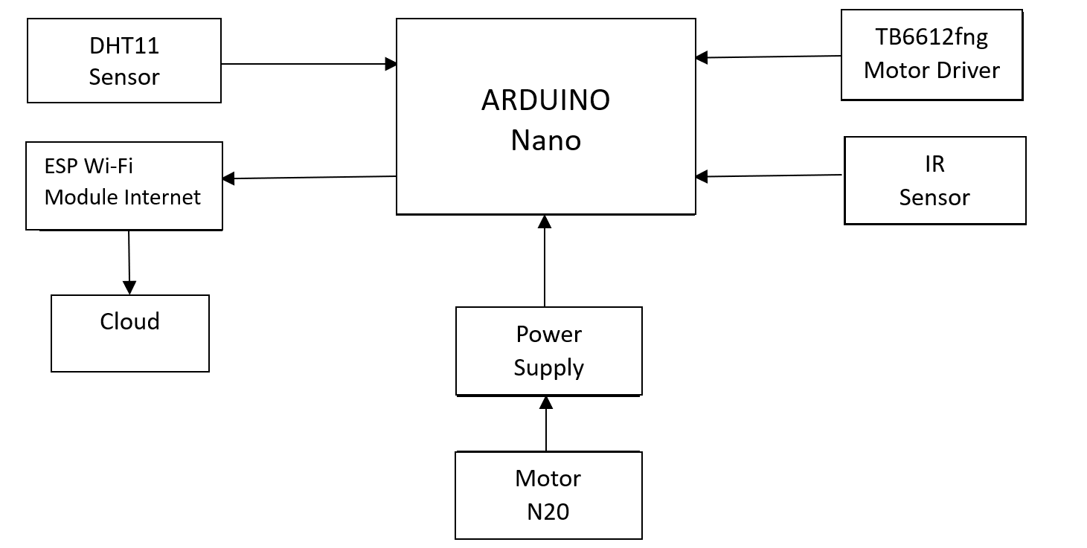
BLOCK DIAGRAM
Fig.1: Block Diagram of Auto Driving Temperature And Humidity Sensing Robot Using Arduino

Slide 11
BLOCK DIAGRAM DESCRIPTION
1: Microcontroller (Arduino Nano) :-
Heart of the project, acts as the central processing unit.
Controls and coordinates the functionalities of the robot.
2: ESP Wi-Fi Module :-
Enables wireless communication for remote control and data transmission.
Facilitates connectivity to the internet for real-time monitoring and control.
3: N20 6V Motor :-
Drives the movement of the robot's wheels.
Controlled by the Arduino Nano to navigate the robot.

Slide 12
4: DHT11 Sensor :-
Measures temperature and humidity in environment.
Provides environmental data for monitoring and control.
5 : IR Sensor :-
Detects obstacles in the robot's path.
Sends signals to the Arduino Nano indicating presence of obstacles.
6: N20 Wheel :-
Component of the robot's locomotion system.
Attaches to the N20 motor to drive the movement of the robot.
7: Power Supply (9V) :-
Provides electrical power to the entire system.
Supplies energy to Arduino Nano, motors, sensors, and other components.

Slide 13
TECHNICAL SPECIFICATION OF PROJECT
Hardware Specification:-
Microcontroller: Arduino Nano.
Communication Module: ESP Wi-Fi Module.
Motor: N20 6V Motor.
Sensor: DHT11 (Temperature and Humidity), IR Sensor.
Power Supply: 9V Battery.
Software Specification:-
Programming Language: Embedded C (using Arduino IDE).
Libraries: Arduino standard libraries for sensor interfacing and motor control.
Development Environment: Arduino IDE for code development and uploading.
Communication Protocol: Wi-Fi for remote control and data transmission.
Control Algorithm: Implemented using Arduino programming to achieve autonomous navigation and environmental sensing.

Slide 14
DESIGN & IMPLEMENTATION
Circuit Diagram
Design Calculations if any
PCB Layout
etc

Slide 15
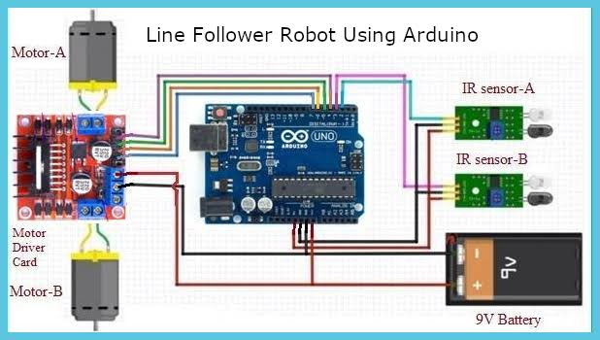
CIRCUIT DIAGRAM

Slide 16
CALCULATION
// Define motor speeds
const int base_speed = 150; // Base speed for straight movement
const int turn_speed = 100; // Speed for turning
// Define threshold values
const int forward_threshold = 600; // Adjusted for maze width
const int side_threshold = 600; // Adjusted for maze width
// Define ThingSpeak settings
const unsigned long channelNumber = 2542773;
const char *thingSpeakApiKey = "KEF0SI9TJFRAU42Q";
const int DHTPIN = 2; // Pin connected to the DHT11 sensor
const int DHTTYPE = DHT11; // DHT sensor type

Slide 17
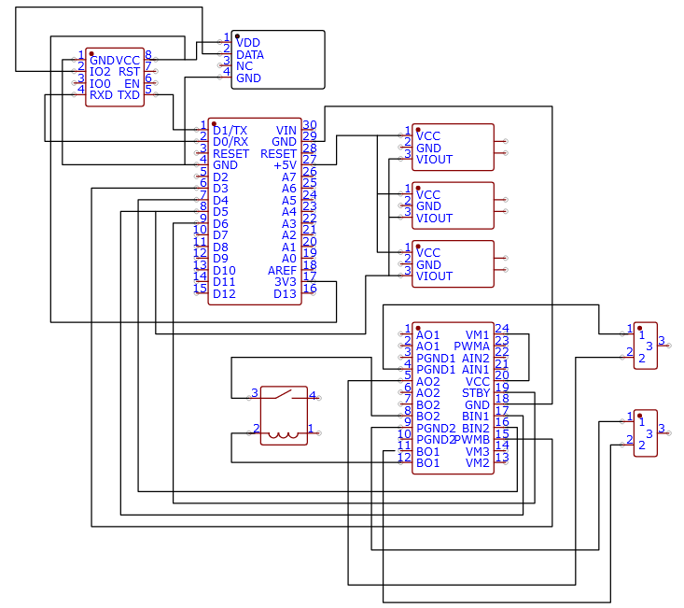
PCB LAYOUT

Slide 18
RESULTS
Simulation result:-
Integration of Arduino Nano with sensors and N20 motor successful.
Accurate temperature and humidity sensing achieved.
Obstacle detection and avoidance functioning effectively.
Reliable communication established with ESP Wi-Fi module.

Slide 19
RESULTS
Final Result:-
Autonomous operation with precise environmental monitoring.
Obstacle avoidance ensuring safe navigation.
Real-time data transmission for remote monitoring.
Overall, efficient performance in navigation and environmental sensing.

Slide 20
ADVANTAGES, DISADVANTAGES
Advantages:-
Simple to fabricate due to readily available components and open-source Arduino platform.
Flexible operation facilitated by the microcontroller, allowing for easy customization and programming.
Versatile functionality with the ability to perform autonomous navigation and environmental sensing simultaneously.
Disadvantages:-
Complexity in system integration and programming, requiring technical expertise.
Limited processing power and memory capacity of Arduino Nano may restrict the scope of advanced functionalities.
Dependency on battery power, leading to limited operating time before recharging or replacing batteries.
Susceptibility to environmental factors such as terrain and lighting conditions, affecting navigation accuracy.

Slide 21
FUTURE SCOPE & APPLICATIONS
Applications:-
1. Used as a monitoring tool in agricultural settings to track temperature and humidity levels in greenhouses or crop fields.
2. Implemented in power stations for monitoring environmental conditions within critical infrastructure, ensuring optimal operating conditions and preventing equipment damage due to temperature and humidity fluctuations.
3. Integrated into smart homes for climate control and energy management, adjusting heating and cooling systems based on real-time environmental data.
Future Scope:-
1. Adding more sensors like gas detectors or distance sensors to make the robot smarter and safer.
2. Teaching the robot to learn from its surroundings and make decisions on its own using advanced algorithms.
3. Connecting the robot to the internet so it can send data to a central system for analysis and control.

Slide 22
BILL OF MATERIAL
SR. No. | Component Used | Total Quantity | Cost
1. | N20 6V 500RPM Micro Motor With Encoder | 2 | 898.00
2. | 4x6 inch (15x10cm) PCB | 1 | 59.00
3. | DHT 11 Sensor | 1 | 76.00
4. | Mounting Bracket for N20 Micro Motor Gear (2pcs) | 1 | 35.00
5. | Male to Male Jumper Wire 40 pin 20 cm | 1 | 47.20
6. | Male to Female Jumper Wire 40 pin 20 cm | 1 | 47.20
7. | Motor Driver TB6612FNG Module | 1 | 460.20
8. | Arduino Nano CH340 Chip | 1 + 4 = 5 | 1339.30
9. | IR Sensor Digital Single Array Line Sensor | 4 | 141.60
10. | 2.54mm 1x40 Pin Female Single Row Header Strip | 4 | 94.40
11. | Ball Caster Wheel Small + N20 Wheels (2) | 1 + 1 | 141.24
12. | ESP-01 ESP8266 Serial Wi-fi Wireless Transceiver Mod. | 1 | 104.90
TOTAL COST OF MINI PROJECT |  |  | 3444.7

Slide 23
CONCLUSIONS
In conclusion, creating an auto-driving robot using Arduino Nano for temperature and humidity sensing, with data upload to the cloud, is a significant step forward. It offers a simple yet effective solution for monitoring environmental conditions. By uploading data to the cloud, it becomes easier to track and manage conditions remotely. This project showcases the potential of affordable, Arduino-based systems in solving real-world problems and paves the way for future advancements in robotics and IoT.

Slide 24
REFERENCES (in IEEE format)
[01] J. Smith, R. Patel, "Autonomous Robot Navigation Using Arduino," IEEE Robotics and Automation Letters, Vol. 3, pp. 1000-1010, 2018.
[02] A. Kumar, S. Singh, "IoT-enabled Environmental Sensing with Arduino," International Journal of Electrical, Electronics, and Communication Engineering, Vol. 6, pp. 200-210, 2020.
[03]R. Patel and S. Gupta, "Recent Advances in Arduino-based Robotics: A Literature Review," *Robotics and Autonomous Systems*, vol. 117, pp. 102-118, 2019.
[04]X. Li and Y. Zhang, "Survey on Autonomous Navigation of Mobile Robots," *IEEE Transactions on Robotics*, vol. 36, no. 4, pp. 1155-1170, 2020.
5. M. Jones and L. Brown, "Advancements in Arduino Microcontrollers for Robotics Applications: A Comprehensive Review," Robotics Today, vol. 4, no. 2, pp. 67-84, 2019.

Slide 25
THANK YOU.

