Slide 1
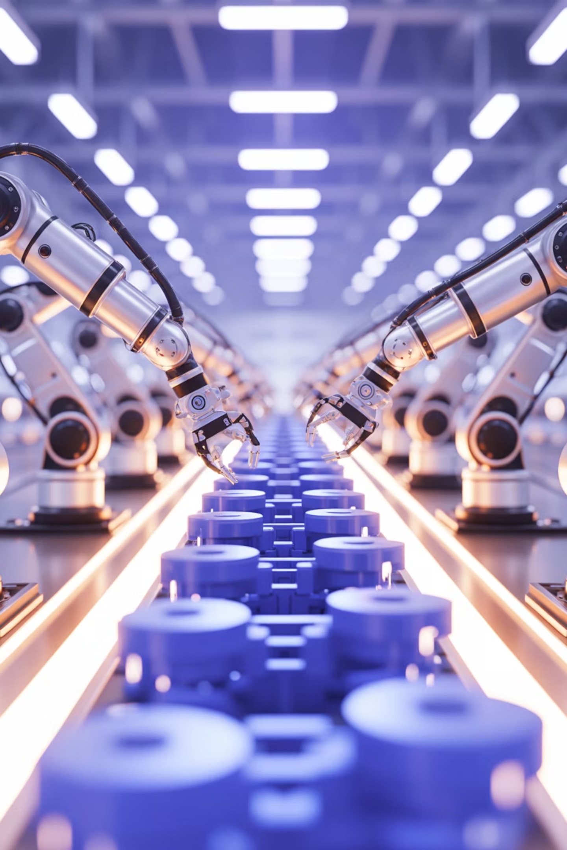




Industry 4.0 & Smart Manufacturing
Cyber-Physical Systems
Integrated sensors and actuators
Advanced Robotics
Collaborative automation
Real-Time Data
Instant production insights
Toyota Excellence: Lean manufacturing principles enhanced with digital twins and IoT sensors—achieving 99.8% quality rates and 30% faster production cycles

