Slide 1



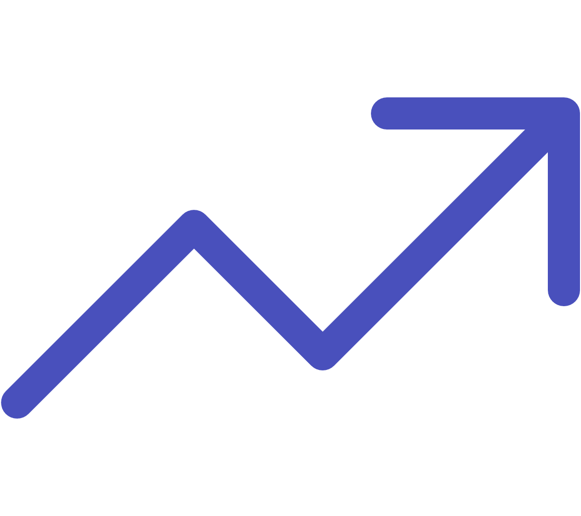
Big Data Analytics in Decision-Making
Inventory Optimization
Analyzing millions of data points to determine optimal stock levels, reducing carrying costs by 20-35%
Supplier Evaluation
Performance metrics and risk scoring enable data-driven sourcing decisions
Demand Prediction
Machine learning models process historical data, market trends, and external factors
Automotive and CPG industries lead adoption—leveraging analytics for everything from raw material sourcing to final mile delivery optimization

