Slide 1
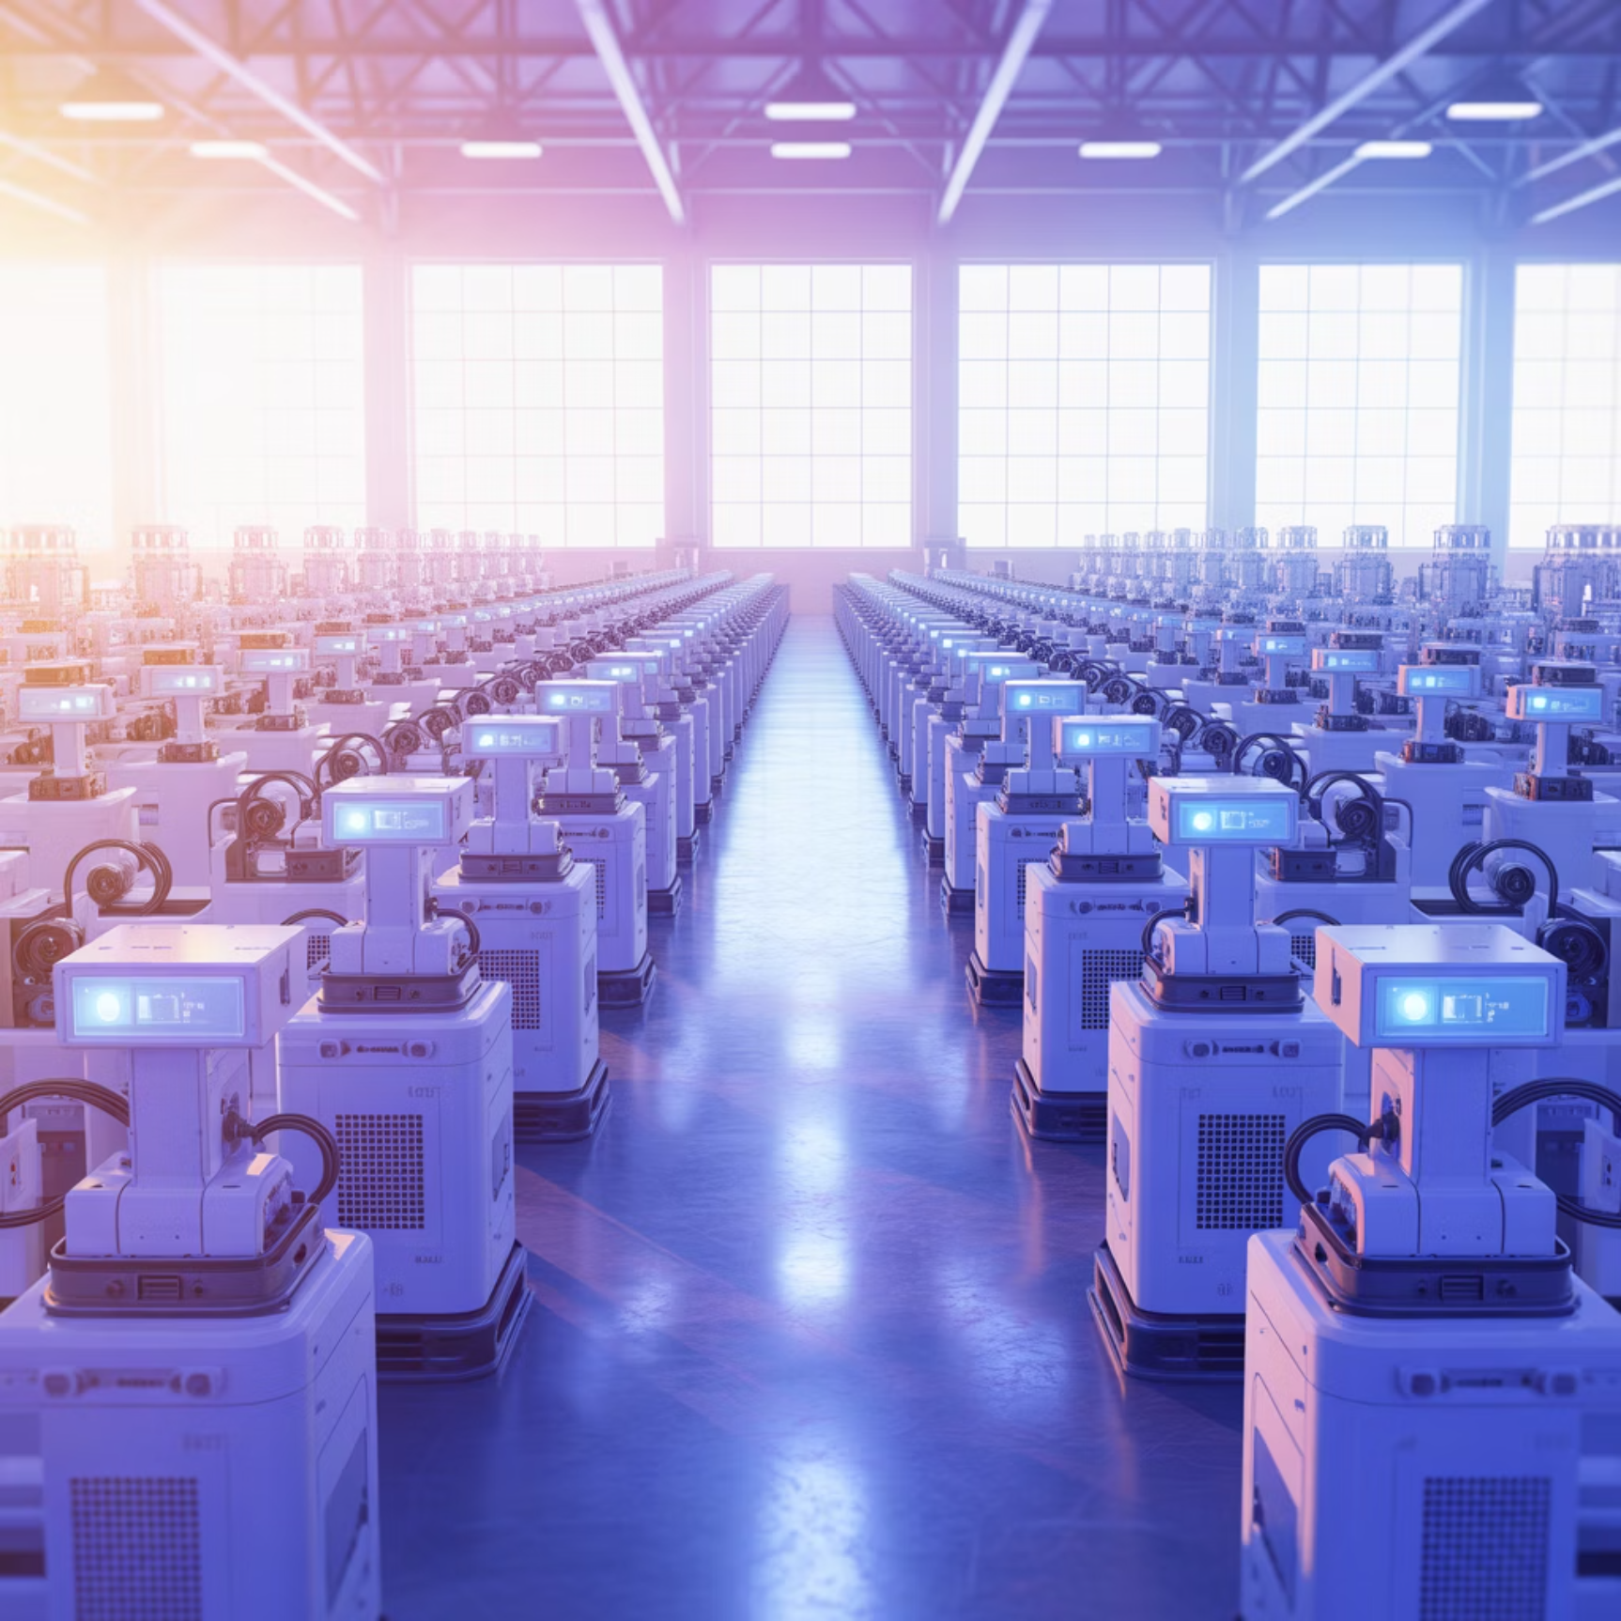

Digital Transformation in Supply Chains
The Digital Revolution
IoT, Cloud computing, and Big Data analytics are fundamentally reshaping supply chain visibility, responsiveness, and agility across industries
Real-time tracking and monitoring
Predictive maintenance capabilities
Enhanced decision-making speed
Seamless data integration
Amazon's Innovation: IoT-enabled warehouses deliver real-time inventory tracking, reducing errors by 40% and improving fulfillment speed

Slide 2
Notes:
Key message: Focus on cost-to-serve reduction and service resilience.

Slide 4
Digital Transformation in Supply Chains
The Digital Revolution
IoT, Cloud computing, and Big Data analytics are fundamentally reshaping supply chain visibility, responsiveness, and agility across industries
Real-time tracking and monitoring
Predictive maintenance capabilities
Enhanced decision-making speed
Seamless data integration
Amazon's Innovation: IoT-enabled warehouses deliver real-time inventory tracking, reducing errors by 40% and improving fulfillment speed
Notes:
Key message: Focus on cost-to-serve reduction and service resilience.

Slide 5
Notes:
Key message: Focus on cost-to-serve reduction and service resilience.

Slide 6
Notes:
Key message: Focus on cost-to-serve reduction and service resilience.

Slide 7
Digital Transformation in Supply Chains
Digital Transformation in Supply Chains
Digital Transformation in Supply Chains
Digital Transformation in Supply Chains
Digital Transformation in Supply Chains
Digital Transformation in Supply Chains
Digital Transformation in Supply Chains
Digital Transformation in Supply Chains
Digital Transformation in Supply Chains
The Digital Revolution
IoT, Cloud computing, and Big Data analytics are fundamentally reshaping supply chain visibility, responsiveness, and agility across industries
Real-time tracking and monitoring
Predictive maintenance capabilities
The Digital Revolution
IoT, Cloud computing, and Big Data analytics are fundamentally reshaping supply chain visibility, responsiveness, and agility across industries
Enhanced decision-making speed
Real-time tracking and monitoring
Seamless data integration
Predictive maintenance capabilities
The Digital Revolution
IoT, Cloud computing, and Big Data analytics are fundamentally reshaping supply chain visibility, responsiveness, and agility across industries
Enhanced decision-making speed
Real-time tracking and monitoring
Seamless data integration
The Digital Revolution
Predictive maintenance capabilities
IoT, Cloud computing, and Big Data analytics are fundamentally reshaping supply chain visibility, responsiveness, and agility across industries
Enhanced decision-making speed
The Digital Revolution
Real-time tracking and monitoring
Digital Transformation in Supply Chains
The Digital Revolution
IoT, Cloud computing, and Big Data analytics are fundamentally reshaping supply chain visibility, responsiveness, and agility across industries
Real-time tracking and monitoring
Predictive maintenance capabilities
Enhanced decision-making speed
Seamless data integration
IoT, Cloud computing, and Big Data analytics are fundamentally reshaping supply chain visibility, responsiveness, and agility across industries
The Digital Revolution
Seamless data integration
Predictive maintenance capabilities
Digital Transformation in Supply Chains
The Digital Revolution
IoT, Cloud computing, and Big Data analytics are fundamentally reshaping supply chain visibility, responsiveness, and agility across industries
Real-time tracking and monitoring
Predictive maintenance capabilities
Enhanced decision-making speed
Seamless data integration
Real-time tracking and monitoring
IoT, Cloud computing, and Big Data analytics are fundamentally reshaping supply chain visibility, responsiveness, and agility across industries
The Digital Revolution
Digital Transformation in Supply Chains
The Digital Revolution
IoT, Cloud computing, and Big Data analytics are fundamentally reshaping supply chain visibility, responsiveness, and agility across industries
Real-time tracking and monitoring
Predictive maintenance capabilities
Enhanced decision-making speed
Seamless data integration
Enhanced decision-making speed
Predictive maintenance capabilities
IoT, Cloud computing, and Big Data analytics are fundamentally reshaping supply chain visibility, responsiveness, and agility across industries
The Digital Revolution
Real-time tracking and monitoring
The Digital Revolution
IoT, Cloud computing, and Big Data analytics are fundamentally reshaping supply chain visibility, responsiveness, and agility across industries
Real-time tracking and monitoring
Predictive maintenance capabilities
Enhanced decision-making speed
Seamless data integration
IoT, Cloud computing, and Big Data analytics are fundamentally reshaping supply chain visibility, responsiveness, and agility across industries
Amazon's Innovation: IoT-enabled warehouses deliver real-time inventory tracking, reducing errors by 40% and improving fulfillment speed
Amazon's Innovation: IoT-enabled warehouses deliver real-time inventory tracking, reducing errors by 40% and improving fulfillment speed
Amazon's Innovation: IoT-enabled warehouses deliver real-time inventory tracking, reducing errors by 40% and improving fulfillment speed
Real-time tracking and monitoring
Predictive maintenance capabilities
Enhanced decision-making speed
Seamless data integration
Amazon's Innovation: IoT-enabled warehouses deliver real-time inventory tracking, reducing errors by 40% and improving fulfillment speed
Notes:
Key message: Focus on cost-to-serve reduction and service resilience.

Slide 12
Digital Transformation in Supply Chains
The Digital Revolution
IoT, Cloud computing, and Big Data analytics are fundamentally reshaping supply chain visibility, responsiveness, and agility across industries
Real-time tracking and monitoring
Predictive maintenance capabilities
Enhanced decision-making speed
Seamless data integration
Amazon's Innovation: IoT-enabled warehouses deliver real-time inventory tracking, reducing errors by 40% and improving fulfillment speed

Slide 13
Digital Transformation in Supply Chains
The Digital Revolution
IoT, Cloud computing, and Big Data analytics are fundamentally reshaping supply chain visibility, responsiveness, and agility across industries
Real-time tracking and monitoring
Predictive maintenance capabilities
Enhanced decision-making speed
Seamless data integration
Amazon's Innovation: IoT-enabled warehouses deliver real-time inventory tracking, reducing errors by 40% and improving fulfillment speed

Slide 18
Notes:
Key message: Focus on cost-to-serve reduction and service resilience.

Slide 19
Notes:
Key message: Focus on cost-to-serve reduction and service resilience.

Slide 21
Notes:
Key message: Focus on cost-to-serve reduction and service resilience.

Slide 22
Notes:
Key message: Focus on cost-to-serve reduction and service resilience.

Slide 24
Digital Transformation in Supply Chains
The Digital Revolution
IoT, Cloud computing, and Big Data analytics are fundamentally reshaping supply chain visibility, responsiveness, and agility across industries
Real-time tracking and monitoring
Predictive maintenance capabilities
Enhanced decision-making speed
Seamless data integration
Amazon's Innovation: IoT-enabled warehouses deliver real-time inventory tracking, reducing errors by 40% and improving fulfillment speed
Notes:
Key message: Focus on cost-to-serve reduction and service resilience.

Slide 25
Digital Transformation in Supply Chains
The Digital Revolution
IoT, Cloud computing, and Big Data analytics are fundamentally reshaping supply chain visibility, responsiveness, and agility across industries
Real-time tracking and monitoring
Predictive maintenance capabilities
Enhanced decision-making speed
Seamless data integration
Amazon's Innovation: IoT-enabled warehouses deliver real-time inventory tracking, reducing errors by 40% and improving fulfillment speed
Notes:
Key message: Focus on cost-to-serve reduction and service resilience.

Slide 27
Notes:
Key message: Focus on cost-to-serve reduction and service resilience.

Slide 28
Notes:
Key message: Focus on cost-to-serve reduction and service resilience.

Slide 30
Notes:
Key message: Focus on cost-to-serve reduction and service resilience.

Slide 31
Notes:
Key message: Focus on cost-to-serve reduction and service resilience.

Slide 33
Notes:
Key message: Focus on cost-to-serve reduction and service resilience.

Slide 34
Notes:
Key message: Focus on cost-to-serve reduction and service resilience.

Slide 36
Digital Transformation in Supply Chains
The Digital Revolution
IoT, Cloud computing, and Big Data analytics are fundamentally reshaping supply chain visibility, responsiveness, and agility across industries
Real-time tracking and monitoring
Predictive maintenance capabilities
Enhanced decision-making speed
Seamless data integration
Amazon's Innovation: IoT-enabled warehouses deliver real-time inventory tracking, reducing errors by 40% and improving fulfillment speed
Notes:
Key message: Focus on cost-to-serve reduction and service resilience.

Slide 37
Digital Transformation in Supply Chains
The Digital Revolution
IoT, Cloud computing, and Big Data analytics are fundamentally reshaping supply chain visibility, responsiveness, and agility across industries
Real-time tracking and monitoring
Predictive maintenance capabilities
Enhanced decision-making speed
Seamless data integration
Amazon's Innovation: IoT-enabled warehouses deliver real-time inventory tracking, reducing errors by 40% and improving fulfillment speed
Notes:
Key message: Focus on cost-to-serve reduction and service resilience.

Slide 39
Notes:
Key message: Focus on cost-to-serve reduction and service resilience.

Slide 40
Notes:
Key message: Focus on cost-to-serve reduction and service resilience.

Slide 42
Notes:
Key message: Focus on cost-to-serve reduction and service resilience.

Slide 43
Notes:
Key message: Focus on cost-to-serve reduction and service resilience.

Slide 45
Notes:
Key message: Focus on cost-to-serve reduction and service resilience.

Slide 46
Notes:
Key message: Focus on cost-to-serve reduction and service resilience.

Slide 48
Digital Transformation in Supply Chains
The Digital Revolution
IoT, Cloud computing, and Big Data analytics are fundamentally reshaping supply chain visibility, responsiveness, and agility across industries
Real-time tracking and monitoring
Predictive maintenance capabilities
Enhanced decision-making speed
Seamless data integration
Amazon's Innovation: IoT-enabled warehouses deliver real-time inventory tracking, reducing errors by 40% and improving fulfillment speed
Notes:
Key message: Focus on cost-to-serve reduction and service resilience.

Slide 49
Digital Transformation in Supply Chains
The Digital Revolution
IoT, Cloud computing, and Big Data analytics are fundamentally reshaping supply chain visibility, responsiveness, and agility across industries
Real-time tracking and monitoring
Predictive maintenance capabilities
Enhanced decision-making speed
Seamless data integration
Amazon's Innovation: IoT-enabled warehouses deliver real-time inventory tracking, reducing errors by 40% and improving fulfillment speed
Notes:
Key message: Focus on cost-to-serve reduction and service resilience.

Slide 51
Notes:
Key message: Focus on cost-to-serve reduction and service resilience.

Slide 52
Notes:
Key message: Focus on cost-to-serve reduction and service resilience.

Slide 54
Notes:
Key message: Focus on cost-to-serve reduction and service resilience.

Slide 55
Notes:
Key message: Focus on cost-to-serve reduction and service resilience.

Slide 57
Notes:
Key message: Focus on cost-to-serve reduction and service resilience.

Slide 58
Notes:
Key message: Focus on cost-to-serve reduction and service resilience.

Slide 60
Digital Transformation in Supply Chains
The Digital Revolution
IoT, Cloud computing, and Big Data analytics are fundamentally reshaping supply chain visibility, responsiveness, and agility across industries
Real-time tracking and monitoring
Predictive maintenance capabilities
Enhanced decision-making speed
Seamless data integration
Amazon's Innovation: IoT-enabled warehouses deliver real-time inventory tracking, reducing errors by 40% and improving fulfillment speed
Notes:
Key message: Focus on cost-to-serve reduction and service resilience.

Slide 61
Digital Transformation in Supply Chains
The Digital Revolution
IoT, Cloud computing, and Big Data analytics are fundamentally reshaping supply chain visibility, responsiveness, and agility across industries
Real-time tracking and monitoring
Predictive maintenance capabilities
Enhanced decision-making speed
Seamless data integration
Amazon's Innovation: IoT-enabled warehouses deliver real-time inventory tracking, reducing errors by 40% and improving fulfillment speed
Notes:
Key message: Focus on cost-to-serve reduction and service resilience.

Slide 63
Notes:
Key message: Focus on cost-to-serve reduction and service resilience.

Slide 64
Notes:
Key message: Focus on cost-to-serve reduction and service resilience.

Slide 66
Notes:
Key message: Focus on cost-to-serve reduction and service resilience.

Slide 67
Notes:
Key message: Focus on cost-to-serve reduction and service resilience.

Slide 69
Notes:
Key message: Focus on cost-to-serve reduction and service resilience.

Slide 70
Notes:
Key message: Focus on cost-to-serve reduction and service resilience.

Slide 72
Digital Transformation in Supply Chains
The Digital Revolution
IoT, Cloud computing, and Big Data analytics are fundamentally reshaping supply chain visibility, responsiveness, and agility across industries
Real-time tracking and monitoring
Predictive maintenance capabilities
Enhanced decision-making speed
Seamless data integration
Amazon's Innovation: IoT-enabled warehouses deliver real-time inventory tracking, reducing errors by 40% and improving fulfillment speed
Notes:
Key message: Focus on cost-to-serve reduction and service resilience.

Slide 73
Digital Transformation in Supply Chains
The Digital Revolution
IoT, Cloud computing, and Big Data analytics are fundamentally reshaping supply chain visibility, responsiveness, and agility across industries
Real-time tracking and monitoring
Predictive maintenance capabilities
Enhanced decision-making speed
Seamless data integration
Amazon's Innovation: IoT-enabled warehouses deliver real-time inventory tracking, reducing errors by 40% and improving fulfillment speed
Notes:
Key message: Focus on cost-to-serve reduction and service resilience.

Slide 75
Notes:
Key message: Focus on cost-to-serve reduction and service resilience.

Slide 76
Notes:
Key message: Focus on cost-to-serve reduction and service resilience.

Slide 78
Notes:
Key message: Focus on cost-to-serve reduction and service resilience.

Slide 79
Notes:
Key message: Focus on cost-to-serve reduction and service resilience.

Slide 81
Notes:
Key message: Focus on cost-to-serve reduction and service resilience.

Slide 82
Notes:
Key message: Focus on cost-to-serve reduction and service resilience.

Slide 84
Digital Transformation in Supply Chains
The Digital Revolution
IoT, Cloud computing, and Big Data analytics are fundamentally reshaping supply chain visibility, responsiveness, and agility across industries
Real-time tracking and monitoring
Predictive maintenance capabilities
Enhanced decision-making speed
Seamless data integration
Amazon's Innovation: IoT-enabled warehouses deliver real-time inventory tracking, reducing errors by 40% and improving fulfillment speed
Notes:
Key message: Focus on cost-to-serve reduction and service resilience.

Slide 85
Digital Transformation in Supply Chains
The Digital Revolution
IoT, Cloud computing, and Big Data analytics are fundamentally reshaping supply chain visibility, responsiveness, and agility across industries
Real-time tracking and monitoring
Predictive maintenance capabilities
Enhanced decision-making speed
Seamless data integration
Amazon's Innovation: IoT-enabled warehouses deliver real-time inventory tracking, reducing errors by 40% and improving fulfillment speed
Notes:
Key message: Focus on cost-to-serve reduction and service resilience.

Slide 87
Notes:
Key message: Focus on cost-to-serve reduction and service resilience.

Slide 88
Notes:
Key message: Focus on cost-to-serve reduction and service resilience.

Slide 90
Notes:
Key message: Focus on cost-to-serve reduction and service resilience.

Slide 91
Notes:
Key message: Focus on cost-to-serve reduction and service resilience.

Slide 93
Notes:
Key message: Focus on cost-to-serve reduction and service resilience.

Slide 94
Notes:
Key message: Focus on cost-to-serve reduction and service resilience.

Slide 96
Digital Transformation in Supply Chains
The Digital Revolution
IoT, Cloud computing, and Big Data analytics are fundamentally reshaping supply chain visibility, responsiveness, and agility across industries
Real-time tracking and monitoring
Predictive maintenance capabilities
Enhanced decision-making speed
Seamless data integration
Amazon's Innovation: IoT-enabled warehouses deliver real-time inventory tracking, reducing errors by 40% and improving fulfillment speed
Notes:
Key message: Focus on cost-to-serve reduction and service resilience.

Slide 97
Digital Transformation in Supply Chains
The Digital Revolution
IoT, Cloud computing, and Big Data analytics are fundamentally reshaping supply chain visibility, responsiveness, and agility across industries
Real-time tracking and monitoring
Predictive maintenance capabilities
Enhanced decision-making speed
Seamless data integration
Amazon's Innovation: IoT-enabled warehouses deliver real-time inventory tracking, reducing errors by 40% and improving fulfillment speed
Notes:
Key message: Focus on cost-to-serve reduction and service resilience.

Slide 99
Notes:
Key message: Focus on cost-to-serve reduction and service resilience.

Slide 100
Notes:
Key message: Focus on cost-to-serve reduction and service resilience.

Slide 102
Notes:
Key message: Focus on cost-to-serve reduction and service resilience.

Slide 103
Notes:
Key message: Focus on cost-to-serve reduction and service resilience.

Slide 105
Notes:
Key message: Focus on cost-to-serve reduction and service resilience.

Slide 106
Notes:
Key message: Focus on cost-to-serve reduction and service resilience.

Slide 108
Digital Transformation in Supply Chains
The Digital Revolution
IoT, Cloud computing, and Big Data analytics are fundamentally reshaping supply chain visibility, responsiveness, and agility across industries
Real-time tracking and monitoring
Predictive maintenance capabilities
Enhanced decision-making speed
Seamless data integration
Amazon's Innovation: IoT-enabled warehouses deliver real-time inventory tracking, reducing errors by 40% and improving fulfillment speed
Notes:
Key message: Focus on cost-to-serve reduction and service resilience.

Slide 109
Digital Transformation in Supply Chains
The Digital Revolution
IoT, Cloud computing, and Big Data analytics are fundamentally reshaping supply chain visibility, responsiveness, and agility across industries
Real-time tracking and monitoring
Predictive maintenance capabilities
Enhanced decision-making speed
Seamless data integration
Amazon's Innovation: IoT-enabled warehouses deliver real-time inventory tracking, reducing errors by 40% and improving fulfillment speed
Notes:
Key message: Focus on cost-to-serve reduction and service resilience.

Slide 111
Notes:
Key message: Focus on cost-to-serve reduction and service resilience.

Slide 112
Notes:
Key message: Focus on cost-to-serve reduction and service resilience.

Slide 114
Notes:
Key message: Focus on cost-to-serve reduction and service resilience.

Slide 115
Notes:
Key message: Focus on cost-to-serve reduction and service resilience.

Slide 117
Notes:
Key message: Focus on cost-to-serve reduction and service resilience.

Slide 118
Notes:
Key message: Focus on cost-to-serve reduction and service resilience.

Slide 120
Digital Transformation in Supply Chains
The Digital Revolution
IoT, Cloud computing, and Big Data analytics are fundamentally reshaping supply chain visibility, responsiveness, and agility across industries
Real-time tracking and monitoring
Predictive maintenance capabilities
Enhanced decision-making speed
Seamless data integration
Amazon's Innovation: IoT-enabled warehouses deliver real-time inventory tracking, reducing errors by 40% and improving fulfillment speed
Notes:
Key message: Focus on cost-to-serve reduction and service resilience.

Slide 121
Digital Transformation in Supply Chains
The Digital Revolution
IoT, Cloud computing, and Big Data analytics are fundamentally reshaping supply chain visibility, responsiveness, and agility across industries
Real-time tracking and monitoring
Predictive maintenance capabilities
Enhanced decision-making speed
Seamless data integration
Amazon's Innovation: IoT-enabled warehouses deliver real-time inventory tracking, reducing errors by 40% and improving fulfillment speed
Notes:
Key message: Focus on cost-to-serve reduction and service resilience.

Slide 123
Notes:
Key message: Focus on cost-to-serve reduction and service resilience.

Slide 124
Notes:
Key message: Focus on cost-to-serve reduction and service resilience.

Slide 126
Notes:
Key message: Focus on cost-to-serve reduction and service resilience.

Slide 127
Notes:
Key message: Focus on cost-to-serve reduction and service resilience.

Slide 129
Notes:
Key message: Focus on cost-to-serve reduction and service resilience.

Slide 130
Notes:
Key message: Focus on cost-to-serve reduction and service resilience.

Slide 132
Digital Transformation in Supply Chains
The Digital Revolution
IoT, Cloud computing, and Big Data analytics are fundamentally reshaping supply chain visibility, responsiveness, and agility across industries
Real-time tracking and monitoring
Predictive maintenance capabilities
Enhanced decision-making speed
Seamless data integration
Amazon's Innovation: IoT-enabled warehouses deliver real-time inventory tracking, reducing errors by 40% and improving fulfillment speed
Notes:
Key message: Focus on cost-to-serve reduction and service resilience.

Slide 133
Digital Transformation in Supply Chains
The Digital Revolution
IoT, Cloud computing, and Big Data analytics are fundamentally reshaping supply chain visibility, responsiveness, and agility across industries
Real-time tracking and monitoring
Predictive maintenance capabilities
Enhanced decision-making speed
Seamless data integration
Amazon's Innovation: IoT-enabled warehouses deliver real-time inventory tracking, reducing errors by 40% and improving fulfillment speed
Notes:
Key message: Focus on cost-to-serve reduction and service resilience.

Slide 135
Notes:
Key message: Focus on cost-to-serve reduction and service resilience.

Slide 136
Notes:
Key message: Focus on cost-to-serve reduction and service resilience.

Slide 138
Notes:
Key message: Focus on cost-to-serve reduction and service resilience.

Slide 139
Notes:
Key message: Focus on cost-to-serve reduction and service resilience.

Slide 141
Notes:
Key message: Focus on cost-to-serve reduction and service resilience.

Slide 142
Notes:
Key message: Focus on cost-to-serve reduction and service resilience.

Slide 144
Digital Transformation in Supply Chains
The Digital Revolution
IoT, Cloud computing, and Big Data analytics are fundamentally reshaping supply chain visibility, responsiveness, and agility across industries
Real-time tracking and monitoring
Predictive maintenance capabilities
Enhanced decision-making speed
Seamless data integration
Amazon's Innovation: IoT-enabled warehouses deliver real-time inventory tracking, reducing errors by 40% and improving fulfillment speed
Notes:
Key message: Focus on cost-to-serve reduction and service resilience.

Slide 145
Digital Transformation in Supply Chains
The Digital Revolution
IoT, Cloud computing, and Big Data analytics are fundamentally reshaping supply chain visibility, responsiveness, and agility across industries
Real-time tracking and monitoring
Predictive maintenance capabilities
Enhanced decision-making speed
Seamless data integration
Amazon's Innovation: IoT-enabled warehouses deliver real-time inventory tracking, reducing errors by 40% and improving fulfillment speed
Notes:
Key message: Focus on cost-to-serve reduction and service resilience.

Slide 147
Notes:
Key message: Focus on cost-to-serve reduction and service resilience.

Slide 148
Notes:
Key message: Focus on cost-to-serve reduction and service resilience.

Slide 150
Notes:
Key message: Focus on cost-to-serve reduction and service resilience.

