Slide 1
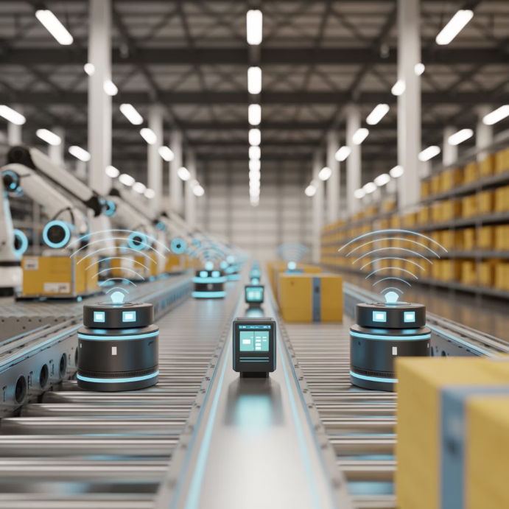
1. Digital Transformation in Supply Chains
The Digital Revolution
IoT, Cloud, and Big Data reshape supply chain visibility and agility
Real-time tracking and monitoring
Enhanced decision-making capabilities
Seamless data integration across operations
Predictive insights driving efficiency
Example: Amazon
IoT-enabled warehouses for real-time inventory tracking and automated replenishment

