Slide 1
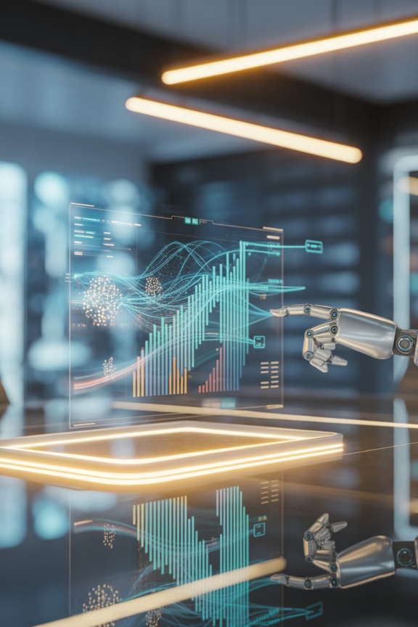
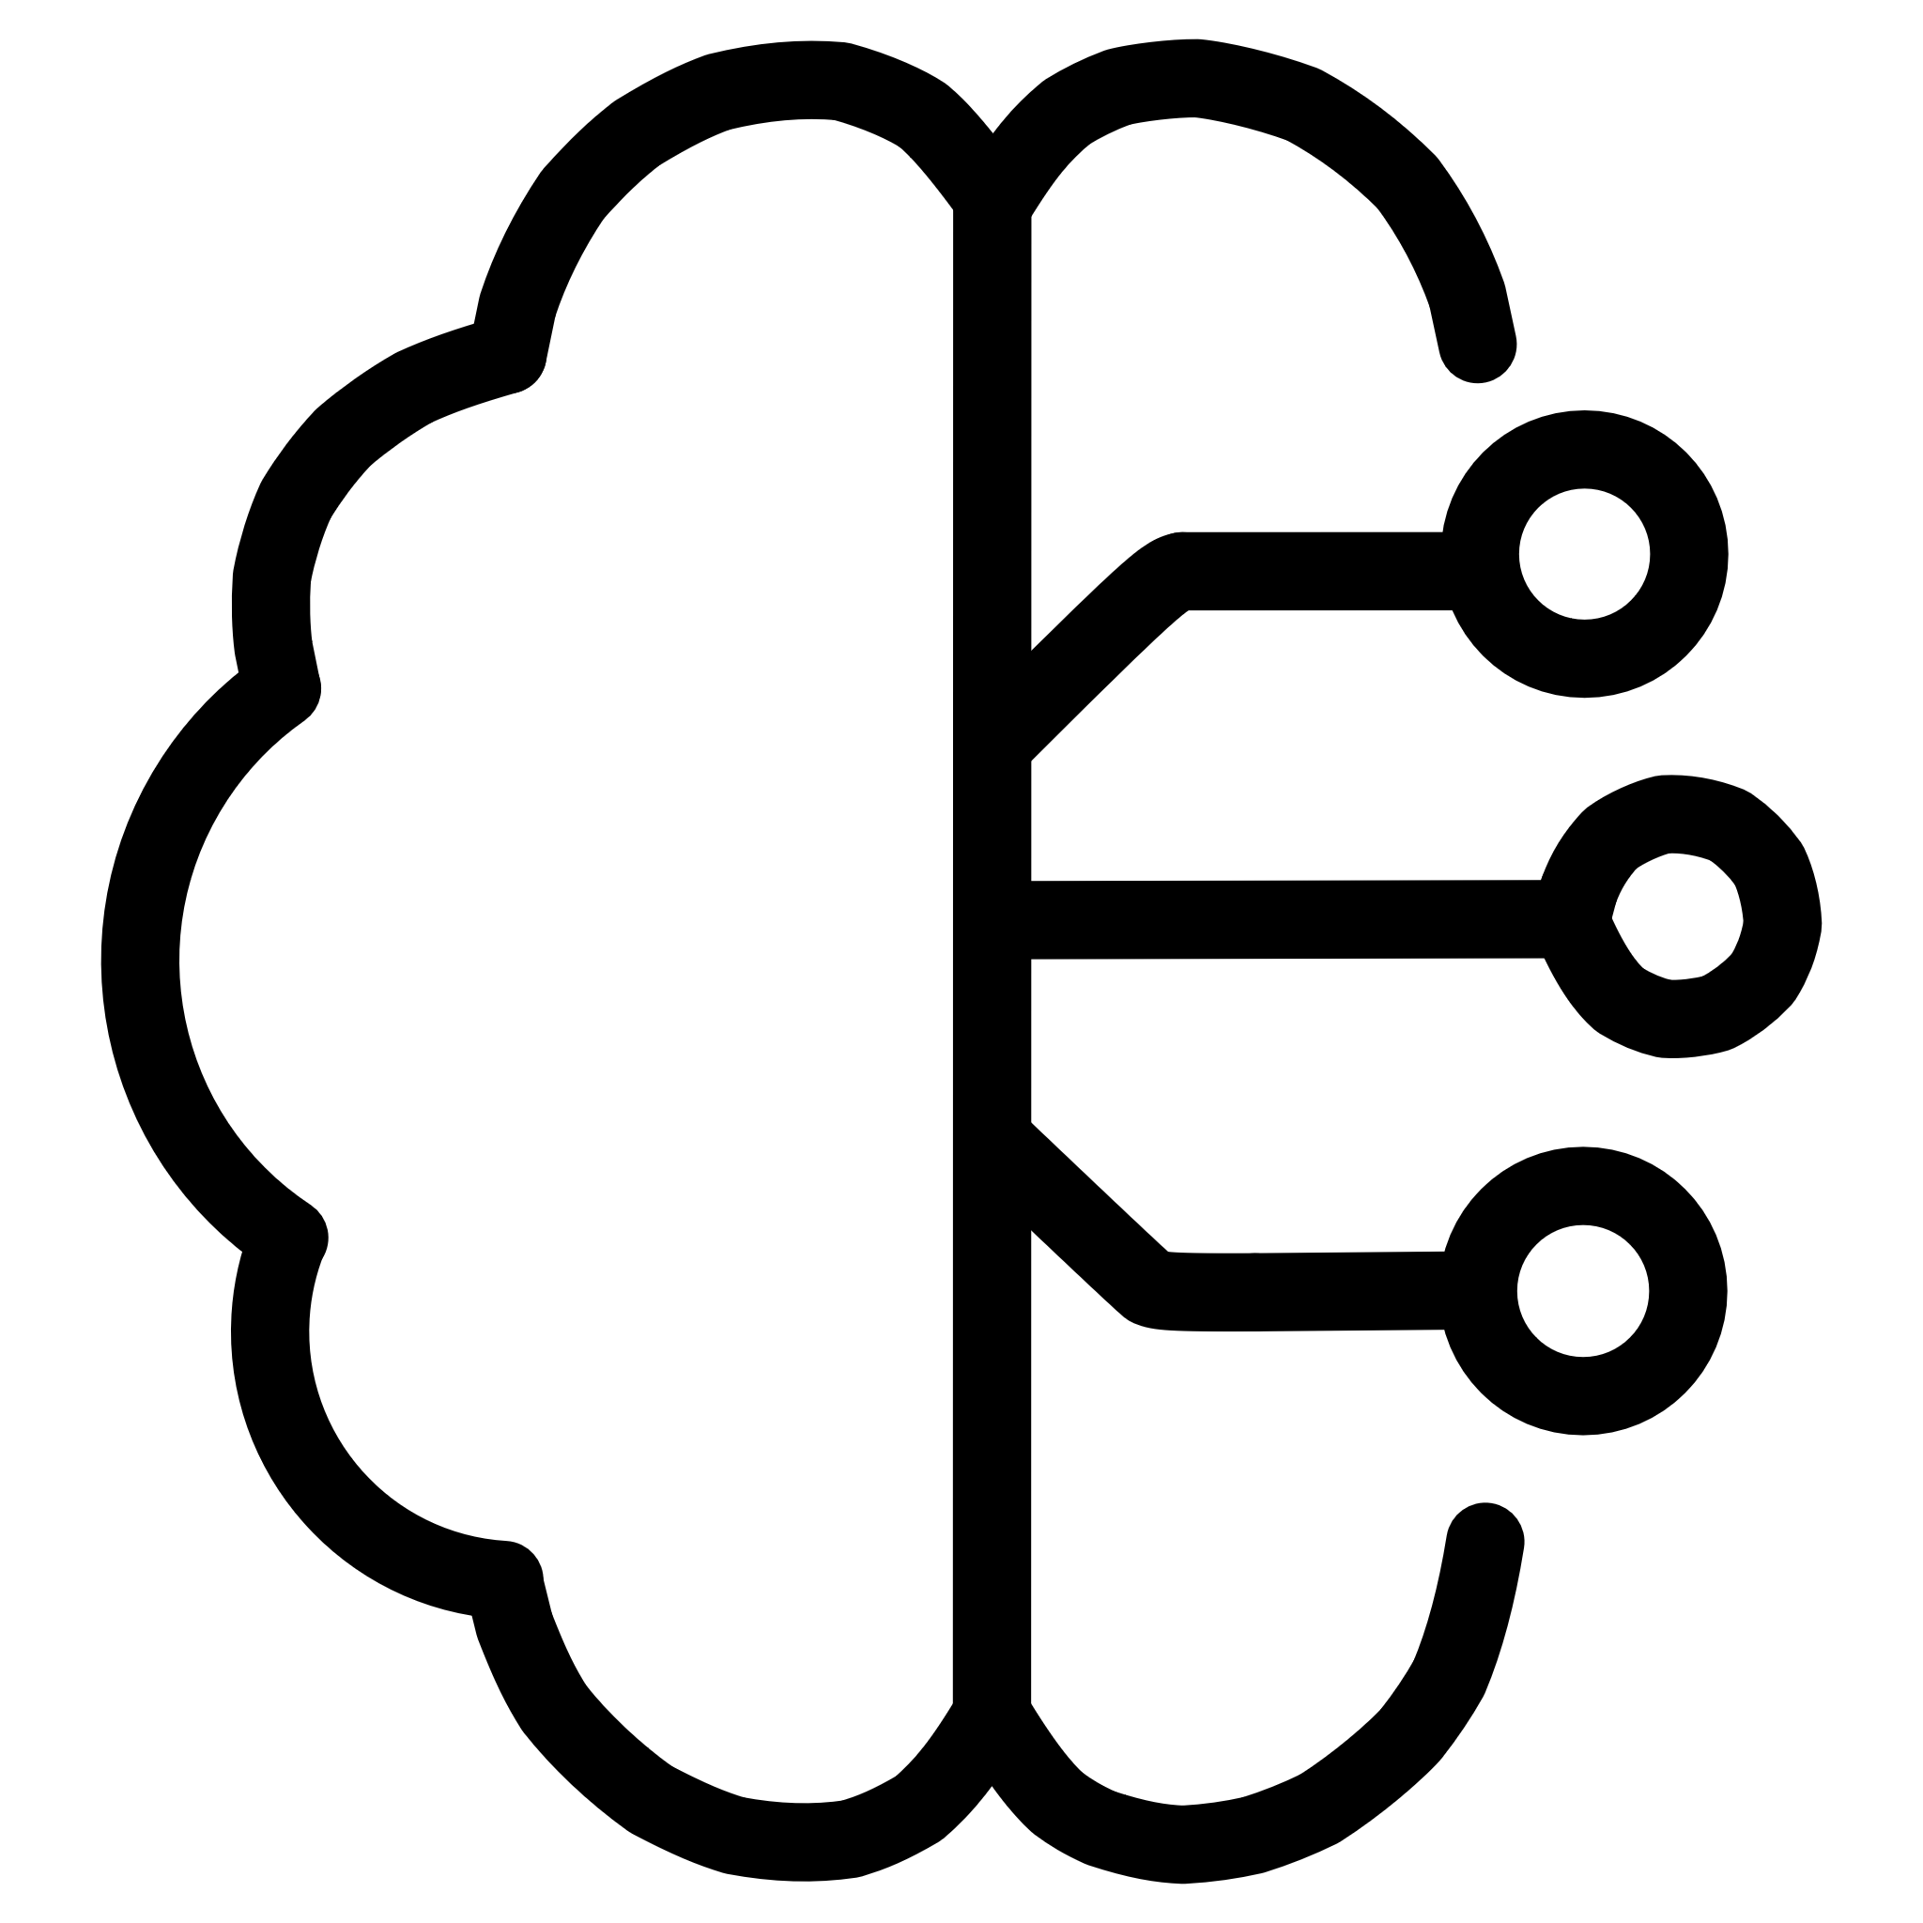


2. Artificial Intelligence & Machine Learning Applications
AI-Driven Forecasting
Predictive analytics enable accurate demand forecasting and inventory optimization
Route Optimization
AI algorithms optimize delivery routes to reduce costs and emissions significantly
Case Study: AI optimizing delivery routes reduces fuel consumption by 15-20% while improving delivery times

