Slide 1
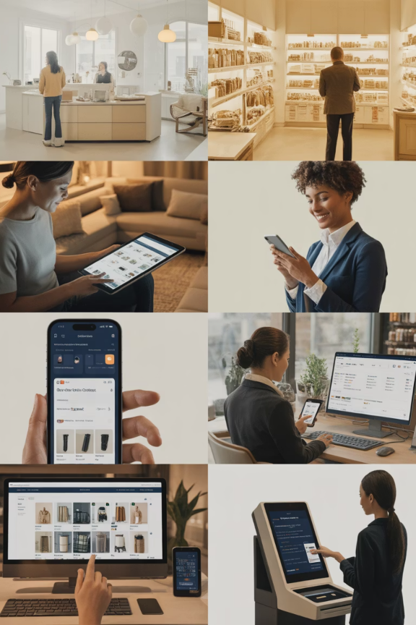
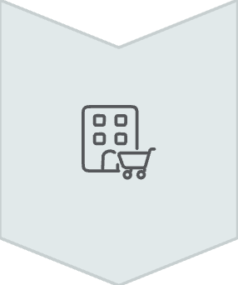


5. Omnichannel and Multichannel Fulfillment
Physical Stores
Traditional retail locations with instant gratification
E-commerce
Online platforms offering vast selection and convenience
Mobile Apps
On-the-go shopping with personalized experiences
Home Depot Case: E-commerce fulfillment centers handling 100,000+ SKUs, seamlessly integrating online orders with in-store pickup

