Slide 1
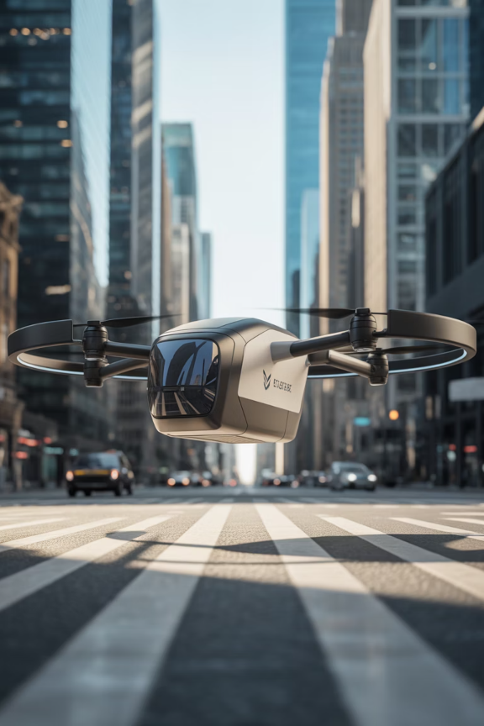
8. Advanced Logistics and Distribution Models
1
3PL Partnerships
Third-party logistics providers handling warehousing and transportation
2
4PL Integration
Fourth-party logistics orchestrating entire supply chain networks
3
Last-Mile Innovation
Autonomous vehicles and drones revolutionizing final delivery
4
Automation
Robotics and AI transforming distribution center operations

