Slide 1
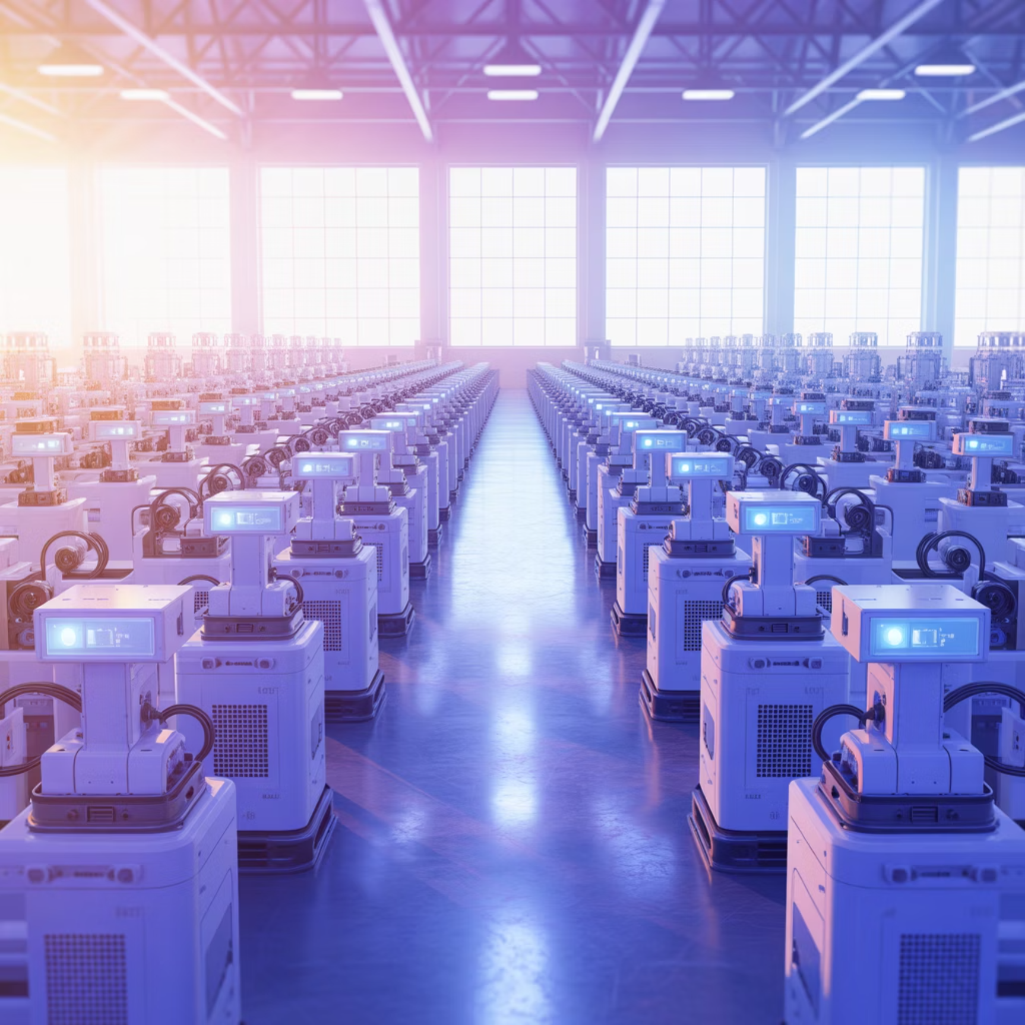

Digital Transformation in Supply Chains
The Digital Revolution
IoT, Cloud computing, and Big Data analytics are fundamentally reshaping supply chain visibility, responsiveness, and agility across industries
Real-time tracking and monitoring
Predictive maintenance capabilities
Enhanced decision-making speed
Seamless data integration
Amazon's Innovation: IoT-enabled warehouses deliver real-time inventory tracking, reducing errors by 40% and improving fulfillment speed

