Slide 1
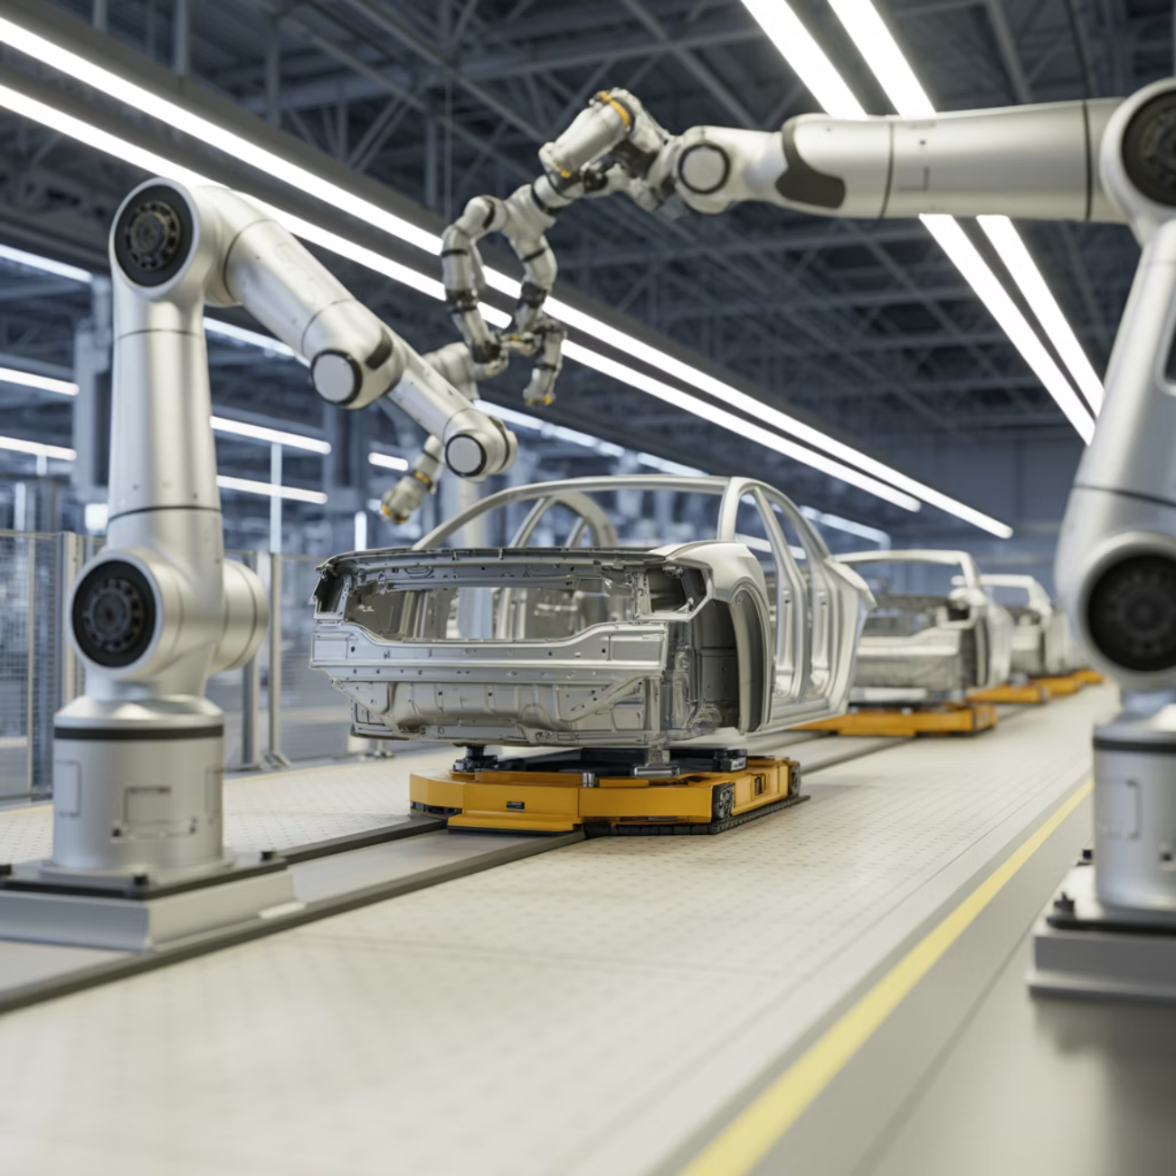
9. Industry 4.0 and Smart Manufacturing
The Fourth Industrial Revolution
Cyber-physical systems, robotics, and real-time data transform production
1
Connected Machines
2
Digital Twins
IoT sensors enable predictive maintenance and optimization
Virtual replicas simulate and optimize manufacturing processes
3
Real-Time Analytics
Data-driven decisions improve quality and efficiency
Toyota Example: Lean manufacturing principles enhanced by digital tools, achieving unprecedented efficiency and quality control

