Slide 1

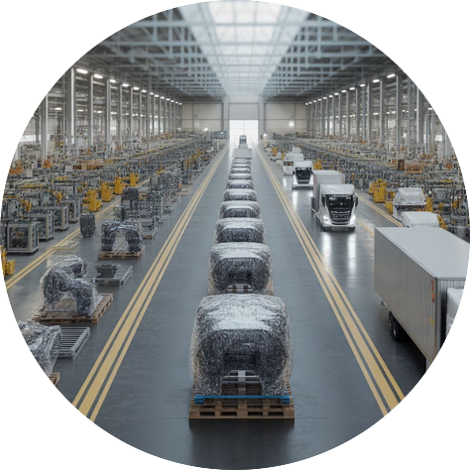

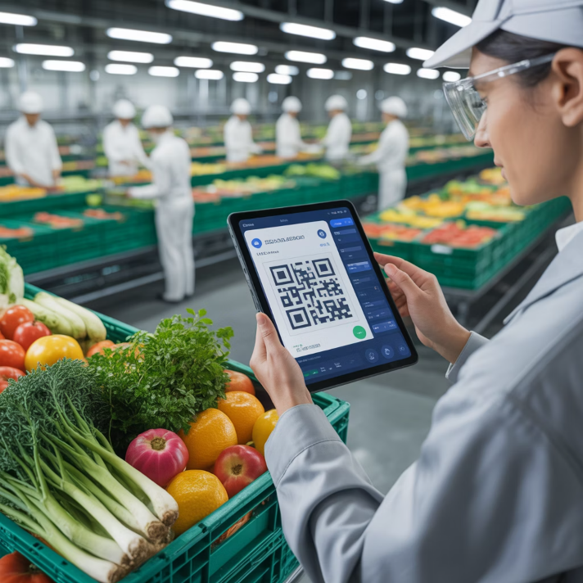
11. Blockchain for Supply Chain Transparency
Immutable Records
Provenance Tracking
Fraud Prevention
Permanent, tamper-proof transaction history ensuring accountability
Complete visibility from raw materials to final consumer
Authentication and verification at every supply chain touchpoint
Walmart's Food Safety Initiative
Blockchain tracking reduces food traceability from days to seconds, enhancing safety and recall efficiency

