Slide 1
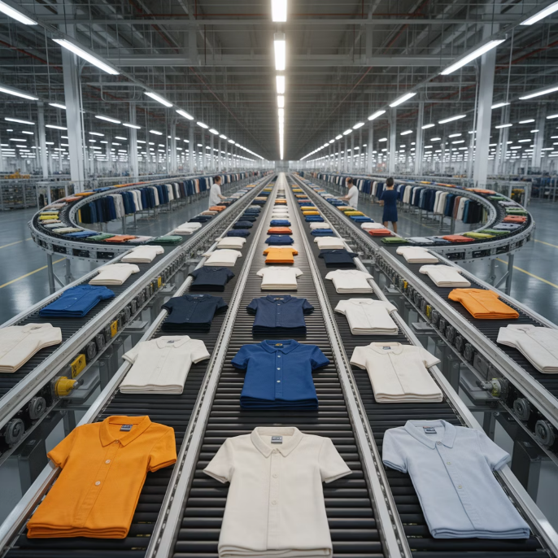
13. Agile Supply Chain Strategies
Flexibility & Responsiveness
Rapid adaptation to market changes and disruptions
Modular Design
Flexible components enabling quick reconfiguration
Strategic Buffers
Inventory and capacity positioned for quick response
Collaborative Networks
Strong partnerships enabling rapid resource mobilization
Real-Time Visibility
Instant awareness enabling swift decision-making
Zara's Fast Fashion: From design to store in 2-3 weeks, responding instantly to fashion trends through agile supply chain

