Slide 1
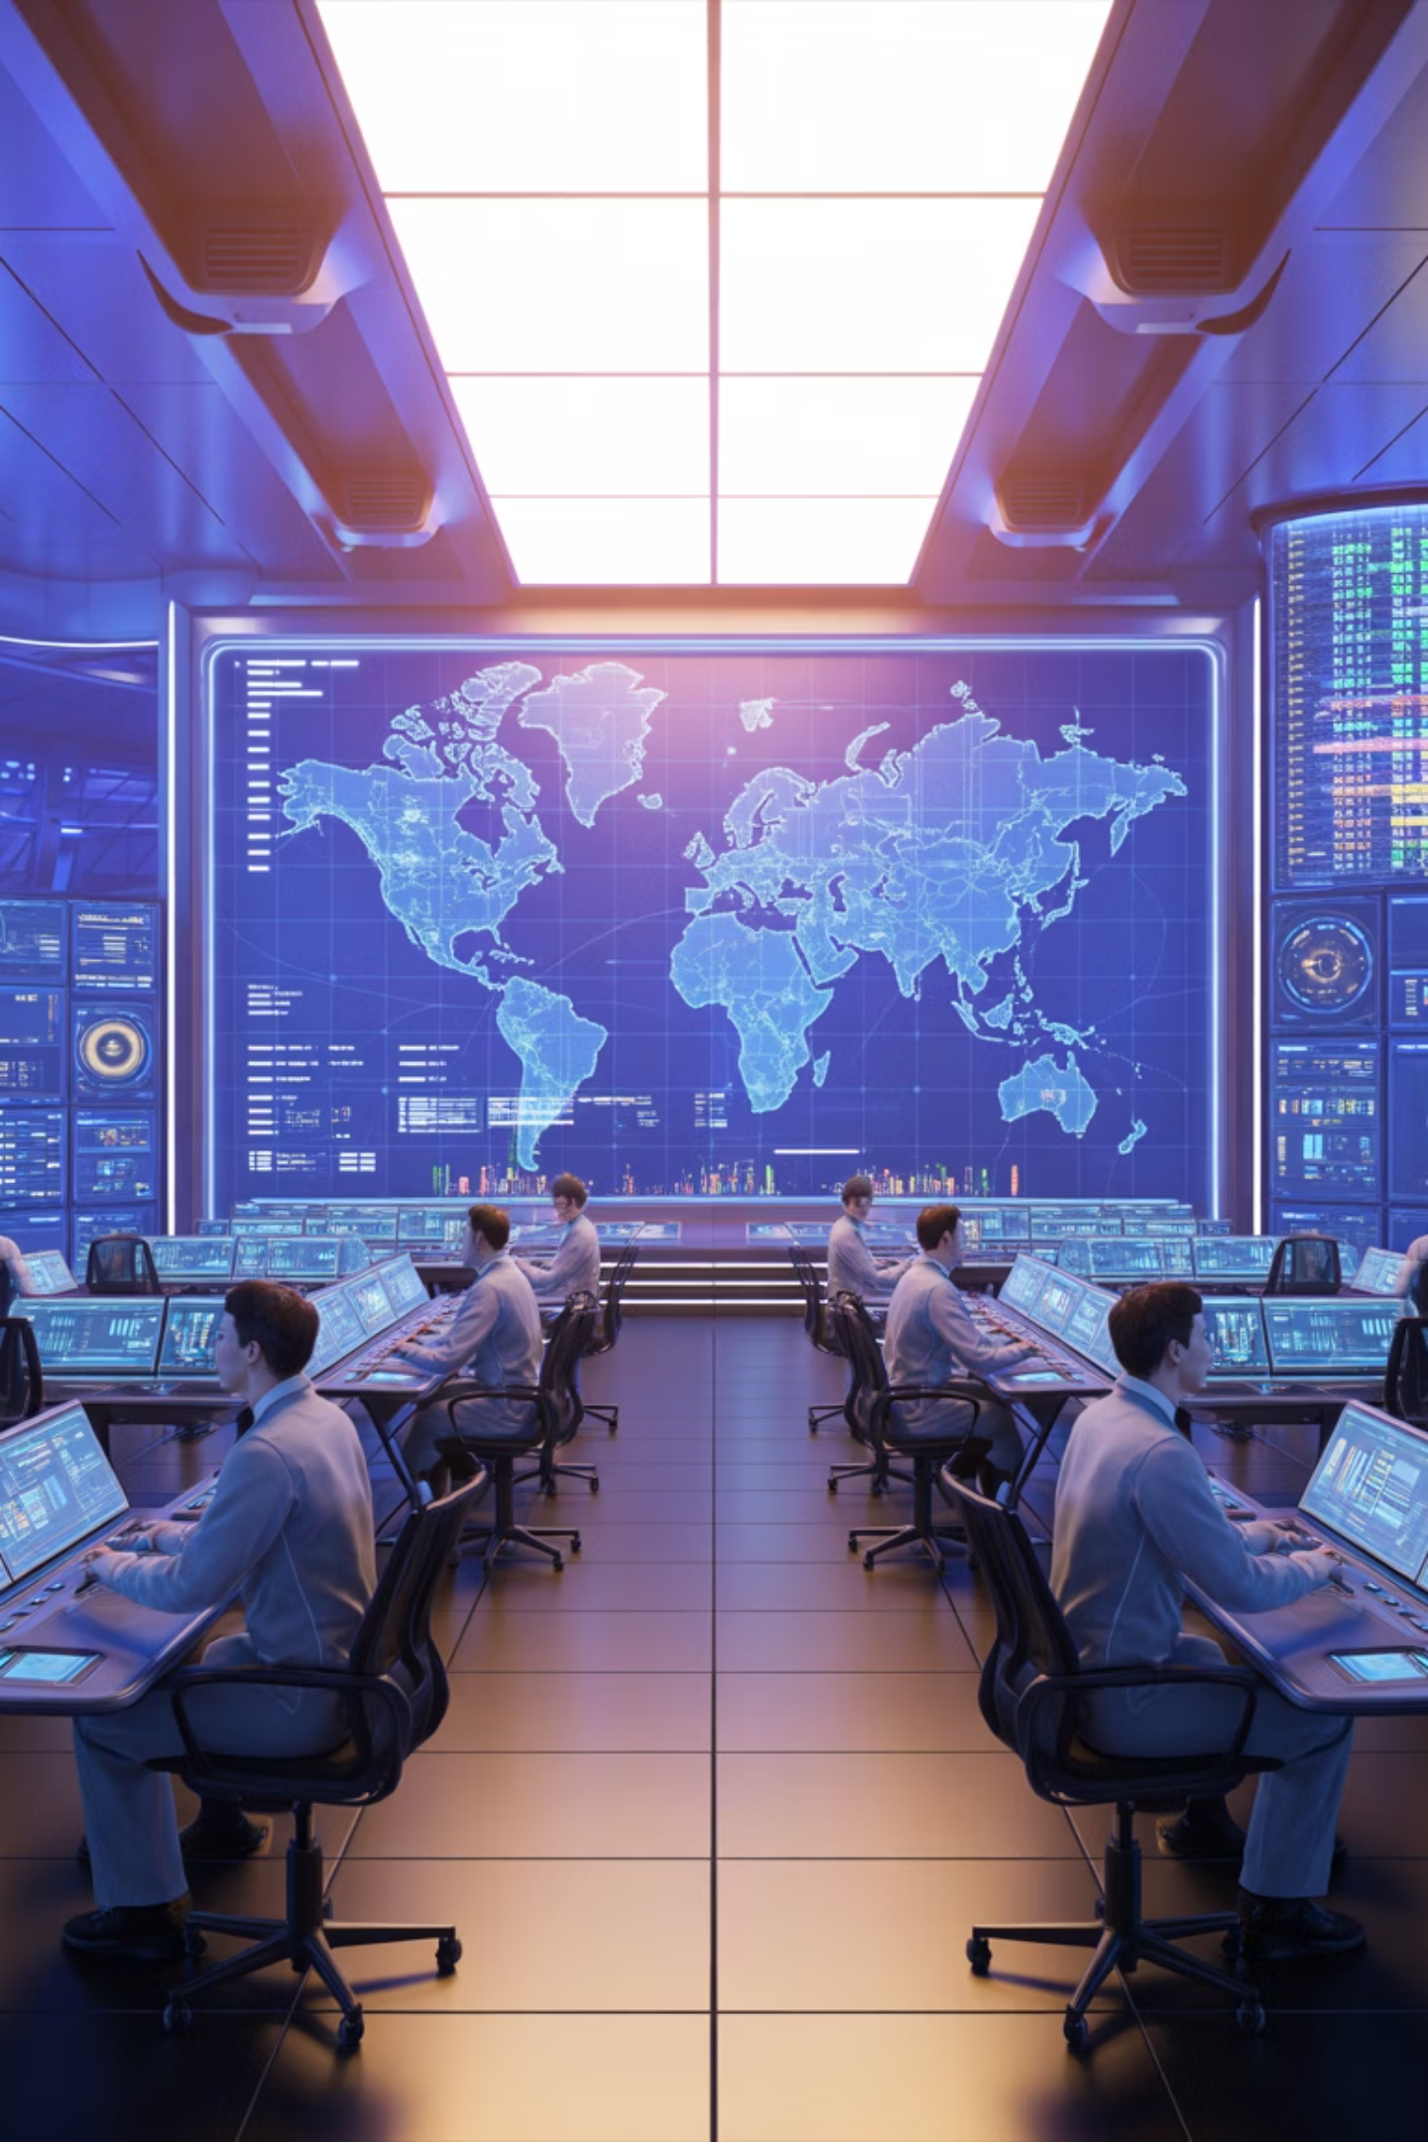



AI & Machine Learning Applications
Demand Forecasting
Route Optimization
AI algorithms predict demand patterns with 95%+ accuracy, reducing stockouts and overstock
Machine learning optimizes delivery routes in real-time, cutting costs by 20% and emissions by 15%
Predictive Analytics
Advanced models identify risks before they materialize, enabling proactive intervention

