Slide 1

Russia-NATO Tensions Impacting Supply Chains
Conflict Disruption
Semiconductor Crisis
Eastern European raw material flows severely interrupted by geopolitical instability
Ukraine war zones directly impact chip production materials
Neon gas supply disrupted
Critical mineral shortages
Palladium sourcing compromised
Energy supply constraints
Manufacturing delays cascade globally
Border crossing delays

Slide 2
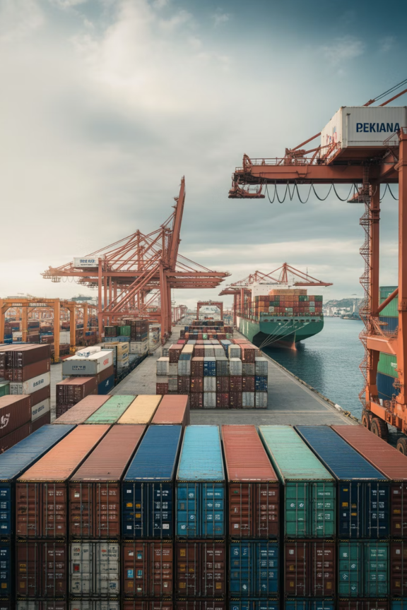



U.S.-China Trade Competition Risks
Tariff Escalation
Export controls drive up costs 15-30% across key categories
Shipping Delays
Customs inspections extend lead times by weeks
Strategic Diversification
Southeast Asia emerges as alternative manufacturing hub

Slide 3

Climate Change and Extreme Weather Events
Factory Shutdowns
2023 Pakistan Floods
Floods, wildfires, hurricanes halt production worldwide
Textile supply chains disrupted for months, affecting global fashion brands
Rising Frequency
Extreme events now 3x more common than decade ago

Slide 4
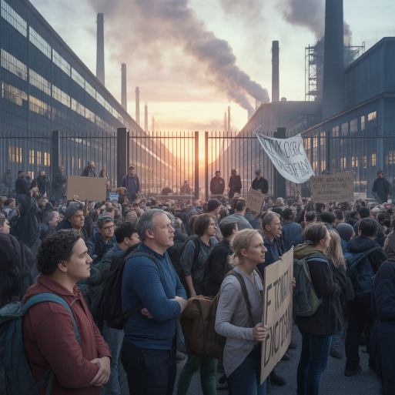
Political Instability in Supplier Countries
Government Upheaval Impact
Sudden regime changes or civil unrest can paralyze production overnight
Border closures without notice
Labor strikes and protests
Asset nationalization risks
Contract enforcement failures
Myanmar Case Study
2021 military coup immediately paused garment exports, leaving global brands scrambling for alternatives

Slide 5

Environmental Regulations and Compliance Risks
01
Carbon Tax Implementation
New emissions rules increase supplier operational costs 10-25%
02
Sustainability Audits
Companies must verify supplier environmental compliance continuously
03
Penalty Exposure
Non-compliance results in fines, delisting, and reputational damage
04
Green Sourcing
Transition to certified sustainable suppliers becomes competitive advantage

