Slide 1
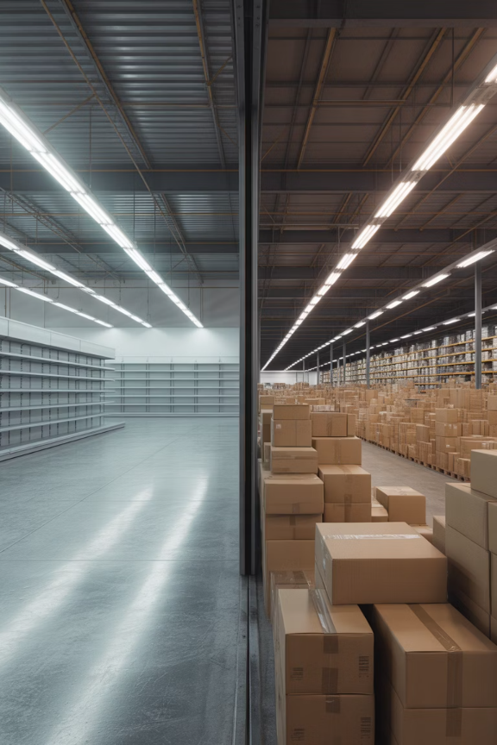
Demand Forecasting Failures
COVID-19 Demand Swings
Pandemic exposed critical forecasting weaknesses as consumer behavior shifted overnight
Financial Consequences
Overstocks and stockouts cost businesses billions annually in lost sales and markdowns
AI-Powered Solutions
Machine learning models now predict demand with 25% greater accuracy

