Slide 1
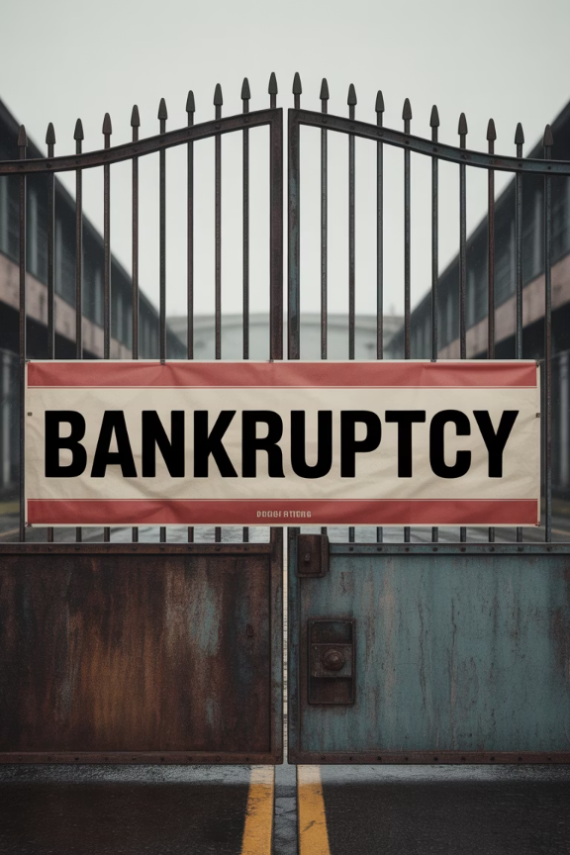
Supplier Bankruptcy and Financial Instability
1
Early 2020
Pandemic triggers wave of supplier bankruptcies globally
2
Supply Gaps
Sudden closures create immediate material shortages
3
New Protocols
Financial health monitoring becomes standard practice
4
Risk Scoring
Continuous credit assessment and early warning systems deployed

