Slide 1
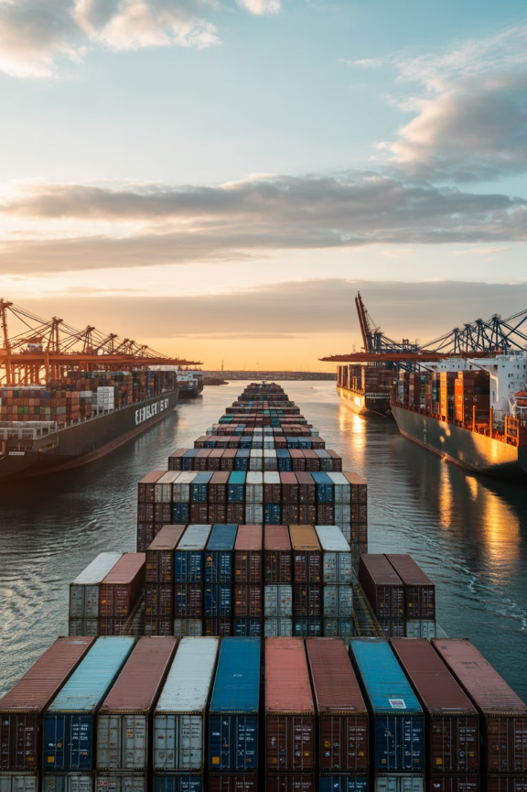
Transportation and Logistics Disruptions
1
Port Congestion
Major ports experiencing 2-4 week backlogs, multiplying lead times
2
Driver Shortages
Trucking industry facing 80,000 driver deficit in U.S. alone
3
Suez Canal Blockage
2023 incident highlighted fragility of critical shipping routes, costing $10B daily
4
Route Diversification
Companies mapping alternative corridors to reduce single-route dependency

