Slide 1
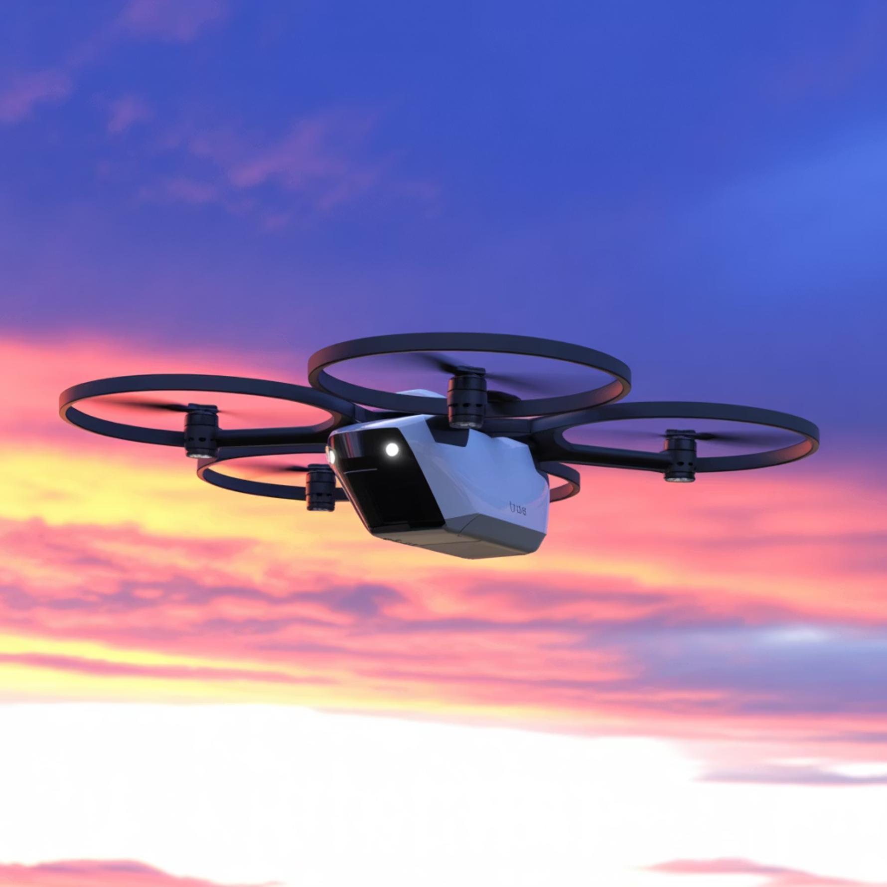
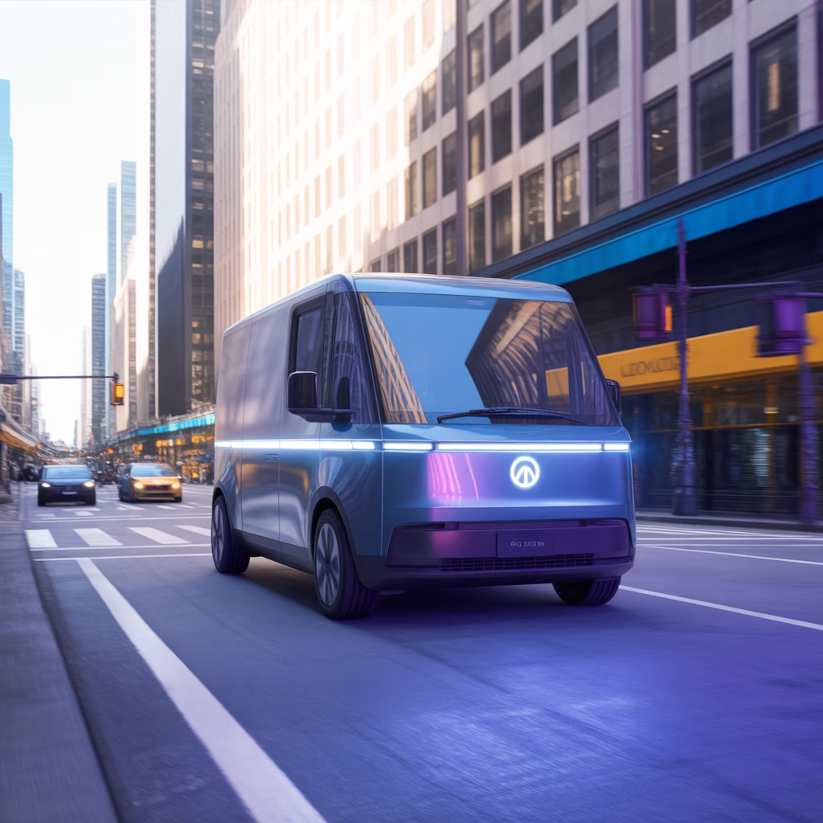
Advanced Logistics & Distribution Models
Partnership Evolution
3PL Partners: Outsourced logistics expertise
4PL Orchestration: Strategic supply chain management
Last-Mile Innovation: Autonomous vehicles and drones
Micro-Fulfillment: Urban distribution hubs
Last-mile delivery represents 53% of total shipping costs—innovations here drive the biggest ROI

