Slide 1
SMART CLASSROOM AND TIMETABLE SCHEDULAR
Review-5
Batch Number:com_9
Under the Supervision of,
Mr. Laxman
Professor of practice
School of Computer Science and Engineering
Presidency University
Roll Number | Student Name
20221COM0017 | Nishanka M
20221COM0031 | Krishna Sai
20221COM0034 | Sunil Kumar Pandab
Name of the Program: Computer Engineering with specialization in Artificial Intelligence and Machine Learning
Name of the HoD: Dr. Gopal Krishna Shyam
Name of the Program Project Coordinator: Ms. Sumitha Guddin
Name of the School Project Coordinators: Dr. Sampath A K , Dr. Geetha A

Slide 2
CONTENT
Abstract
Existing Methods and Drawbacks
Proposed Method & Feasibility Study
Architecture Diagram
System Implementation
Results & Performance Evaluation
UI Demonstration
References

Slide 3
Existing methods and drawbacks:
Methodology | Algorithm(s) | Key Strengths | Specific Drawbacks
Evolutionary Computing | Genetic Algorithm (GA), NSGA-II | Efficiently searches massive datasets; excellent for global optimization. | Local Optima: Can get "stuck" in a good-but-not-perfect solution early on.
Swarm Intelligence | Spotted Hyena (SHO), Firefly (FA) | High precision; excels at finding the "best possible" fit for complex constraints. | High Latency: Significant computational time compared to simpler models.
Neural Models | Artificial Neural Networks (ANN) | Adaptive; learns from historical data and faculty leave patterns. | "Black Box" Logic: Hard for humans to understand or manually tweak the results.
Constraint Logic | Rule-Based, CSP | Straightforward implementation; great for simple, fixed schedules. | Lack of Scalability: Breaks down when facing cross-departmental dependencies.
Web-Based Tools | React / Flask Apps | High accessibility; user-friendly dashboards for staff and students. | Static Nature: Often focuses on data display rathe

Slide 4
Proposed Method & Feasibility Study
Phase I: Data Collection & Preprocessing
Structured Storage: Store faculty information, subject loads, and room capacities in a relational database (PostgreSQL) or JSON format.
Constraint Normalization: Preprocess data to identify "Hard" (non-negotiable) and "Soft" (desirable) constraints.
Phase II: The Hybrid Scheduling Engine
Step 1: Global Search (GA): Initialize a population of random timetables. Use selection, crossover, and mutation to evolve towards a conflict-free "chromosomal" representation.
Step 2: Local Repair (Simulated Annealing): To prevent the GA from stalling (Local Optima), apply Simulated Annealing (SA). SA "polishes" the best results by exploring neighboring solutions and accepting small "worse" moves temporarily to jump out of dead zones.
Step 3: Machine Learning Refinement: Use a supervised learning model (e.g., Random Forest) to evaluate historical "quality" scores and predict which room-slot pairs lead to the highest faculty satisfaction.
Phase III: Real-Time Adaptation Module
Dynamic Adjustment: Implement WebSockets for instant updates. If a faculty member marks an absence, the system triggers a "Local Repair" instead of a full regeneration, finding a substitute room or teacher without disrupting the rest of the schedule.

Slide 5
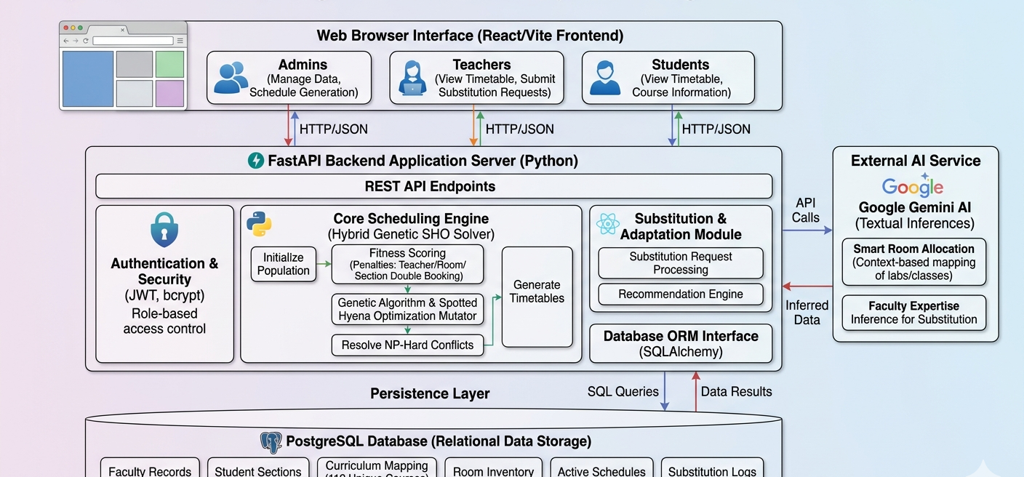
Architecture Diagram

Slide 6
System Implementation
Backend Framework: Implemented a modular backend using FastAPI (Python) rather than the initially proposed Flask, ensuring higher performance and native asynchronous support.
Frontend Interface: Built a dynamic, responsive UI using React JS and Vite, styled with custom CSS variables for a modern dashboard experience.
Database Management: Utilized PostgreSQL with SQLAlchemy ORM for relational data storage, successfully migrating away from flat-file vulnerabilities.
Security: Integrated JWT (JSON Web Tokens) and bcrypt password hashing for secure Admin, Teacher, and Student role-based access.

Slide 7
The Hybrid Scheduling Engine in Action
Initialization: The system generates an initial population representing potential schedules.
Fitness Function: Schedules are penalized based on a strict conflict-scoring system:
+100 penalty for Teacher double-booking.
+100 penalty for Room double-booking.
+200 penalty for Section double-booking.
Optimization Pipeline: * Simulated Annealing (SA): Explores neighboring solutions to resolve localized bottlenecks and escape local optima.
Genetic Algorithm (GA) & SHO: Applies crossover and Spotted Hyena Optimization mutation bounds to evolve the schedule toward a zero-conflict state.

Slide 8
Real-World Data Integration
To prove your system isn't just theoretical, but handles actual university scale (pulling from database.py).
Curriculum Mapping: Successfully seeded the database with the real Presidency University curriculum structure.
Scale of Execution:
135 Real Faculty Members with reverse-engineered subject expertise arrays.
112 Unique Courses (Theory and Lab separated).
87 Distinct Student Sections across multiple years and branches.
Dozens of specific physical resources (Lecture Halls vs. Software-equipped Labs).

Slide 9
AI Integration & Contextual Inference
To highlight the Gemini AI integrations which elevate this from a standard scheduler to a "Smart" system.
Smart Room Allocation: Implemented an AI-driven enrichment function (ai_enrich_and_map_rooms) that parses course requirements and automatically maps them to appropriate physical rooms (e.g., ensuring lab courses get assigned to lab rooms).
Expertise Inference: Built an AI-powered substitution recommendation engine. When a teacher is absent, the system queries Gemini to analyze the active schedules of free teachers, inferring their academic domains to recommend the most highly qualified substitute.

Slide 10
Real-Time Substitution & Adaptation Module
To address the "Real-Time Adaptation" promise from Review-2.
Dynamic Workflows: Implemented an API-driven substitution request system where faculty can request cover for specific time slots.
Targeted Resolution: When a substitution is accepted, the system executes a "Local Repair" on the database schedule without requiring a full, computationally expensive regeneration of the entire university timetable.

Slide 11
Results & Performance Evaluation
To show the panel that the system actually works. (Note: You will need to run your code to get these exact numbers for the presentation).
Convergence Rate: Show how many iterations it typically takes for the HybridGeneticSHOSolver to reach a fitness score of 0 (zero conflicts).
Time to Generate: Detail the execution time (in seconds/minutes) required to generate a schedule for the massive 87-section dataset.
Constraint Adherence: Reiterate that 100% of Hard Constraints (no double bookings) are met.

Slide 12
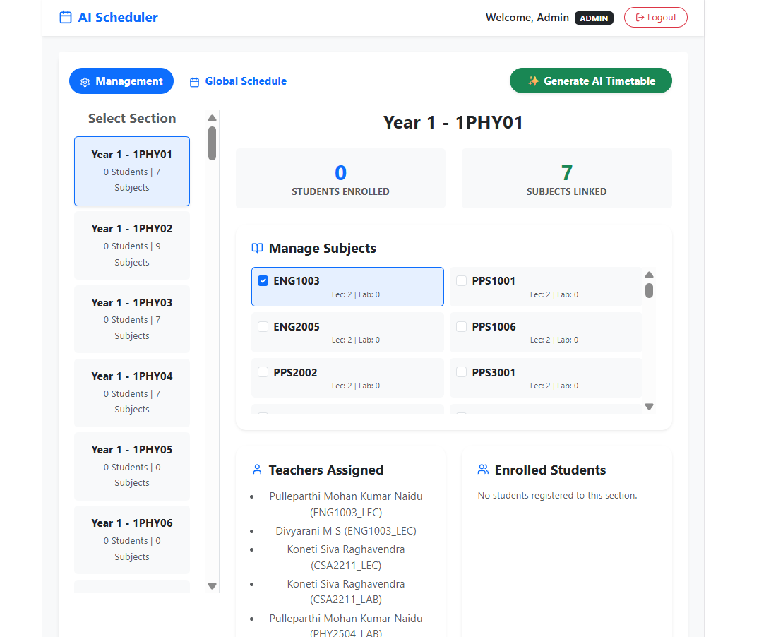
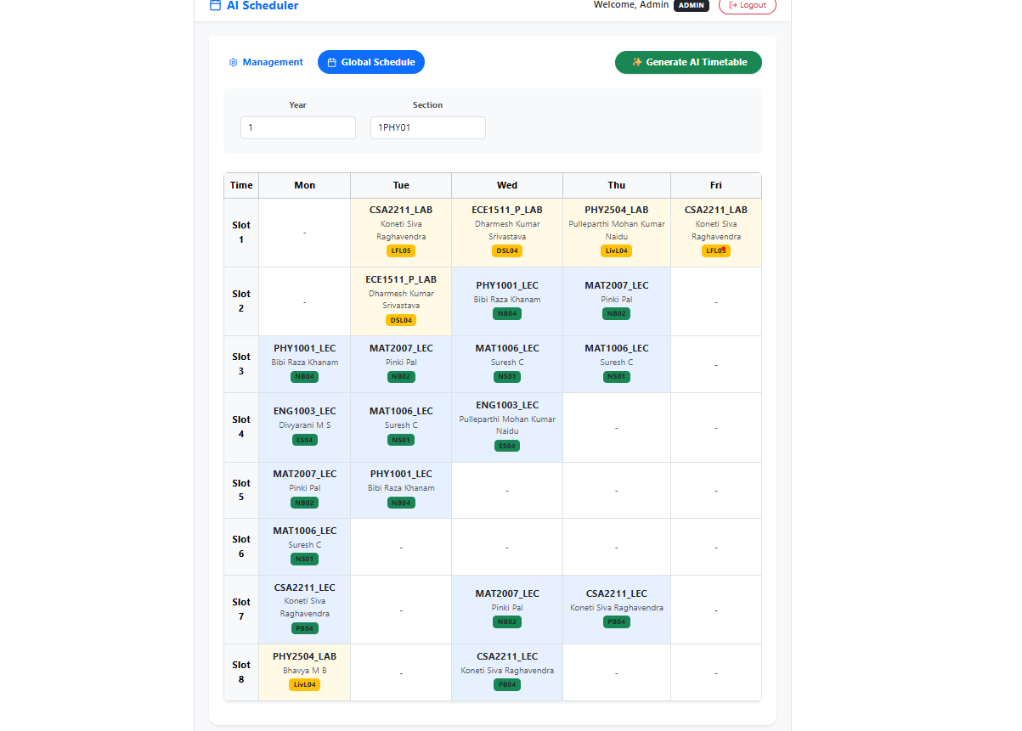
UI Demonstration (Screenshots)
Admin Dashboard-
The generated Timetable view-

Slide 13
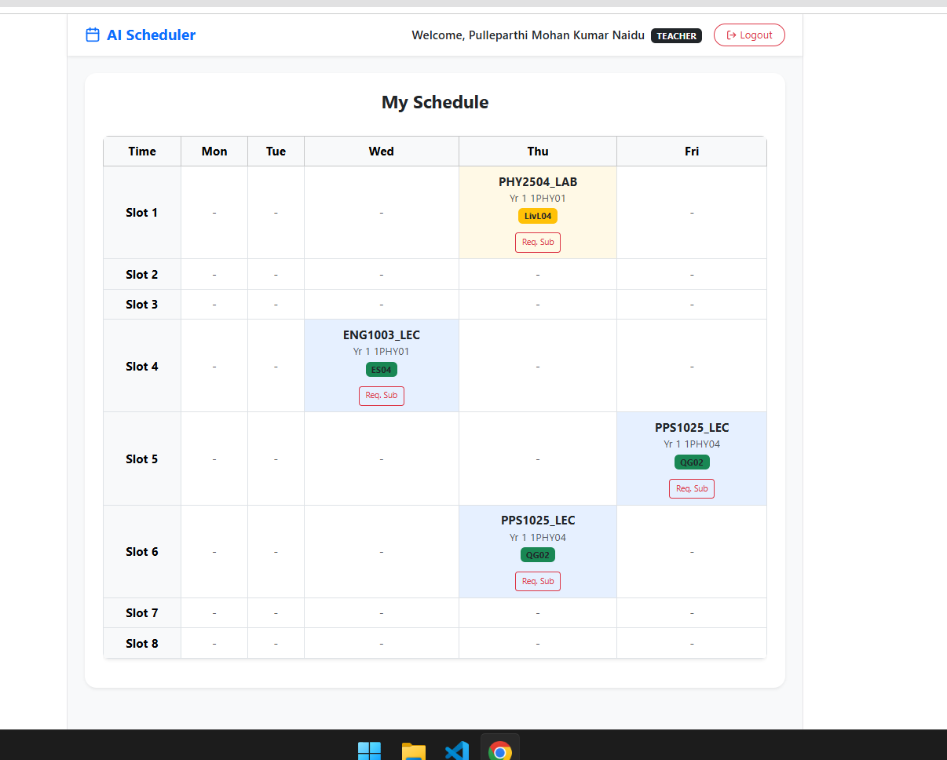
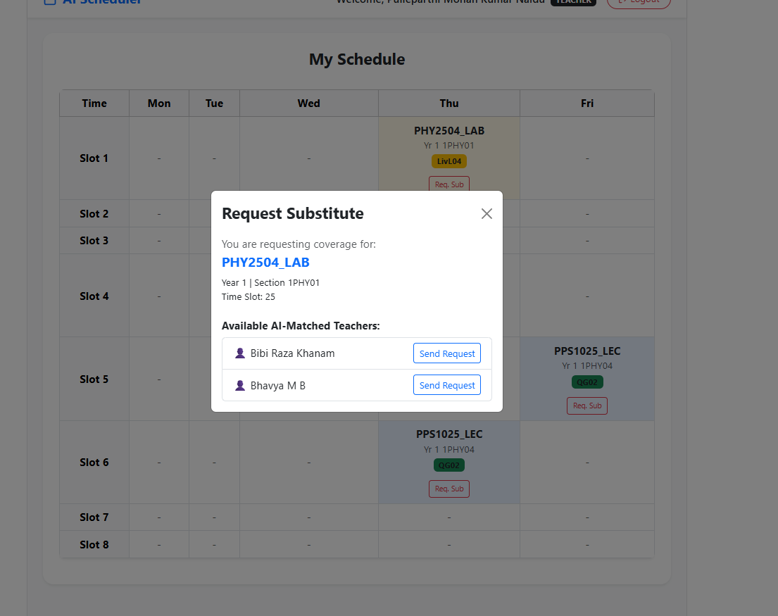
UI Demonstration (Screenshots)
The Teacher Substitution request portal-

Slide 14
Hardware and Software Details
Hardware: 8–12 GB VRAM GPU (e.g., RTX 3060), 32–64 GB RAM, ≥1 TB SSD; optional RTK UAV (DJI/Parrot).

Slide 15
References (IEEE Paper format)
[1] Nguyen & Nguyen (2021) - "An SHO-based approach to timetable scheduling: a case study".
[2] Dhiman & Kumar (2018) - "Multi-objective spotted hyena optimizer".
[3] Goli et al. (2019) - "Solving a University Exam Scheduling Problem Using Genetic and Firefly Algorithms".
[4] Kumari Herath (2017) - "Genetic Algorithm For University Course Timetabling Problem".
[5] Shah et al. (2025) - "Optimizing Timetable Generation for Educational Institute Using Genetic Algorithm.
[6] Alonge et al. (2025) - "An Automated Timetable Scheduler Using NSGA II for Optimized Scheduling.
[7] Saw et al. (2025) - "Adaptive Scheduler: AI Optimization of Academic Timetable".
[8] Firer et al. (2025) - "Features of automation of university schedule management through Class Schedule WEB application".

Slide 16


