Slide 1
Cloud Computing For Emerging Technologies
Setting Up a Cloud Account and Exploring Cloud Services
Name: Vaishnavi Purankmath
Enrollment : 2314405008
Course : BCA(Sem 4)
Subject : Emerging technology

Slide 2
What is Cloud Computing? Cloud Computing means storing and accessing the data and programs on remote servers that are hosted on the internet instead of the computer’s hard drive or local server. Cloud computing is also referred to as Internet-based computing, it is a technology where the resource is provided as a service through the Internet to the user. The data that is stored can be files, images, documents, or any other storable document.

Slide 3
The following are some of the Operations that can be performed with Cloud Computing 1.Storage, backup, and recovery of data 2.Delivery of software on demand 3.Development of new applications and services 4.Streaming videos and audio

Slide 4
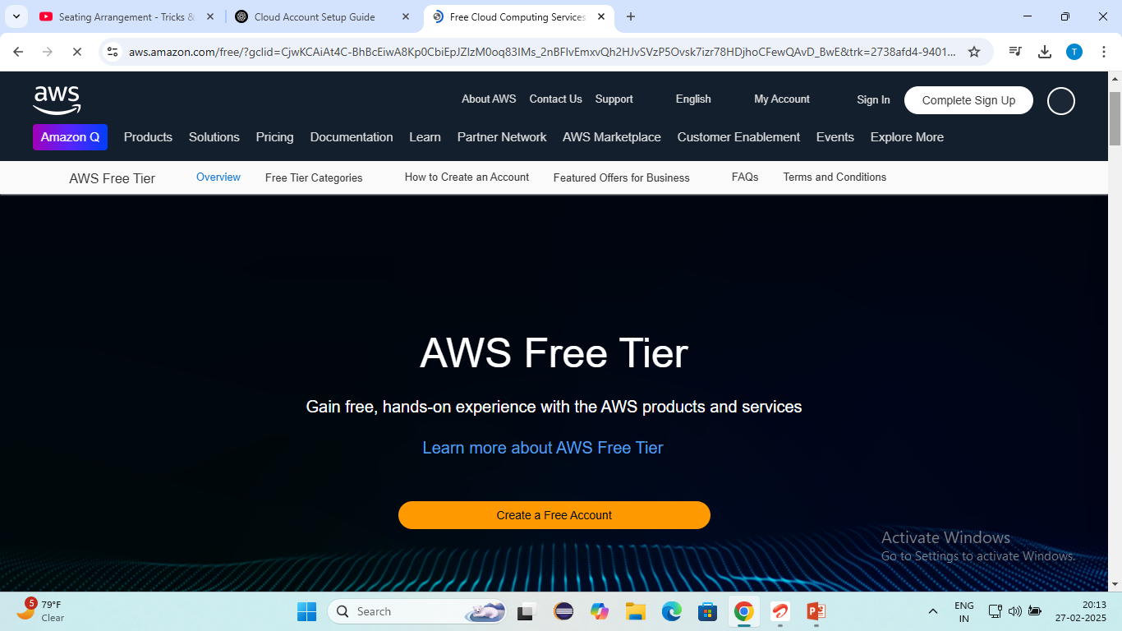
Setting Up Cloud Account AWS(Amazon Web Services)

Slide 5
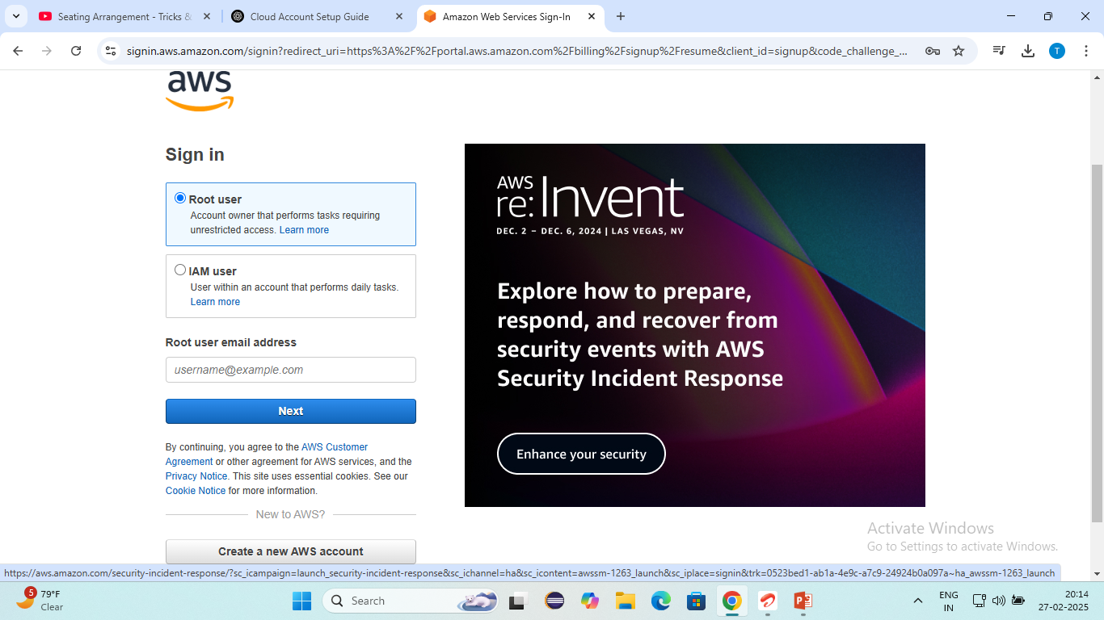
Step2: Give your root user mail address

Slide 6
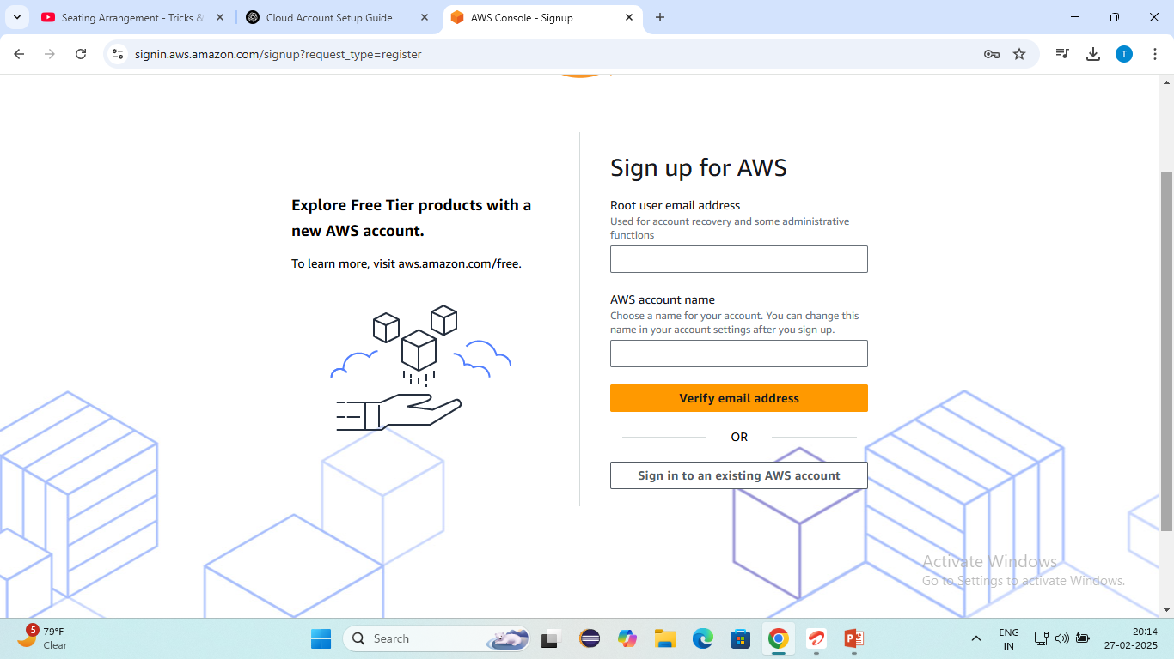
Step 3: Verify your mail address

Slide 7
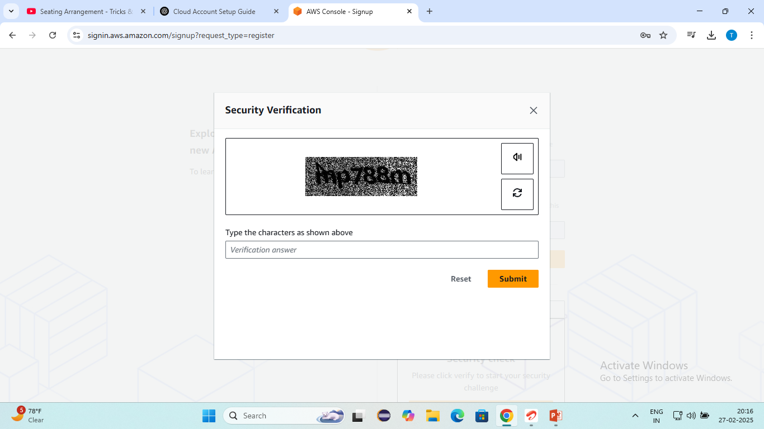
Step 4: Security Verification

Slide 8
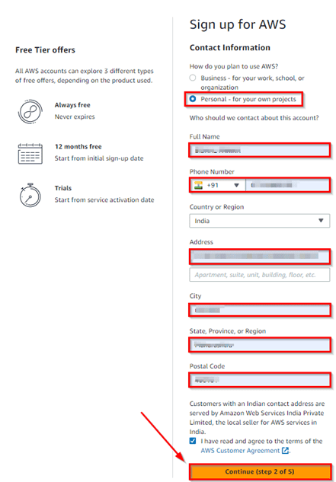
Step 5: Contact Information

Slide 9
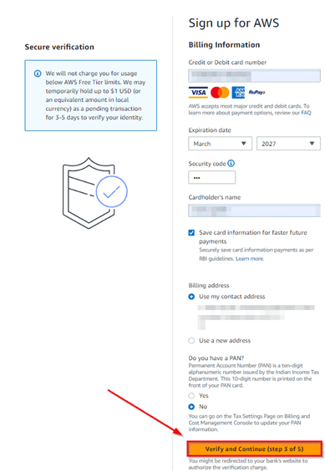
Step 6: Payment Method

Slide 10
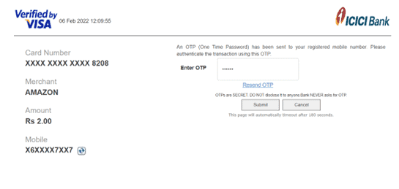
Step 7: Payment gateway and payment information and your credit card

Slide 11
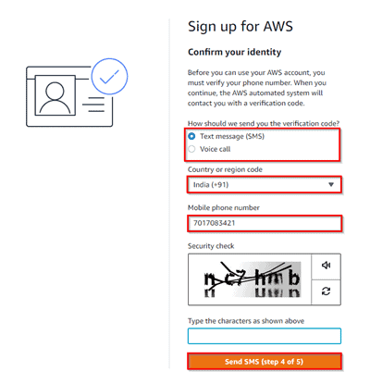
Step 8: Phone Verification

Slide 12
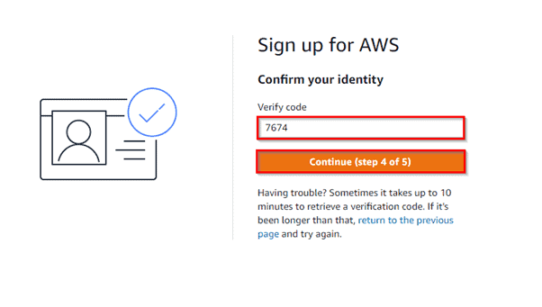
Step 9: Confirming your identity

Slide 13
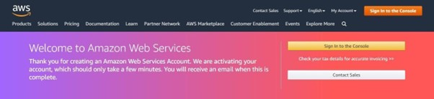
Step 10: Registration Confirming Page

Slide 14
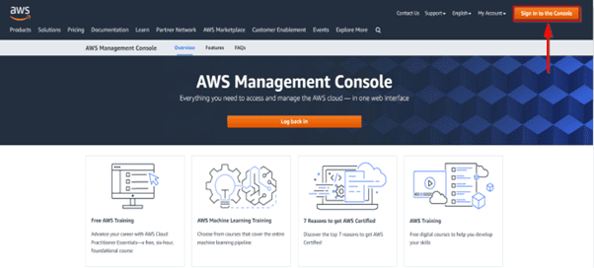
Login In To The AWS Console Step 1:Open your web browser, navigate to https://aws.amazon.com/console/, and Click on sign-in to the console.

Slide 15
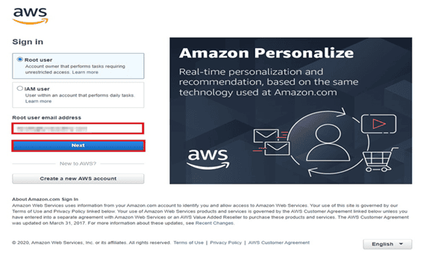
Step 2: Enter the username which you have chosen while creating the account and click on Next.

Slide 16
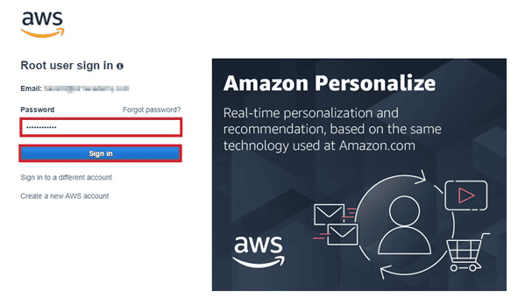
Step 3: Enter the password, associated with the user and then click on Sign in

Slide 17
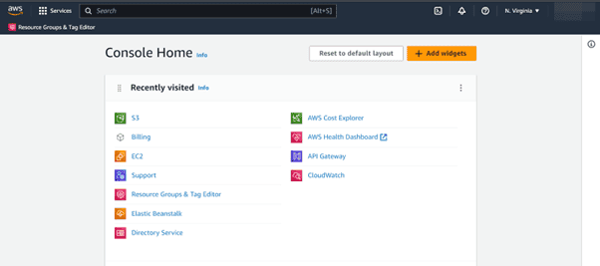
Step 4: You can see the below home screen after you log in.

Slide 18
Console Home After signing up for a new AWS account and logging in, you will see the console dashboard. This is the starting point for interacting with the various AWS services and other important console components. The dashboard consists of a navigation bar at the top and a number of widgets in the main body of the page, which you can configure and rearrange. AWS is developing more widgets so you can further customize your console experience. We will start by taking a look at the navigation bar at the top. In the image to the right, we have highlighted five controls within the navigation bar:

Slide 19
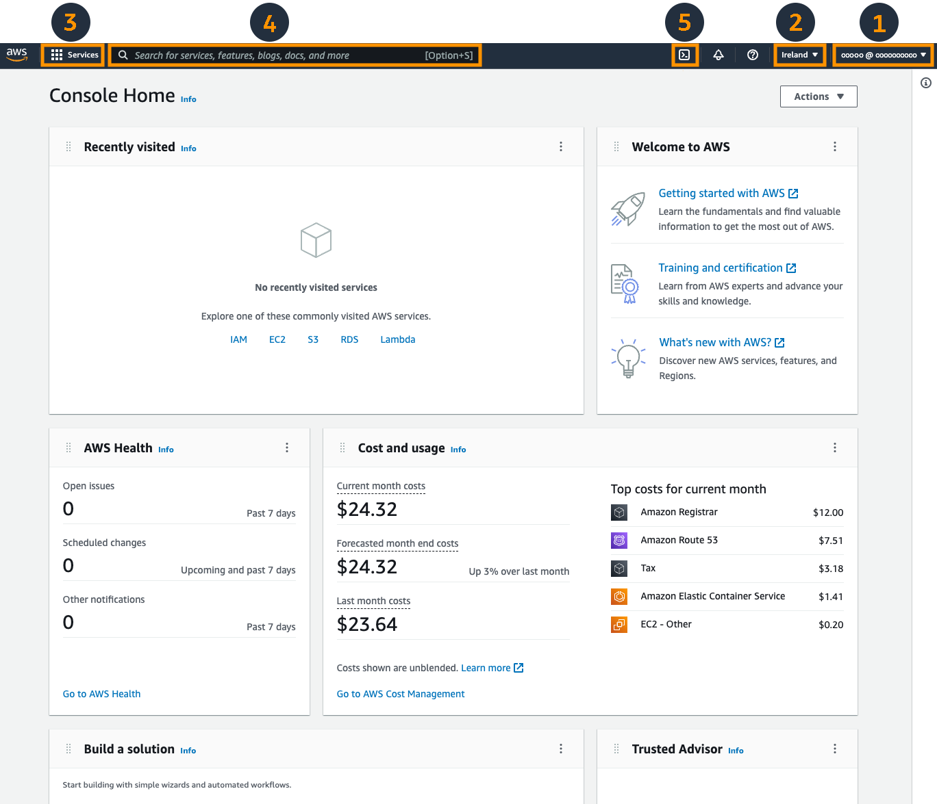
1.Account information 2.Region selector 3.Service selector 4.Search box 5.AWS CloudShell

Slide 20
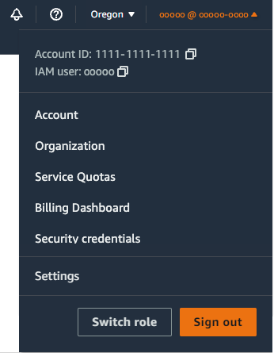
AWS Account Information The first highlighted menu contains information and links for your account. It displays the AWS Account ID, and the current user logged in to the console, along with links to navigate to the following pages:

Slide 21
Account - Details about your account, including the address, contact information, billing settings, and more. For a full list of topics that describe how to manage your account, see Managing your AWS account in the AWS Account Management Reference Guide. Organization - AWS Organizations is an account management service that enables you to consolidate multiple AWS accounts into an organization that you create and centrally manage. For more details, see the AWS Organizations User Guide. Service Quotas - Quotas, also referred to as limits in AWS services, are the maximum values for the resources, actions, and items in your AWS account. When a new account is created, there are default values, such as assigning five Elastic IP addresses. These limits can be increased by logging a support ticket. For more details, please see the quotas documentation. Billing Dashboard - You can use the dashboard page of the AWS Billing console to gain a general view of your AWS spending. For more details, see Using the AWS Billing console dashboard in the AWS Billing User Guide. Security Credentials - This link will take you to your AWS IAM user's page in the IAM part of the console where you can change your password, add 2 factor authentication, generate AWS API keys, and more. For more details, see the AWS Identity and Access Management User Guide. Settings - This link will take you to General Settings configuration page. From here you can manage console global settings such as default language and region as well preferences to optimize your console display experience.

Slide 22
AWS Service Selector

Slide 23
Service Selector The third highlighted menu is the AWS service selector. You can use this to navigate between services grouped by top-level categories, such as Compute, which includes Amazon EC2, along with other services like AWS Elastic Beanstalk and Amazon Lightsail. This is a great way to explore the various services by category, especially if you are new to AWS. You can also mark services as favorites by selecting the star next to their names, which will pin them to the navigation bar. This can be done anywhere you see the star, including the search box.

Slide 24
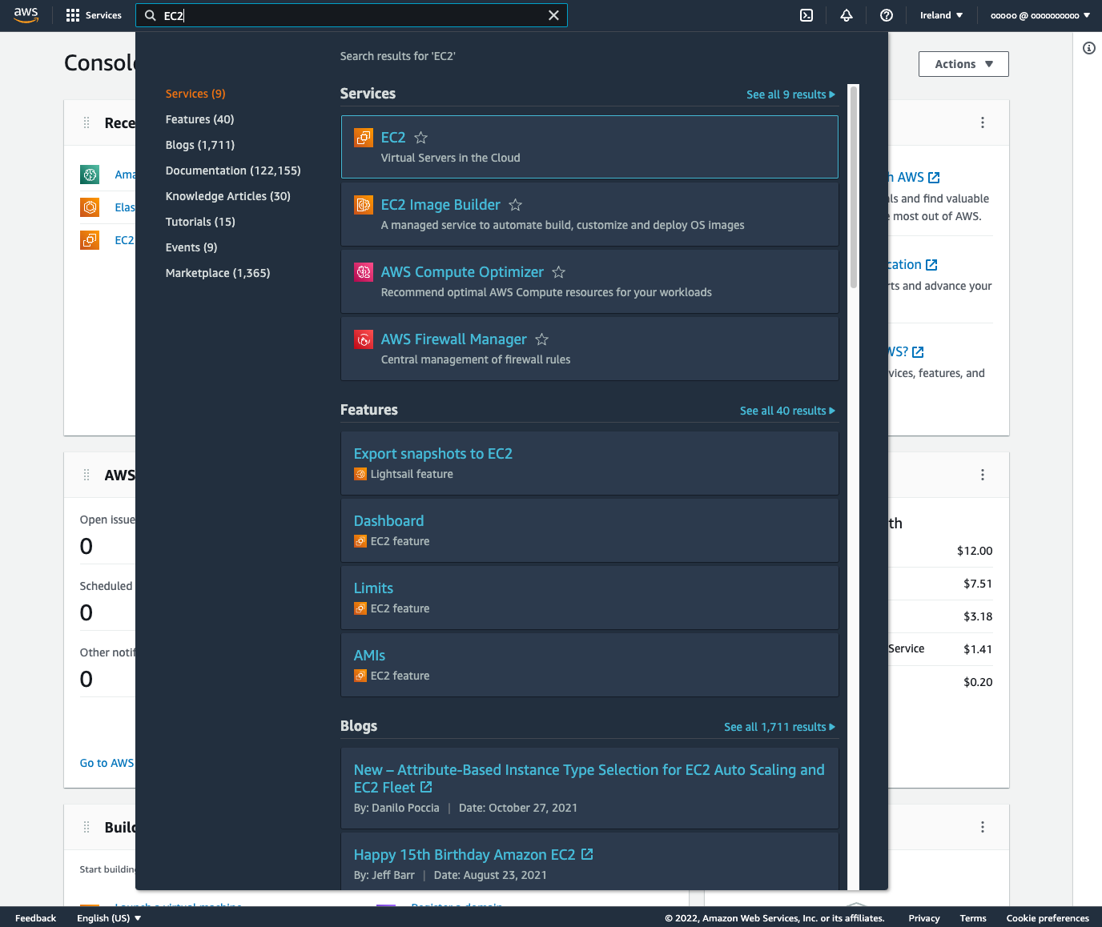
AWS Search The fourth highlighted item is the search box. When you enter text into the box, the underlying search engine searches across a number of different locations to match the text that you entered. It will return matches in eight sections:

Slide 25
AWS Search Services: List of AWS services Features: List of features of AWS services Blogs: Posts from the AWS blog Documentation: AWS Documentation Knowledge Articles: AWS Premium Support Knowledge Center Tutorials: Hands-on guides from the AWS Getting Started Resource Center Events: AWS hosted events that are upcoming, or available on-demand Marketplace: AWS Marketplace offerings that you can deploy in your AWS account

Slide 26
AWS CloudShell The fifth highlighted item is the AWS CloudShell icon. By selecting this icon, you will launch a browser-based shell environment that is pre-authenticated with your console credentials. Use this to execute AWS CLI commands or scripts using the AWS CDK from your browser. If you add any files to CloudShell (up to the 1GB limit), it will persist the files between sessions. CloudShell is a useful tool for securely interacting with your AWS account, and is Region specific, so any files that you upload are specific to that Region. The current selected Region is displayed in orange above the terminal.

Slide 27
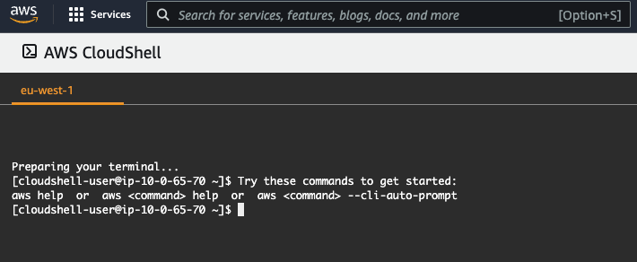
AWS CloudShell

Slide 28
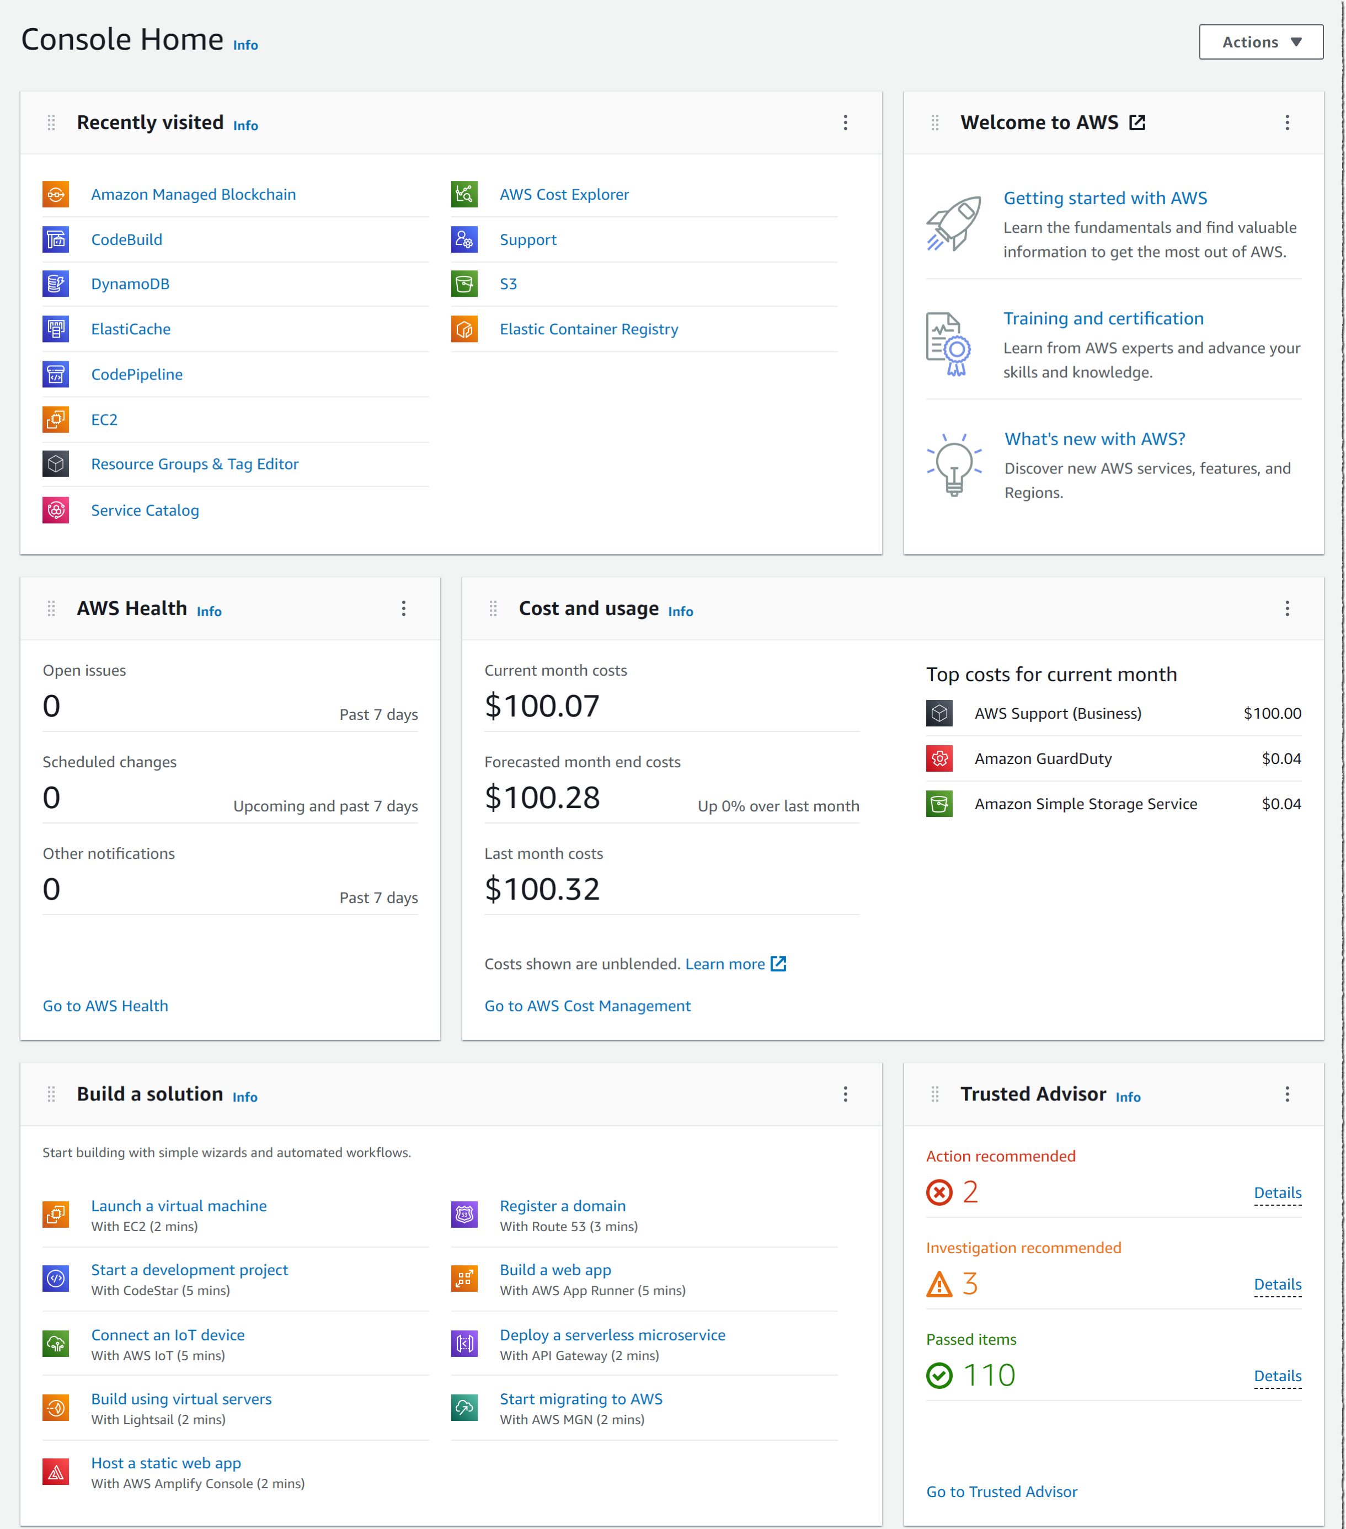
AWS Dashboard Widgets

Slide 29
AWS Dashboard Widgets The dashboard also contains a number of widgets to help you get started. We will discuss the widgets that appear by default, but you can move and resize these, or add different ones from the "Actions" dropdown. Three of the widgets provide you with static links to learn how to build a solution or to explore AWS (Welcome to AWS, Build a solution, and Explore AWS). The other five are dynamic and provide important information about AWS services, your AWS costs and usage, and best practices: AWS Health: information on events that might affect your AWS infrastructure and account Cost and usage: an overview of service costs, with a breakdown by AWS service Favorites: a list of your favorite AWS services Recently visited: a list of top recently visited services Trusted Advisor: recommendations to follow AWS best practices

Slide 30
CONCLUSION Congratulations! You have finished the Getting Started with the AWS Management Console getting started guide. In this guide, you learned about the various parts of the AWS Management Console dashboard, and how to use the dashboard to navigate to services and account and billing information; search for services, features, articles, and guides; and view your billing dashboard.

Slide 31
THANK YOU

