Slide 1







Aegis Security v4.0.0
AI-Powered Incident Response Console
For Modern Security Operations Centers (SOC)
Node.js
Express
Supabase
Vercel

Slide 2













Problem Statement
SOC analysts face thousands of alerts daily — most are noise and false positives
Manual investigation takes 30–60 minutes
per incident, creating dangerous delays
No unified correlation between IDS alerts,
host inventory, CVE data, and threat intelligence
Containment actions are reactive, manual,
and inconsistent across team members
Existing tools are expensive, complex,
and require extensive training
Need: An automated, open-source platform
that triages, enriches, and decides, and contains — with full audit trail

Slide 3









Approach & Objectives
Build an end-to-end incident response pipeline
that automates alert triage to containment
01
02
Integrate 14+ threat intelligence sources
for real-time IP/domain/hash enrichment
03
Match host inventory against NVD CVE data
using CPE version ranges for vulnerability assessment
04
Correlate IDS alerts with host logs
(HTTP, auth, EDR) for evidence-based verdicts
05
Provide 4 firewall enforcement modes
(Feed, Webhook, Cloudflare, Record) with verification
06
Support both rule-based deterministic playbooks
and optional LLM-powered investigation
07
Expose 35 MCP tools for AI agent integration
(Claude, Cursor, any MCP client)

Slide 4








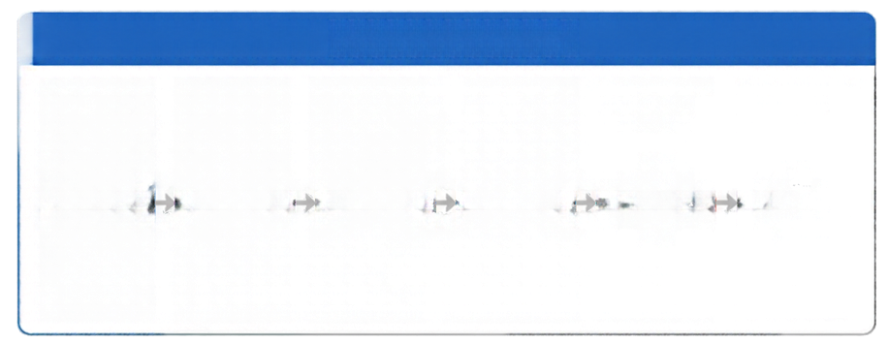













































Technical Approach
Aegis Security is built on a three-layer architecture that turns telemetry into decisive action.
INGESTION
ANALYSIS
DATA SOURCES
INVESTIGATION ENGINE
ENFORCEMENT ENGINE
Suricata
EVE JSON
TRIAGE
ENRICH
CORRELATE
DECIDE
CONTAIN
VERIFY
Zeek
OUTPUTS
Nmap
XML
Firewall
feeds
1
2
3
4
5
6
CMDB
CSV
Webhooks
INTEL HUB
DETECTION ENGINE
Cloudflare
API
14+ Sources
~250 compiled
SigmaHQ rules
Agent
abuse.ch, NVD, GreyNoise, Shodan, MISP, OTX
Audit logs
and reports
4 built-in detection rules

Slide 5



















Technology Stack
express
Node.js 18+
Express 4.21
Supabase Postgres
Vanilla ES modules
Vercel
server-side
JavaScript runtime
lightweight
HTTP framework
managed PostgreSQL with Row Level Security
SPA with no React and no build step
serverless or any Node.js host
PRODUCTION DEPENDENCIES
SECURITY BY DESIGN
@supabase/supabase-js
dotenv
express
js-yaml
script hashing
HMAC-signed sessions
AES-256-GCM encryption

Slide 6


















Workflow Diagram —
6-Phase Investigation Engine
1
2
3
4
5
6
TRIAGE
ENRICH
CORRELATE
DECIDE
CONTAIN
VERIFY
Classify payload
(JNDI, SQLi, XSS,
traversal, brute
force, beaconing)
Score source IP
against 14+
reputation feeds,
match CVEs via
NVD CPE
Search host's
ingested logs for
attacker's address
and activity
Weigh exposure
vs evidence,
assign verdict with
MITRE ATT&CK
mapping
Create BLOCK/
ISOLATE rules
and push to
firewall
enforcement
backend
Read-back from
firewall — confirm
ENFORCED,
PENDING; FAILED,
or RECORDED

Slide 7
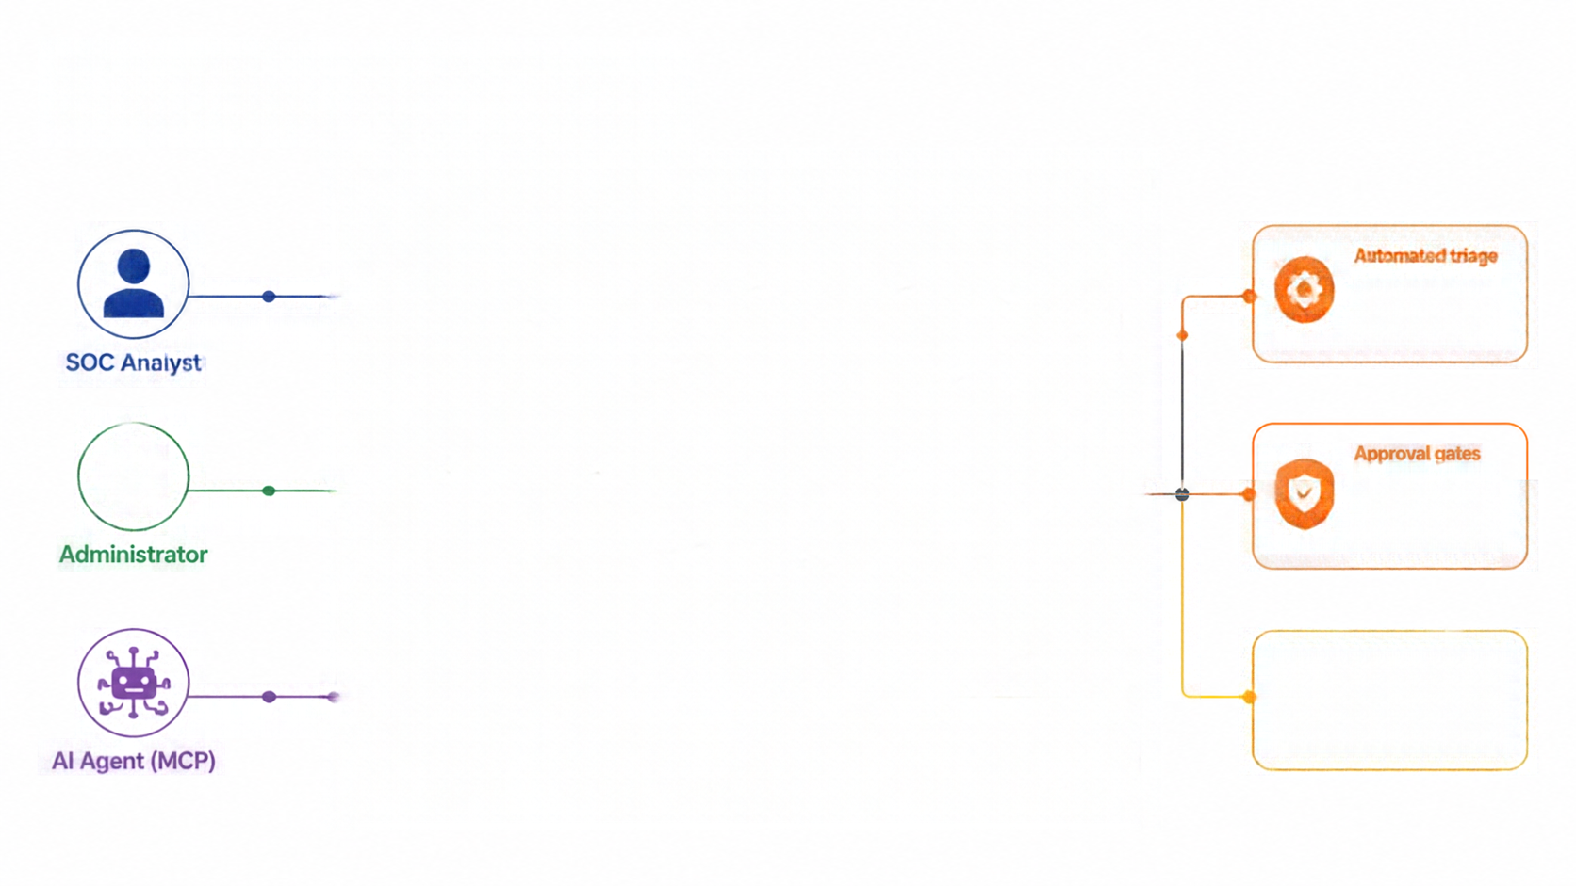






























Use Case Diagram
Aegis Security Incident Response Console
Automated triage
threat enrichment, containment,
audit logging
Investigate
alerts
Manage
cases
Hunt
threats
Run
workflows
View
reports
SOC Analyst
Approval gates
confidence-based routing ensures human oversight for critical actions
Manage
users
API
keys
Configure
policies
CVE
sync
Backup /
restore
Administrator
All actions logged
complete audit trail for compliance and post-incident review
Read
alerts
Run
investigations
Block
IPs
Manage
cases
AI Agent (MCP)

Slide 8















Feasibility & Viability
TECHNICAL
OPERATIONAL
ECONOMIC
SCALABILITY
Built on proven Node.js/Express
stack, only 4 deps, zero build step
Deploys in
under 5 minutes
(npm install →
npm start)
Full open source
(MIT), free
Supabase tier,
free Vercel
deployment
Vercel serverless
auto-scales;
Supabase Postgres handles enterprise workloads
TESTING
INTEGRATION
MARKET GAP
186 end-to-end tests covering
auth, CSRF, ingestion, enforcement, MCP
Works with existing IDS, firewalls (PAN-OS, FortiGate, pfSense), Jira, PagerDuty
No comparable open-source tool offers triage + enrichment + containment + MCP

Slide 9































Impact & Benefits
80%
Cost Savings
replaces expensive
SOAR platforms with
free open-source
Reduction in False
Positive Investigation Time
A
Real-Time
Threat Containment
AI-Native
Integration
from alert to firewall
rule in seconds
35 MCP tools for
autonomous case work
Aegis Security
incident response console
for SOC teams
Complete
Audit Trail
Measurable
SLA Tracking
SOC 2, ISO 27001,
HIPAA compliance
MTTA/MTTR metrics
and ATT&CK coverage

Slide 10














Implementation Approach
1
2
3
4
5
6
Setup
Data
Onboarding
IDS
Integration
Enforcement
Team Setup
Production
Ongoing
5 min
Clone repo
npm install
configure .env
start server
Import
Nmap scans
and CMDB
Connect Suricata/
Zeek via agent
or API
Configure
firewall mode
and test rule
delivery
Create accounts
configure
Slack/Teams/
PagerDuty
Deploy on
Vercel + Supabase
enable
auto-triage
Custom Sigma rules
threat hunts
workflow
automation
LLM agents

