Slide 1


Aegis Security
Incident Response Console for SOC Teams
An AI-Powered Incident Response Console
for Modern Security Operations Centers
Built with Node.js • Express • Supabase • Vercel | Version 4.0.0 | MIT License

Slide 2













PROBLEM STATEMENT
SOC analysts face thousands of alerts daily — most are noise and false positives
Manual investigation takes 30-60 minutes
per incident, creating dangerous response delays
No unified correlation between IDS alerts,
host inventory, CVE data, and threat intelligence
Containment actions are reactive,
manual, and inconsistent across team members
Existing tools are expensive, complex, and require extensive training
Need: An automated, open-source platform that triages, enriches, decides, and contains — with full audit trail

Slide 3








APPROACH & OBJECTIVES
01
Build an end-to-end incident response pipeline that automates alert triage to containment
02
Integrate 14+ threat intelligence sources for real-time IP/domain/hash enrichment
Match host inventory against NVD CVE data
using CPE version ranges for vulnerability assessment
03
Correlate IDS alerts with host logs
(HTTP, auth, EDR) for evidence-based verdicts
04
05
Provide 4 firewall enforcement modes
(Feed, Webhook, Cloudflare, Record) with verification
06
Support both rule-based deterministic playbooks
and optional LLM-powered investigation
07
Expose 35 MCP tools for AI agent integration
(Claude, Cursor, any MCP client)

Slide 4





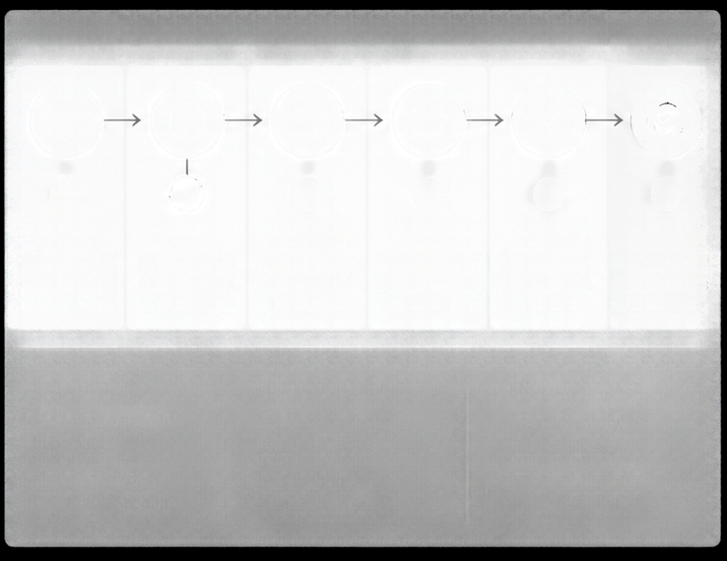



















































TECHNICAL APPROACH
Aegis Security unifies ingestion, investigation, and enforcement into one automated incident response console.
DATA SOURCES
INGESTION LAYER
INVESTIGATION ENGINE (6-PHASE PIPELINE)
ENFORCEMENT LAYER
OUTPUTS
IDS Sensors
Firewall
feeds
Suricata
EVE JSON
Webhooks
1
2
3
4
5
6
Normalize Validate
Enrich
Triage
Enrich
Correlate
Decide
Contain
Verify
Automated response execution
Zeek
Prioritize and validate alerts
Add context from intel and assets
Link events, hosts, and indicators
Assess risk and determine action
Execute containment actions
Confirm effectiveness and closure
Cloudflare
API
Nmap XML
Audit logs
Standardized events
and assets
INTEL HUB
DETECTION ENGINE
KNOWLEDGE BASE
Policies
Playbooks
Approvals
CMDB CSV
14+ sources queried in parallel
–250 compiled
SigmaHQ rules
Asset inventory, vulnerabilities,
Reports
abuse.ch, NVD, GreyNoise, Shodan, MISP, OTX
+ 4 built-in
detection rules
historical incidents, and threat intel
Agent
3-layer architecture built for SOC scale
6-phase automation eliminates manual gaps
Threat intel and detection powered by real-time data
Consistent, measurable containment outcomes
Full audit trail
and reporting

Slide 5







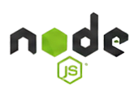










TECHNOLOGY STACK
Built for speed, simplicity, and security
express
supabase
Vercel
Node.js 18+
Express 4.21
Supabase Postgres
Vanilla ES
modules SPA
Vercel serverless
Server-side
JavaScript runtime
Lightweight HTTP
framework
Managed PostgreSQL
with Row Level Security
Zero config
or any Node.js host
No React, no build step, served from public/
Production Dependencies
Security by Design
@supabase/supabase-js
dotenv
express
js-yaml
script hashing
HMAC-signed sessions
AES-256-GCM encryption

Slide 6












WORKFLOW DIAGRAM
6-PHASE INVESTIGATION ENGINE
01
02
03
04
05
06
TRIAGE
ENRICH
CORRELATE
DECIDE
CONTAIN
VERIFY
Classify payload (JNDI, SQLi, XSS, traversal, brute force, beaconing)
Score source IP against 14+ reputation feeds, match CVEs via NVD CPE ranges
Search host’s ingested logs for attacker’s address and activity
Weigh exposure vs evidence, assign verdict with confidence and MITRE ATT&CK mapping
Create BLOCK/ ISOLATE rules and push to firewall enforcement backend
Read-back from firewall — confirm ENFORCED, PENDING, FAILED, or RECORDED

Slide 7


















USE CASE DIAGRAM
Agis Security
Incident Response Console
SOC Analyst
Automated triage
Investigate alerts
Manage cases
Hunt threats
Run workflows
View reports
AI Agent (MCP)
Threat enrichment
35 tools
Read alerts
Run investigations
Block IPs
Manage cases
(via JSON-RPC)
Containment
Administrator
Audit logging
Manage users
API keys
Configure policies
CVE sync
Backup/restore
Approval gates
All actions logged
Confidence-based routing ensures human oversight for
critical actions
Complete audit trail
for compliance and
post-incident review

Slide 8









FEASIBILITY & VIABILITY
Aegis Security is technically sound, operationally efficient, and economically viable.
TECHNICAL FEASIBILITY
Built on proven Node.js/Express stack,
only 4 deps, zero build step
OPERATIONAL FEASIBILITY
Deploys in under 5 minutes
(npm install → npm start)
ECONOMIC FEASIBILITY
Fully open source (MIT),
free Supabase tier, free Vercel deployment
AEGIS
SECURITY
SCALABILITY
Vercel serverless auto-scales;
Supabase Postgres handles enterprise workloads
Built for SOC teams.
TESTING
186 end-to-end tests covering
auth, CSRF, ingestion, enforcement, MCP, and more
INTEGRATION
Works with existing IDS (Suricata/Zeek), firewalls (PAN-OS, FortiGate, pfSense),
Jira, PagerDuty
MARKET GAP
No comparable open-source tool offers
automated triage + enrichment +
containment + MCP

Slide 9

























IMPACT & BENEFITS
80% REDUCTION
COST SAVINGS
in false positive investigation time automated payload classification and
CVE matching
replaces expensive SOAR platforms with a free, open-source solution
REAL-TIME
THREAT CONTAINMENT
AI-NATIVE INTEGRATION
35 MCP tools let
Claude/Cursor/any AI agent work cases
autonomously
from alert to firewall rule
in seconds, not hours
AEGIS SECURITY
incident response console
for SOC teams
COMPLETE AUDIT TRAIL
MEASURABLE SLA TRACKING
every action logged for
compliance
(SOC 2, ISO 27001, HIPAA)
MTTA/MTTR metrics,
analyst workload, and
ATT&CK coverage reports

Slide 10















IMPLEMENTATION APPROACH
A phased roodmap to deploy Aegis Security and operationalize incident response from day one.
SETUP
DATA ONBOARDING
IDS INTEGRATION
ENFORCEMENT
TEAM SETUP
PRODUCTION
Clone repo
Deploy aegis-agent.js
Connect Suricata/Zeek
Configure firewall
Create analyst
Deploy on Vercel +
npm install
on Linux hosts
via agent or direct
mode (Feed/Webhook/
accounts
Supabase
configure .env
import Nmap scans
API ingestion
Cloudflare)
configure notification
enable auto-triage
start server
and CMDB
and test rule delivery
channels (Slack/
set retention and
5 MINUTES
Teams/PagerDuty)
SLA targets
ONGOING EVOLUTION
CUSTOM SIGMA RULES
THREAT HUNTS
WORKFLOW AUTOMATION
LLM AGENT CONFIGURATION

