Slide 1
















C
H
D, P, M
B, V
S

Slide 2
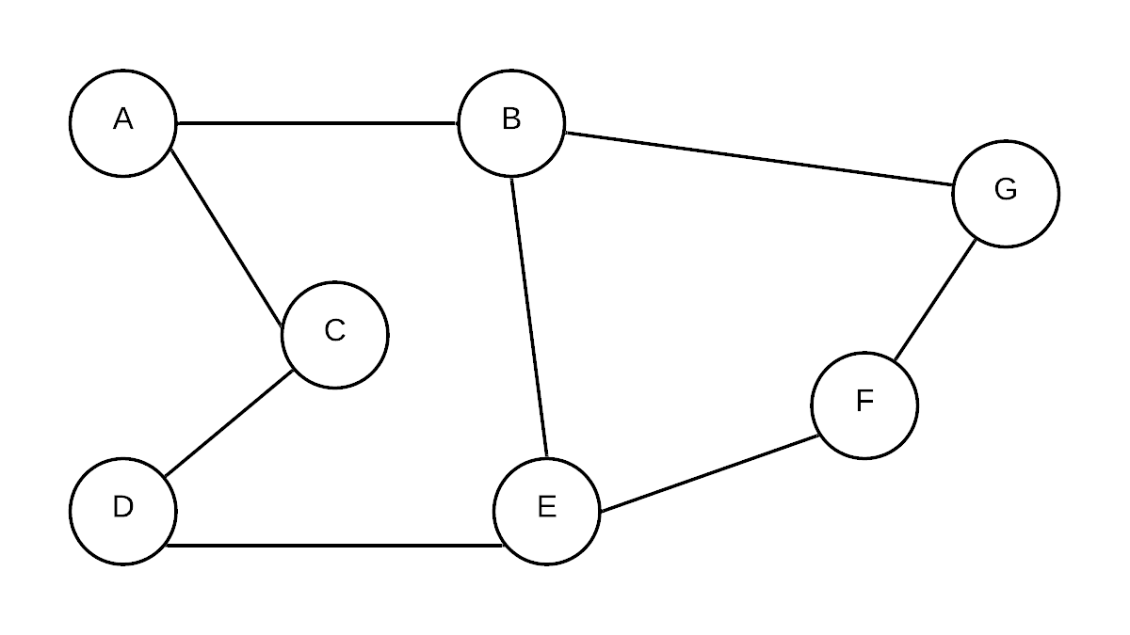
A
B, C
G, D
E
F

Slide 3
Visted nodes
A
B C
D E
Breath First Search
B
A
2
E
A
5
4
B
C
1
1
4
D
5
7
E
C
3
D
Queue

Slide 4
Depth First Search
B
A
2
E
5
1
1
4
7
C
3
D

Slide 5
2
B
A
2
E
5
7
1
1
4
7
C
3
D
6
3

Slide 7
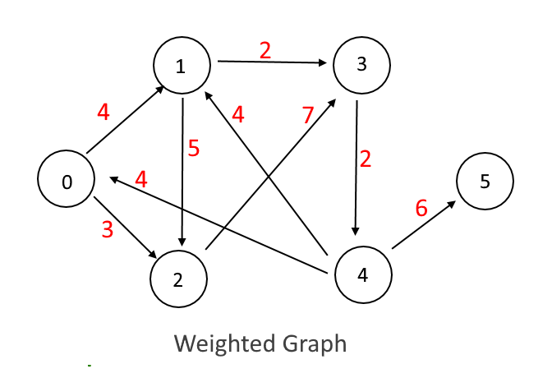
4
10
18
3
12

